Slide 1
Control Flow Statements
CSE 1111 – Structured Programming Language
Course teacher: Shoib Ahmed Shourav

Slide 2
Switch … case
Shorthand for equality check only
Only applicable for integers and characters
Cannot compare with another variable

Slide 3
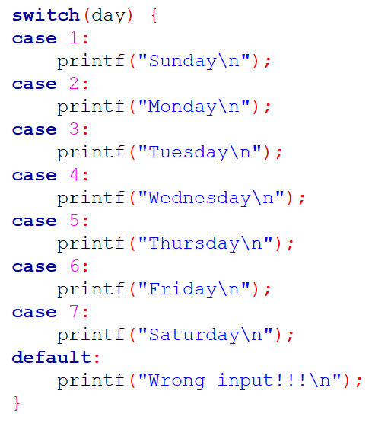
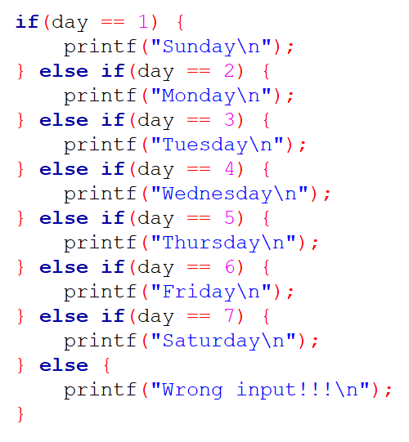

Slide 4
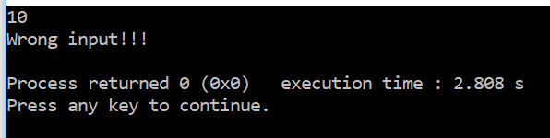
So when I input 10, I am getting this –

Slide 5
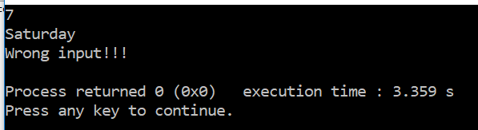
And when I input 7, I am getting this –
What???

Slide 6
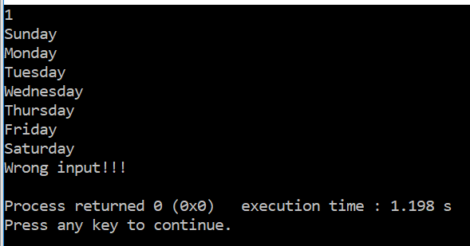
Just to make sure, when I input 1, …

Slide 7
So all the printf calls are executed
after the only one we wanted to happen!!!
How do we prevent that?

Slide 8
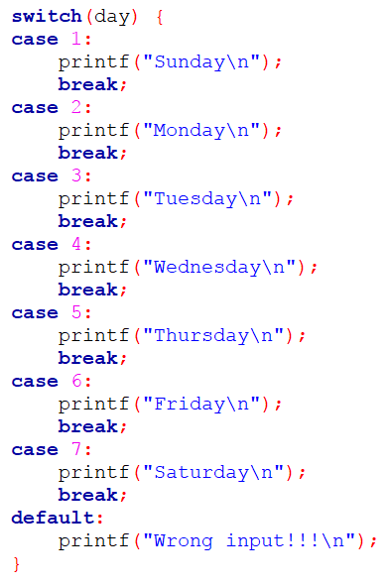

Slide 9
switch … case can also optimize if execution time

Slide 10
This code will get to the error case after checking all the if conditions

Slide 11
This code will get to the error case directly!!!

Slide 12
Problem: Simple calculator
Write a program that will add/subtract/multiply/divide two numbers according to user’s choice.
Enter two numbers: 30 20
1. Add
2. Subtract
3. Multiply
4. Divide
Enter your choice: 3
The result is 600.000000

