Slide 1

Structured Programming Language CSI 121

Slide 2
The Parts of a C Program
//A simple C program
#include <stdio.h>
int main()
{
printf ("Hello, world\n”);
return 0;
}
Preprocessor-
It setups the source code for the compiler. It reads your program before it is compiled.
It tells a C compiler to Include stdio.h file before going to actual compilation.
comment
preprocessor command
beginning of function named main
beginning of block for main
output statement
string literal
send 0 to operating system and terminates the main function
end of block for main

Slide 3
What is a Program Made of?
Common elements in programming languages:
Key Words
Programmer-Defined Identifiers
Operators
Punctuation
Syntax

Slide 4
Program 1-1
//A simple C program
#include <stdio.h>
int main()
{
// Variable Definition
int a, b;
int c;
float f;
// Actual Initialization
a = 10;
b = 20;
c = a + b;
printf (”value of c: %d \n”, c); f = 70.0 / 3.0;
printf (”value of f: %f \n”, f);
return 0;
}

Slide 5
Key Words
Also known as reserved words
Have a special meaning in C
Can not be used for any other purpose
Key words in the Program 1-1: int, float and return

Slide 6
Key Words
//A simple C program
#include <stdio.h>
int main()
{
// Variable Definition
int a, b;
int c;
float f;
// Actual Initialization
a = 10;
b = 20;
c = a + b;
printf (”value of c: %d \n”, c);
f = 70.0 / 3.0;
printf (”value of f: %f \n”, f);
return 0;
}

Slide 7
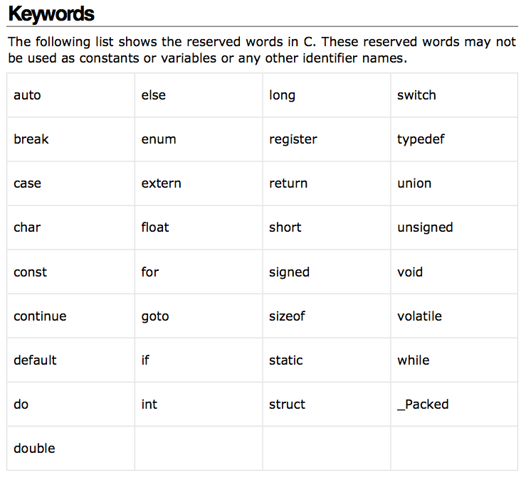
C Key Words

Slide 8
Programmer-Defined Identifiers
Names made up by the programmer
Not part of the C language
Used to represent various things: variables (memory locations), functions, etc.
In Program 1-1: a, b, c, and f.

Slide 9
Identifiers
//A simple C program
#include <stdio.h>
int main()
{
// Variable Definition
int a, b;
int c;
float f;
// Actual Initialization
a = 10;
b = 20;
c = a + b;
printf (”value of c: %d \n”, c);
f = 70.0 / 3.0;
printf (”value of f: %f \n”, f);
return 0;
}

Slide 10
Operators
Used to perform operations on data
Many types of operators:
Arithmetic - ex: +,-,*,/
Assignment – ex: =

Slide 11
Operators
//A simple C program
#include <stdio.h>
int main()
{
// Variable Definition
int a, b;
int c;
float f;
// Actual Initialization
a = 10;
b = 20;
c = a + b;
printf (”value of c: %d \n”, c);
f = 70.0 / 3.0;
printf (”value of f: %f \n”, f);
return 0;
}

Slide 12
Punctuation
Characters that mark the end of a statement, or that separate items in a list
In Program 1-1: , and ;

Slide 13
Punctuation
//A simple C program
#include <stdio.h>
int main()
{
// Variable Definition
int a, b;
int c;
float f;
// Actual Initialization
a = 10;
b = 20;
c = a + b;
printf (”value of c: %d \n”, c);
f = 70.0 / 3.0;
printf (”value of f: %f \n”, f);
return 0;
}

Slide 14
Syntax
The rules of grammar that must be followed when writing a program
Controls the use of key words, operators, programmer-defined symbols, and punctuation

Slide 15
Variables
A variable is a named storage location in the computer’s memory for holding a piece of data.
In Program 1-1 we used three variables:
The a, b, c and f variables were used to hold the values

Slide 16
Variable Definitions
To create a variable in a program you must write a variable definition (also called a variable declaration)
Here is the statement from Program 1-1 that defines the variables: int a, b, c;
float f;

Slide 17
Variable Definitions (Cont’d)
There are many different types of data
A variable holds a specific type of data.
Variable definition specifies the type of data a variable can hold, and the variable name.

Slide 18
Variable Definitions (Cont’d)
Once again, line 7 from Program 1-1: int a, b, c; float f;
The word float specifies that the variables can hold floating point numbers.

Slide 19
Exercise 1
There are three sections in Fall 2018 who has taken CSI 121 course, where 35 in Sec A, 40 in Sec B, 30 in Sec C and 45 in Sec D. What is the total number of students in Fall 2018 who have taken taken CSI 121 course?
Write a C code to display the total number.

Slide 20
Exercise 2
There are total 100 students in CSE. However, only 35 of them took CSI 121 course.
Write a C code to display how many
percentage is attending the course?

Slide 21
Special Characters
Character | Name | Meaning
// | Double slash | Beginning of a comment
# | Pound sign | Beginning of preprocessor directive
< > | Open/close brackets | Enclose filename in #include
( ) | Open/close parentheses | Used when naming a function
{ } | Open/close brace | Encloses a group of statements
" " | Open/close quotation marks | Encloses string of characters
; | Semicolon | End of a programming statement

Slide 22
The \n Escape Sequence
You can also use the \n escape sequence to start a new line of output. This will produce two lines of output: printf( "Programming is\n”);
Notice that the \n is INSIDE
the string.

Slide 23
The #include Directive
Inserts the contents of another file into the program
This is a preprocessor directive, not part of C language
#include lines not seen by compiler
Do not place a semicolon at end of #include line

Slide 24
Variables and Literals
Variable: a storage location in memory
Has a name and a type of data it can hold
Must be defined before it can be used:
int area;
area = 100;

Slide 25
Variable Definition in Program 1-2
//A simple C program to calculate the area
#include <stdio.h>
int main()
{
// Variable Definition & Initialization
int length = 10;
int width = 5;
int area;
// Calculating area
area = length * width;
printf (”value of area: ”, area);
return 0;
}
Variable Definition

Slide 26
Literals
Literal: a value that is written into a program’s code.
"value of area:" (string literal)
12 (integer literal)

Slide 27
Integer Literal in Program 1-3
//A simple C program to calculate the area
#include <stdio.h>
int main()
{
// Variable Definition & Initialization
int length;
int width;
int area;
length = 20;
width = 10;
// Calculating area
area = length * width;
printf (”value of area: ”, area);
return 0;
}
20 is an integer literal

Slide 28
String Literals
//A simple C program to calculate the area
#include <stdio.h>
#define PI 3.14159
int main()
{
// Variable Definition & Initialization
int length = 10;
int width = 5;
int area;
// Calculating area
area = length * width;
printf (”value of area: ”, area);
return 0;
}
This is string literals

Slide 29
Identifiers
An identifier is a programmer-defined name for some part of a program: variables, functions, etc.

Slide 30
Variable Names
A variable name should represent the purpose of the variable. For example: int x;
int itemsOrdered; The purpose of this variable is to hold the number of items ordered.
Notes:
23.60

Slide 31
Identifier Rules
The first character of an identifier must be an alphabetic character or an underscore ( _ ),
After the first character you may use alphabetic characters, numbers, or underscore characters.
Upper- and lowercase characters are distinct

Slide 32
Valid and Invalid Identifiers
IDENTIFIER | VALID? | REASON IF INVALID
totalSales | Yes
total_Sales | Yes
total.Sales | No | Cannot contain .
4thQtrSales | No | Cannot begin with digit
totalSale$ | No | Cannot contain $

Slide 33
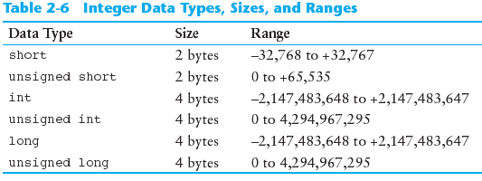
Integer Data Types
Integer variables can hold whole numbers such as 12, 7, and -99.

Slide 34
Defining Variables
Variables of the same type can be defined
- On separate lines:
int length;
int width;
unsigned int area;
- On the same line:
int length, width;
unsigned int area;
Variables of different types must be in different definitions
int length;
unsigned int area;

Slide 35
Exercise 3
Write a C program to calculate the area of a circle (A = pi * radius²).
printf(“Radius = ?”);
scanf ( “%f ”, &radius ) ;

Slide 36
The char Data Type
Used to hold characters or very small integer values
Usually 1 byte of memory
Numeric value of character from the character set is stored in memory:
CODE:
char letter;
letter = 'C';
MEMORY:
letter
67

Slide 37
Character Literals
Character literals must be enclosed in single quote marks. Example: 'A'
printf(control string, arg₁, arg₂, . . . , arg_{n})
where control string refers to a string that contains formatting information, and arg₁, arg₂, . . . , arg_{n} are arguments that represent the individual output data items.

Slide 38
Character Literals in Program
//A simple C program to calculate the area
#include <stdio.h>
int main()
{
// Variable Definition & Initialization
char letter;
letter = ‘B’;
printf (”value of the letter is: %c”, letter);
letter = ‘C’;
printf (”value of the letter is: %c”, letter);
return 0;
}

Slide 39
double in Program
//A simple C program to calculate the area
#include <stdio.h>
int main()
{
// Variable Definition & Initialization
double val1, val2;
scanf (“Enter values: %lf ”, &val1, &val2 );
printf (”value is: %lf”, val1, val2);
return 0;
}

Slide 40
Exercise
Write a program that asks the users to perform the following processes:
Display : 1. Obtained grades in Math:
Input : mathGrade;
Display : 2. Obtained grade in Programing:
Input : programmingGrade;
Display : 1. Grade in Math is : B
Display : 2. Grade in Progmramming is : A

Slide 41
Exercise
Write a program that asks the users to input two integer values:
Task 1. Perform addition
Task 2. Perform subtraction
Task 3. Perform multiplication
Task 4. Perform division

Slide 42
Commonly Used Conversion Characters for Data Output
Conversion Character Meaning
c Data item is displayed as a single character
d Data item is displayed as a signed decimal integer
e Data item is displayed as a floating-point value with an exponent
f Data item is displayed as a floating-point value without an exponent
0 Data item is displayed as an octal integer, without a leading zero
S Data item is displayed as a string
U Data item is displayed as an unsigned decimal integer
X Data item is displayed as a hexadecimal integer, without the leading Ox

Slide 43
Floating-Point Data Types
Can hold real numbers i.e., fractional values
The floating-point data types are: float double long double
They can hold real numbers such as:
12.45 -3.8
Stored in a form similar to scientific notation
All floating-point numbers are signed

Slide 44
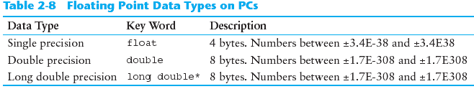
Floating-Point Data Types

Slide 45
Floating-Point Literals
Can be represented in
Fixed point (decimal) notation:
31.4159 0.0000625
E notation:
3.14159E1 6.25e-5
Are double by default
Can be forced to be float (3.14159f) or long double (0.0000625L)

Slide 46
Variable Assignments and Initialization
An assignment statement uses the = operator to store a value in a variable. item = 12;
This statement assigns the value 12 to the item variable.

Slide 47
Assignment and Initialization
The variable receiving the value must appear on the left side of the = operator.
This will NOT work: // ERROR! 12 = item;
To initialize a variable means to assign it a value when it is defined:
int length = 12;
Can initialize some or all variables:
int length = 12, width = 5, area;

Slide 48
Arithmetic Operators
Used for performing numeric calculations
C++ has unary, binary, and ternary operators:
unary (1 operand)
ex. int value = 12;
binary (2 operands)
ex. value = val1 + val2
Ex. if (a == b)
ternary (3 operands) exp1 ? exp2 : exp3
Ex. a < b : true

Slide 49
Binary Arithmetic Operators
SYMBOL | OPERATION | EXAMPLE | VALUE OF ans
+ | addition | ans = 7 + 3; | 10
- | subtraction | ans = 7 - 3; | 4
* | multiplication | ans = 7 * 3; | 21
/ | division | ans = 7 / 3; | 2
% | modulus | ans = 7 % 3; | 1

Slide 50
Comments
Used to document parts of the program
Intended for persons reading the source code of the program:
Indicate the purpose of the program
Describe the use of variables
Explain complex sections of code
Are ignored by the compiler

Slide 51
Single-Line/Multiple Lines Comments
Begin with // through to the end of line:
int length = 12; // length in inches
int width = 15; // width in inches
int area; // calculated area
// calculate rectangle area
area = length * width;
Begin with /*, end with */
/* this is a multi-line
comment
*/
Can begin and end on the same line:
int area; /* calculated area */

Slide 52
Named Constants
Named constant (constant variable): variable whose content cannot be changed during program execution
Used for representing constant values with descriptive names:
const double TAX_RATE = 0.0675;
const int NUM_STATES = 50;
Often named in uppercase letters

