Slide 1

Structured Programming Language CSI 121

Slide 2
Topics (Decision Making)
The if Statement
The if/else Statement
The if/else if Statement
condition
true
false
1 or more
statements
1 or more
statements

Slide 3
Relational Operators
Allow to compare numeric and char values and determine relative order
Operators:
> | Greater than
< | Less than
>= | Greater than or equal to
<= | Less than or equal to
== | Equal to
!= | Not equal to

Slide 4
Relational Expressions
Relational expressions are Boolean (i.e., the value can be true or false)
Examples:
12 > 5 is true
7 <= 5 is false
if x is 10, then
x == 10 is true,
x != 8 is true, and
x == 8 is false

Slide 5
Relational Expressions
Do not confuse
= (assignment)
== (equal to)
Notes:
See pr4-01.cpp

Slide 6
The if Statement
Allows statements to be conditionally executed or skipped over
Models the way we mentally evaluate situations
1. if (checks < 50)
fees = 100 + checks * 25;
2. if (checks >= 50)
fees = 100 + checks * 50;

Slide 7
Several logical expressions
count <= 100
sqrt (a+b+c)> 00.005(#include <math.h)
answer == 0
balance >= cutoff
ch < ‘T’
letter != ‘x’

Slide 8
Format of the if Statement
if (condition){
statement1;
statement2;
…
statementn;
}
The block inside the braces is called
the body of the if statement.
If there is only 1 statement in the body,
the { }may be omitted.
No ; goes here
; goes here

Slide 9
Example if Statements
int score;
char grade;
if (score == 55){
grade = ’D’;
printf (“ Your grade is : %c”, grade);
}
if (score >= 90){
grade = 'A';
printf (“ Your grade is : %c”, grade);
}
Notes:
File pr4-02A.cpp is the version of Program 4-2 found on p. 164 in the text. Files pr4-02B.cpp through pr4-02D.cpp contain the variations on Program 4.2 in the text.

Slide 10
How the if Statement Works
If (condition) is true,
then the statement(s) in the body are executed.
If (condition) is false,
then the statement(s) are skipped.

Slide 11
if Statement Notes
Do not place ; after (condition)
Don't forget the { } around a multi-statement body
Place each statement; on a separate line after (condition), indented
0 is false; any other value is true

Slide 12
The if/else Statement
Allows a choice between statements depending on whether (condition) is true or false
Format: if (condition){
statement set 1;
}
else{
statement set 2;
}

Slide 13
if/else Flow of Control
true
false
condition
statement set 1
statement
set 2

Slide 14
How the if/else Works
If (condition) is true, statement set 1 is executed and statement set 2 is skipped.
If (condition) is false, statement set 1 is skipped and statement set 2 is executed.

Slide 15
Example if/else Statements
if (score >= 60){
printf (“%d”);
}
else{
printf (“ %d”);
}
if (intRate > 0){
interest = loanAmt * intRate;
printf (“%f”, interest);
}
else{
printf (“%f”, interest);
}
Notes:
See pr4-05.cpp and pr4-06.cpp

Slide 16
The if/else if Statement
Chain of if statements that test in order until one is found to be true
Also models thought processes
“If it is raining, take an umbrella,
else, if it is windy, take a hat,
else, if it is sunny, take sunglasses.”

Slide 17
if/else if Format
if (condition 1){
statement set 1;
}
else if (condition 2){
statement set 2;
}
…
else if (condition n){
statement set n;
}
Notes:
See pr4-07.cpp, compare to pr4-08.cpp

Slide 18
Using a Trailing else
Chain of if statements. They perform their tests one after the other until one of them is found to be true.
Used with if/else if statement when all of the conditions are false
Provides a default statement or action
Can be used to catch invalid values or handle other exceptional situations

Slide 19
Example if/else if with Trailing else
if (age >= 21){
printf (“Adult”);
}
else if (age >= 13){
printf (“Teen”);
}
else if (age >= 2){
printf (“Child”);
}
else{
printf (“Baby”);
}
Notes:
See pr4-09.cpp

Slide 20
Nested if Statements
An if statement that is part of the if or else part of another if statement
Can be used to evaluate > 1 data item or condition
if (score < 100){
if (score > 90){
printf (“Grade is : A+”);
}
else if (score > 80){
printf (“Grade is : A”);
}
}

Slide 21
Notes on Coding Nested ifs
An else matches the nearest if that does not have an else
if (score < 100){
if (score > 90){
grade = 'A';
}
else ... // goes with second if,
// not first one
}
Proper indentation aids comprehension
Notes:
See pr4-11.cpp

Slide 22
Logical Operators
Connect two or more relational expressions into one or reverse the logic of an expression.
Operators, Meaning, and Explanation
&& | AND | New relational expression is true if both expressions are true
|| | OR | New relational expression is true if either expression is true
! | NOT | Reverses the value of an expression; true expression becomes false, false expression becomes true

Slide 23
Logical Operator Examples
int x = 12, y = 5, z = -4;
(x > y) && (y > z) | true
(x > y) && (z > y) | false
(x <= z) || (y == z) | false
(x <= z) || (y != z) | true
!(x >= z) | false
Notes:
See pr4-12.cpp, pr4-13.cpp, pr4-14.cpp, and pr4-15.cpp

Slide 24
Logical Precedence
Highest ! (!(x + y), (!x + y)
&&
Lowest ||
Example:
(2 < 3) || (5 > 6) && (7 > 8)
is true because AND is evaluated before OR

Slide 25
More on Precedence
Highest
arithmetic operators
relational operators
Lowest
logical operators
Example:
8 < 2 + 7 || 5 == 6 is true

Slide 26
Example
if (x <= 3.0) { y = 3 * pow (x, 2);
printf (”%f \n”, y ) ;
if ((balance < 1000) || (status == ‘R’))
printf ( “%f” , balance) ;
if ((a >= 0) && (b <= 5)) {
xmid = (a + b) / 2; ymid = sqrt(xmid); }

Slide 27
Example
Please input grade.
if (grade >= 0 && grade <= 100) {
printf("Valid grade”)
if (grade > 90){
printf(“You have obtained A+”);
}
else if (grade > 80){
printf(“You have obtained A”);
}
else {
printf(“You have to work hard”);
}
}
else if (grade <= 0 || grade >= 100)
printf ("Invalid grade”);

Slide 28
Checking Numeric Ranges with Logical Operators
Used to test if a value is within a range
if (grade >= 0 && grade <= 100)
printf("Valid grade”);
Can also test if a value lies outside a range
if (grade <= 0 || grade >= 100)
printf(”Invalid grade”);
Cannot use mathematical notation
if (0 <= grade <= 100) //Doesn’t
//work!

Slide 29
Validating User Input
Input validation: inspecting input data to determine if it is acceptable
Want to avoid accepting bad input
Can perform various tests
Range
Reasonableness
Valid menu choice
Zero as a divisor
Notes:
See pr4-16.cpp

Slide 30
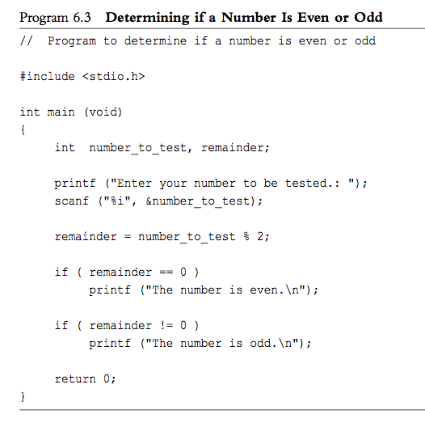
Example: Even or Odd

Slide 31
Comparing Characters
Can use relational operators with characters object
if (menuChoice == 'A')
Comparing characters is really comparing ASCII values of characters
Notes:
See pr4-20.cpp and pr4-21.cpp

Slide 32
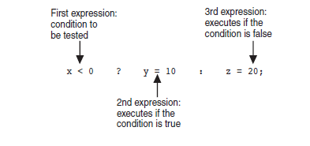
The Conditional Operator
Can use to create short if/else statements
Format: expr ? expr : expr;
Notes:
See pr4-22.cpp

Slide 33
Exercise No.1
Write a C program that calculates the gross pay :
If the salary is over 5000RM then the bonus to be paid is 500 RM
Otherwise, if the salary is over 2000RM then the bonus to be paid is 300 RM
Otherwise, the salary is over 1000RM then the bonus to be paid is 200 RM
Else, the bonus to be paid is 100 RM

Slide 34
Ex.2
Write a C program that asks the user to enter two numbers. The program should use the conditional operator to determine which number is smaller and which is the larger.

Slide 35
Ex.3
Write a C program that asks the user to enter a number within the range of 1 through 10.
Display the Roman numeral version of that number.

Slide 36
Leap Year
Write a C program that asks the user to enter a year value. The program should use the conditional operator to determine which number is smaller and which is the larger.
Notes:
#include <stdio.h> int main() { int year; printf("Enter a year to check if it is a leap year\n"); scanf("%d", &year); if ( year%400 == 0) printf("%d is a leap year.\n", year); else if ( year%100 == 0) printf("%d is not a leap year.\n", year); else if ( year%4 == 0 ) printf("%d is a leap year.\n", year); else printf("%d is not a leap year.\n", year); return 0; }

Slide 37
