Slide 1
CSI 121: Structured Programming Language Arrays Salekul Islam United International University

Slide 2
Outline
Arrays
The concept of array
Defining arrays
Initializing arrays
Character arrays
Multidimensional arrays
Variable length arrays

Slide 3
The concept of array
Array: a set of ordered data items
You can define a variable called x, which represents not a single value, but an entire set of values.
Each element of the set can then be referenced by means of a number called an index number or subscript.
Mathematics: a subscripted variable, x_{i}, refers to the ith element x in a set
C programming: the equivalent notation is x[i]

Slide 4
Declaring an array
Declaring an array variable:
Declaring the type of elements that will be contained in the array—such as int, float, char, etc.
Declaring the maximum number of elements that will be stored inside the array.
The C compiler needs this information to determine how much memory space to reserve for the array.)
This must be a constant integer value
The range for valid index values in C:
First element is at index 0
Last element is at index [size-1]
It is the task of the programmer to make sure that array elements are referred by indexes that are in the valid range ! The compiler cannot verify this, and it comes to severe runtime errors !

Slide 5
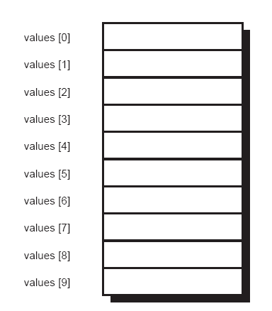
Arrays - Example
Example:
int values[10];
Declares an array of 10 elements of type int
Using Symbolic Constants for array size:
#define N 10
…
int values[N];
Valid indexes:
values[0]=5;
values[9]=7;
Invalid indexes:
values[10]=3;
values[-1]=6;
In memory: elements of an array are stored
at consecutive locations

Slide 6
Arrays - Example
Using symbolic constants for array size makes program more general
#include <stdio.h>
#define N 6
int main (void)
{
int values[N];
int index;
for ( index = 0; index < N; ++index ) {
printf(“Enter value of element #%i \n”,index);
scanf(“%i”, &values[index]);
}
for ( index = 0; index < N; ++index )
printf("values[%i]= %i\n",index, values[index]);
return 0;
}
Typical loop for processing all elements of an array

Slide 7
Class Room Practice

Slide 8
What goes wrong if an index goes out of range ?
#include <stdio.h>
#define NA 4
#define NB 7
int main (void) {
int b[NB],a[NA];
int index;
for ( index = 0; index < NB; ++index )
b[index]=10+index;
for ( index = 0; index < NA+2; ++index )
a[index]=index;
for ( index = 0; index < NA+2; ++index )
printf ("a[%i] = %i ", index, a[index]);
printf("\n");
for ( index = 0; index < NB; ++index )
printf ("b[%i] = %i ", index, b[index]);
printf("\n");
return 0;
}

Slide 9
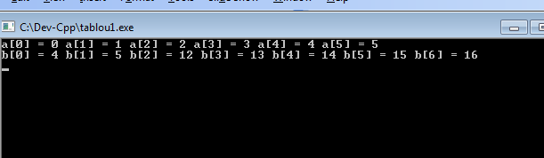
What goes wrong if an index goes out of range ?
#include <stdio.h>
#define NA 4
#define NB 7
int main (void) {
int b[NB],a[NA];
int index;
for ( index = 0; index < NB; ++index )
b[index]=10+index;
for ( index = 0; index < NA+2; ++index )
a[index]=index;
for ( index = 0; index < NA+2; ++index )
printf ("a[%i] = %i ", index, a[index]);
printf("\n");
for ( index = 0; index < NB; ++index )
printf ("b[%i] = %i ", index, b[index]);
printf("\n");
return 0;
}
!?!

Slide 10
Exercise
Suppose you took a survey to discover how people felt about a particular television show and you asked each respondent to rate the show on a scale from 1 to 10, inclusive. After interviewing 5,000 people, you accumulated a list of 5,000 numbers. Now, you want to analyze the results.
One of the first pieces of data you want to gather is a table showing the distribution of the ratings: you want to know how many people rated the show a 1, how many rated it a 2, and so on up to 10.
Develop a program to count the number of responses for each rating.

Slide 11
Exercise: Array of counters
response
ratingCounters
++
0
1
2
9
10
ratingCounters[i] = how many persons rated the show an i

Slide 12
Exercise: Array of counters
#include <stdio.h>
int main (void) {
int ratingCounters[11], i, response;
for ( i = 1; i <= 10; ++i )
ratingCounters[i] = 0;
printf ("Enter your responses\n");
for ( i = 1; i <= 20; ++i ) {
scanf ("%i", &response);
if ( response < 1 || response > 10 )
printf ("Bad response: %i\n", response);
else
++ratingCounters[response];
}
printf ("\n\nRating Number of Responses\n");
printf ("------ -------------------\n");
for ( i = 1; i <= 10; ++i )
printf ("%4i%14i\n", i, ratingCounters[i]);
return 0;
}

Slide 13
Exercise: Fibonacci numbers
// Program to generate the first 15 Fibonacci numbers
#include <stdio.h>
int main (void)
{
int Fibonacci[15], i;
Fibonacci[0] = 0; // by definition
Fibonacci[1] = 1; // ditto
for ( i = 2; i < 15; ++i )
Fibonacci[i] = Fibonacci[i-2] + Fibonacci[i-1];
for ( i = 0; i < 15; ++i )
printf ("%i\n", Fibonacci[i]);
return 0;
}

Slide 14
Difficult Exercise: Prime numbers
An improved method for generating prime numbers involves the notion that a number p is prime if it is not evenly divisible by any other prime number
Another improvement: a number p is prime if there is no prime number smaller than its square root, so that it is evenly divisible by it
If you can find a primes[i] < sqrt(p) that divides evenly p, than p is not prime
Is p the next prime number here ?
primes
2
3
5
7
11
0
1
2
primeIndex

Slide 15
Exercise: Prime numbers
#include <stdio.h>
#include <stdbool.h>
// Modified program to generate prime numbers
int main (void) {
int p, i, primes[50], primeIndex = 2;
bool isPrime;
primes[0] = 2;
primes[1] = 3;
for ( p = 5; p <= 50; p = p + 2 ) {
isPrime = true;
for ( i = 1; isPrime && p / primes[i] >= primes[i]; ++i )
if ( p % primes[i] == 0 )
isPrime = false;
if ( isPrime == true ) {
primes[primeIndex] = p;
++primeIndex;
}
}
for ( i = 0; i < primeIndex; ++i )
printf ("%i ", primes[i]);
printf ("\n");
return 0;
}

Slide 16
Initializing arrays
int counters[5] = { 0, 0, 0, 0, 0 };
char letters[5] = { 'a', 'b', 'c', 'd', 'e' };
float sample_data[500] = { 100.0, 300.0, 500.5 };
The C language allows you to define an array without specifying the number of elements. If this is done, the size of the array is determined automatically based on the number of initialization elements:
int counters[] = { 0, 0, 0, 0, 0 };

Slide 17
Class Room Practice

Slide 18
Character arrays
#include <stdio.h>
int main (void)
{
char word[] = { 'H', 'e', 'l', 'l', 'o', '!' };
int i;
for ( i = 0; i < 6; ++i )
printf ("%c", word[i]);
printf ("\n");
return 0;
}
a special case of character arrays: the character string type =>in a later chapter

Slide 19
Multidimensional arrays
C language allows arrays of any number of dimensions
Two-dimensional array: matrix
int M[4][5]; // matrix, 4 rows, 5 columns
// M[i][j] – element at row i, column j
int M[4][5] = {
{ 10, 5, -3, 17, 82 },
{ 9, 0, 0, 8, -7 },
{ 32, 20, 1, 0, 14 },
{ 0, 0, 8, 7, 6 }
};
int M[4][5] = { 10, 5, -3, 17, 82, 9, 0, 0, 8, -7, 32,20, 1, 0, 14, 0, 0, 8, 7, 6 };

Slide 20
Example: Typical matrix processing
#define N 3
#define M 4
int main(void) {
int a[N][M];
int i,j;
/* read matrix elements */
for(i = 0; i < N; i++)
for(j = 0; j< M; j++) {
printf("a[%d][%d] = ", i, j);
scanf("%d", &a[i][j]);
}
/* print matrix elements */
for(i = 0; i < N; i++) {
for(j = 0; j< M; j++)
printf("%5d", a[i][j]);
printf("\n");
}
return 0;
}

