Slide 1
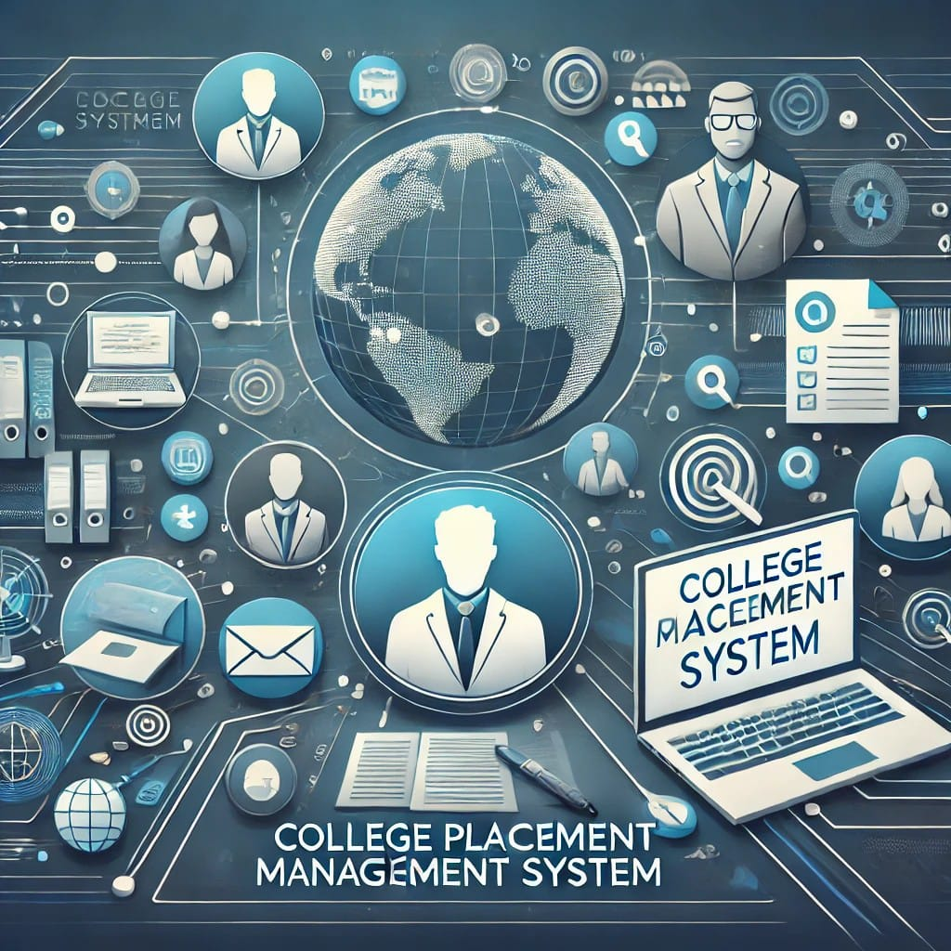
Collage Placement Management System
This project aims to develop an automated web application that simplifies the college placement process, supporting seamless connectivity among students, placement, and faculty members.
By:
Ankit Singh (2100290120031)
Anurag Singh (2100290120040)
Aditya Chandra (2100290120015)
Anuj Karnwal (2100290120037)

Slide 2

Project Abstract
CPMS aims to automate and streamline the college placement process through analytics, attendance, and personalized learning pathways.
The system improves communication among students, faculty and HOD, ensuring a transparent and efficient placement experience.

Slide 3

Key Objectives
Attendance Tracking – It is designed to efficiently record, monitor, and manage student attendance.
Enhance Placement Management – Real-time data analytics for student profiling.
Personalized Learning Pathways – AI-driven recommendations based on academic records.

Slide 4
Problem Statement
Traditional methods of placement management are inefficient and lack personalization.
Manual attendance tracking leads to inaccuracies and administrative delays.
Students struggle to align skills with job market demands due to a lack of structured guidance.
Need for a data-driven approach to bridge the gap between education and employment.

Slide 5

Sustainable Development Goals (SDGs) Alignment
CPMS supports multiple SDGs:
SDG 4: Quality Education – Personalized learning and skill enhancement.
SDG 8: Decent Work and Economic Growth – Improves employability and job placement success.
SDG 9: Industry, Innovation, and Infrastructure – Implements AI for education systems.
SDG 10: Reduced Inequalities – Provides equal access to job opportunities through unbiased AI recommendations.

Slide 6

Related Work
Attendance tracking improves accuracy compared to manual methods.
ERP systems support academic operations but often exclude end-to-end placement management for students and faculty.
Authentication and access control models have been implemented in previous systems using token-based or role-based approaches.
Mobile-first or responsive designs are often overlooked in older systems, affecting accessibility.

Slide 7

Methodology
Step 1: Data Collection
Student academic records, skills, and job preferences.
Employer job descriptions, hiring trends, and placement feedback.
Step 2: Data Processing
Data Cleaning – Remove duplicates and outdated records.
Normalization – Standardize resume formats and job postings.
Step 3: System Design
Role-Based Access (Students, Placement, Faculty, HOD).
AI-based learning method and job-matching algorithm.
Step 4: Data Analysis
Skill gap analysis and placement success prediction.
AI-driven jo
Step 5: Continuous Improvement
Regular system updates, employer feedback integration, and AI enhancements.

Slide 8
Results & Impact
Scalability for Future Use: The system can be expanded to include internship tracking or alumni placement data.
Improved Placement Rates –job matching enhances success rates.
Better Student Engagement – Personalized recommendations keep students motivated.
Enhanced Transparency –Ensures secure and tamper-proof student records.

Slide 9
Conclusion
CPMS transforms the traditional placement process through predictive analytics.
Ensures higher employability, efficient recruitment, and transparent placement tracking.
Aligns with SDGs to promote quality education, decent work, and innovation in career development.
Future expansions will further enhance its impact on students and the recruitment ecosystem.

Slide 10

THANK YOU

