Slide 1


I Project Presentation (KCS 753) HUMAN INTRUSION DETECTION SYSTEM
KIET Group of Institutions, Ghaziabad
(An ISO – 9001: 2008 Certified & ‘A+’ Grade accredited Institution by NAAC)
Guide Name: Mr. Sreesh Gaur(Assistant Professor, CS Department)
1.Archit Kaushik (2100290120046 , Section A)
2. Asmit Tyagi (2100290120058 , Section A)
3. Arun Kumar (2000290120042 , Section A)
4. Ashish Sikarwar (2100290120053 , Section A)

Slide 2
Problem Statement
Unauthorized human infiltrations pose significant security risks in defense and sensitive areas. Conventional security measures often struggle to detect and prevent such infiltrations in real-time, leading to potential security breaches and compromised safety.
There is a pressing need for advanced surveillance and detection systems capable of effectively identifying and thwarting unauthorized infiltrations. Current solutions lack the precision and speed required to address evolving security threats, highlighting the urgency for innovative approaches.
Security breaches in defense areas can have severe consequences, including compromised national security and endangerment of lives. Inadequate detection and response capabilities exacerbate the risk of infiltration incidents, underscoring the importance of developing robust and efficient security solutions.

Slide 3
Objectives
HIDS aims to enhance security measures by providing real-time detection and prevention of unauthorized infiltrations.
By integrating advanced surveillance technology with deep learning algorithms, the system improves security and reduces the risk of breaches.
Security breaches in defense areas can compromise national security and endanger lives. Robust security measures, like HIDS, are essential for safeguarding critical assets and ensuring the safety of personnel and resources.

Slide 4
Technology Used
Python – Core language for deep learning and model development.
TensorFlow / Keras – For building and training the Sequential Neural Network.
OpenCV – For video frame extraction and preprocessing.
TimeDistributed CNN – Spatial feature extraction from video frames.
LSTM (Long Short-Term Memory) – Temporal pattern analysis.
Max Pooling Layer – Dimensionality reduction and feature selection.
Flatten Layer – Converts multi-dimensional arrays into a vector.
Classification Layer – Final layer for intrusion detection output.
UCF-Crime Dataset – Surveillance videos for training and testing

Slide 5
SDG’s Mapped
SDG 9: Industry, Innovation, and Infrastructure
The project leverages deep learning and artificial intelligence to enhance surveillance and security infrastructure.
Encourages technological advancements in automated security systems for smart cities and industries.
SDG 11: Sustainable Cities and Communities
Helps in preventing unauthorized access to restricted or sensitive areas.
Contributes to smart surveillance systems in urban planning for safer public spaces.
SDG 16: Peace, Justice, and Strong Institutions
Helps in real-time detection of suspicious activities, reducing threats like theft, vandalism, and assaults.
Supports law enforcement and security agencies with advanced monitoring tools.

Slide 6
Literature Survey
Smart Surveillance as an Edge Network Service: from Haar-Cascade, SVM to a Lightweight CNN (Nikouei et al., 2018) This study explores the feasibility of human-object detection schemes at the edge and introduces a lightweight Convolutional Neural Network (L-CNN) for human detection. The algorithms are validated using real-world campus surveillance video streams and open datasets, demonstrating efficient performance in resource-constrained environments.
Video Anomaly Detection System Using Deep Convolutional and Recurrent Models (Qasim & Verdú, 2023) This research presents a system that utilizes deep convolutional and recurrent models to detect anomalies in video surveillance, focusing on identifying unusual activities that may indicate security threats. The hybrid approach effectively captures both spatial and temporal features, enhancing intrusion detection accuracy.
Real-World Anomaly Detection in Surveillance Videos (Sultani et al., 2018) This paper introduces a method to learn anomalies by exploiting both normal and anomalous videos through a deep multiple instance ranking framework. The study presents a large-scale dataset of real-world surveillance videos encompassing various anomalies such as fighting, road accidents, burglary, and robbery, showcasing strong performance in real-world scenarios.

Slide 7
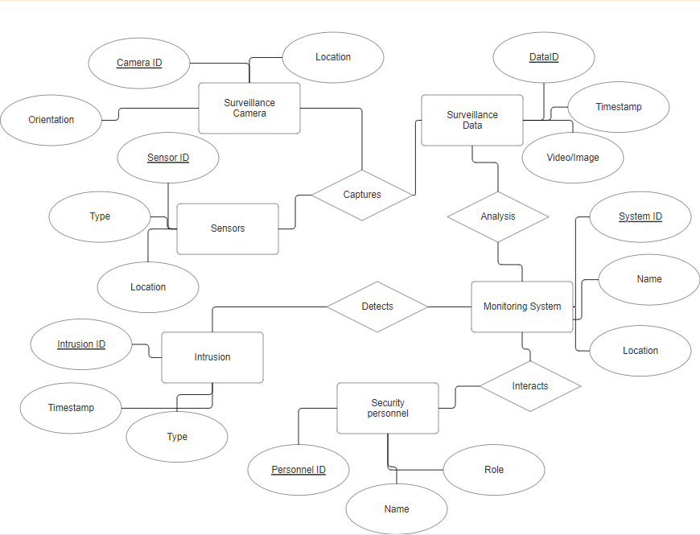
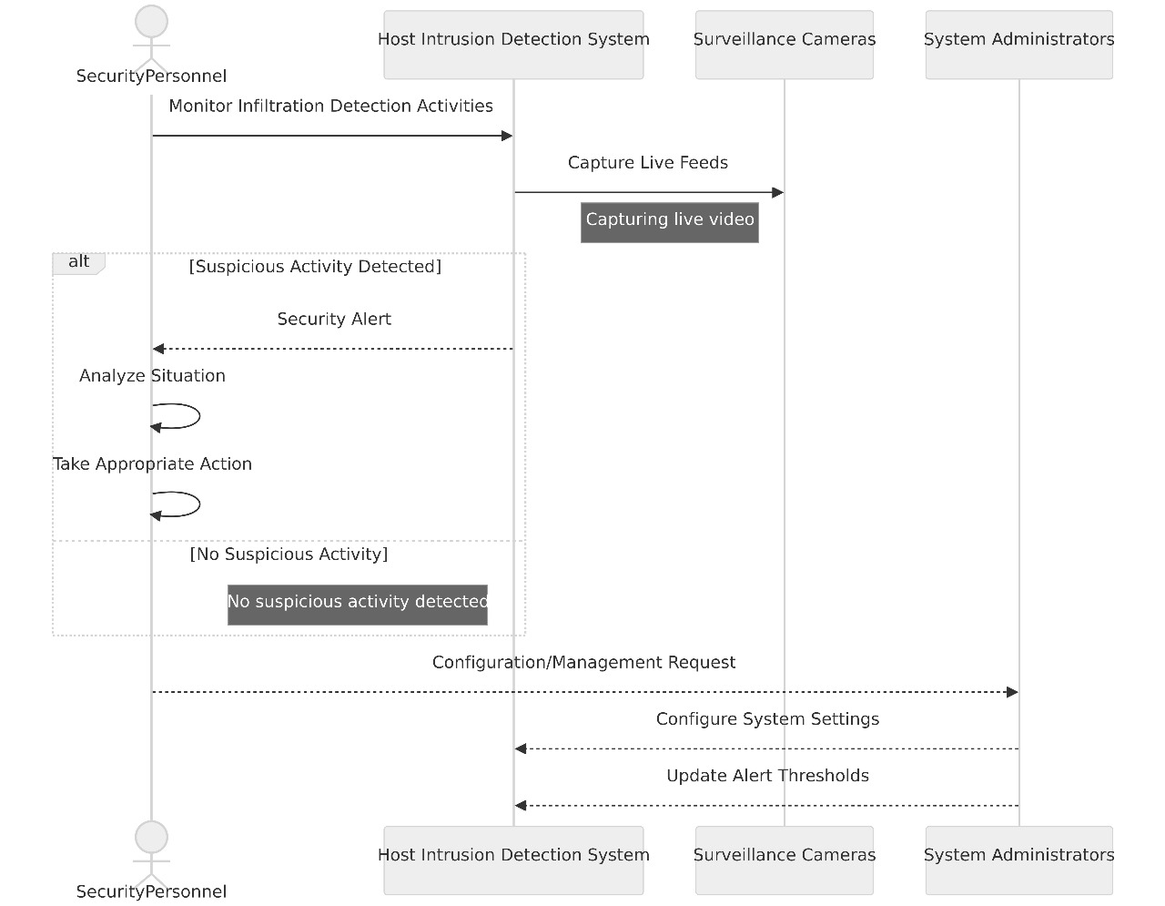
Workflow Diagram
ER DIAGRAM
SEQUENCE DIAGRAM

Slide 8

Patent Status
Submitted for publication

Slide 9
Project Status
Deep Learning based model is working
Tested and working can detect intrusions such as shop lifting, fighting, arson, etc
Working on the deployment of project

Slide 10
References
Nikouei, S. Y., Chen, Y., Song, S., Xu, R., Choi, B. Y., & Shu, L. (2018). Smart Surveillance as an Edge Network Service: from Haar-Cascade, SVM to a Lightweight CNN. arXiv preprint arXiv:1805.00331.
Qasim, M., & Verdú, E. (2023). Video Anomaly Detection System Using Deep Convolutional and Recurrent Models.
Sultani, W., Chen, C., & Shah, M. (2018). Real-World Anomaly Detection in Surveillance Videos. IEEE Conference on Computer Vision and Pattern Recognition (CVPR).

