Slide 1
IncidentDesk
From one commit to a monitored, autoscaled Kubernetes deployment
DevOps Final Capstone · Session 21 · github.com/BinaryBhakti/incidentdesk-devops-capstone
FastAPI · React · PostgreSQL
GitHub Actions · Trivy · GHCR
Terraform · Helm · Prometheus
Notes:
Introduce yourself. IncidentDesk is an incident-management app; the point of the project is the delivery chain around it: Git, CI, security gate, registry, Terraform, Kubernetes, monitoring and troubleshooting.

Slide 2
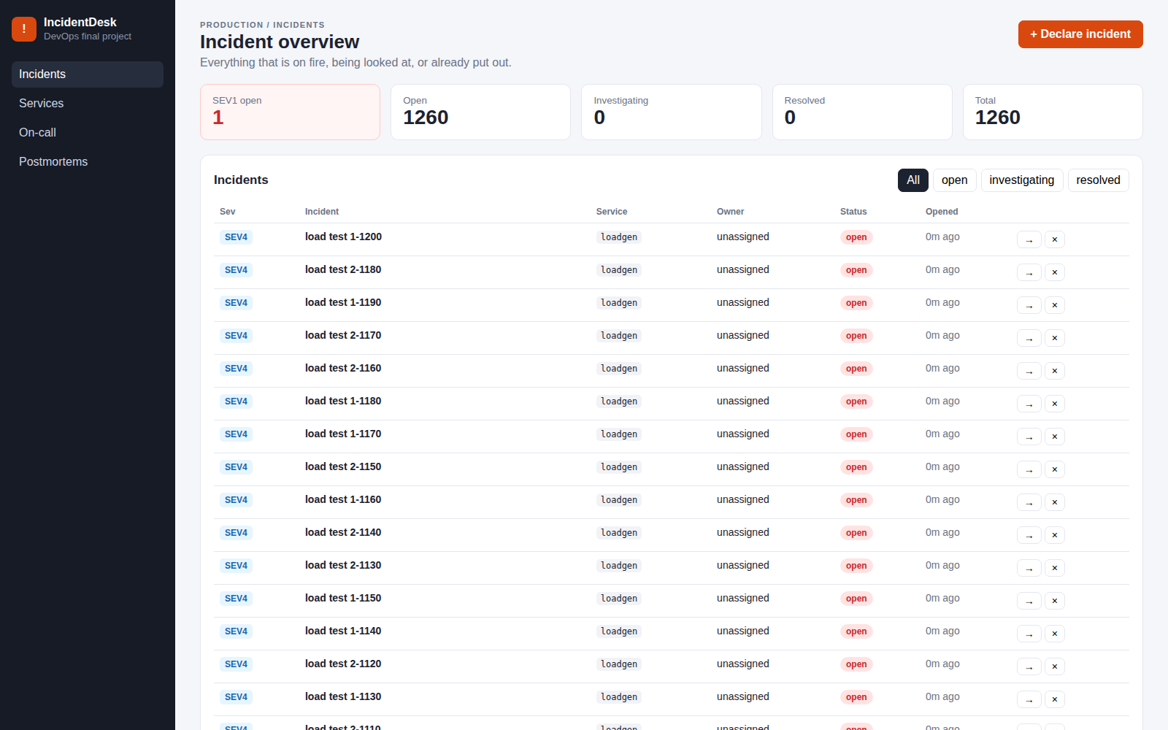
What IncidentDesk does
1
Declare
Open an incident with a title, the affected service and a severity from SEV1 to SEV4
2
Track
Move it OPEN → INVESTIGATING → RESOLVED; resolving stamps the time, reopening clears it
3
See
Live KPI cards: SEV1 open, open, investigating, resolved, total
4
Integrate
FastAPI REST API with Swagger at /docs; health, readiness and Prometheus metrics endpoints
The real UI, captured by headless Chromium through the NGINX Ingress in CI (rows are load-test incidents)
Notes:
Walk through the four rows. The screenshot is the real app served through the Ingress during the CI run; the incidents are from the load test.

Slide 3
Tech stack
A
D
P
O
Application
Delivery
Platform
Observability
Python 3.12 · FastAPI
SQLAlchemy 2 · Alembic
PostgreSQL 16
pytest · ruff
React 19 · Vite · nginx
Docker multi-stage, non-root
Docker Compose
GitHub Actions
GitHub Container Registry
Trivy · gitleaks
Terraform: AWS VPC + EKS
LocalStack (CI)
Kubernetes (kind) · Helm
NGINX Ingress · HPA
Argo CD (GitOps)
prometheus-fastapi-instrumentator
Prometheus + kube-state-metrics
Grafana dashboard as code
6 alert rules
Playwright screenshots
Notes:
Four groups: the application itself, how it is delivered, the platform it runs on, and how it is observed.

Slide 4
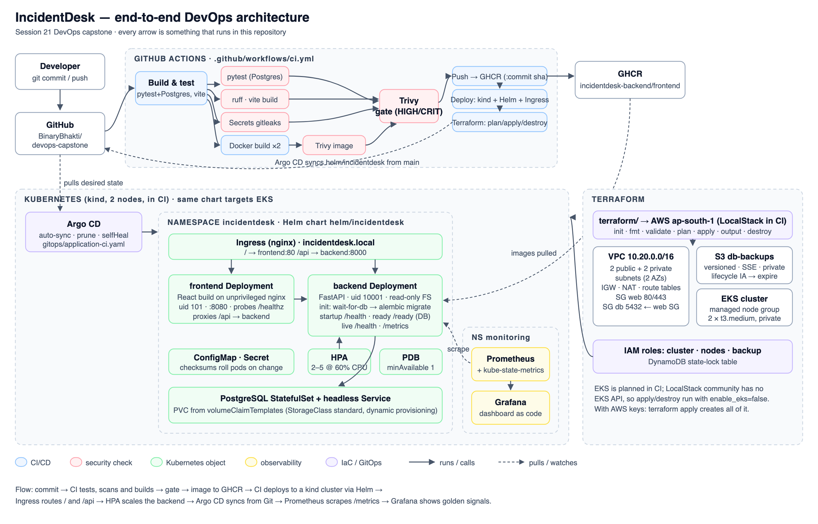
Architecture
Notes:
Follow one commit left to right: GitHub Actions tests, scans and builds; images go to GHCR with the commit SHA; Helm deploys into Kubernetes behind an Ingress; Prometheus scrapes /metrics and Grafana shows it. Terraform owns the AWS network and EKS on the right.

Slide 5
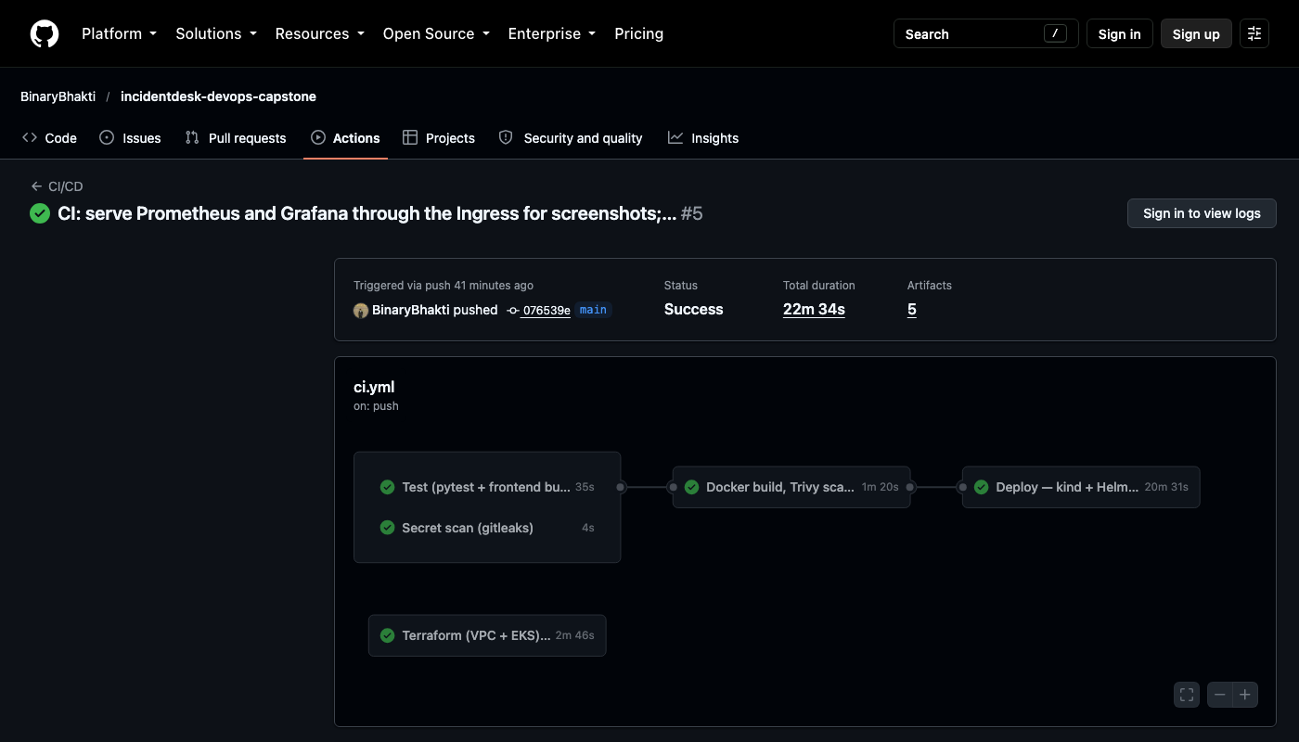
CI/CD: every stage is a gate
1
Test
2
Secret scan
3
Build + Trivy
4
Push to GHCR
5
Deploy
ruff · pytest -v on a real Postgres · vite build
gitleaks over the full Git history
both images; fail on fixable HIGH/CRITICAL
tag = commit SHA, never latest
kind · Helm · Ingress · HPA · monitoring · Argo CD
Run #5: 5/5 jobs green in 22 min
Triggers on every push to main (docs-only changes skipped), on PRs and on demand
A failing test, lint error or fixable HIGH CVE stops the run before anything is pushed
Image tag = full commit SHA, so production traces back to one exact commit
Terraform runs alongside: plan, apply and destroy on LocalStack
Notes:
Explain the five jobs. Show the real run in the video: push a commit and open the Actions tab.

Slide 6
Results from the evidence run
13/13
0
38
2 → 5
5/5
pytest cases passed
HIGH / CRITICAL CVEs
Terraform resources planned
backend pods
Prometheus targets UP
97% coverage, gate at 85%
Trivy, both images
VPC, subnets, NAT, EKS, node group
HPA scaled under load (CPU 342%/60%)
every backend pod scraped
All numbers come from the logs in demo/evidence/, downloaded from GitHub Actions run #5
Notes:
These are measured results, not targets. Each number links to a log file in demo/evidence.

Slide 7
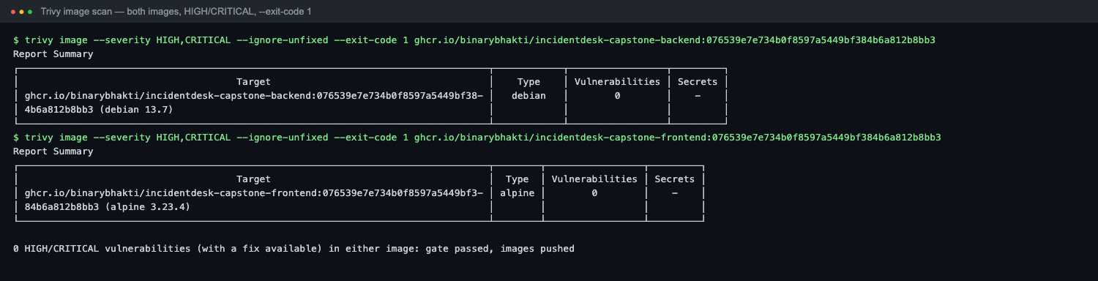
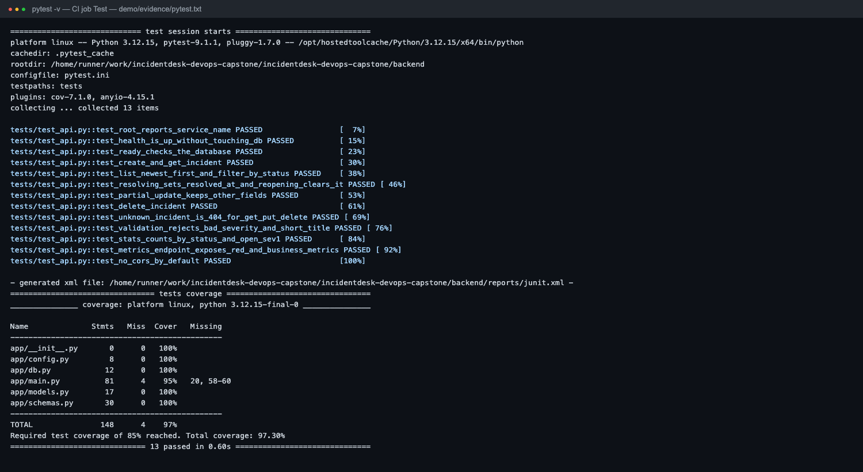
DevSecOps: scan before you ship
Layer | Control
Secrets | gitleaks, full history
Containers | Trivy on both images, before push
Code / deps | Semgrep, Bandit, pip-audit configs
Runtime | non-root, read-only FS, no default password
trivy image --severity HIGH,CRITICAL --ignore-unfixed --exit-code 1, run on both images
What the clean result means
Trivy checked the Debian and Alpine OS packages plus the Python and npm dependencies in each image. It found no HIGH or CRITICAL CVE that has a fix. That is one control, not a guarantee: unfixed CVEs and runtime behaviour are covered by other layers.
Notes:
Security is layered. Trivy runs before the push step, so a vulnerable image never reaches the registry. Explain the clean result in your own words.

Slide 8
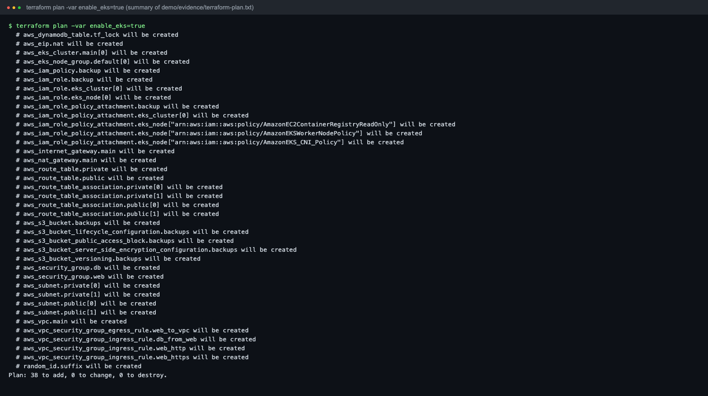
Terraform: AWS VPC + EKS as code
N
Network
VPC 10.20.0.0/16 in ap-south-1 · 2 public + 2 private subnets · IGW · NAT
E
EKS
cluster v1.33 · managed node group, 2 × t3.medium in private subnets
S
Security
IAM roles for cluster and nodes · SGs: web 80/443, db 5432 from web only
B
Storage
versioned, encrypted backup bucket · DynamoDB state lock
terraform plan -var enable_eks=true → Plan: 38 to add (EKS cluster + node group included)
No AWS account: CI runs it on LocalStack. The plan includes EKS; apply and destroy skip EKS (LocalStack Pro only).
Notes:
Infrastructure as code: the same files run against real AWS by default. Be clear that the EKS cluster was planned but not created, because there was no AWS account.

Slide 9
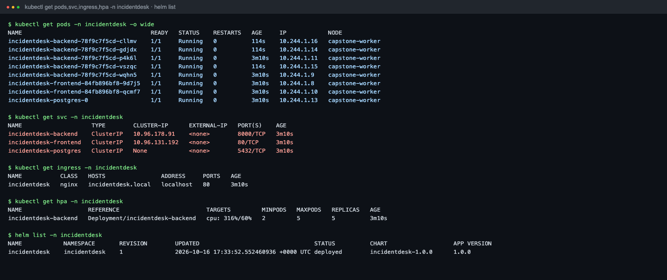
Kubernetes + Helm
Namespace incidentdesk (k8s/namespace.yaml)
Backend + frontend Deployments, 2 replicas each, zero-downtime rolling updates
Probes: startup and liveness /health, readiness /ready (database)
PostgreSQL StatefulSet with a PVC
ClusterIP Services; Ingress routes / to the frontend and /api to the backend
HPA 2–5 pods at 60% CPU, PodDisruptionBudget
Every pod Running · HPA at 5/5 under load · release deployed (helm list)
helm upgrade --install incidentdesk \
./helm/incidentdesk -n incidentdesk
GitOps with Argo CD
The same chart synced from Git into incidentdesk-gitops: Healthy, 5/5 pods Running, auto-sync, prune and self-heal on
GO
Notes:
Show kubectl get pods, svc, ingress and hpa. Point out that the HPA scaled the backend from 2 to 5 pods during the load test. Argo CD deployed the same chart from Git.

Slide 10
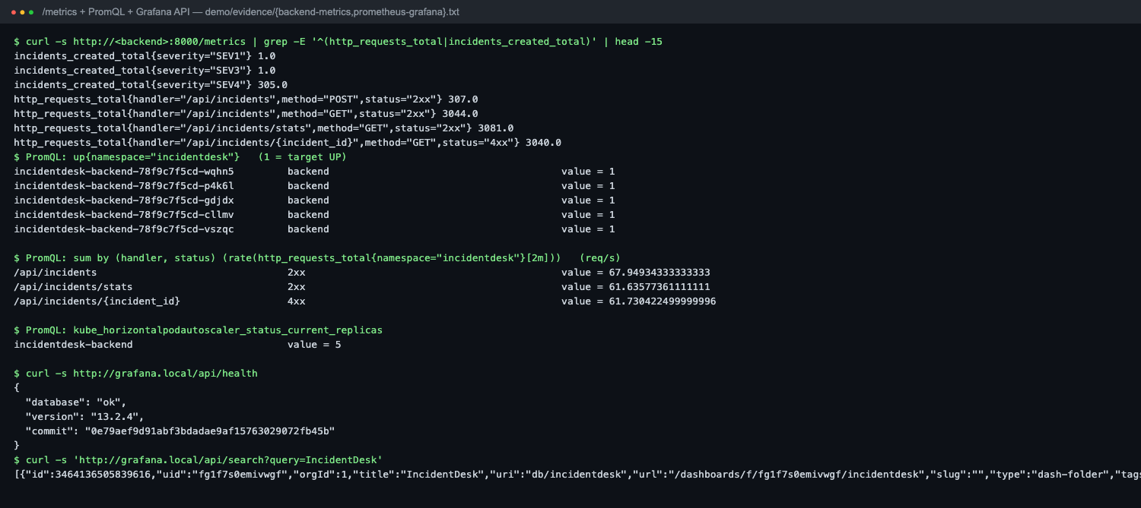
Observability: metrics to dashboard
1
/metrics
requests, latency per route, incidents created
2
Prometheus
scrapes annotated pods + kube-state-metrics; 6 alert rules
3
Grafana
golden-signals dashboard provisioned from code
Every backend pod is up = 1, with live request rates per route
Grafana API: healthy, and the IncidentDesk dashboard is provisioned
Alerts: backend down, pod not ready, restarts, 5xx ratio, p95 latency, HPA at max
Notes:
Prometheus answers: is traffic arriving, which endpoint is slow, are errors rising, is the HPA scaling. Show the Grafana dashboard live if you have a cluster.

Slide 11
Troubleshooting lab
Break | Symptom | How to find it | Fix
Image tag that doesn't exist | ErrImagePull → ImagePullBackOff | kubectl describe pod, get events | set image to the CI commit SHA
Service selector typo | Service has no endpoints | get endpoints, get pods --show-labels | make the selector match the pod labels
Wrong readiness path | pods 0/1 Ready | describe pod: probe events | point readiness at /ready
HPA without requests | targets <unknown> | describe hpa | set CPU requests
Hand edit in the cluster | drift from Git | Argo CD diff | self-heal or git revert
The first two labs run automatically on every deploy in CI: break it, observe the symptom, diagnose, fix (demo/evidence/troubleshooting.txt).
Notes:
Pick one and narrate it: a Service selects pods by labels; no matching labels means no endpoints means no traffic.

Slide 12
Known limitations, stated plainly
!
!
!
No AWS account
Monitoring UI screenshots
Argo CD sync status
Terraform targets real AWS, but ran on LocalStack. EKS is in the plan and was not created, so there is no AWS Console screenshot.
Prometheus and Grafana web UIs did not render in headless Chromium in CI. The Prometheus and Grafana APIs prove targets UP and the dashboard provisioned.
Argo CD deployed the chart (Healthy, 5/5 pods Running), but sync settled on Unknown and the self-heal test did not recreate the Service in 90 s.
Kubernetes ran in a kind cluster inside the CI runner; the same Helm chart targets EKS.
Notes:
Graders value honesty. Say what was not done and why, and how you would finish it with an AWS account.

Slide 13
Key learnings
Gates belong before the registry: tests and the scanner decide what is allowed to exist
Liveness ≠ readiness: /ready checks the database, so traffic only reaches pods that can serve
SHA tags beat latest: a rollback means picking a commit
A Service is only labels; most "network" bugs are selector bugs
HPA needs requests and a metrics provider; an Ingress needs a controller
Declare everything: Terraform, Helm, dashboards, so a rebuild looks identical
Thank you
Notes:
Pick three learnings and say them in your own words, then close.

