Slide 1
Data Extraction Tool
James Senior

Slide 2
Project Overview
Connect to an endpoint on the internet
Retrieve data
Parse Json and extract values
Present data visually on screen
Round temperature to 1 decimal place
Identify those people with a temperature over 37 degrees and display them separately
Export data to CSV file
Endpoint: https://dev.osbornetechnologies.co.uk/project/
GitHub: https://github.com/BinaryBoi/Osborne-Data-Gathering-Software

Slide 3
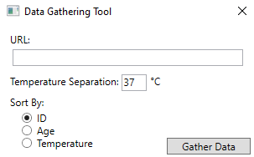
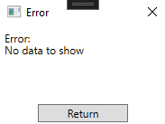
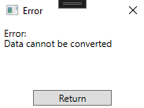
Tool Configuration
Changeable URL
Catches invalid URLs
Catches URLs with incorrect data layouts
Changeable temperature separation
Catches non integer inputs
Options for default sort method

Slide 4
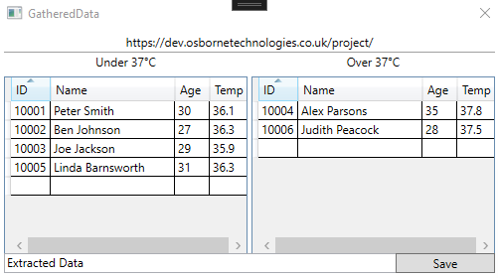
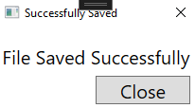
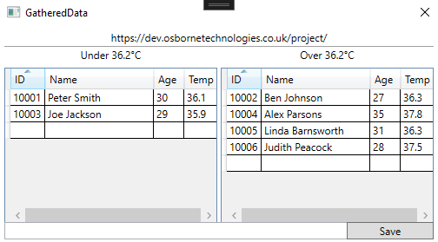
Displaying Data And Saving Data
Displays URL endpoint
Separates data by temperature
Save data to a .csv document
Allows the user to enter the name of the document
Adds to existing documents instead of overwriting them

Slide 5
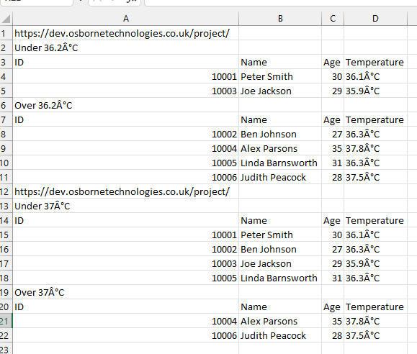

Slide 6
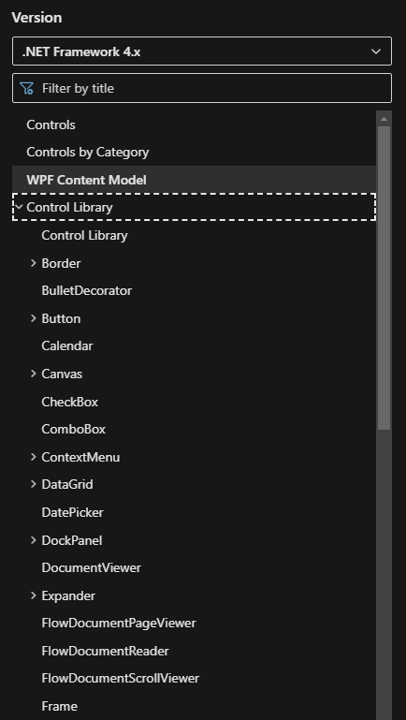
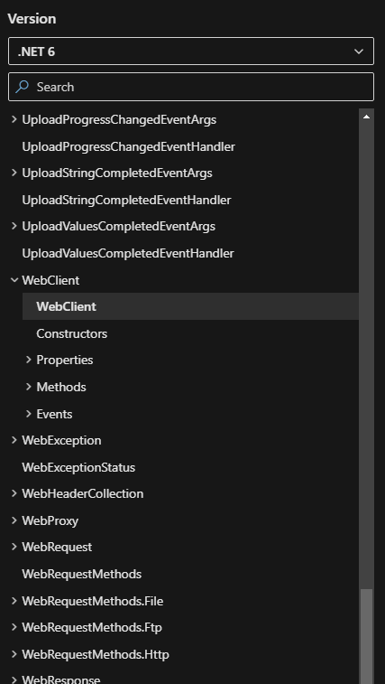
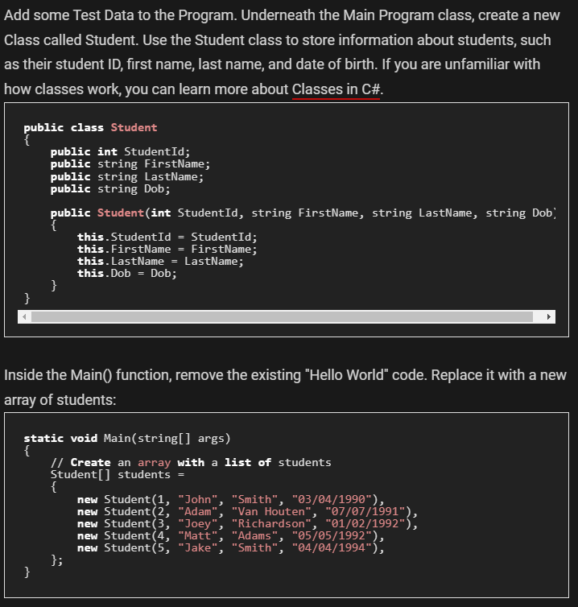
External Help
WPF
Microsoft Documentation
Web Client
Microsoft Documentation
.csv formatting
Make Use Of
Link
Link
Link

Slide 7
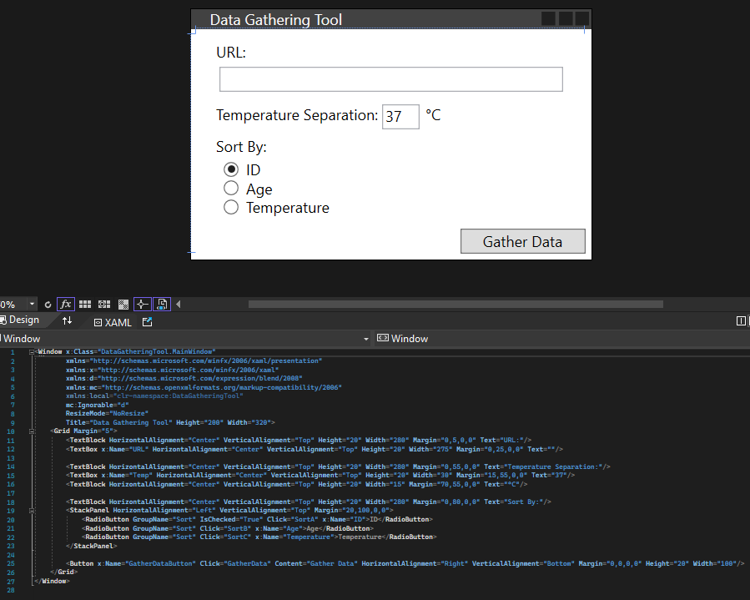
WPF

Slide 8
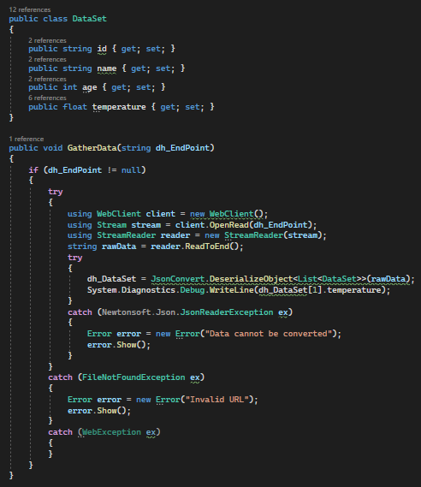
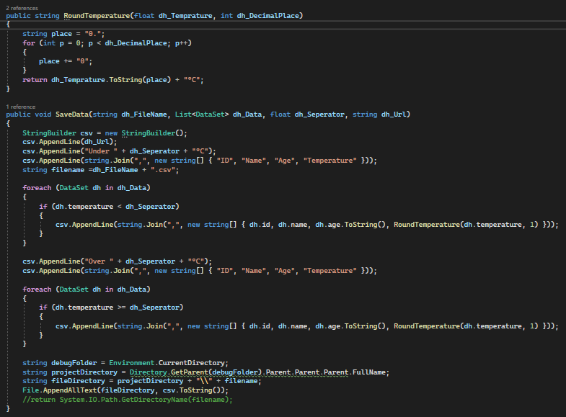
Data Handler

Slide 9
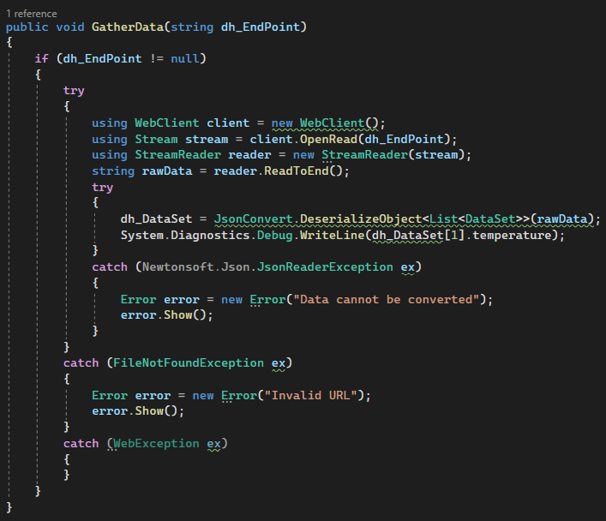
Error Handling

Slide 10
Thank you Any Questions

