Slide 1

International Islamic University
Department Of Computer Science & Engineering
Project Proposal
Course Code: CSE-1222
Submitted by Team “404_Error” |  | Submitted to
Team Leader | : Abdur Rahman Adnan (C223076) | MD Nazim Habib Adjunct Lecturer, Department of CSE, International Islamic University, Chittagong.
Member-01 | : Faisal Ahammod Yasin (C223059)
Member-02 | : Syed Musabbir Turag (C223041) | International Islamic University,
Member-03 | : Dipton Dey (C223054) | Chittagong.

Slide 3
Password Manager
By
Team 404 error
Under the guidance of
mD Nazim Habib

Slide 4
Introduction
Password manager is a c++ programming project. A password manager is a technology tool that helps internet users to create, save, manage and use passwords across different online services. It doesn't send any data to anyone and none can access it without the master password. Thus it can keep all user id and password secure and encrypted.​

Slide 5
Objective
The root objective is to save the multiple user id and password securely and use it further.
A central access of all id and passwords.
To reduce the hassle of remembering password.
To use strong and unique password.
To ensure encryption of the information.

Slide 6






Main features
Record Unlimited Username & Password with Domain
Display individual Username & Password
Display all Saved Username & Password with Domain
Edit any record
Delete any record
Encrypted and safe record

Slide 7
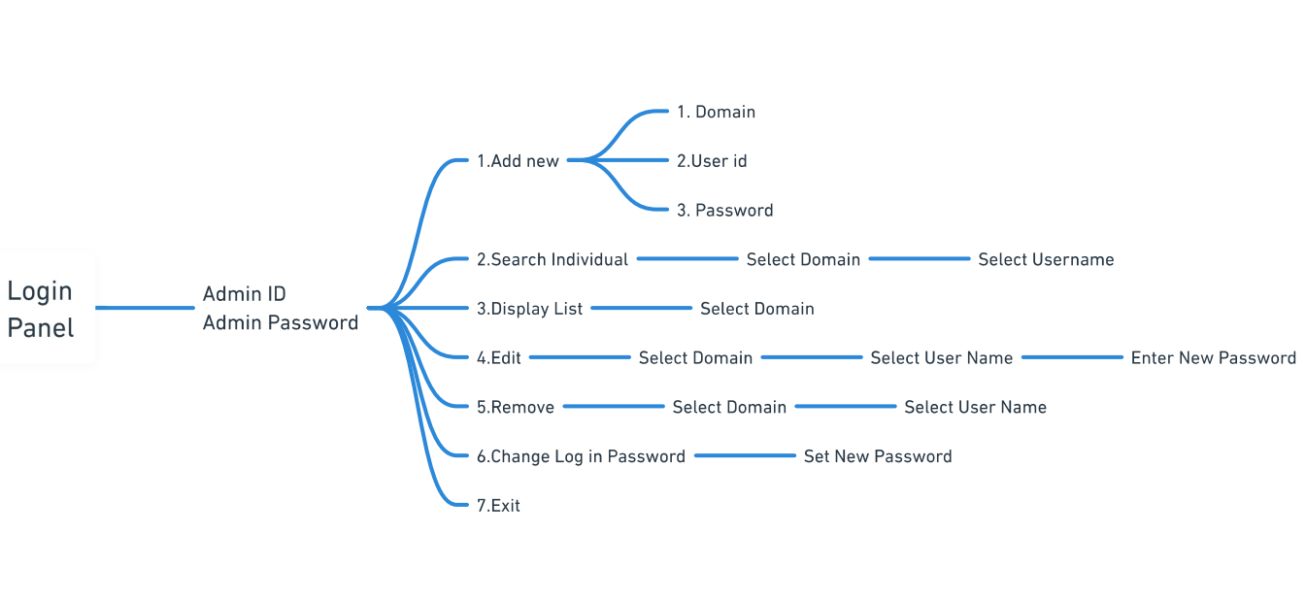
Program structure and data flow

Slide 8
Conclusions
Nowadays everyone uses online services. Many online services require a username and password to create an account and gain access to a specific service. If a site is breached, exposing usernames and passwords, attackers try those passwords on other sites of the users which is threaten for the internet users. On the other hand it is very hard to remember multiple unique and strong user id and password for an internet users.​ So a password manager can help us to overcome from this issue surely.

Slide 9
Thank you.

