Slide 1

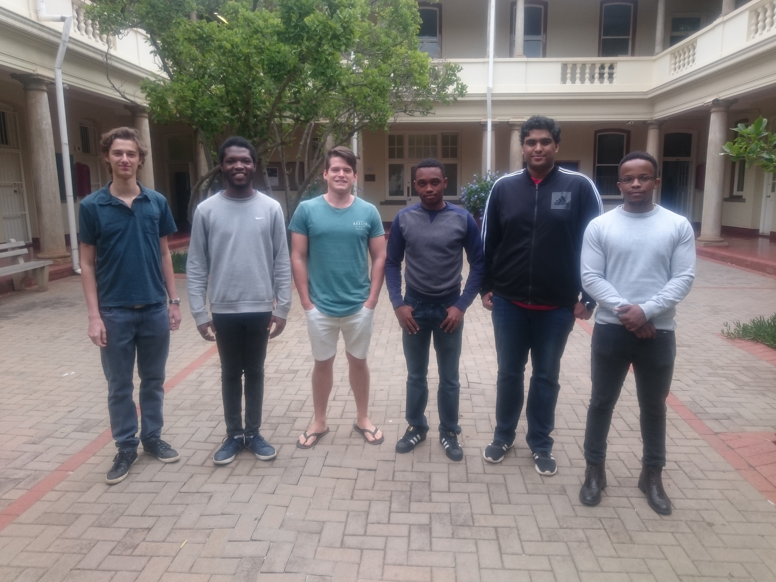
Binary Ninjaz
COS 301: Software Engineering
Demo 3
11/05/2018

Slide 2
Roles
John Ojo – Group Leader
Sizo Duma – Frontend Architect
Kevin Reid – Backend Architect
Letanyan – QA lead
Teboho Mokoena – UI developer
Shaun Yates – UX developer

Slide 3
Brief Description
Harvest is a software system to assist farmers with farm management and facilitation of work. It will assist growers with yield data and optimising worker’s performances. The system will efficiently measure a worker productivity, track the foremen on a farm, record information and data, and display the necessary information. This system is aimed at farming communities to help then record data and get work done more efficiently. Harvest will consist of: an Android application, IOS application and a website.

Slide 4
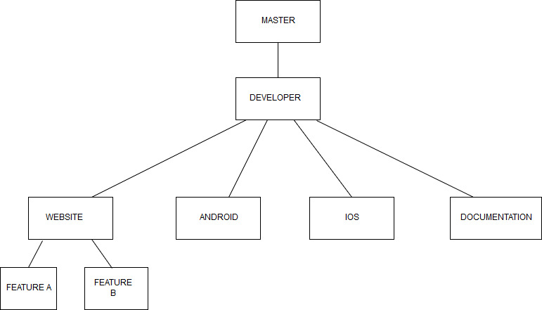
Git Structure
- Code Quality

Slide 5
Other
Landing page: http://www.cs.up.ac.za/teams/pages/manage/215/6

