Slide 1
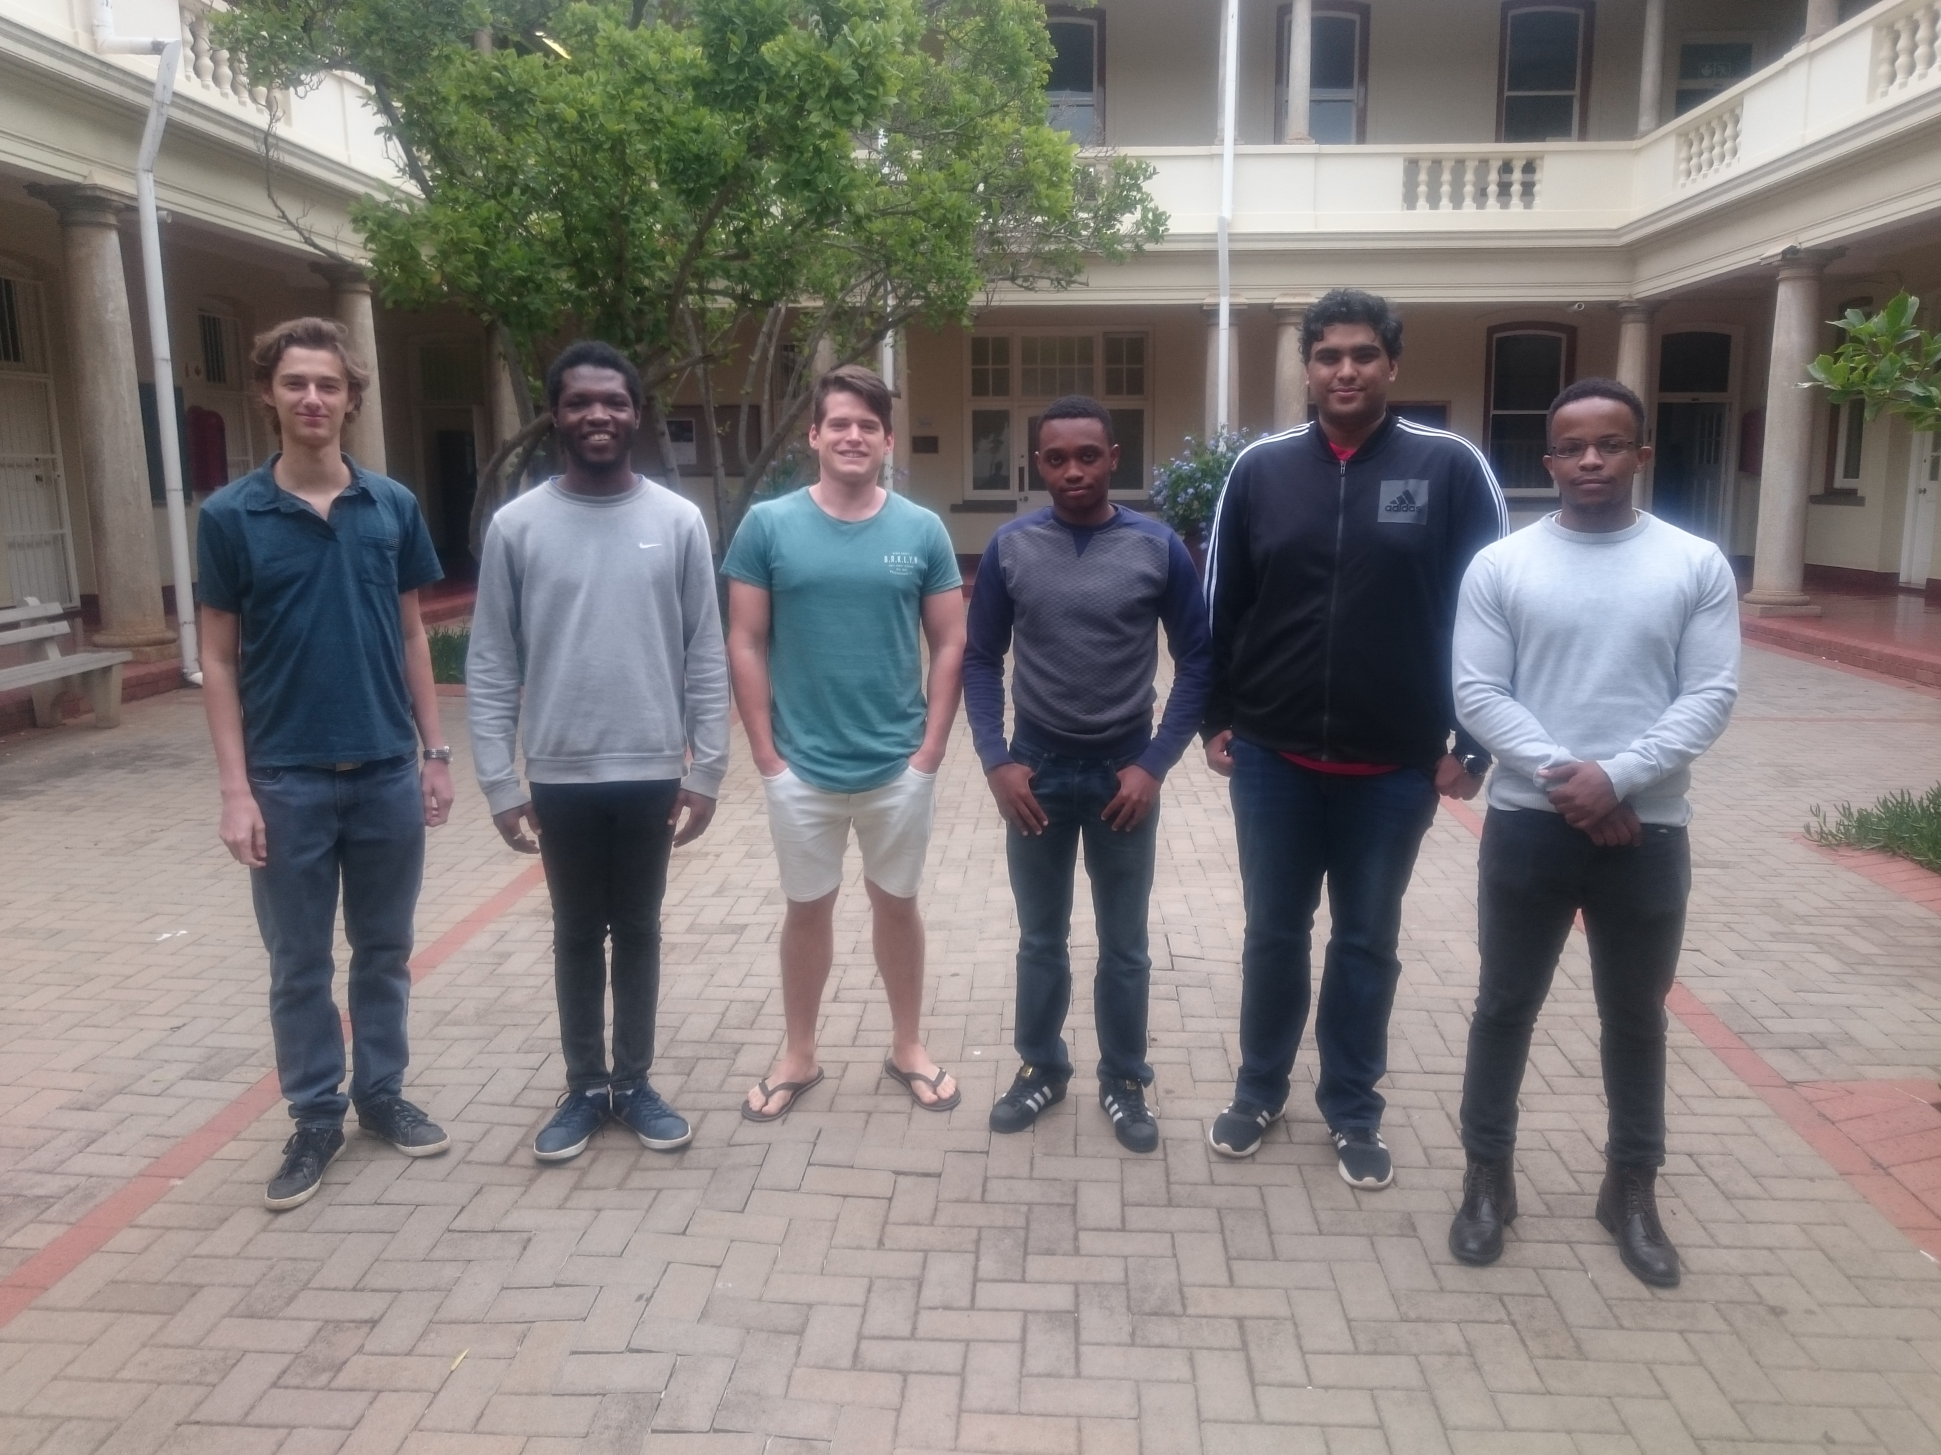
Introduction
We are the Binary Ninjaz
Diverse Team
Roles
At the end of the day, it’s a team effort

Slide 2
Brief Description of Project
Harvest 2018
Optimize work performance
Track foreman
Record information and data
Display necessary information

Slide 3
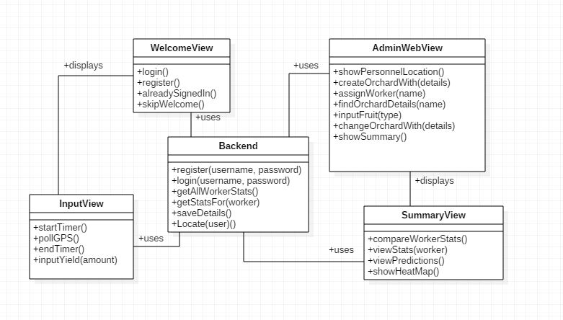
Domain Model

Slide 4
Outline of Requirements
Goal: a system to be used in the farming community
Application needs:
Measures yield by combining a clocking system with yield data
Give approximate yield estimates for each location
Display heat map in web interface
Accepts detailed information about produce
Tracking the foremen in real-time
Administrative tasks on web interface
Available on Google Playstore and/or the Appstore

Slide 5
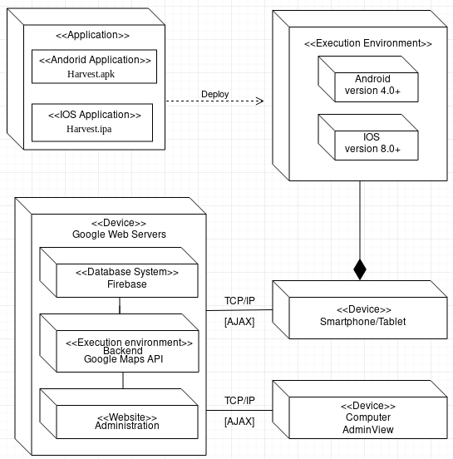
Deployment Diagram

Slide 6
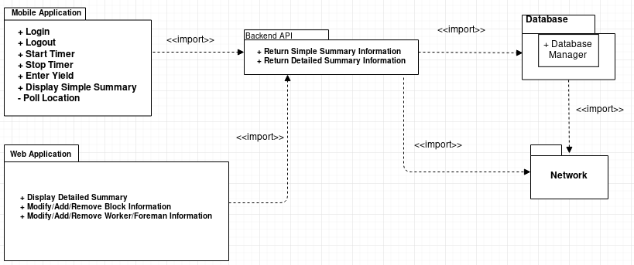
Package Diagram

