Slide 1
5COSC001W – Object Oriented Programming Week 4
Dr. Barbara Villarini
b.villarini@westminster.ac.uk

Slide 2
What we learnt so far
A real-life scenario can be modelled using objects.
All objects that share similar characteristics or behaviours, that are of the same kind, belong to the same class.
Object Oriented languages provide the features to implement an object-oriented model.

Slide 3
Object Oriented Principles we saw so far
Encapsulation
It keeps the data and the code safe from external interference. It is a mechanism for restricting direct access to some of the object’s component. Binding the data with the code that manipulates it.
Inheritance
Inheritance allows a class to use the properties and methods of another class. In other words, the derived class inherits the states and behaviors from the base class.
Polymorphism.
Polymorphism is the ability of an object to take on many forms. The most common use of polymorphism in OOP occurs when a parent class reference is used to refer to a child class object.
Notes:
REMEMBER: In encapsulation, the variables of a class will be hidden from other classes, and can be accessed only through the methods of their current class. Therefore, it is also known as data hiding.
To achieve encapsulation in Java:
-Declare the variables of a class as private.
-Provide public setter and getter methods to modify and view the variables values.

Slide 4
Summary
Object Class in Java
Final classes and methods
Abstract classes
Interfaces
Introduction to design patterns

Slide 5
Java Inheritance Tree
All Java classes you ever use or write yourself are in the inheritance tree with class Object at the top:
Object
String
Shape
Everything else
Square

Slide 6
Everything is an Object
Object obj = new Square() ;
• OK
But can only call methods declared by class Object.
Of course, they may be overridden by subclasses.

Slide 7
The Object Class
Every java class has Object as its superclass and thus inherits the Object methods.
Object is a non-abstract class (You will see in a few slides the meaning of Abstract class)
Many Object methods, however, have implementations that aren’t particularly useful in general
In most cases, it is a good idea to override these methods with more useful versions.
In other cases, it is required if you want your objects to correctly work with other class libraries.

Slide 8
Some Object Class methods
Object methods of interest:
equals
hashcode
toString
Other object methods
getClass
wait, notify, notifyAll (relevant for threaded programming)
Notes:
boolean equals(Object obj)
Indicates whether some other object is "equal to" this one.
Class<?> getClass()
Returns the runtime class of this Object.
int hashCode()
Returns a hash code value for the object.

Slide 9
toString() method
The Object method
String toString();
is intended to return a readable textual representation of the object upon which it is called. This is great for debugging!
Best way to think of this is using a print statement. If we execute:
System.out.println(someObject);

Slide 10
Final keyword – Final Variables
Public static variables are often used to create symbolic constants.
– E.g., Math.PI (static variable PI in class Math)
Such variables are additionally declared final:
– public static final double PI = 3.141;
The value of a final variable cannot be changed by assignment.

Slide 11
Final classes
public final class X { }
The final keyword can be used:
to prevent inheritance, as final class cannot be extended
to create an immutable class like the predefined String class. You can not make a class immutable without making it final.
Notes:
NOTE:
For example, all Wrapper Classes like Integer, Float etc. are final classes. We can not extend them.
One scenario where final is important, when you want to prevent inheritance of a class, for security reasons. This allows you to make sure that code you are running cannot be overridden by someone.
Immutable class means that once an object is created, we cannot change its content. In an Immutable class there are Getter method for all the variables in it. No setters(To not have the option to change the value of the instance variable)

Slide 12
Final methods
• Declaring a method “final” stops it being overridden:
public final void doSomething() {
doThis() ; ... // Whatever
doThat() ;
}
doThis and doThat can be overridden but not doSomething.
A constructor cannot be final

Slide 13
Why use final?
Gives the class programmer control.
Not all classes or methods are designed to be subclassed or overridden.
Can explicitly enforce design decisions.
Notes:
Final class cannot be extended. Final classes are created so the methods implemented by that class cannot be overridden. Best example is Math final class of java. If a class is final, all its methods are also final.
Syntax of final class
final class className
{
// body of class
}

Slide 14
Abstract classes and interfaces

Slide 15
Abstract Method
Methods that are declared, with no implementation
You can declare an object without defining it:
Person p;
Similarly, you can declare a method without defining it:
public abstract void draw(int size);
Notice that the body of the method is missing
There is only the signature (a method signature is part of the method declaration. It's the combination of the method name and the parameter list)

Slide 16
Abstract classes
Any class containing an abstract method is an abstract class
You must declare the class with the keyword abstract:
abstract class MyClass {...}
An abstract class is incomplete
It has “missing” method bodies
You cannot instantiate (create a new instance of) an abstract class. But it can provide a constructor!

Slide 17
Abstract classes
You can extend (subclass) an abstract class
If the subclass defines all the inherited abstract methods, it is “complete” and can be instantiated
If the subclass does not define all the inherited abstract methods, it must be abstract too
You can declare a class to be abstract even if it does not contain any abstract methods
This prevents the class from being instantiated

Slide 18
Example
public abstract class Animal { abstract String eat(); abstract void breathe(); }
This class cannot be instantiated
Any non-abstract subclass of Animal must provide the eat() and breathe() methods

Slide 19
Why abstract classes?
Suppose you wanted to create a class Shape, with subclasses Square, Rectangle, Triangle, etc.
You don’t want to allow creation of a “Shape”
Only particular shapes make sense, not generic ones
If Shape is abstract, you can’t create a new Shape
You can create a new Square, a new Rectangle, etc.
Abstract classes are good for defining a general category containing specific, “concrete” classes
Notes:
Suppose you have a class Shape, but it isn’t abstract
Shape should not have a draw() method
Each subclass of Shape should have a draw() method
Now suppose you have a variable Shape figure; where figure contains some subclass object (such as a Star)
It is a syntax error to say figure.draw(), because the Java compiler can’t tell in advance what kind of value will be in the figure variable
A class “knows” its superclass, but doesn’t know its subclasses
An object knows its class, but a class doesn’t know its objects
Solution: Give Shape an abstract method draw()
Now the class Shape is abstract, so it can’t be instantiated
The figure variable cannot contain a (generic) Shape, because it is impossible to create one
Any object (such as a Star object) that is a (kind of) Shape will have the draw() method
The Java compiler can depend on figure.draw() being a legal call and does not give a syntax error

Slide 20
A problem if we not use Abstract class
It is not abstract and it does not have draw() method
class Shape { ... }
class Star extends Shape { void draw() { ... } ... }
class Square extends Shape { void draw() { ... } ... }
Shape someShape = new Star();
someShape.draw();
Remember: A class knows its superclass, but not its subclasses
This is legal, because a
Star is a Shape
This is a syntax error, because someShape might not have a draw() method

Slide 21
Solution
abstract class Shape { abstract void draw(); }
class Star extends Shape { void draw() { ... } ... }
class Square extends Shape { void draw() { ... } ... }
Shape someShape = new Star();
// However, Shape someShape = new Shape(); is no longer legal
someShape.draw();
This is legal, because a Star is a Shape
This is legal, because every actual instance must have a draw() method

Slide 22
Interfaces
An interface declares (describes) methods but does not supply bodies for them
interface KeyListener { public abstract void keyPressed(KeyEvent e); public abstract void keyReleased(KeyEvent e); public abstract void keyTyped(KeyEvent e); }
All the methods are implicitly public and abstract
You can add these qualifiers if you like, but why bother?
You cannot instantiate an interface
An interface is like a very abstract class—none of its methods are defined
An interface may also contain constants (final variables)
Notes:
Full abstraction : all the methods are abstract

Slide 23
Define interface
To distinguish an interface from a class, Java uses the following syntax to define an interface:
public interface InterfaceName {
constant declarations;
method signatures;
}
Example:
public interface Edible {
/** Describe how to eat */
public abstract String howToEat();
}

Slide 24
Implements Interface
When you say a class implements an interface, you are promising to define all the methods that were declared in the interface
Example:
class MyKeyListener implements KeyListener { public void keyPressed(KeyEvent e) {...}; public void keyReleased(KeyEvent e) {...}; public void keyTyped(KeyEvent e) {...}; }
The “...” indicates actual code that you must supply

Slide 25
Partially implementing an Interface
It is possible to define some but not all of the methods defined in an interface:
abstract class MyKeyListener implements KeyListener { public void keyTyped(KeyEvent e) {...}; }
Since this class does not supply all the methods it has promised, it is an abstract class
You must label it as such with the keyword abstract
You can even extend an interface (to add methods):
interface FunkyKeyListener extends KeyListener { ... }

Slide 26
What’s the difference between an interface and an abstract class?
An interface cannot implement any methods, whereas an abstract class can
A class can implement many interfaces but can have only one superclass (abstract or not)
An interface is not part of the class hierarchy. Unrelated classes can implement the same interface

Slide 27
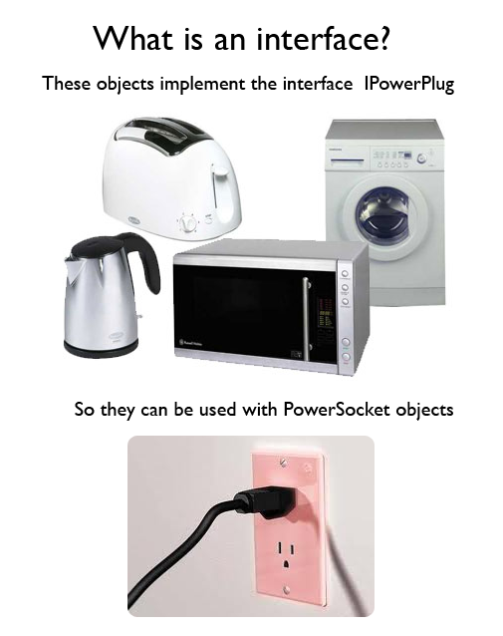
Why are they useful?
By leaving certain methods undefined, these methods can be implemented by several different classes, each in its own way.
Notes:
The idea of an Interface is to specify what a Class needs to do, then you implement the Interface in the Class to actually do it.

Slide 28
What about inheritance?
An abstract class can’t inherit from more than one other class. (In java multiple inheritance is not allowed! In C++ it is!)
Interfaces can inherit from other interfaces, and a single interface can inherit from multiple other interfaces

Slide 29
Example
interface Singer {
void sing();
void warmUpVoice();
}
interface Dancer {
void dance();
void stretchLegs();
}
interface Talented extends Singer, Dancer {
// can sing and dance. Wowwee.
}

Slide 30
Where else can interfaces be used?
You can pass an interface as a parameter
You can assign a class to an interface variable
Just like you would do to an abstract class.

Slide 31
Example
Let’s assume:
Person is an Interface and Student class implements Person
Sandwich and Apple are subclasses and extend Food class
Food myLunch = new Sandwich();
Food mySnack = new Apple();
Person steve = new Student();
If Person has methods eat(Food f) and teach(Person s), the following is possible:
Person bob = new Student();
steve.teach(bob);
steve.eat(myLunch);

Slide 32
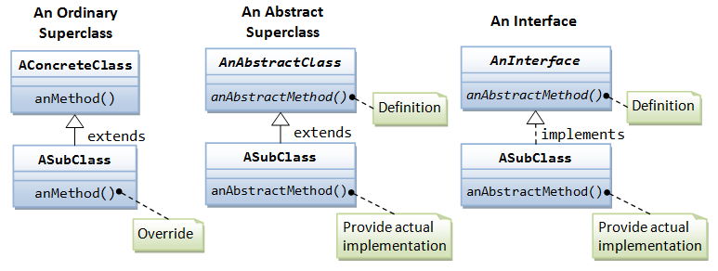
UML Class diagrams
Abstract classes and interfaces are represented by placing the "<<abstract>>" stereotype and the "<<interface>>” stereotype respectively, above the class name or showing the class name in italics.

Slide 33
What is Design Pattern
Christopher Alexander says “ Each pattern describes a problem which occurs over and over again in our environment, and then describes the core of the solution to that problem, in such a way that you can use this solution a million times over, without ever doing it the same way twice”
A design pattern is a descriptions of communicating objects and classes that are customized to solve a general design problem in a particular context
A pattern is made by four elements:
Name
Problem
Solution
Consequences

Slide 34
Design Patter - Name
Describe a design problems and its solutions in a word or two
Used to talk about design pattern with our colleagues
Used in the documentation
Increase our design vocabulary
Have to be coherent and evocative
Notes:
Having a vocabulary for patterns lets us talk about them – developing a catalog of patterns
Higher level of abstraction
Hard part finding good names

Slide 35
Design Pattern - Problem
Describes when to apply the patterns
Explains the problem and its context
Sometimes include a list of conditions that must be met before it makes sense to apply the pattern
Have to occurs over and over again in our environment
Notes:
Problem and its context: how to represent algorithms as objects

Slide 36
Design Pattern - Solution
Describes the elements that make up the design, their relationships, responsibilities and collaborations
Does not describe a concrete design or implementation
Has to be well proven in some projects
Notes:
Does not describe a concrete implementation because a pattern is like a template that can be applied in many different situation.
It provides an abstract description

Slide 37
Design Pattern - Consequences
Results and trade-offs of applying the pattern
Helpful for describe design decisions, for evaluating design alternatives
Benefits of applying a pattern
Impacts on a system’s flexibility, extensibility or portability
Notes:
To understand the cost and benefits

Slide 38
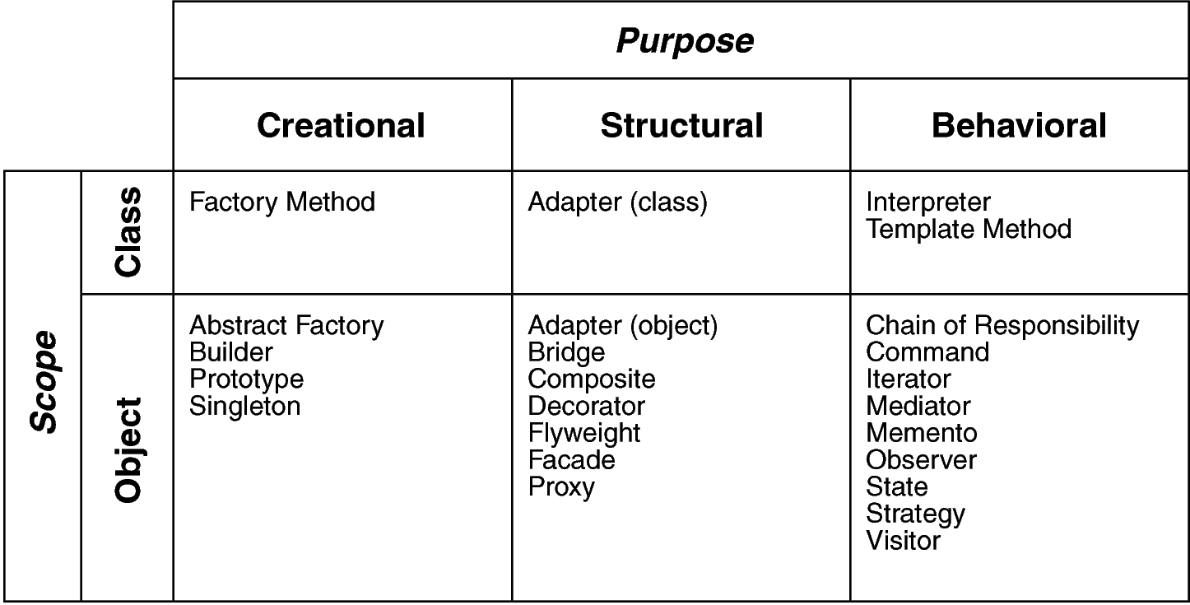
Classification of Design Pattern
Scope: domain over which a pattern applies
Purpose: reflects what a pattern does
Notes:
Scope: specifies whether the pattern applies primary to classes or object. Class patterns deal with relationship between classes and their subclasses. (Relationship such as inheritance that is the most used…almost every pattern use it) Satic, fixed at run time.
Object patterns deal with object relationships that can change at run time that are dynamic.
Creational: concern object creation, Structural deal with composition of classes and objects, behavioral is how class and objects interacts

Slide 39
Template Method Pattern
Intent/Problem: Define the skeleton of an algorithm in an operation, deferring some steps to client subclasses. Template Method lets subclasses redefine certain steps of an algorithm without changing the algorithm's structure.
Solution: The component designer decides which steps of an algorithm are invariant (or standard), and which are variant (or customizable). The invariant steps are implemented in an abstract base class, while the variant steps are either given a default implementation, or no implementation at all.

Slide 40
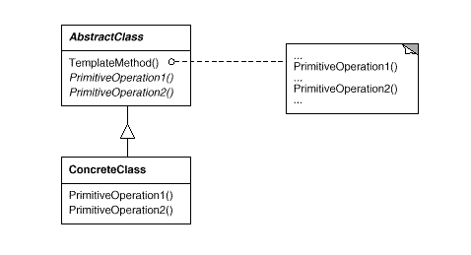
Template Method Pattern
The key point to mention is that template method should be final, so that subclass can not override and change steps of the algorithm, but same time individual step should be abstract, so that child classes can implement them.
Notes:
The AbstractClass contains the template method. The abstract versions of the operations used in the template method.
There may be many ConcreteClasses, each implementing the full set of operations required by the template method.
The ConcreteClasses implements the abstract operations, which are called when the templateMethod() needs them.
The template method makes use of the primativeOperations to implement an algorithm. It is decoupled from the actual implementation of these operations

Slide 41
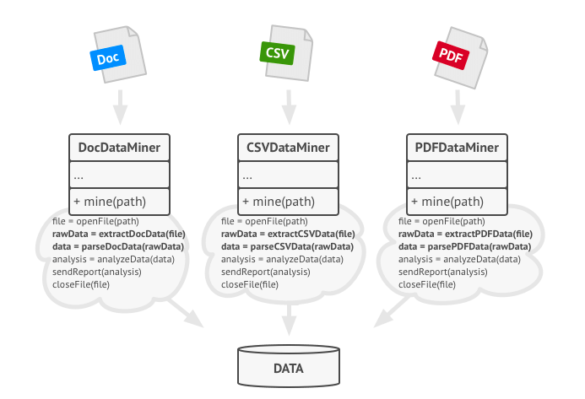
Example
Suppose to create a data mining application that analyzes corporate documents. Users feed the app documents in various formats (PDF, DOC, CSV), and it tries to extract meaningful data from these docs in a uniform format.
Notes:
you noticed that all three classes have a lot of similar code. While the code for dealing with various data formats was entirely different in all classes, the code for data processing and analysis is almost identical. Wouldn’t it be great to get rid of the code duplication, leaving the algorithm structure intact?

Slide 42
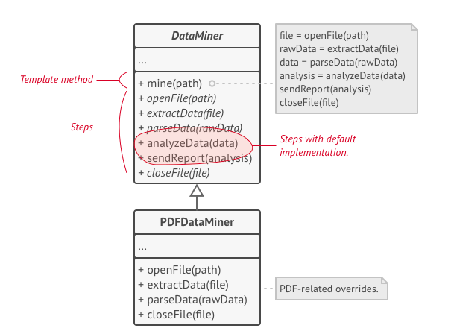
Solution using Template Method Pattern
Template method breaks the algorithm into steps, allowing subclasses to override these steps but not the actual method.

