Slide 1
5COSC019W – Object Oriented Programming Week 8
Dr. Barbara Villarini
b.villarini@westminster.ac.uk

Slide 2
Summary
Event Handling
Implementing Event Handler
File and Stream
File handling

Slide 3
What is an Event
GUI components communicate with the rest of the applications through events.
An event is an object that describes a state changes in a source
An event occurs every time the user
Types a character or
Pushes a mouse button
The source of an event is the component that causes that event to occur.
The listener of an event is an object that receives the event and processes it appropriately.
That object must:
Implement the appropriate interface
Be registered as an event listener on the appropriate event source.

Slide 4
Delegation Event Handling Model
Three parts
Event source
GUI component which user interacts with
Event object
Encapsulates information about event that occurred
Event listener
Receives event object when notified, then responds
Programmer must perform two tasks
Register event listener for event source
Implement event-handling method (event handler)

Slide 5
What is an Event Listener?
An event listener is an object
It "listens" for events from a specific GUI component (itself an object)
When an event is generated by the GUI component a method in the listener object is invoked to respond to the event

Slide 6
Recap the Event Handling process
Event Source
1
Source
registers
Listener
2
Fires an
Event Object
Event Listener
Reacts to the
Event
3

Slide 7
Implement an Event Handler
Every event handler requires three bits of code:
Code that specifies that the class either
Implements a listener interface or
Extends a class that implements a listener interface.
public class MyClass implements ActionListener {…
Code that implements the methods in the listener interface. public void actionPerformed(ActionEvent e) { ...//code that reacts to the action... }
Code that registers an instance of the event handler class as a listener upon one or more components. someComponent.addActionListener(instanceOfMyClass);

Slide 8
Example using JTextField
JTextField
Single-line area in which user can enter text
JPasswordField
Extends JTextField
Hides characters that user enters

Slide 9
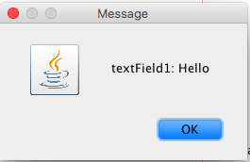

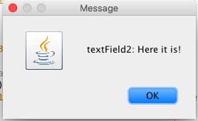
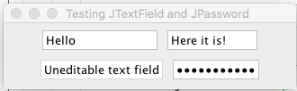
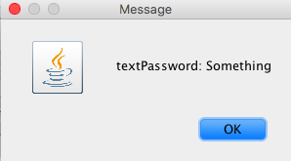
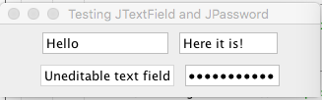
What we visualise:
If you enter “Hello!” in the text field 1 and press enter:
If you enter “Here it is!” in the text field 2 and press enter:
If you enter “Something” in the text Password and press enter:

Slide 10
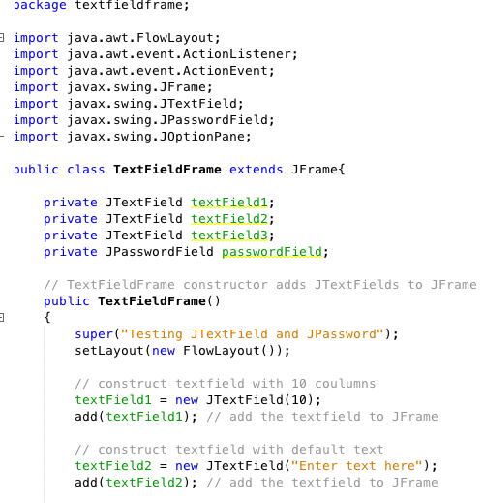
Part (1)
Import Swing Packages
We define our class that extends JFrame
Constructor and we define the layout
adding the components

Slide 11
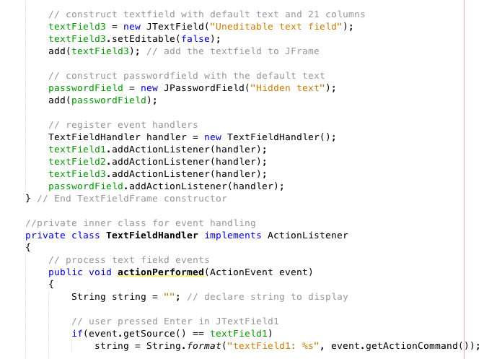
Part (2)
textField3 will not be editable!
Register event handler to our components:
addActionListener(handler)
Class for event handling
Override actionPerformed(ActionEvent event)
getSource() is specified by the EventObject class that ActionEvent is a child of (via java.awt.AWTEvent)
getActionCommand() gives you a String representing the action command

Slide 12
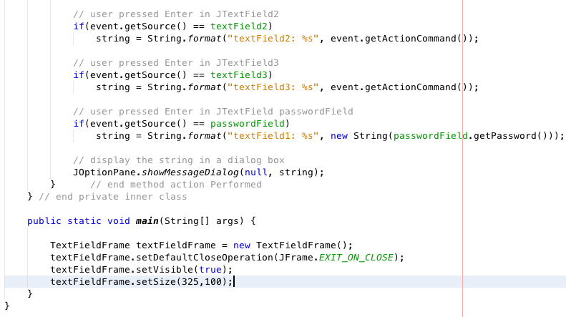
Part (3)
Show the string in dialog box

Slide 13
Steps required to set up and event handler
Several coding steps are required for an application to respond to events
Create a class for the event handler
Implement an appropriate event-listener interface
Register the event handler

Slide 14
Using a Nested Class to Implement an Event Handler
Top-level classes
Not declared within another class
Nested classes
Declared within another class
Non-static nested classes are called inner classes
Frequently used for event handling
Note: An inner class is allowed to directly access its top-level class’s variables and methods, even if they are private.

Slide 15
Types of Event
Act causing Event | Listener Type
User clicks a button, presses Enter, typing in text field | ActionListener
User closes a frame | WindowListener
Clicking a mouse button, while the cursor is over a component | MouseListener
User moving the mouse over a component | MouseMotionListener
Component becomes visible | ComponentListener
Table or list selection changes | ListSelectionListener

Slide 16
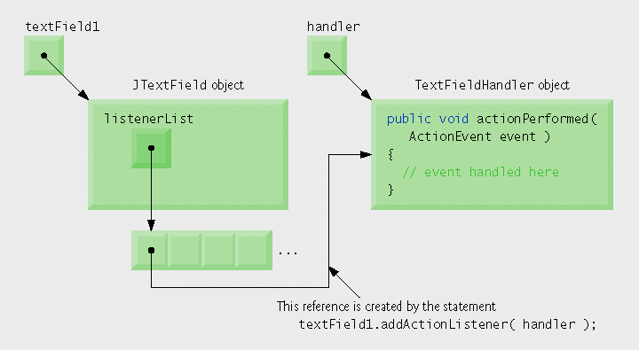
How Event Handler works
How did the event handler get registered?
How does the GUI component know to call actionPerformed rather than some other event-handling method?
Every JComponent has instance variable listenerList
Object of type EventListenerList
Maintains references to all its registered listeners

Slide 17
Mouse Event Handling
Every time an action is performed using a mouse a MouseEvent object is created
Handled by MouseListeners and MouseMotionListeners
MouseInputListener combines the two interfaces
Interface MouseWheelListener declares method mouseWheelMoved to handle MouseWheelEvents

Slide 18
Mouse Events

Slide 19
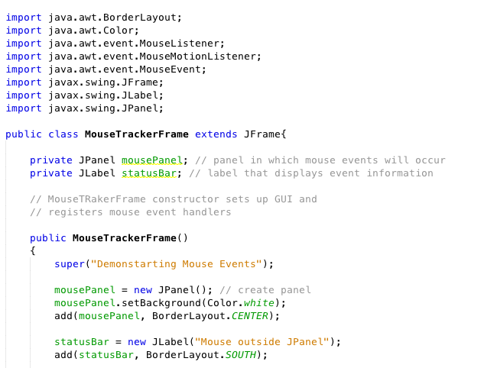
Example – Part(1)
Create a panel and a label in
MouseTrackerFrame

Slide 20
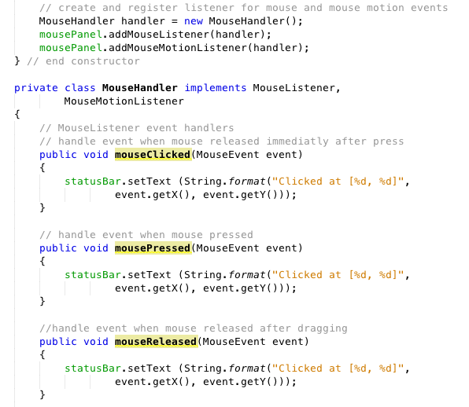
Part (2)
Register listeners for mouse
and mouse motion
Definition of our class MouseHandler

Slide 21
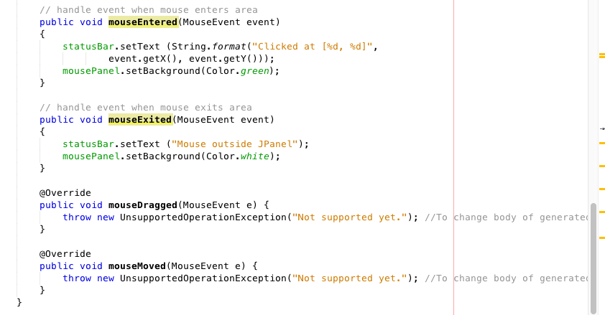
Part (3)

Slide 22
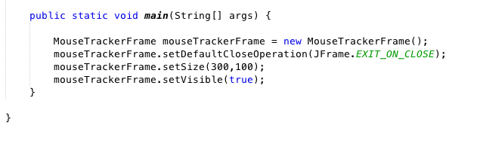
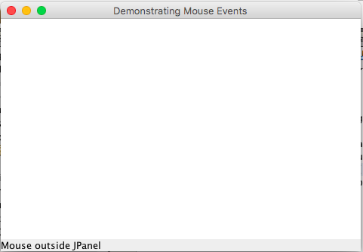
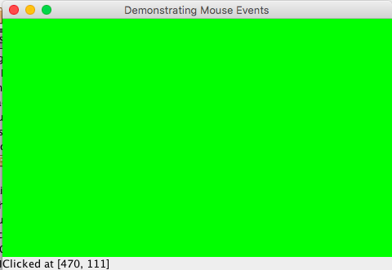
Part (4)

Slide 23
Listener Interface
Suppose your class directly implements MouseListener,
Then you must implement all five MouseListener methods.
Even if you care only about mouse clicks
Methods for those events you don't care about can have empty bodies.
Resulting collection of empty method bodies can make code harder to read and maintain

Slide 24
Adapter Class
Solution is to use adapter classes
For example, the MouseAdapter class implements the MouseListener interface.
An adapter class implements empty versions of all its interface's methods.
To use an adapter
Create a subclass of it, instead of directly implementing a listener interface.
By extending MouseAdapter, your class inherits empty definitions of all five of the methods that MouseListener contains.

Slide 25
Adapter Classes
Characteristics of an adapter class
Implements interface
Provides default implementation of each interface method
Used when all methods in interface is not needed

Slide 26
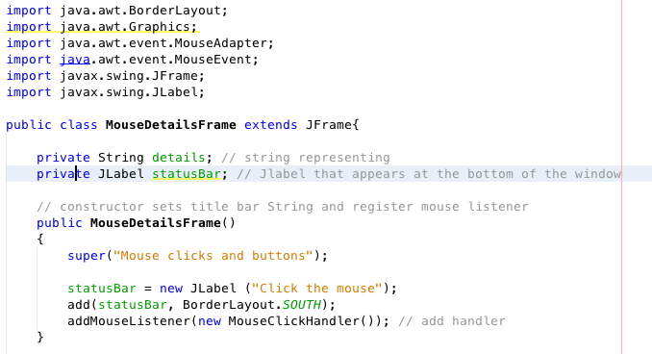
Example - Part (1)

Slide 27
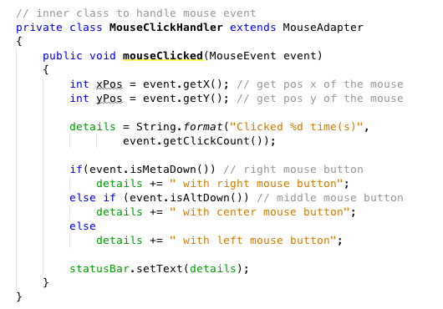
Part (2)
You don’t need to implement all the others methods!
Check if the event is right, left or center clicked

Slide 28
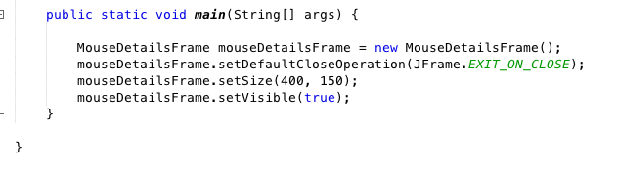
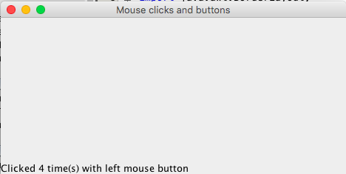
Part (3)

Slide 29
File Handling

Slide 30
Introduction
Storage of data in variables and arrays is temporary
when the program is done running or when computer is turned off The data is gone!
Files used for long-term retention of large amounts of data, even after the programs that created the data terminate
Persistent data – exists beyond the duration of program execution
Files stored on secondary storage devices (hard disks, CD-ROMs, etc.)
Requirements information stored in secondary memory
can be retrieved in the future
kept separate from other documents, programs, etc.

Slide 31
Intro Example: Stock Market Analysis
Problem: large amounts of stock prices/indices are recorded and processed
taken every day
stored in a text file dataStockMarcket.dat
Analyzing this data means find minimum, maximum, and average of the data
Data must be read from file, statistics calculated, results written to a text output file

Slide 32
Java's I/O System
All input and output in Java is accomplished by classes called streams
The purpose of the stream abstraction is to keep program code independent from physical devices.
Input Stream
Output Stream
Executing Program

Slide 33
Type of Stream
There are 2 kinds of streams
byte streams: stores data in binary format
character streams: stores data as a sequence of characters
Java opens file by creating an object and associating a stream with it
Java libraries define a number of stream classes (java.io classes):
– Reader and Writer for dealing with character formatted data (e.g., unicode characters).
– InputStream and OutputStream for dealing with unformatted data (bytes)
Note that the classes InputStream, OutputStream, Reader, and Writer are abstract classes.

Slide 34
Predefined Stream
Three stream objects are automatically created for every application: System.in, System.out, and System.err.
System.in
InputStream object, usually for the keyboard
System.out
a buffered PrintStream object, usually the screen or an active window
System.err
an unbuffered PrintStream object usually associated with the screen or console window

Slide 35
File Class
Useful for retrieving information about files and directories from disk
Object of class File doesn’t open the actual files/directories.
It provides methods to operate on the files/directories named.

Slide 36
Create a File object
Creating a File object specifies name/path only:
File myDirectory = new File("/Desktop/directory”);
File myFile = new File(“/Desktop/directorydataset.txt");
File myFile = new File("/Desktop/directory”, “dataset.txt");
File myFile = new File(myDirectory, “dataset.txt");

Slide 37
Methods to manipulate Files and Directory
exists()
isDirectory()
isFile()
canRead()
canWrite()
isHidden()
getName()
getPath()
getAbsolutePath()
getParent()
list()
length()
renameTo( newPath )
delete()
mkdir()
createNewFile()

Slide 38
Listing files
import java.io.*;
import java.util.*;
public class ListFile {
public static void main(String[] args) {
File currentDirectory = new File(".");
String[] contents = currentDirectory.list();
for (int i = 0; i < contents.length; i++)
{
System.out.println(contents[i]); }
}
}
It is considering the current directory, but you could pass any path

Slide 39
FileReader
• FileReader opens file for reading and throws exception if open fails.
Constructors:
FileReader reader = new FileReader("filename");
FileReader reader = new FileReader(fileObject);
• Provides basic set of methods for reading:
– read character (mapped to character set).
– read array of characters.
• Also provides method to close stream.

Slide 40
FileWriter
FileWriter opens file for writing and throws exception if open fails
Constructors:
FileWriter writer = new FileWriter("filename");
FileWriter writer = new FileWriter(fileObject);
• Provides basic set of write methods:
– write character.
– write array of characters.
– write String.
• Also provides method to close stream.
If you don’t close the file some data may not be written to file.

Slide 41
Remember
All FileReader/Writer methods throw exceptions. You should use try/catch blocks or write methods with a throws declaration.
If you open an existing file for writing, you delete existing contents, unless append mode is selected:
FileWriter writer = new FileWriter(fileObject,true);
boolean append_to_file

Slide 42
Example – Copying a text file
import java.io.*;
public class CopyTextFile {
public static void main(String[] args) throws IOException {
File inputFile = new File(“text.txt”);
File outputFile = new File(“text_copy.txt”);
FileReader in = new FileReader(inputFile);
FileWriter out = new FileWriter(outputFile);
int c;
while ((c = in.read()) != -1)
{
out.write(c);
}
in.close();
out.close();
}
}
Copy one character at a
time. read() returns -1
when no more data.
Reading
Writing

Slide 43
Reading/writing files using Byte Streams
Java methods to read and write bytes from and to a file:
FileInputStream
FileOutputStream
Create an object of one of these classes to open a file
Specify the name of the file as argument to the constructor.
Once the file is open you can read/write it

Slide 44
Example – copy a file as bytes
import java.io.*;
public class CopyBytesFile {
public static void main(String[] args) throws IOException {
File inputFile = new File(“Text.txt”);
File outputFile = new File(“Text_copy.txt”);
FileInputStream in = new FileInputStream(inputFile);
FileOutputStream out = new FileOutputStream(outputFile);
int c;
while ((c = in.read()) != -1) {
out.write(c);
}
in.close();
out.close();
}
}
Type int used to store
byte.
Copy one byte at a time.

Slide 45
BufferedReader and BufferedWriter Class
An object of these classes reads/writes an entire line of text into a buffer
The constructor take as parameter an object of type Reader
It provides a readLine method to read complete line into a String
BufferedReader in = new BufferedReader(new FileReader("data.txt"));
String s = in.readLine();
• String can then be converted to other types (int, double, etc.)

Slide 46
Example – Copying a file
import java.io.*;
public class ReadString{
public static void main(String[] args) throws IOException {
FileReader in = new FileReader("File1.txt");
BufferedReader br = new BufferedReader(in);
FileWriter out = new FileWriter("File2.txt", true);
BufferedWriter bw = new BufferedWriter(out);
String line = br.readLine();
while(line != null){
bw.write(line);
bw.newLine();
line = br.readLine();
}
in.close();
br.close();
bw.close();
out.close();
}
}
Use readLine() from BufferReader to read a line of text

Slide 47
Other Reader/Writers
StringReader, StringWriter: read/write to/from strings rather than files or writers.
InputStreamReader: Convert from stream to reader.
OutputStreamWriter: Convert from writer to stream.
Plus a family of InputStream and OutputStream classes.

Slide 48
Summary
We saw file handling in Java
Remember that it is important to save data in files and permanent storage.
Reading and writing data from and to a file is a must for a good developer!

