Slide 1
5COSC019W – Object Oriented Programming Week 3
Dr. Barbara Villarini
b.villarini@westminster.ac.uk

Slide 2
Summary
Inheritance
Create subclasses
Override inherited methods
Substitution principle
Dynamic binding
Polymorphism

Slide 3
What you learnt so far
Classes are blueprints that we can use to create objects
Objects have state and behaviour:
- State: instance variables (e.g. balance)
- Behavior: instance methods (e.g. withdraw)
We create new objects using constructors
We also have class methods and class variables
- these belong to the blueprint (class) but not to any specific object

Slide 4
Make sure you understood:
The concept of class / object
How to create objects using constructors and the new keyword
Static vs. instance contexts
Access modifiers and how to call methods from
other classes

Slide 5
Subclasses
In the real world, objects have similarities to other, seemingly different, objects
Example: car is-a vehicle, bicycle is-a vehicle, truck is-a vehicle, Ferrari is-a car (and also a vehicle)
Cars and trucks are both vehicles that have engines and that can carry a specific number of other properties
Cars and trucks are special types of vehicles A vehicle is a more general type of a car or a truck

Slide 6
Inheritance
In OOP these kind of relationships are modeled using inheritance
car is a subclass of vehicle, vehicle is a superclass of a car
Inheritance is a basic concept of object-oriented programming
Inheritance allows a class to have a parent class from which it can inherit variables and methods

Slide 7
Inheritance in Classes
If a class B inherits from class A then it contains all the characteristics (information structure and behavior) of class A
The parent class is called base class and the child class is called derived class
Besides inherited characteristics, derived class may have its own unique characteristics

Slide 8
Inheritance
Superclass
(Parent)
Person
- name: String
age: int
email: String
+ getEmail()
+setEmail()
Student inherits
From Person
Teacher inherits
From Person
Teacher
Student
Teacher
Student
- name: String
age: int
email: String
- salary: double
+ getEmail()
+setEmail()
…
- name: String
age: int
email: String
- idNumber: String
+ getEmail()
+setEmail()
…
salary: double
idNumber: String
Subclass
(Child class)

Slide 9
Example – Inheritance
Superclass
Person
Student
Doctor
Employee
Subclasses

Slide 10
Another Example
Shape
Square
Triangle
Circle

Slide 11
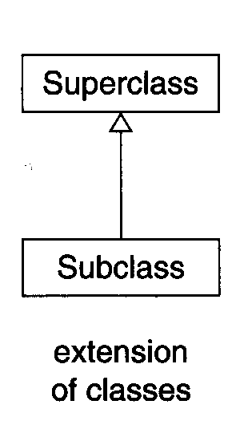
UML: Modeling Relationships
Class diagrams can be used to model:
Inheritance -- extension and implementation

Slide 12
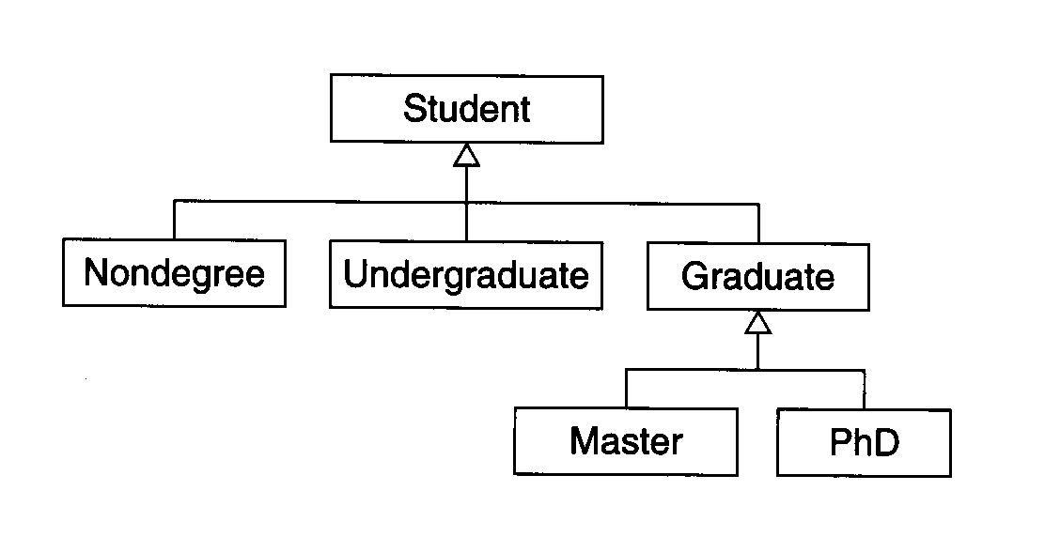
Example

Slide 13
Inheritance – “IS A” or “IS A KIND OF” Relationship
A Teacher is a Person
A Car is a Vehicle
A Student is a Person
A Motorbike is a Vehicle
A Student is a Module
A bus is a Car
A SavingAccount is kind of BankAccount
A Ferrari is a Car is a Vehicle
A Cat is a Mammal is an Animal

Slide 14
Inheritance – Advantages
Reuse
Less redundancy
Increased maintainability

Slide 15
Class extension
Members of subclasses inherit variables and methods from their superclass(es)
they do not inherit private variables & methods, or constructors
But they also can have their own special instance variables and methods that are not present in the superclass
public class Employee extends Person {
... }

Slide 16
Class extension in Java
public class Employee extends Person {
... }
Employee is a subclass of Person
Person is the superclass of Employee
Employee inherits from Person

Slide 17
Example – Class Person
^{public class Person {}
^{private String name;}
^{private String dob;}
public Person(String n, String d) {
^{name = n;}
^{dob = d;}
}
^{Public Person (String n){}
^{name = n;}
}
public void setName(String newName) {
^{name = newName;}
}
^{public String getName() {}
^{return name;}
}
^{public String getDoB() {}
^{return dob;}
}
}

Slide 18
Example – Class Employee
public class Employee extends Person {
^{private double salary;}
public Employee(what goes here?) {
^{// What to write here?}
}
^{public double getSalary() {}
^{return salary;}
}
public void setSalary(double newSalary) {
^{salary = newSalary;}
}
}

Slide 19
Exercise 1
Remember: Employees are also Persons
What methods can we call on Employee objects?
setSalary
getSalary
setName (inherited)
getName (inherited)
getDoB (inherited)
If emp is an Employee object:
String n = emp.getName();
emp.setName(“John Smith”);
emp.setSalary(25000.0);

Slide 20
Exercise 2
if p is a Person object, we can have:
p.setName(“Dr Who”);
String n = p.getName();
Can we have p.setSalary(25000); ?
NO! Because the method is declared in the subclass!

Slide 21
Overview so far
Employees are also Persons, so they inherit methods from Persons
Java looks for a method first in the class to which the calling object belongs
If it does not find it there, Java looks in the class’s superclass, ...
Persons are not always Employees, so Persons will not have access to the methods that are defined only within Employees
what about variables?

Slide 22
Inheritance & instance variables
An instance of a subclass stores all the instance variables of the superclass (even private ones), plus all the instance variables defined in the subclass.
Be careful though, private instance variables of the superclass are NOT INHERITED
Employee object
Name : Ted White
Dob: 11/12/1990
Salary: 25000

Slide 23
Instance Variable
Problem: superclass variables are likely to be private
Why private?
Why is this a problem?
Notes:
When you inheritance other class, you cannot access your private attributes directly. So, if you have a class named "A" and other called "B", and make B extends A, B cannot access private attributes of A.
Think this like a protection. This way, you can write some attributes in class "A" that you don’t want others classes access them through inheritance.
The "B" class can access only public, protected and default attributes directly in "A" class. But if you want to access a private attribute in "A" class for any reasons, you can write a method in "A" to return this attribute.

Slide 24
Subclass Constructor
A subclass does not inherit constructors from the superclass
The subclass constructor will need to initialise instance variables that belong to the subclass and to the superclass (see previous slide)

Slide 25
Exercise: which is the problem?
public class Employee extends Person {
... public Employee(String initialName, double initialSalary) {
name = initialName;
salary = initialSalary; }
...
}

Slide 26
Solution: Super keyword
We invoke superclass constructors by using the super keyword
public Employee(String initialName, double initialSalary)
{
super(initialName);
salary = initialSalary;
}
Employee e = new Employee(“Ted White”, 25000.0);

Slide 27
Super: some rules
super must come first, before the other statements in the body of the subclass constructor
the order, type and number of the arguments we pass to super from the subclass must match those of the constructor of the superclass
If a subclass has no constructors at all, Java will create a no-arguments constructor that contains only super();

Slide 28
A new access modifier: protected
For making access to methods and variables easier between classes in an inheritance relationship, the protected access modifier is available
private: can be accessed only in same class
protected: can be accessed in the same class, or in a subclass, or in the same package
public: can be accessed in any class

Slide 29
Access modifier: protected
Protected variables and methods can be accessed by subclasses, subclasses of subclasses, etc.
protected vs. private
declaring variables as protected exposes them to all subclasses
best to declare variables as private (even in inheritance relationships) and write getter and setter methods to provide access to variables

Slide 30

Notes:
When a class is based on another class, it inherits:
https://www.polleverywhere.com/multiple_choice_polls/coJlyeApB6kRIuS

Slide 31
Notes:
Can constructor be inherited?
https://www.polleverywhere.com/multiple_choice_polls/GmFKjd7Uq7PB0yp

Slide 32
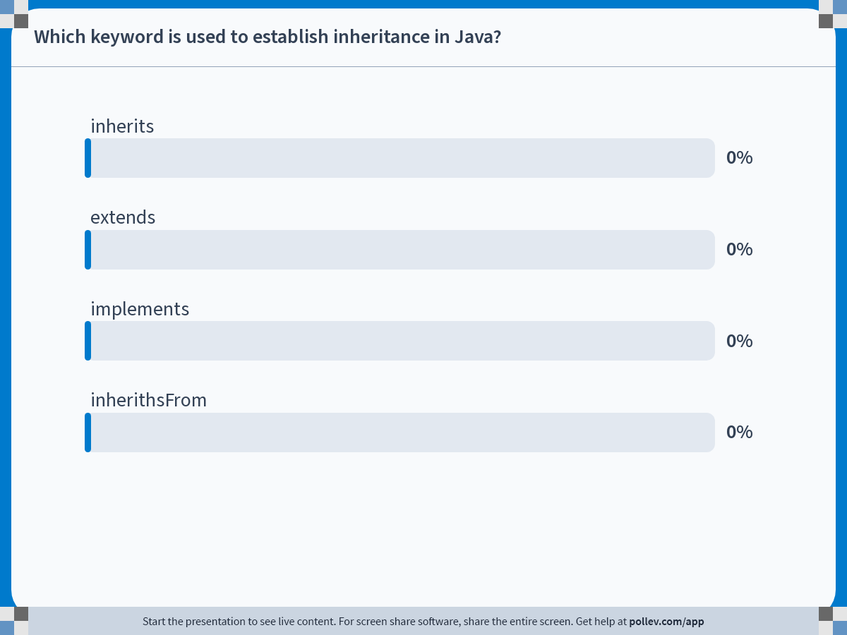
Notes:
Do not modify the notes in this section to avoid tampering with the Poll Everywhere activity. More info at polleverywhere.com/support Which keyword is used to establish inheritance in Java?
https://www.polleverywhere.com/multiple_choice_polls/HfBuLJrHz9kCJoFjXzueS?state=opened&flow=Default&onscreen=persist

Slide 33
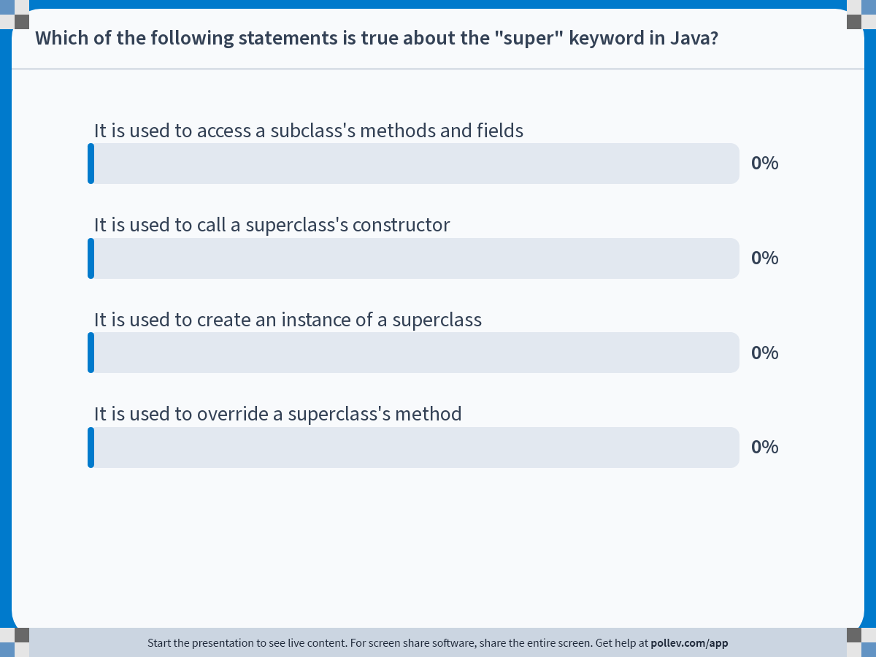
Notes:
Do not modify the notes in this section to avoid tampering with the Poll Everywhere activity. More info at polleverywhere.com/support Which of the following statements is true about the "super" keyword in Java?
https://www.polleverywhere.com/multiple_choice_polls/QmWnURxU4pioanYmQ5Sf2?state=opened&flow=Default&onscreen=persist

Slide 34
Overriding
SavingAccount is-an Account (so SavingAccount is a subclass of Account)
Assume we can print a statement from a generic Account
We can print a statement from the SavingAccount with additional information
A subclass can override an inherited instance method, by supplying a new method with:
the same name
the same number of parameters
the same type of parameters as the original inherited method

Slide 35
Example - Account
public class Account {
private double balance;
...
public void printStatement() {
// print statement and account details
}
}

Slide 36
Example – SavingsAccount
public class SavingsAccount extends Account {
private double interestRate;
. ..
public void printStatement() {
print the normal statement like Account but after that print also details of interestRate, and other Savings specific information
}
...
}
How can we call the overridden method printStatement (of Account) from within SavingsAccount?

Slide 37
Example – SavingsAccount
public class SavingsAccount extends Account {
private double interestRate;
. ..
public void printStatement() {
super.printStatement(); //but after also print details of
//interestRate, and other Savings specific //information
}
...
}
Java will look first in the direct subclass for a method called printStatement. If it does not find it there, it will look in the superclass of that class, and so on ...

Slide 38
Polymorphism
‘polymorphism' from the ancient greek poly (many) morph (shapes)
In OOP, it describes the capability to use the “same code” to process objects of various types and classes, as long they have a common super class

Slide 39
Polymorphism
Car is a Vehicle, Bicycle is a Vehicle
Consider giving instructions to someone operating
a Vehicle:
Start Vehicle
Release break
Accelerate
Apply break
Stop Vehicle
These instructions will work for any kind of Vehicle, not only a Car
for a Bicycle, accelerate may just mean “pedal faster”
Notes:
Inheritance is when a 'class' derives from an existing 'class'. So if you have a Person class, then you have a Student class that extends Person, Student inherits all the things that Person has. There are some details around the access modifiers you put on the fields/methods in Person, but that's the basic idea. For example, if you have a private field on Person, Student won't see it because it ‘s private, and private fields are not visible to subclasses.
Polymorphism deals with how the program decides which methods it should use, depending on what type of thing it has. If you have a Person, which has a read method, and you have a Student which extends Person, which has its own implementation of read, which method gets called is determined for you by the runtime, depending if you have a Person or a Student. It gets a bit tricky, but if you do something like
Person p = new Student();
p.read();
the read method on Student gets called.

Slide 40
Substitution Principle
In order to allow polymorphism, Java introduces the Substitution Principle, defined as:
An instance of a subclass can take the place of an instance of any of its superclasses
Vehicle v = new Car();
Vehicle v = new Bicycle();
Variables holding object types are polymorphic variables - they can hold objects of different acceptable types
acceptable types: the declared type, or any subtype of the declared type

Slide 41
Exercise: Which is correct?
Animal
Mammal
Bird
Cat
Dog
^{1) Animal myBird = new Bird();}
^{2) Mammal felix = new Cat();}
3) myBird tweetie = new Bird();
^{4) Dog snoopy = new Mammal();}
5) Bird littleBird = new Animal();
^{6) Mammal m = new felix;}
^{7) Animal snoopy= new Dog();}
NO
NO
NO
NO

Slide 42
Method polymorphism
A Java version of the “algorithm” for operating a vehicle:
v.start(); v.releaseBreak();
v.accelerate(); v.applyBrake(); v.stop();
It does not matter what exactly v is, as long as it is Vehicle or any of its subtypes
This algorithm is polymorphic, it works for a variety of vehicle types, not only for a single type

Slide 43
Dynamic method binding
How can v.start() work if the compiler at compile time does not know what type v refers to?
We do not really know which version of start() is being called
v will have to be tested during program execution each time it calls an instance method
This process is known as dynamic binding
the exact method called will not be known until the program is actually run

Slide 44
Dynamic vs static binding
static binding - what method to call is resolved at compile time (e.g. overloaded methods)
dynamic binding - what method to call is resolved at run time (most overridden methods)

Slide 45
Dynamic binding
If different objects are assigned to v during execution, different versions of start() may be called:
v = new Car(); v.start(); // Calls start method in Car class
v = new Bicycle(); v.start(); //Calls start method in Bicycle class

Slide 46
instanceof
In case of polymorphic variables it is useful to be able to determine what the exact type is
if (myVehicle instanceof Car) ...
object instanceof class
this expression will return true if object is an instance of class, or if object is an instance of any subclass of class .

Slide 47
Casting object references
if (acct instanceof SavingsAccount) {
SavingsAccount savingsAcct = (SavingsAccount) acct;
savingsAcct.creditInterest(); }
This is object casting: we cast object acct to type SavingsAccount
but only after we have checked that it really is of SavingsAccount type

