Slide 1
Revision
Basics: Arithmetic Operators, Precedence level
Conditions
Loops, Nested Loops, Break & Continue
Lists, Strings, Subscript operations, slices
Mutable / Immutable
Lists - Built-In Operations / List comprehension
Functions

Slide 2
1. Arithmetic Operators
Operator | Operation | Examples
+ | Addition | b = a + a
- | Subtraction | newTotal = price – discount
* | Multiplication | total = cost * vat
/ | Division Python 3 - integer / integer -> float | 8 / 3 # 2.6666666666666665
% | Modulus - Returns remainder | result = 16 % 5
** | Exponent | answer = 4**2 (4 to power of 2)
// | Floor division (only integer part) Python 3 - integer // integer -> integer | 8 // 3 # 2

Slide 3
1. Precedence level
Which has the same precedence level?
a) Addition and Subtraction b) Multiplication, Division and Addition c) Multiplication, Division and Subtraction d) Addition and Multiplication

Slide 4
2. Which is wrong with the following condition?
if (x < 10)
size = "small"
else (x < 20)
size = "medium"

Slide 5
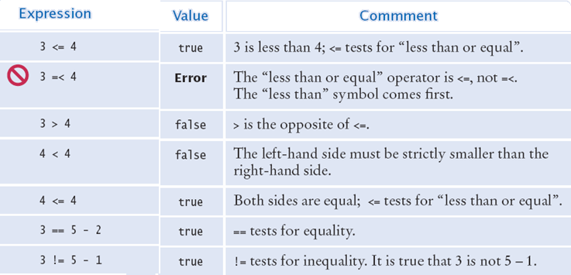
2. Expressions

Slide 6
2. Which solution?
#1 if mark >= 70:
print(’Exceptional result’)
if mark >= 40:
print(’Satisfactory result’)
else:
print(’You have failed’)
#2 if mark >= 70:
print(’Exceptional result’)
elif mark >= 40:
print(’Satisfactory result’)
else:
print(’You have failed’)

Slide 7
3. Loops
Which is a valid for loop in Python?
for(a = 0; a < 3; a++)
for a in range(3)
for a loop 3:
for a in range(1,3):
Which is a valid way to start a while loop in Python?
while loop a < 10
while a < 10:
while(a < 10)
while loop a < 10:

Slide 8
3. Loops: What is displayed?
sum=10 for number in range (1, 10, 2): sum += number
print(sum)
a) 19 b) 35 c) 23 d) 45

Slide 9
3. Nested loops: What is the output?
for x in range(1,5):
for y in range(x):
print('a', end='')
print()

Slide 10
3. Nested loops: What is the output?
for x in range(2):
for y in range(2,4):
print(x, y)

Slide 11
3. Break & Continue
for c in range (1,6):
if c == 3:
continue
print (c)
What will this print?
for c in range (1,6):
if c == 3:
break
print (c)
What will this print?

Slide 12
4. Lists: What is the output?
x = [0,1,2,3,4,5,6]
for i in x :
if i > 3 :
break
print(i)
x = [0,1,2,3,4,5,6]
for i in x :
if i > 3 and i < 6 :
continue
print(i)

Slide 13
4. Subscript operations / slices
w = 'python‘
# subscript - what character is accessed?
w[0]
w[-3]
# slice operation – what substring is accessed?
w[2:5]
w[:5]
w[2:]
w[-3:]

Slide 14
4. Slices
We can slice a list:
friends = ['Joe', 'Zoe', 'Brad', 'Angelina', 'Zuki']
print(friends[2:4]) #['Brad', 'Angelina']
Question - How do you get ['quick', 'brown', 'fox'] from the following list?
fox = ['the', 'quick', 'brown', 'fox', 'jumps', 'over']

Slide 15
5. Which are Mutable / Immutable?
1. greet = 'Good day'
greet[0] = 'F'
2. my_list = [2, 4, 5, 3, 6, 1]
my_list[0] = 9
3. my_tuple = (2, 5, 3, 1)
my_tuple[0] = 9

Slide 16
6. Lists - Built-In Operations
This is our current list:
planets = ['venus', 'mercury', 'earth', 'mars', 'jupiter', 'saturn', 'uranus', 'neptune']
However, we want the following list:
['mercury', 'venus', 'earth', 'mars', 'jupiter', 'saturn', 'uranus', 'neptune', 'pluto']
Actions:
Remove 'venus' from the list
Insert 'venus' directly after 'mercury'
Add 'pluto' to the end of the list

Slide 17
6. List comprehension
Which is the list comprehension to pick out only negative integers from ‘list1’.
a) [x<0 in list1]
b) [x for x<0 in list1]
c) [x in list1 for x<0]
d) [x for x in list1 if x<0]

Slide 18
7. How to Define a Function
First line:
Use the keyword def to declare the function and follow this with the function name.
Add parameters to within parentheses of the function.
End your line with a colon.
Function Block (Indented):
Add statements that the functions should execute.
End your function with a return statement if required.

Slide 19
7. Function with parameter
def happyBirthday(person):
("Happy Birthday to you!")
("Happy Birthday to you!")
("Happy Birthday, dear " + person + ".")
("Happy Birthday to you!")
happyBirthday('Emily')
happyBirthday('Andre')

Slide 20
7. Function with return: What is output?
def myfunction1(a, b):
s = a + b
return s
def myfunction2(a, b):
s = a * b
return s
a = 5
b = 3
print(myfunction1(a, b))
print(myfunction2(a, b))

Slide 21
7. Functions: What is output?
def test(): x = 1 print('testing')
x = 4 print(x) testing() print(x)

Slide 22
7. Functions: Local variables. What is output?
def testing(): x = 1 print('testing')
x = 4 print(x) testing() print(x)

Slide 23
7. Functions: What is output?
def testing(x) : x = x * 2 return x
a = 7 print(testing(a))
x
7
14
a

