Slide 1
Profit prediction model
Name – Binay Borun Mann
Internship – Machine learning Engineer
Company – Exposys Data Labs

Slide 2
INTRODUCTION
Predicting profit for the start-up with the help of the given revenue spend on R&D, Administration and the marketing for the various start-ups.
Various machine learning models are used with the help of the sci-kit learn library

Slide 3
Models used
Linear Regression
Support Vector Machine
Lasso
Neural Network
Polynomial
Random Forest Regressor

Slide 4
Method used
Loading the dataset
Preprocessing the data
Train, test data of the dataset using train_test_split
Model evaluation
Model prediction
Analyzing results

Slide 5
Regression Metrics Used
Mean Squared Error
Mean Absolute Error
R-Square (Accuracy)
Explained Variance
R-Squared percentage
Mean Squared Error
Mean Squared Log Error

Slide 6
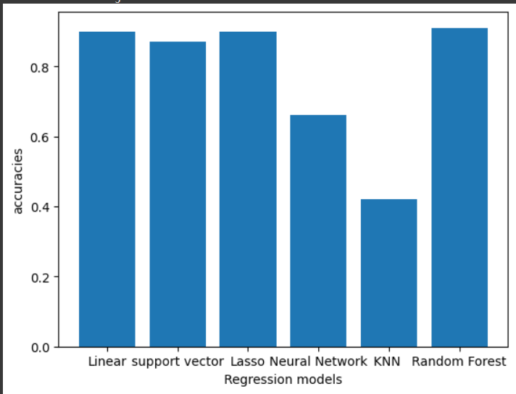
Accuracy
The highest accuracy is obtained in the case of the Random Forest Regressor while the second highest with the Linear Regressor model.

