Slide 1
Do explicit festival features help?
Binay Verma · College results update · 1 November 2026
An exploratory added-feature experiment, with matched controls.
Daily supplied electricity · Delhi, Karnataka and Maharashtra.
Binay Verma | Exploratory added-feature study | 1 Nov 2026 1/8
Notes:
This is distinct from the preceding diagnostic comparison, which measured errors during festivals without supplying all festival identities. The current experiment supplies family-specific day or window features. No new foundation-model architecture or clean final test is claimed.

Slide 2
What was checked between the steps?
Named training/context dates cover 2022–2025: 58 anchors.
Karnataka Ganesh 2023: 18 Sep; Maharashtra: 19 Sep.
Same-size zeros and shifted active placebo features.
Original pre-year model settings retained; tree capacity checked separately.
Binay Verma | Exploratory added-feature study | 1 Nov 2026 2/8
Notes:
The Maharashtra2023official PDF and Karnataka2023English notice support state-specific training dates. The annual-as-issued ledger is not a full amendment or statewide shutdown certification. Rich Ridge and stable LightGBM reuse original ordinary-calendar hyperparameters for every arm. Leaf-minimum2is a fixed sensitivity with its own baseline, not an outcome-selected winning setting. Day flags may have only1–2historical positive examples.

Slide 3
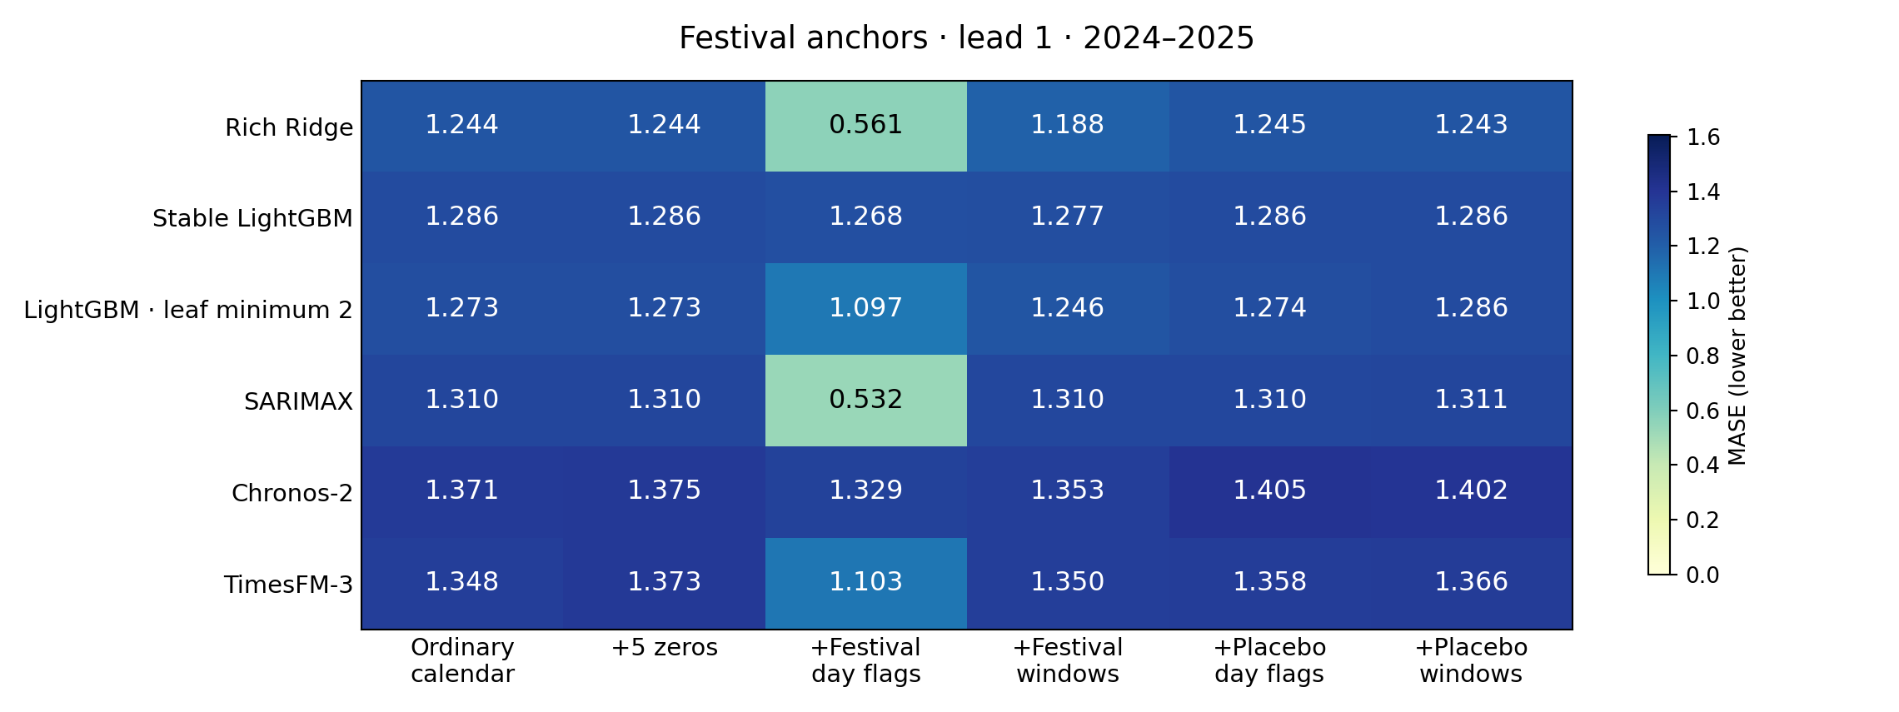
Matched festival-anchor comparison
Binay Verma | Exploratory added-feature study | 1 Nov 2026 3/8
Notes:
Six model variants, six arms and72identical anchor cases at leads1/7/14. This slide shows lead1; all leads and individual families/years/states are saved. Lower MASE is better; it is not accuracy percent. Zero and placebo arms are included so a gain from adding channels alone is not assigned to event information. Two years and related states/days limit inference.

Slide 4
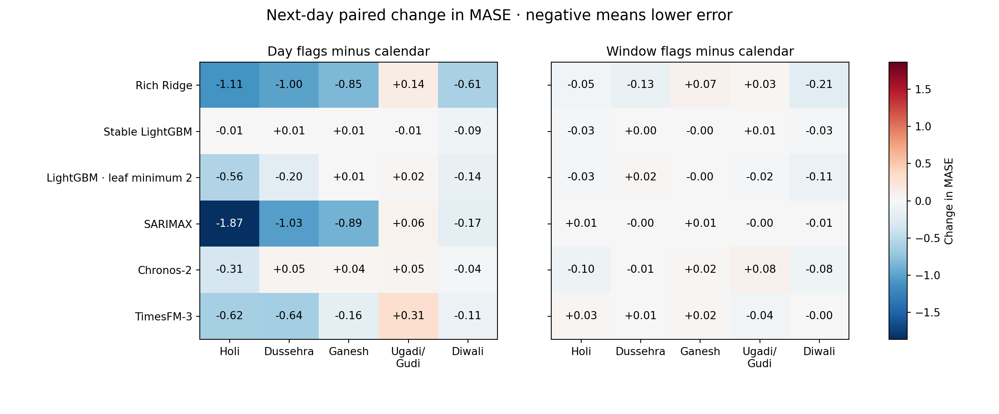
Effects differ across festival groups
Binay Verma | Exploratory added-feature study | 1 Nov 2026 4/8
Notes:
These are paired next-day MASE changes relative to the same model calendar baseline, with equal states within year then equal years. Negative values mean lower error. The two representations are separate: do not select whichever looks best for a clean test. Compare true features with zero/placebo controls in the full tables before attributing value to event information. Cohort state coverage differs by festival.

Slide 5
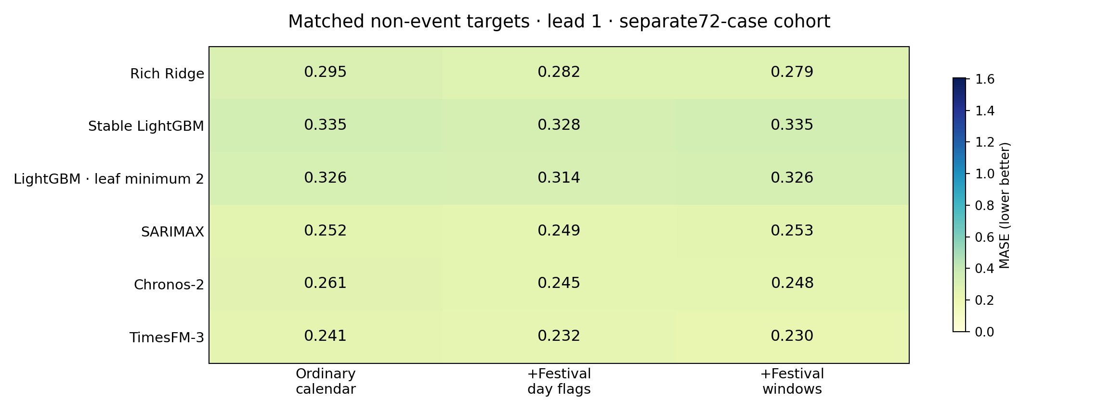
Check costs away from festivals
Binay Verma | Exploratory added-feature study | 1 Nov 2026 5/8
Notes:
Separate72date-selected non-event targets, matched by weekday and28–42day seasonal shifts. Every model uses identical cases. Control targets exclude +/-3days of annual/registered holiday anchors; source amendments remain incomplete. Family labels denote the matched event, not an observed holiday on the control date. Compare feature arms within this cohort; do not compare its raw error level with event errors as a causal effect. This is not an exhaustive all-day evaluation.

Slide 6
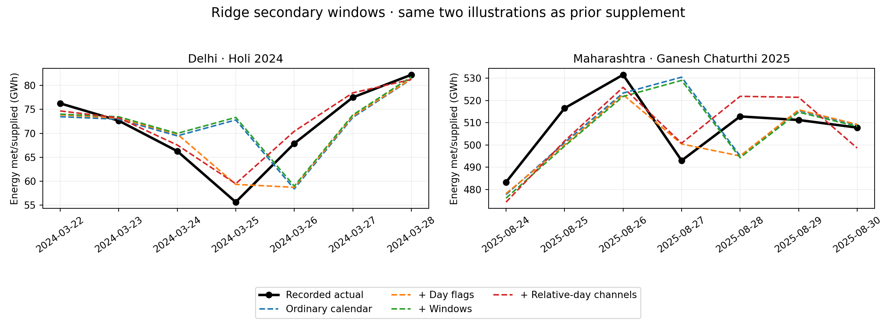
Inspect timing in the wider windows
Binay Verma | Exploratory added-feature study | 1 Nov 2026 6/8
Notes:
Only Ridge is plotted here on its secondary full-window cohort. The same Delhi Holi2024and Maharashtra Ganesh2025illustrations were used in the prior supplement; they were not newly selected for favorable intervention results. Every point is a rolling next-day forecast. Relative-day channels are a separate regression sensitivity, not a foundation-model experiment. Classical full-window scores must not be compared with foundation anchor-only scores.

Slide 7
What these results can establish
Whether these fixed festival encodings change matched forecast errors.
Whether changes exceed the zero and active placebo controls.
Whether ordinary-day errors also change under the same settings.
Model, representation, sparse-history and year limits remain.
Binay Verma | Exploratory added-feature study | 1 Nov 2026 7/8
Notes:
All positive/negative outcomes, unsuccessful optimiser attempts and earlier results remain preserved. Across the new event/non-event outputs, 8native adjacent-quantile crossings were retained without sorting or clipping. Point-error audit success does not establish calibrated uncertainty or independent human approval. No p-values or universal/causal winner claim is supported.

Slide 8
Sources and next scientific gates
Data: Robbie Andrew / GRID-INDIA / POSOCO; source clarification pending.
Calendar evidence: annual state notices, with documented scope limits.
Models: pinned Chronos, TimesFM and local classical/ML baselines.
Later: source/human review and unchanged prospective outcome scoring.
Binay Verma | Exploratory added-feature study | 1 Nov 2026 8/8
Notes:
Cite the data curator, upstream organisation, model developers and close calendar/event-encoding prior work in the original presentation/references. This is not a new architectural method or first-ever holiday encoding. Source reuse response, amendment certification and independent human review remain open. The original31October–11Novemberprospective freeze is unchanged and cannot have a complete score on1November. These files are prepared locally; no new public upload is authorised by this supplement.

