Slide 1
Do festival features help electricity
forecasting, and is the answer stable?
Typed versus pooled festival inputs for foundation and local models
Binay Verma
College viva · November 2026
Research in progress
Binay Verma | Research in progress | Nov 2026 01/12
Notes:
This is an empirical study, not a new model. I compare ways of giving festival information to two pretrained forecasting models (Chronos-2 and TimesFM-3) and four local models, on daily electricity supplied in three Indian states. The main finding is that festival information helps at short leads, but which way of encoding it works best is not stable.

Slide 2
Why study this?
Festivals move
A simple design choice
Precise target
Diwali, Holi, Dussehra, Ganesh Chaturthi and Ugadi/Gudi Padwa change date every year and differ by state.
Give each festival its own input (typed), or one shared "festival day" input (pooled)?
Daily energy met/supplied in GWh: what the grid delivered, not unconstrained demand.
Binay Verma | Research in progress | Nov 2026 02/12
Notes:
Typed means five separate flags, one per festival. Pooled means one flag that is on for any of them, padded with four zeros so both use five input channels. The question is which works better, and whether the answer holds across years and data sources.

Slide 3
Data and evaluation rules
• Delhi, Karnataka, Maharashtra; event years 2024 and 2025; five festival families.
• 528 forecast cases = 176 state-dates × leads 1, 7, 14 (75 distinct dates).
• Effective event units: 10 festival-year clusters, not 528 independent tests.
• Past-only fitting, 730-day history, recorded labels only; NYC holidays as a separate-source check.
These outcomes were already inspected, so the results are exploratory, not a clean test.
Binay Verma | Research in progress | Nov 2026 03/12
Notes:
Each case is a target day within ±3 days of a festival. Lead 1 means forecasting the next day; lead 7 and 14 are single target days further ahead. Nearby days, states and leads share the same festival, weather and source, so I count festival-year clusters as the real units. NYC (subway and bus ridership around Yom Kippur and Columbus Day 2026) is a separate source registered before its data were downloaded.

Slide 4
Six models, eight matched input designs
Local models
Foundation models
Input designs
Ridge regression
SARIMAX
LightGBM (+ leaf-2 variant)
Refit monthly, past data only
Chronos-2 and TimesFM-3
Pinned pretrained weights
No fine-tuning
Calendar only
Typed / pooled, day or ±3-day window
Zero channels and fake-date placebos as controls
Binay Verma | Research in progress | Nov 2026 04/12
Notes:
All models see the same cases. Zero channels check whether merely adding inputs changes forecasts. Placebos put the festival flags on wrong dates, shifted by whole weeks, to check that gains come from the real dates. Local and foundation models adapt differently, so rankings are not a pure architecture comparison.

Slide 5
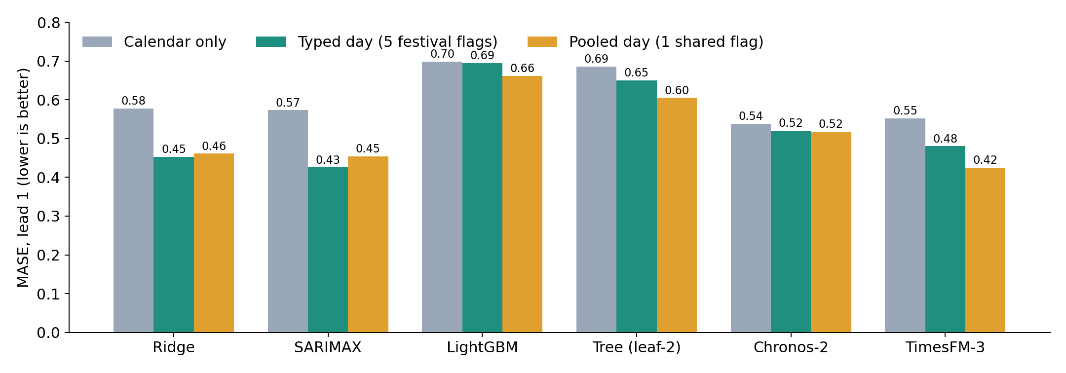
Finding 1: festival flags help at lead 1
Lowest here: TimesFM-3 pooled (0.4246) and SARIMAX typed (0.4253).
Corrected Indian festival windows, 528 cases, lead 1. Source: v6 Table 1. No significance test; two event years.
Binay Verma | Research in progress | Nov 2026 05/12
Notes:
Compared with calendar-only inputs, both typed and pooled day flags lower the error for most models at lead 1. But the two best results use different encodings: TimesFM prefers pooled, SARIMAX prefers typed. That already hints that there is no single best encoding.

Slide 6
Finding 2: the best encoding is not stable
19/36
17/36
11/36
cells where 2024 and 2025 disagree on typed vs pooled (+1 exact tie)
cells where dropping one festival flips the result
cells where India and NYC disagree (+3 ties); all 6 TimesFM-3 cells reverse
Main lesson: report the ordering by year and source; do not pick one "winning" encoding.
Binay Verma | Research in progress | Nov 2026 06/12
Notes:
A cell is one model, one representation (day or window) and one lead: 6 × 2 × 3 = 36. These counts are descriptive. I registered this analysis before computing it, but it uses results I had already seen. I first reported 20 and 14 here; that counted exact ties as disagreements, so I corrected it to 19 and 11.

Slide 7
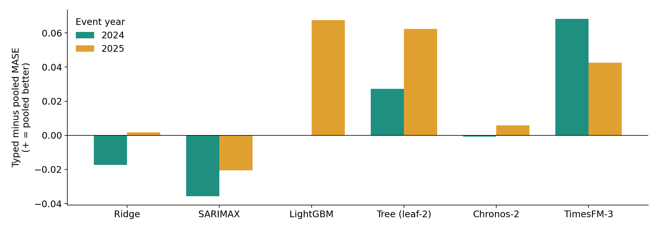
Year by year: few orderings persist
SARIMAX favours typed in both years; TimesFM-3 favours pooled in 9/10 clusters.
Day flags, lead 1, typed minus pooled MASE by event year. Source: v6 Table A4.
Binay Verma | Research in progress | Nov 2026 07/12
Notes:
Above zero means pooled was better that year; below zero means typed was better. Several models switch sides between 2024 and 2025. SARIMAX consistently prefers typed flags, and TimesFM prefers pooled in India, but in NYC TimesFM prefers typed. These persistent patterns are expectations for future testing, not proven effects.

Slide 8
Checks that changed the evidence
Calendar correction
Interval coverage
Honest counting
Karnataka 2025: the notice names Vijayadashami on 1 Oct, not 2 Oct. The ledger was fixed from the document, not from errors.
80% intervals cover less than 80% in 85 of 100 lead-1 festival clusters (Chronos-2 and TimesFM-3).
An exact-tie counting error was found and corrected; original outputs kept.
121 automated tests pass; this is software checking, not independent human review.
Binay Verma | Research in progress | Nov 2026 08/12
Notes:
Checking which festival the notice actually names is stronger than checking that a date is a holiday. Native uncertainty intervals are too narrow around festivals. All failures and corrections are kept in the repository so they can be checked.

Slide 9
Closest prior work and what is new
Ziel (2018)
Kreusel et al. (2026)
This study
Compared one shared holiday dummy with separate dummies for German load: separate ones did not generally help.
Calendar encodings (ordinal, one-hot, cyclic, target) in Chronos-2 and TimesFM-3, on hourly data.
The same typed-vs-pooled choice through foundation-model inputs, with zero and placebo controls, across two sources.
Not a new architecture and not a causal holiday effect.
Binay Verma | Research in progress | Nov 2026 09/12
Notes:
The typed-versus-pooled question itself is old in load forecasting. What I add is testing it in foundation-model covariate channels with matched controls, and showing that the answer is unstable. Whether this is enough for a journal is for my supervisor and reviewers to judge.

Slide 10
Confirmation on genuinely future data
1. Frozen forecasts
2. Weekly study
3. Singapore replication
30–31 Oct 2026: forecasts saved publicly before outcomes. Score from 12 Nov (Diwali period included).
Registered: 52 weekly forecasts from 16 Nov. Starts only after rights and calendar checks.
New country and festival calendar; protocol drafted, code ready, no data downloaded yet.
No future accuracy result exists yet.
Binay Verma | Research in progress | Nov 2026 10/12
Notes:
Historical results were already seen, so real confirmation must come from forecasts made before outcomes exist. The first frozen episode is one period; it cannot confirm the typed-versus-pooled pattern on its own. The weekly study needs verified 2026 calendars and a data-rights reply before it can start; missed weeks are recorded, not filled in later.

Slide 11
What I can claim, and the limits
• Festival flags often reduce lead-1 error on these cases.
• Which encoding is best depends on model, year, festival set and source.
• Calendar provenance and native uncertainty need explicit checks.
• Limits: 2 event years, 3 related states, inspected data, rights reply pending, no external reviewer yet.
A careful, reproducible empirical study, still in progress.
Binay Verma | Research in progress | Nov 2026 11/12
Notes:
I avoid claiming a universal winner, a causal effect or journal readiness. All code, protocols, forecasts and failures are public on GitHub, except model weights.

Slide 12
Sources and questions
• Robbie Andrew, Indian Energy and Emissions Data (GRID-INDIA/POSOCO); reuse request pending.
• Hunt & Bloomfield, Zenodo 14983362 (CC BY 4.0); MTA NYC ridership; NESO demand.
• Ziel 2018, JMPSCE 6(2); Kreusel et al. 2026, arXiv 2610.13676; Chronos-2, arXiv 2510.15821.
• Code and results: github.com/Binay-verma/tsaf_project
Charts are generated from this project’s recorded results.
Binay Verma | Research in progress | Nov 2026 12/12
Notes:
Thank the data curators and model developers. End with questions.

