Slide 1

NETFLIX DATASET
SQL PROJECT

Slide 2
PROJECT OVERVEIW:
This project involves a comprehensive analysis of Netflix's movies and TV shows data using SQL. The goal is to extract valuable insights and answer various business questions based on the dataset.

Slide 3
OBJECTIVES:
Analyze the distribution of content types (movies vs TV shows).
Identify the most common ratings for movies and TV shows.
List and analyze content based on release years, countries, and durations.
Explore and categorize content based on specific criteria and keywords.

Slide 4
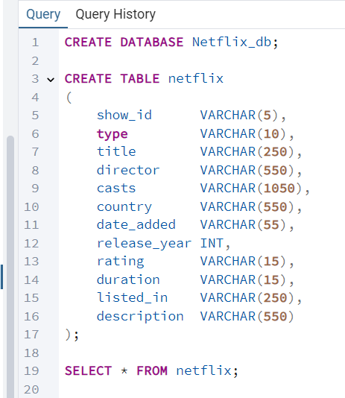
DATA IMPORT:
Created a table to import all the columns of the dataset.
There are 8807 rows.

Slide 5

DATA ANALYSIS AND BUSINESS PROBLEM SOLUTION

Slide 6
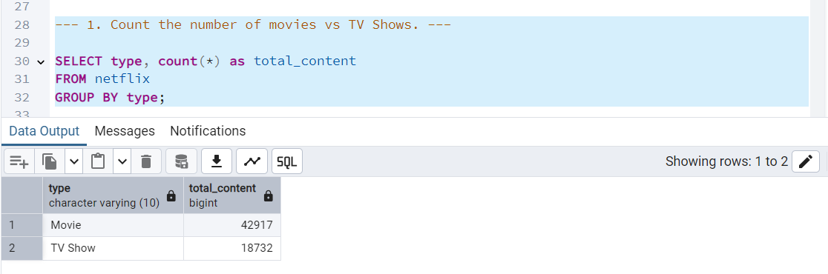
1. Count the number of Movies vs TV Shows.

Slide 7
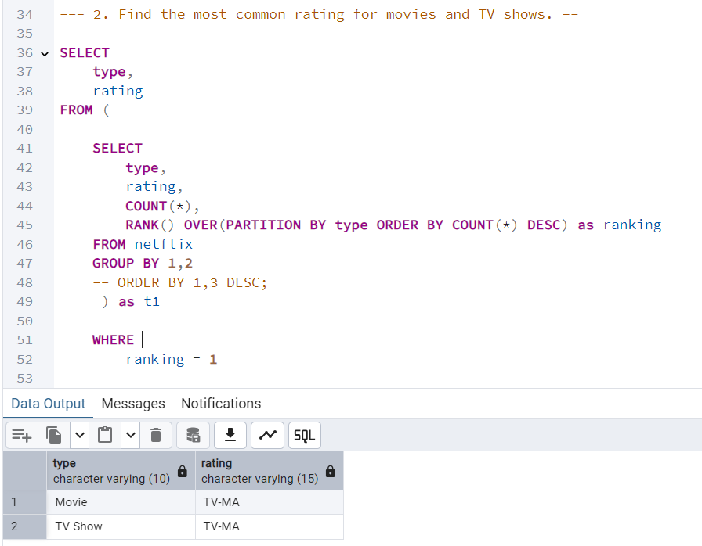
2. Find the most common rating for movies and TV shows.

Slide 8
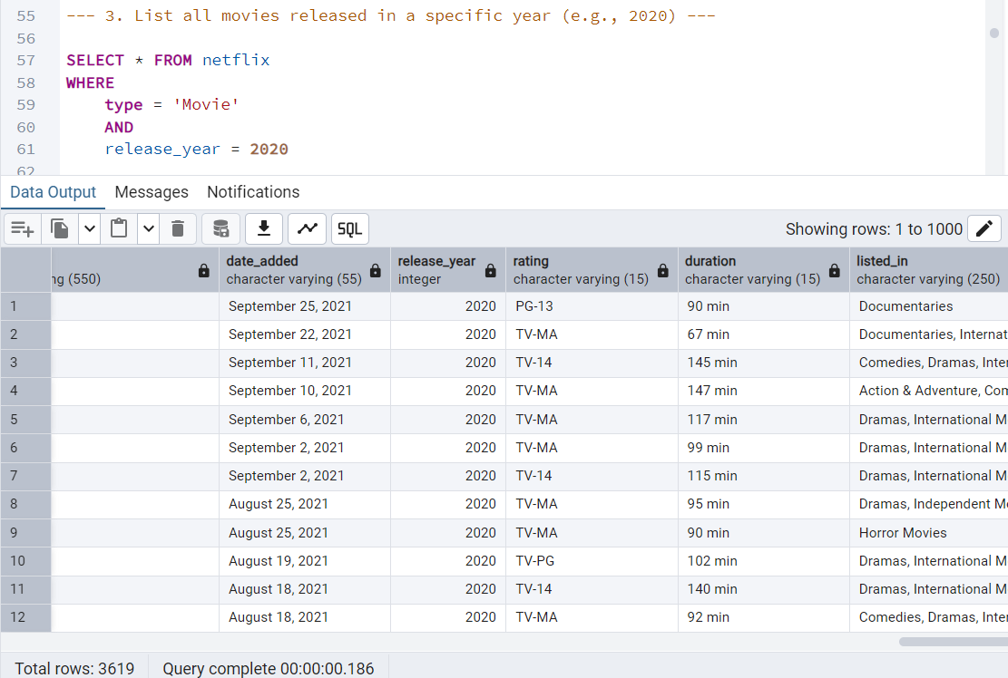
3. List all movies released in a specific year (e.g., 2020)

Slide 9
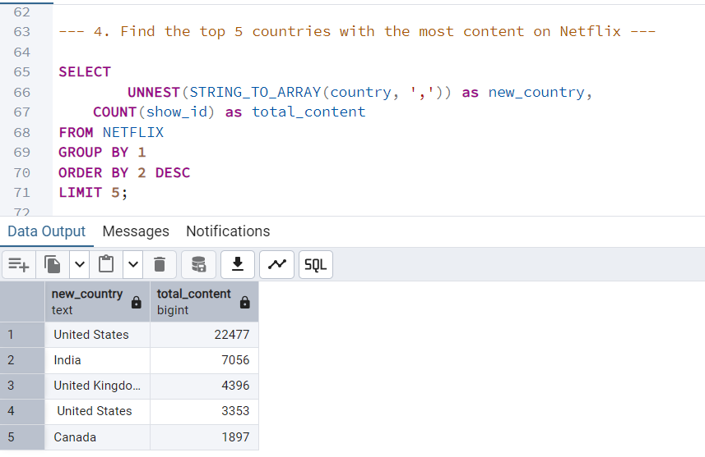
4. Find the top 5 countries with the most content on Netflix

Slide 10
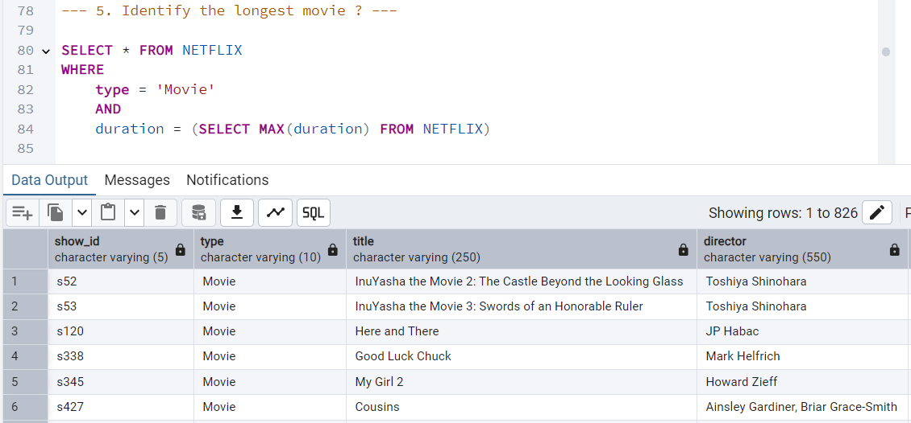
5. Identify the longest movie ?

Slide 11
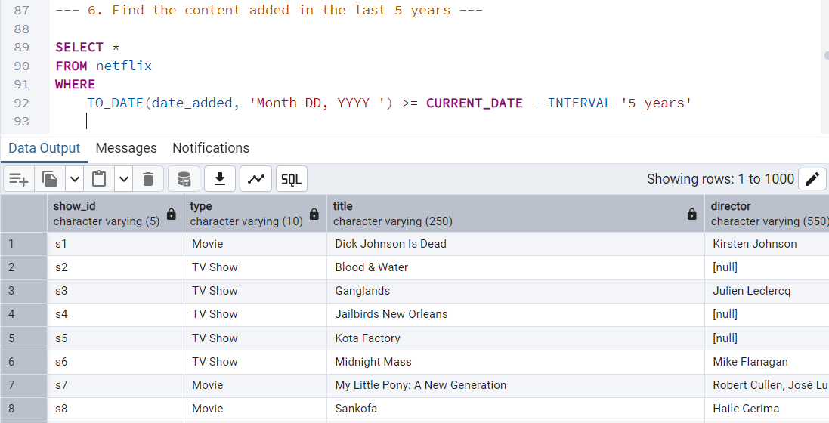
6. Find the content added in the last 5 years

Slide 12
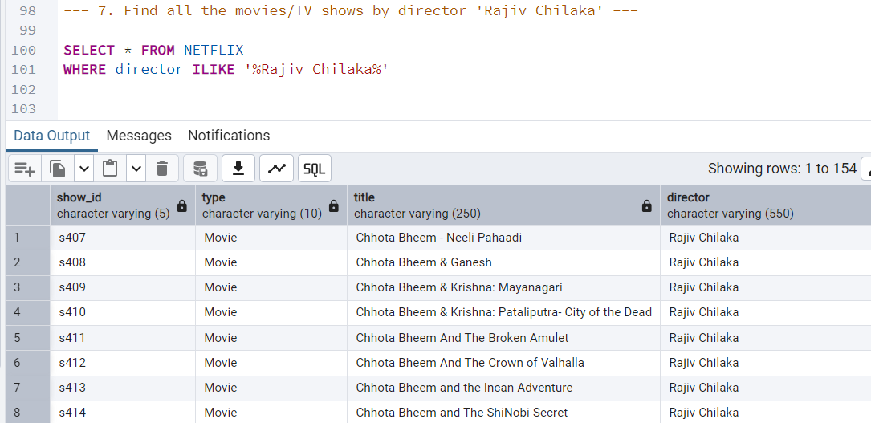
7. Find all the movies/TV shows by director 'Rajiv Chilaka'

Slide 13
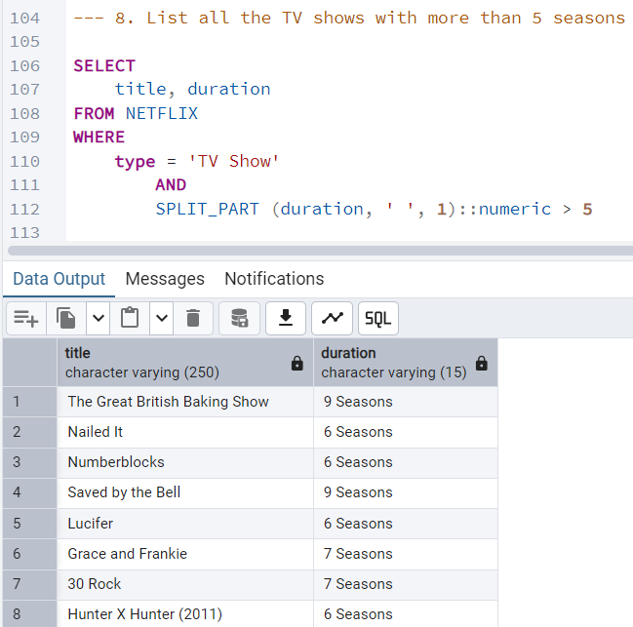
8. List all the TV shows with more than 5 seasons

Slide 14
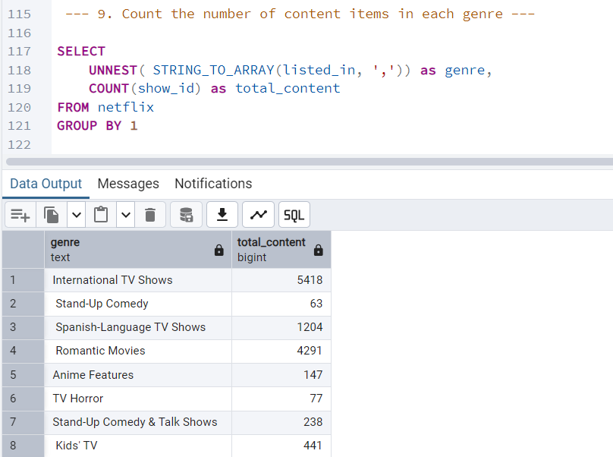
9. Count the number of content items in each genre

Slide 15
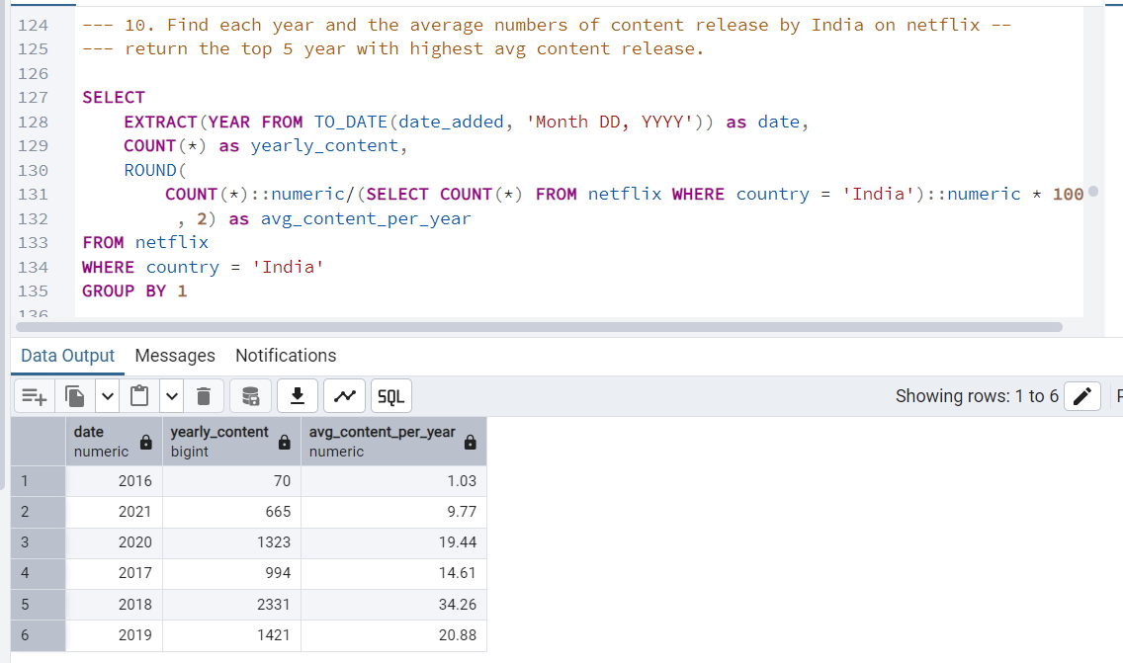
10. Find each year and the average numbers of content release by India on Netflix return the top 5 year with highest average content release.

Slide 16
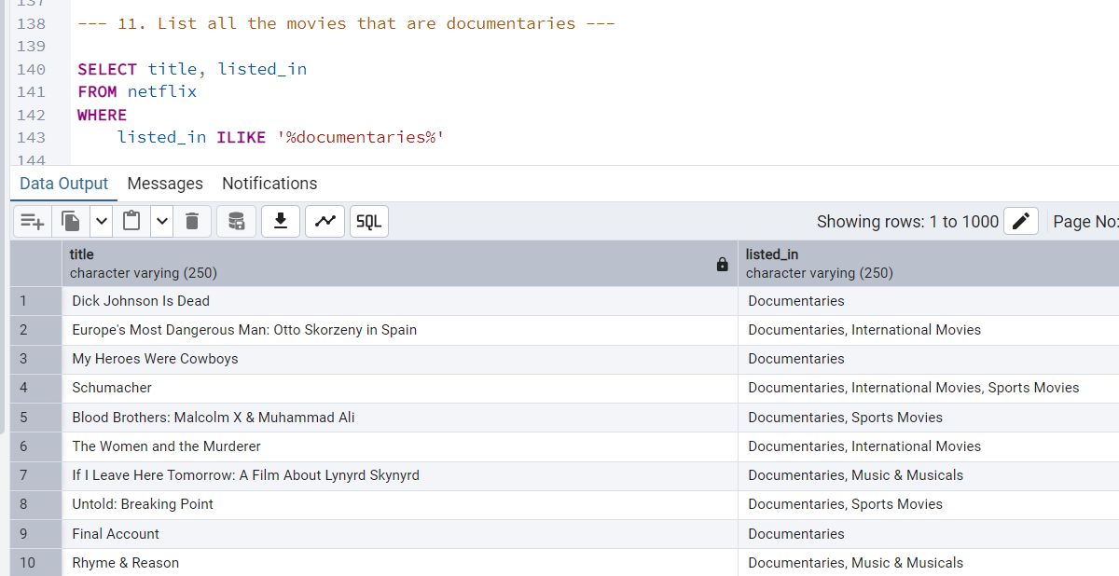
11. List all the movies that are documentaries.

Slide 17
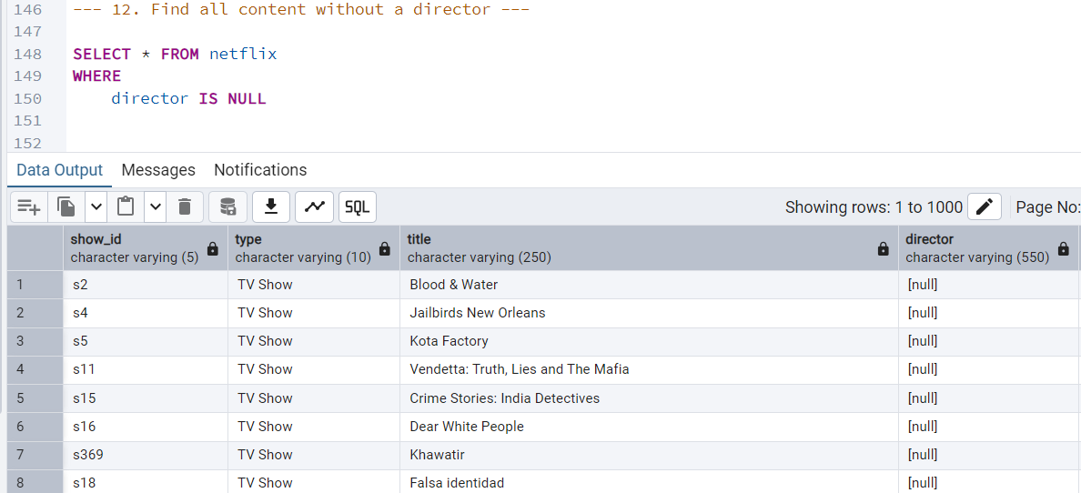
12. Find all content without a director.

Slide 18
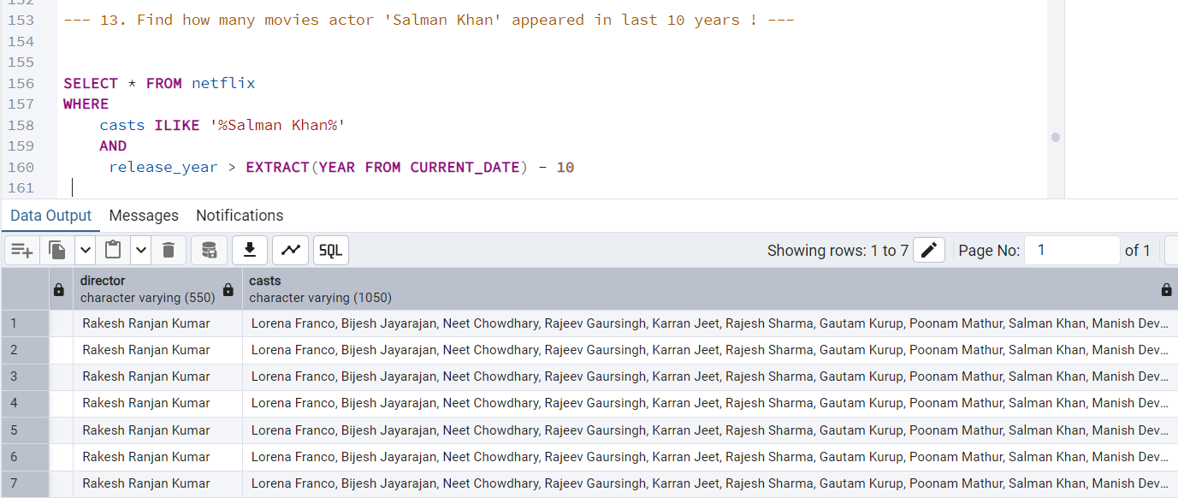
13. Find how many movies actor 'Salman Khan' appeared in last 10 years

Slide 19
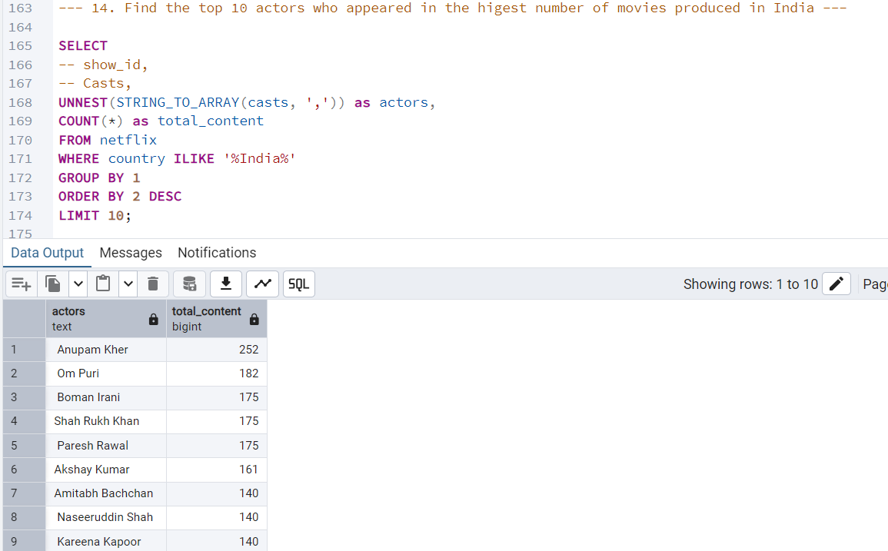
14. Find the top 10 actors who appeared in the higest number of movies produced in India

Slide 20
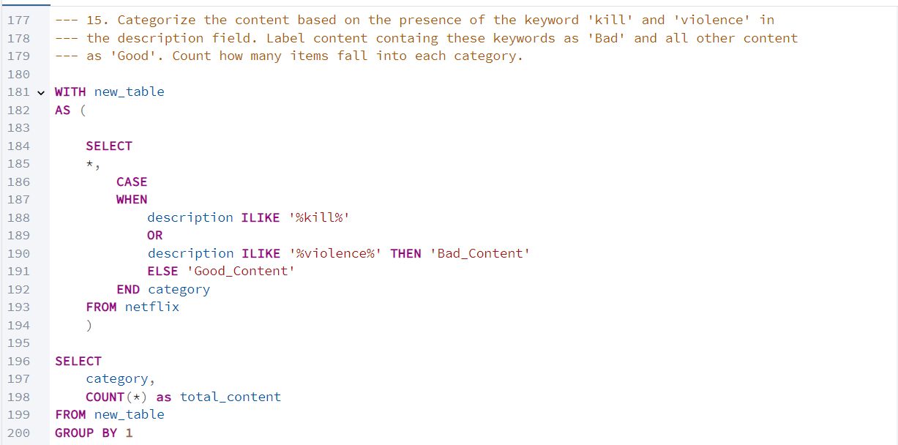
15. Categorize the content based on the presence of the keyword 'kill' and 'violence' in the description field. Label content containg these keywords as 'Bad' and all other content as 'Good'. Count how many items fall into each category.

Slide 21
15. Categorize the content based on the presence of the keyword 'kill' and 'violence' in the description field. Label content containg these keywords as 'Bad' and all other content as 'Good'. Count how many items fall into each category.

