Slide 1
Using Firebase Firestore
Reza Etemadi

Slide 2
Firebase
Firebase is Backend as a Services (BaaS) platform that provides a collection of server-side services that can be used by web or mobile clients.
These services include :
Database
Authentication
Storage
Messaging
Firebase Functions
Hosting
Analytics
Machine Learning Kit
And more…
In this session we will discuss the Database service and how to store data in Firebase.

Slide 3
Firebase : Firestore
At the database level, firebase provides two DB services:
Realtime Database : This is the older DB with a simpler structure.
Cloud Firestore : This is the newer DB and provides more features & better API.
Both of them, are type of NoSQL database. The data are stored as collections of documents and not as tables of records (more on this later). Also, both have real time behavior.
When creating a new Database, you should choose the Cloud Firestore. It is the newer service and has more features. The other DB is a legacy service, and you should only use it, if dealing with an existing project that is using it.
Before discussing Firestore database we would talk a bit about NoSQL vs. SQL databases.

Slide 4
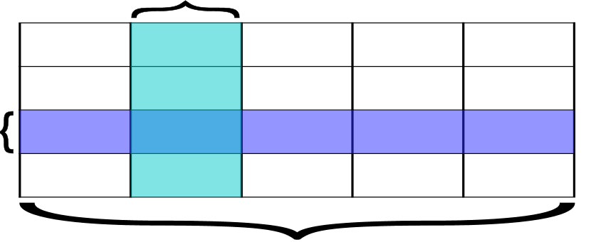
Relational Database (SQL based DB)
A Relational Database is a type of DB that stores data in tabular format
A Relational DB uses a language called SQL to access and/or modify stored data.
In a Relational DB:
Data are stored in Tables (a.k.a. Relations).
Tables contain Rows and Columns.
Each Table normally represents one data type.
e.g., Student, Employee or Course Table etc.
Rows (a.k.a. records) represent instances of that data type.
e.g., Student, Employee or Course record, etc.
Columns (a.k.a. fields) represent properties of that data type.
e.g., Student id, Employee DoB, Course name, etc.
All records (rows) in a table have the “exact” same fields (columns).
Each record (row) normally have different values for different fields (columns) to represent a distinct instance of the Table’s data type.
Column (Field)
Row
(Record)
Table (Relation)

Slide 5
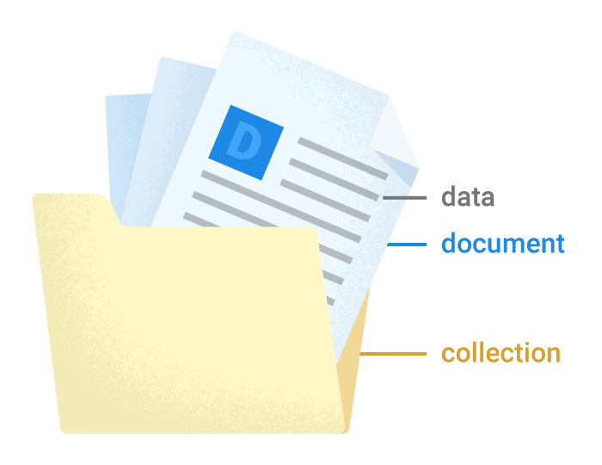
NoSQL Database
A NoSQL Database is a type of DB that stores data in non-tabular format.
i.e., there is no concept of row and column in NoSQL DB.
A one common type of NoSQL DB is the document-based NoSQL
In the document-based NoSQL Database:
Data are stored as a collections of documents.
Each document has a unique identifier within the collection.
Each document stores an arbitrary set of key/value pairs of data.
The key/values pairs can even be nested. (This is very similar to nested JavaScript objects)
In this type of DB, there is no need for documents in a collection to have the exact structure. (unlike records in a table that all have the same fields)
One way to visualize this type of Database is to use the analogy of file system in your computer (i.e., collections, documents and key/value set are analogous to folders, files and file contents).
Notes:
To compare NoSQL with Relational DB
Collection is substituted for Table
Document is substituted for Record
Key/value is substituted for Field/value

Slide 6
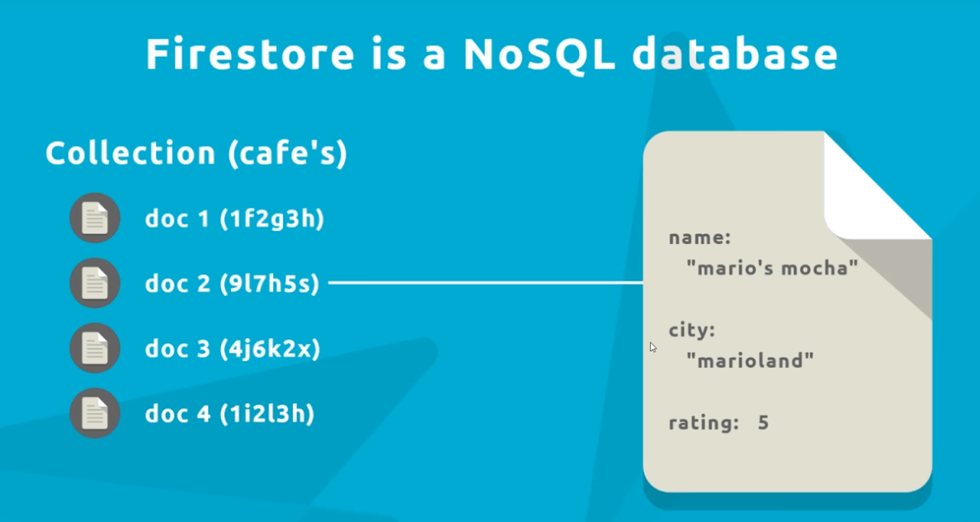
Cloud Firestore, a NoSQL DB
Firebase Cloud Firestore is a type of document-based NoSQL Database.
In Firestore you start by creating a collection.
Within a collection you can create many documents.
(but each document has a unique id within the collection)
Each document also contains any set of key/value pairs
i.e., Each document is very similar to a JavaScript object.
The keys (a.k.a. fields) don’t have to be the same in all documents, although generally, all documents in the same collection have many common fields.
Firestore also generates index based on each field found in the documents. Theses indexes help you to easily sort or find documents based on any field.
For any field, only documents that have that field present, will be included in the index of that field.
Notes:
The advantage of Document over Record is that if a document doesn’t have a value for some field (key) it doesn’t waster any space for that key at all.
Also note, in complex cases a document can contain a collection (i.e.. a sub collection). But be careful not to end up with a hard to handle data model.

Slide 7
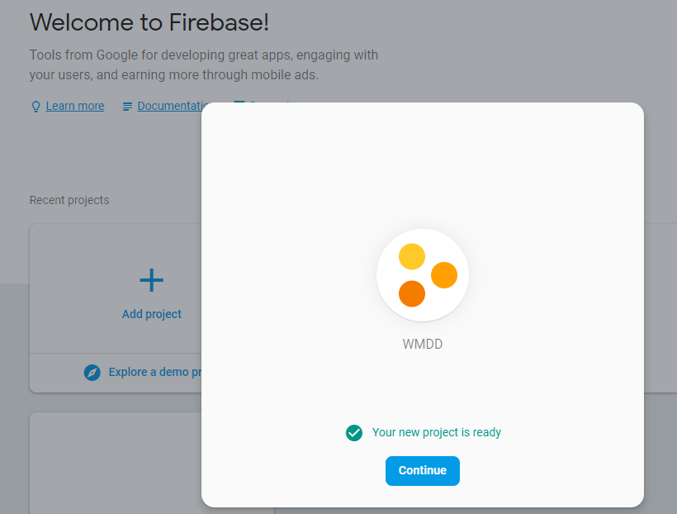
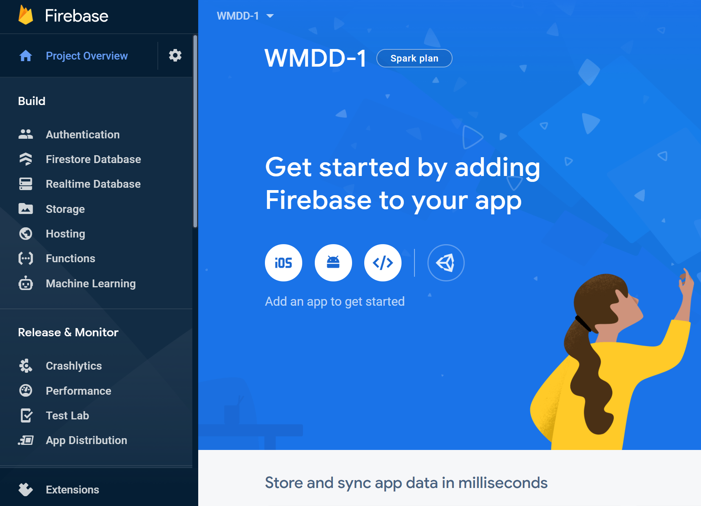
Firebase Dashboard/Console
To use any Firebase service (including Firestore DB), first, you would need to have an account with Firebase. You can use any google account (gmail) for this purpose.
Using the account, you would be able to create a Firebase project through Firebase console (a.k.a. dashboard):
https://console.firebase.google.com/
Inside a firebase project you then have access to all Firebase services.
Firebase comes with a free service tier called Spark Plan. This plan provides all basic needs for a small project or even a start-up company.
Next, we discuss how to create DB using Firebase Firestore service.

Slide 8
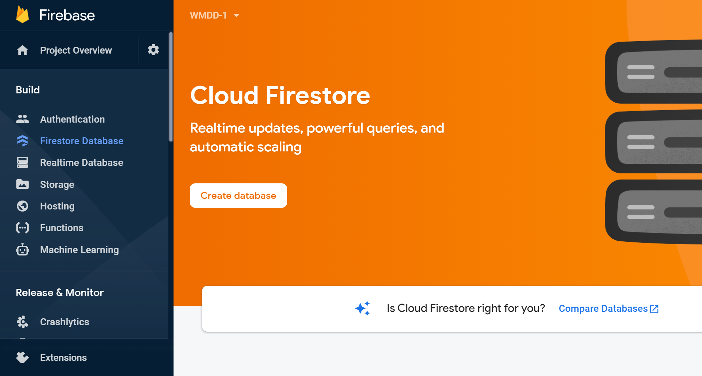
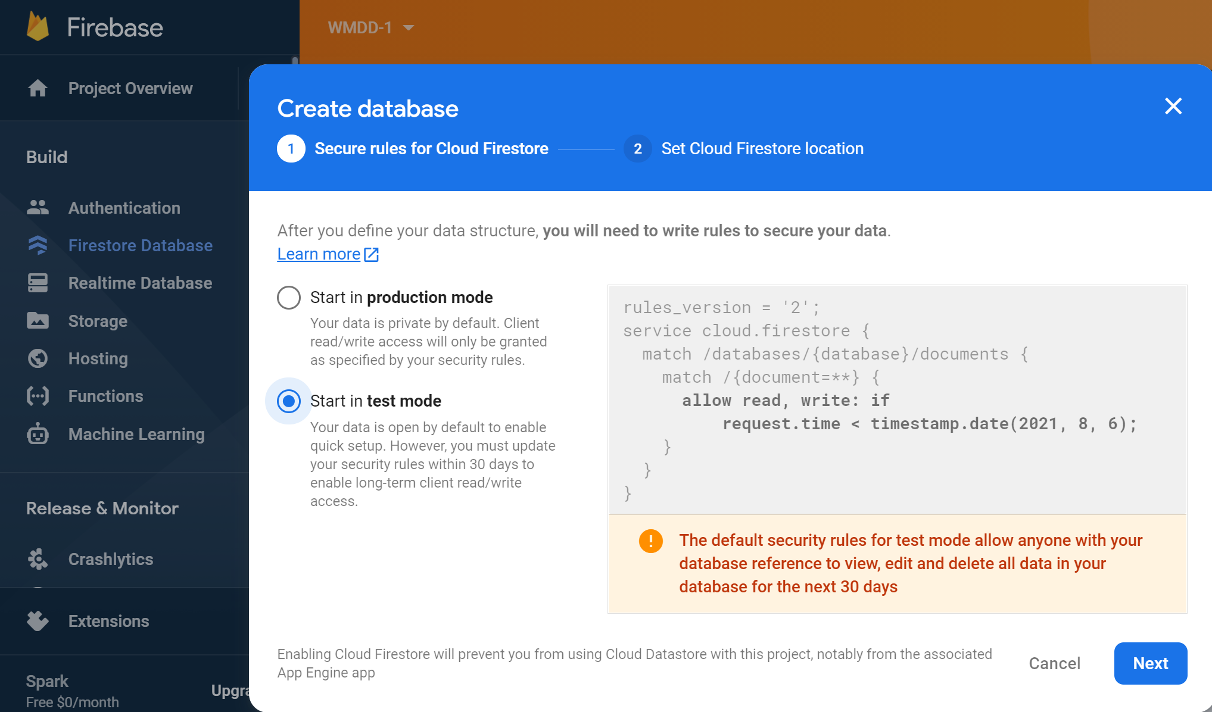
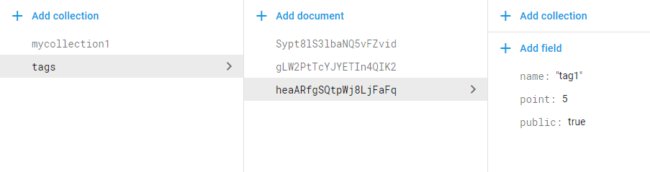
Creating Cloud Firestore Database
To create a Firestore database, inside your project console, select Firestore Database
Then click on “Create database” button.
For simplicity, use “test mode”.
Then if it asks, select a region near your location (e.g., us-central ) to host your DB.
Once the Database service is ready you can create collections and add documents to them.
The firebase console lets you to:
Add/delete collections.
Add/delete documents inside collections.
Add/delete/update fields & values inside documents.
But as a programmer you’ll use Firestore API in your application to operate on the database.

Slide 9
Exercise 1:
Using a google account, login to Firebase console : https://console.firebase.google.com
Create a new firebase project and call it “wmdd”
Create a new Firestore database in test mode.
Add a collection named “TestCollection”
Add some documents with different fields and values through firebase console.

Slide 10
Basic Database Operations
Regardless of the type of a database (i.e., SQL or NoSQL), the basic interaction with a database includes these four operations :
Create : Create a new entity (e.g., a new record or document)
Read : Read the data of an existing entity.
Update : Update the data in an entity
Delete : Remove an entity from database.
These operations are also known as CRUD
In addition to CRUD operations a database provides some form of query operations to find specific entities on demand and with different orders and limits.
To perform any of these operations programmatically, databases provide some APIs (Application Programming Interface) through SDKs (Software Development Kit) for different programming languages that you can choose.
Firebase Firestore provides such API through its own SDK for different programming languages including JavaScript.

Slide 11
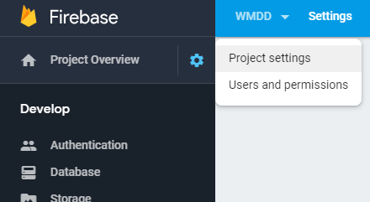


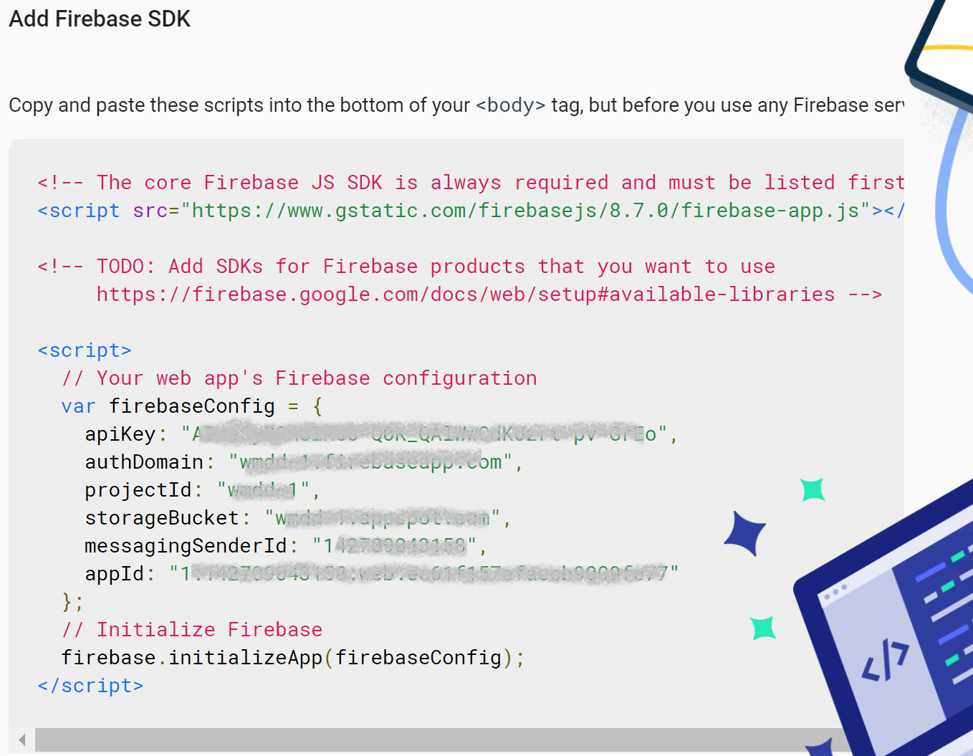
Firebase initialization and API Key
Before using any of Firebase APIs (including Firestore API) you will need to import the Firebase client SDK into your codebase & initialize the SDK using your firebase project ID & API Key.
Every Firebase project comes with a unique API Key that can be found in the Project Settings page.
Firebase also gives sample codes in the project settings page on how to import and initialize the SDK in a Web or Mobile app.
For web or hybrid apps, simply click on icon & copy the code into your HTML page (or JS file)
API keys are not for security of your firebase services, although you shouldn’t share them publicly. To secure your firebase services, you should setup proper access rules for each service & enable authentication and create users in your project. (Subject of another session)
Notes:
Why API Key ? generally cloud services use it to identify and track your usage of their services
So they can cap your usage or charge accordingly .

Slide 12
Initializing Firebase (v.9+) (w. Module)
Here is a basic step to import and initialize firebase in your application using ES module
You need to import initializeApp function from firebase-app module & some functions from firebase-firestore module that are in Firebase JavaScript client SDK e.g. :
import { initializeApp } from "https://www.gstatic.com/firebasejs/9.12.1/firebase-app.js";
// Import functions that you need from the SDKs* e.g.
import { getFirestore, collection, … } from "https://www.gstatic.com/firebasejs/9.12.1/firebase-firestore.js";
Then initialize the firebase with your project ID and API key that you obtained from project setting page
const firebaseConfig = {
apiKey: "...",
projectId: "...",
. . .
};
const app = initializeApp( firebaseConfig ); // Initialize Firebase with your project settings
app object is now a reference to your firebase project .
After above initialization, you can use getFirestore(app) to perform CRUD and query operations of Firestore Database as we see next.
Notes:
Each service has a separate module to import , see this list : https://firebase.google.com/docs/web/learn-more#available-libraries

Slide 13
Firestore JS API (Create) V.9+ (w. module)
After you have imported and initialized firebase, get a handle to firestore service using initialized app. e.g. :
const db = getFirestore(app)
You need to import collection, doc and addDoc as well as the getFirebase from the firebase-firestore module.
To add a new document to a collection you can use addDoc function by passing a collection reference using collection() function and the data that need to be stored as new document as below :
addDoc( collection( db , <collection name > ) , <object to add> );
For example, the code below adds a JavaScript object as a document to a collection named “TestCollection”
const object = { first: "John",
last: "Doe",
status: "unknown"
} ;
const docRefPromise = addDoc( collection( db , "TestCollection") , object );
The addDoc() method returns a Promise object.
if add is successful the new document will get a unique auto-generated id that can be seen in then() callback.
E.g., use docRefPromise.then(…) in above example to receive the document id if the add is successful.
Notes:
The response is a Promise Object that is discussed in OOP course
If you want to set the Document id yourself, you need to use setDoc( ) method instead of addDoc( ) as we discuss
Firestore DB provides API in different languages (e.g. Swift, Java, JavaScript, PHP, …).
You can access firestore database from web pages and hybrid apps using JavaScript API.

Slide 14
Firestore JavaScript API (Read) V.9+
To read a document, you need to import doc and getDoc as well as the getFirebase from the firebase-firestore module.
Get the db handle from getFirestore() function (if not already): e.g., const db = getFirestore(app);
Use getDoc() function by passing a document reference from doc() function with the following syntax:
To get the document reference, the doc() function needs the db handle, collection name and document id
getDoc( doc( db , <collection name > , <doc id> ) );
E.g., the following code retrieves the document with id “doc1” from a collection named “TestCollection” (if it exists).
getDoc( doc( db , "TestCollection" , "doc1" ) );
The getDoc() function also returns a Promise object.
More at : https://firebase.google.com/docs/firestore/query-data/get-data

Slide 15
Firestore JavaScript API (Update)V.9+
To update a document, you need to import doc & updateDoc as well as the getFirebase from the firebase-firestore module.
Get the db handle from getFirestore() function (if not already): e.g. const db = getFirestore(app);
Use updateDoc() function by passing a document reference from doc() function, as well as data to be updated with the following syntax:
To get the document reference the doc() function needs the db handle, collection name and document id
updateDoc( doc( db , <collection name > , <doc id> ) , { field : value, … } );
For example, following code updates the document with id “doc1” inside the collection “TestCollection” with the given field and value.
updateDoc( doc( db , “TestCollection“ , "doc1“ ) , { field : value, … } );
NOTE: updateDoc() Can Not create a new document. It can only modify existing documents. (But it still can add new fields to an existing document). If no document with given <doc id> exists in the collection, updateDoc() will fail.
If you want to delete a field you can still use update, but, set the new value to firebase.firestore.FieldValue.delete() . E.g. { status : firebase.firestore.FieldValue.delete() }
The updateDoc() method returns a Promise object too.
More at : https://firebase.google.com/docs/firestore/manage-data/add-data#update-data

Slide 16
Firestore JavaScript API (Delete)V.9+
To delete a document, you need to have imported doc and deleteDoc as well as the getFirebase from the firebase-firestore module.
Get the db handle from getFirestore() function (if not already):e.g. const db = getFirestore(app);
Use deleteDoc() function by passing a document reference from doc() function with the following syntax (it is similar to getDoc() ):
To get the document reference the doc() function needs the db handle, collection name and document id
deleteDoc( doc( db , <collection name > , <doc id> ) );
For example, following code deletes the document with id “doc1” from the collection “TestCollection”.
deleteDoc( doc( db , “TestCollection“ , "doc1“ ) );
deleteDoc also returns a promise
More at: https://firebase.google.com/docs/firestore/manage-data/delete-data

Slide 17
Firestore JavaScript API (Replace)V9.+
To replace a document, you need to import doc and setDoc as well as the getFirebase from the firebase-firestore module.
Get the db handle from getFirestore() function (if not already): e.g. const db = getFirestore(app);
To overwrite/ replace an existing document, use setDoc() function by passing a document reference from doc() function as well as new data to replace the existing data with the following syntax:
To get the document reference the doc() function needs the db handle, collection name and document id
setDoc( doc( db , <collection name > , <doc id> ) , <object to set> );
E.g. The following code overwrites the document with id “doc1” in “TestCollection” collection w. given JS object
const person = { first: "Erlich", last: "Bachman", company: "Aviato" };
setDoc( doc( db , "TestCollection“ , "doc1“ ) , person );
The good news is that that unlike update, if document with <doc id> doesn’t exist , the setDoc() will simply create it.
In other words, this way you can create a document with pre-defined id instead of auto-generated id .
NOTE: When using setDoc() you also have the option to merge with the existing document instead of overwriting it, by passing { merge : true } as 3rd parameter.
This way setDoc() works like updateDoc() but has the advantage that it creates if document doesn’t exist.
More at : https://firebase.google.com/docs/firestore/manage-data/add-data#set-data

Slide 18
Firestore JavaScript API (query)V.9+
To query a group of documents you need to import collection, query, where, getDocs (notice the ending S) & getFirebase from firebase-firestore module.
Get the db handle from getFirestore() function (if not already) e.g.: const db = getFirestore(app);
If you want to query all documents of a collection then use getDocs() function using a reference to the collection as follow
getDocs( collection( db , <collection name > ) ); // it returns a Promise
E.g., following code retrieves all documents in a collection named “TestCollection”
const whole = await getDocs( collection( db , " TestCollection" ) ); // using await inside a async function
If you want to query a subset of a collection you need to create a query object using query() function & using a collection() and where() function and passing that query object as parameter to getDocs() function as filter condition.
const qu = query( collection(db, <collection name> ), where(<condition> )); const subCollection = await getDocs( qu ) );
E.g., following code retrieves from “TestCollection” all documents that have a field named status with the value “known”.
const subCollection = await getDocs( query( collection(db, "TestCollection" ), where("status", "==", "known" )); ) );
To see different condition operators, see: https://firebase.google.com/docs/firestore/query-data/queries#query_operators
You can also have limits and orders in your query by importing and using limit and orderBy functions from module. e.g.
const qu = query( collection(db, "TestCollection" ), where("status", "==", "known" ), orderBy("name"), limit(100); ) ; const subCollection = await getDocs( qu ) );
For other examples see : https://firebase.google.com/docs/firestore/query-data/order-limit-data
More at : https://firebase.google.com/docs/firestore/query-data/get-data
Notes:
You can include multiple where() , where() as parameter of query()

Slide 19
Firestore events
In addition to various functions, Firestore API includes various events that can be listened to, on the client side.
These events include:
https://firebase.google.com/docs/functions/firestore-events
You can handle each event by registering an event handler callback function
For tracking real time updates of the database, use onSnapshot event at a collection or a document level as we see next.
https://firebase.google.com/docs/firestore/query-data/listen
onCreate | It is triggered when a document is written to for the first time.
onUpdate | It is triggered when a document already exists and has any value changed.
onDelete | It is triggered when a document with data is deleted.
onWrite | It is triggered when any of onCreate, onUpdate or onDelete is triggered.

Slide 20
Sample use of Snapshot event V.9+
By listening to snapshot event, you can get the latest data in real time.
The onSnapshot function will be given a snapshot of a collection or a document every time there is a change.
In addition to first parameter that can be a collection, query or doc, it takes a callback as 2nd parameter to pass the snapshot of data to it e.g.
onSnapshot( collection(db, "TestCollection"), (snapshot) => { //the callback function
console.log(`Total records : ${ snapshot.size } `)
snapshot.forEach((doc) => {
console.log(" Document id: ", doc.id );
console.log(`Document content: ${JSON.stringify(doc.data()) }`);
}
};
);
Similar to using getDocs, you can pass a query() as first parameter e.g.
const qu = query( collection(db, "TestCollection"), orderBy("name"));
onSnapshot( qu, (snapshot) => { ... });
Alternatively, you can pass a document reference if you are only interested in realtime changes in one document
More on : https://firebase.google.com/docs/firestore/query-data/listen
https://firebase.google.com/docs/reference/node/firebase.firestore.QuerySnapshot

Slide 21
Use of Snapshot docChanges V.9+
Inside the callback function you can identify what has changed since the last snapshot using docChanges() method of the snapshot object that is given to event handler. e.g.
onSnapshot( collection(db, "TestCollection"), (snapshot) => {//the callback function
snapshot.docChanges().forEach( ( change ) => {
if (change.type === "added") {
console.log("New doc: ", change.doc.data());
}
if (change.type === "modified") {
console.log("Modified doc: ", change.doc.data());
}
if (change.type === "removed") {
console.log("Removed doc: ", change.doc.data());
}
});
});
More on : https://firebase.google.com/docs/reference/node/firebase.firestore.QuerySnapshot#docchanges
Notes:
If you want to loop through all documents every time any change happens, use snapshot.forEach() instead of snapshot.docChanges().forEach()
e.g.
db.collection("myCollection").onSnapshot ( (snapshot) => { //the callback function
snapshot.forEach( (doc) => {
console.log("New doc: ", doc.data());
});
});

Slide 22
Exercise 2: V.9+
Create a sample HTML
Load and initialize firebase using your project settings
Access the collection you created in Exercise 1
Add a form to read TODO data from user
Add a button to store the data into your Firestore collection.
Add a snapshot event handler to get notified of changes in DB
Use below page as starter if you need
https://stackblitz.com/edit/web-platform-m1cmkf?file=script.js

Slide 23
More on Firebase Firestore
There are other features in Firestore database such as transactions and batch operations , custom indexes etc.
https://firebase.google.com/docs/firestore/manage-data/transactions
https://firebase.google.com/docs/firestore/query-data/indexing
Full documentation available at : https://firebase.google.com/docs/firestore/
CodeLab : Firestore documentation has a code lab exercise too:
https://codelabs.developers.google.com/codelabs/firestore-web/#0

Slide 24
Sample Security Rule for Firestore
In general, you should limit the read & write access to authorized users only. And we will discuss this with Firebase Auth.
For now, we define an open policy that allows anyone access to all documents in all your collection.
To take effect, this code should be added to the Rules section of your Firestore DB in firebase console.
service cloud.firestore { // limit the rules to Cloud Firestore service
match /databases/{database}/documents { // apply the rules to all databases in the project (currently a single DB exists)
match /{document=**} { // apply the rules to all documents in DB
allow read, write; // allow read and write to everyone
}
}
}
For more on firestore security : https://firebase.google.com/docs/firestore/security/get-started
For more on storage security: https://firebase.google.com/docs/storage/security/start
For role base access see : https://firebase.google.com/docs/firestore/solutions/role-based-access

Slide 25
Some Common Errors w. writing to DB
ERROR : Function DocumentReference.set() called with invalid data. Unsupported field value: undefined …
This happens if you are trying to add or set a field with undefined value.
Solution: check for value !== undefined before passing it to firestore and if you really don’t have value for it, either don’t include that field or set it to null
ERROR : Function DocumentReference.set() called with invalid data. Unsupported field value: a custom … object
This happens if you try to add or set a custom JS object into DB.
Solution : Either stringify your custom object, or use spread operator { …your custom object }
Note that if you have any setter/getter property, you need to explicitly set them as normal property into plain object

Slide 26
References
https://firebase.google.com/docs/
https://firebase.google.com/docs/firestore/quickstart
https://www.youtube.com/watch?v=4d-gIPGzmK4
git clone https://github.com/firebase/friendlyeats-web
https://firebase.google.com/docs/web/learn-more#available-libraries

Slide 27
Firebase SDK v.8 -
Prior to version 9 of Firebase JavaScript SDK there was no ES module and the API was based on namespace style
This API is still available in version 9 as compatibility with older version of SDK.
Following slides shows how the namespace based API can be used in case you want to use that.
In any case you should only use one approach in your code and stick with it. i.e. either use the newer API based on ES module or use the namespace style API. Do not mix and match

Slide 28
Initializing Firebase (V.8-) (w.o. Module)
Here is a basic step to load and initialize firebase in your application.
Load firebase-app and firebase-firestore JavaScript client SDK e.g. .
<script src="https://www.gstatic.com/firebasejs/8.10.0/firebase-app.js"></script>
<script src="https://www.gstatic.com/firebasejs/8.10.0/firebase-firestore.js"></script>
If you are going to use version 9+ , use the compatibility version
<script src="https://www.gstatic.com/firebasejs/9.8.4/firebase-app-compat.js"></script>
<script src="https://www.gstatic.com/firebasejs/9.8.4/firebase-firestore-compat.js"></script>
Then initialize the firebase with your project ID and API key e.g.
<script> // copy paste from settings of your project page
const firebaseConfig = { apiKey: "..."
projectId: "..."
. . .
};
firebase.initializeApp( firebaseConfig ); // Initialize Firebase w. your project settings
</script>
After above initialization you can use firebase.firestore() to use Firestore Database API in your JavaScript code.

Slide 29
Firestore JS API (Create) V.8- (w.o. Module)
After you have loaded and initialized firebase (as discussed) you can get a handle to firestore service like this:
const db = firebase.firestore();
Using firestore you can create collections, documents and fields or update or delete them.
To add a new document to a collection you can use add() method of collection API:
db.collection( <collection name > ).add( <object to add> );
For example, this code adds a given JavaScript object as a document to a collection named “myCollection”
const person = { first: "John",
last: "Doe",
status: "unknown"
} ;
const prom = db.collection(“TestCollection").add( person );
The add() method returns a Promise object.
if add is successful the new document will get a unique auto-generated id that can be seen in then() callback.
E.g., you can use prom.then(…) in above example to receive the document if the add is successful.
Notes:
The response is a Promise Object that is discussed in OOP course
If you want to set the Doc Id yourself you need to use set( ) method instead of add( )
Firestore DB provides API in different languages (e.g. Swift, Java, JavaScript, PHP, …).
You can access firestore database from web pages and hybrid apps using JavaScript API.

Slide 30
Firestore JavaScript API (Read)V.8-
If you want to access an existing document you can use doc() method of a collection, using collection name and the document id:
db.collection( <collection name> ).doc( <doc id> );
From there you can use get() method to read the document’s content.
For example, the following code retrieves the document with id “doc1” from a collection named “TestCollection”.
const myDoc = db.collection(“TestCollection").doc("doc1").get();
The get() method also returns a Promise object
More at : https://firebase.google.com/docs/firestore/query-data/get-data

Slide 31
Firestore JavaScript API (Update)V.8-
If you want to update some of the fields of an existing document, you can use update() method of the doc API (you would need to have the document id).
db.collection( <collection name> ).doc( <doc id> ).update( { field : value, … } );
For example, following code updates the document with id “doc1” inside the collection “myCollection” with the given field and value.
db.collection(“TestCollection").doc("doc1").update( { status: "known" } );
NOTE: update() cannot create new document. It can only modify existing documents. (But it still can add new fields to an existing document)
If you want to delete a field you can still use update, but, set the new value to firebase.firestore.FieldValue.delete() . E.g. { status : firebase.firestore.FieldValue.delete() }
The update() method also returns a Promise object
More at : https://firebase.google.com/docs/firestore/manage-data/add-data#update-data

Slide 32
Firestore JavaScript API (Delete)V.8-
If you want to delete a document from a collection you can use delete() method of document object. In this case also, you need to have the id of the document you want to remove.
db.collection( <collection name > ).doc( <doc id> ).delete();
For example, following code deletes the document with id “doc1” from the collection “TestCollection”
db.collection(“TestCollection").doc("doc1").delete();
Note the delete() also returns a promise
More at: https://firebase.google.com/docs/firestore/manage-data/delete-data

Slide 33
Firestore JavaScript API (Replace)V.8-
If you want to overwrite a document with a new data, you can use set() method of document API.
db.collection( <collection name > ).doc( <doc id> ).set( <object to set> );
E.g. following code overwrites the document with id “doc1” in “TestCollection” collection w. given JS object
const person = { first: "Erlich",
last: "Bachman",
company: "Aviato"
};
db.collection("TestCollection").doc("doc1").set( person );
If no document with given <doc id> exists, the set() will simply create a new document.
In other words, this way you can create a document with pre-defined id instead of auto-generated id .
NOTE: When using set() you also have the option to merge with existing document instead of overwriting it by passing { merge : true } as second parameter.
This way set() works like update but has advantage that it won’t fail if document doesn’t exist.
More at : https://firebase.google.com/docs/firestore/manage-data/add-data#set-data

Slide 34
Firestore JavaScript API (query)V.8-
If you want to query all documents of a collection then use get() method of the collection itself.
db.collection( <collection name > ).get();
E.g., following code retrieves all documents in a collection named “TestCollection”
db.collection(“TestCollection").get();
If you want to query a subset of a collection use where() method with a filter condition.
db.collection( <collection name> ).where( <condition> );
E.g., following code retrieves from “TestCollection” all documents that have a field named status with the value “known”.
db.collection("TestCollection").where("status", "==", "known");
To see different query operators, see: https://firebase.google.com/docs/firestore/query-data/queries
You can also have limits and orders in your query using limit() and orderBy() methods e.g.
db.collection("TestCollection").where("status", "==", "known").orderBy("name").limit(100);
For other examples see : https://firebase.google.com/docs/firestore/query-data/order-limit-data
More at : https://firebase.google.com/docs/firestore/query-data/get-data
Notes:
You can combine multiple where().where()….

Slide 35
Sample use of Snapshot event V.8-
By listening to snapshot event, you can get the latest data in realtime.
The onSnapshot callback will be given a snapshot of a collection or a document every time there is a change. e.g.
db.collection("TestCollection").onSnapshot( (snapshot) => { //the callback function
console.log(`Total records : ${ snapshot.size } `)
snapshot.forEach((doc) => {
console.log(" Document id: ", doc.id );
console.log(`Document content: ${JSON.stringify(doc.data()) }`);
}
});
});
More on : https://firebase.google.com/docs/firestore/query-data/listen
https://firebase.google.com/docs/reference/node/firebase.firestore.QuerySnapshot
Notes:
If you want to loop through all documents every time any change happens, use snapshot.forEach() instead of snapshot.docChanges().forEach()
e.g.
db.collection("myCollection").onSnapshot ( (snapshot) => { //the callback function
snapshot.forEach( (doc) => {
console.log("New doc: ", doc.data());
});
});

Slide 36
Sample use of Snapshot docChanges V.8-
If you want to distinguish between what has changed since the last snapshot you can use docChanges() method of snapshot given to the event handler. e.g.
db.collection("TestCollection").onSnapshot ( (snapshot) => { //the callback function
snapshot.docChanges().forEach( ( change ) => {
if (change.type === "added") {
console.log("New doc: ", change.doc.data());
}
if (change.type === "modified") {
console.log("Modified doc: ", change.doc.data());
}
if (change.type === "removed") {
console.log("Removed doc: ", change.doc.data());
}
});
});
More on : https://firebase.google.com/docs/reference/node/firebase.firestore.QuerySnapshot#docchanges
Notes:
If you want to loop through all documents every time any change happens, use snapshot.forEach() instead of snapshot.docChanges().forEach()
e.g.
db.collection("myCollection").onSnapshot ( (snapshot) => { //the callback function
snapshot.forEach( (doc) => {
console.log("New doc: ", doc.data());
});
});

Slide 37
Exercise 2: V.8-
Create a sample HTML
Load and initialize firebase using your project settings
Access the collection you created in Exercise 1
Add a form to read TODO data from user
Add a button to store the data into your Firestore collection.
Add a snapshot event handler to get notified of changes in DB
Use below page as starter if you need
https://stackblitz.com/edit/web-platform-7cvvzz?file=script.js

