Slide 1
Using Firebase Authentication
Reza Etemadi

Slide 2
Firebase
Firebase is a Backend as a Services (BaaS) platform that provides a collection of server-side services to be used by web or mobile clients.
These services include :
Database
Authentication
Storage
Messaging
Firebase Functions
Hosting
Analytics
Machine Learning Kit
And more
Here we discuss the Authentication service

Slide 3
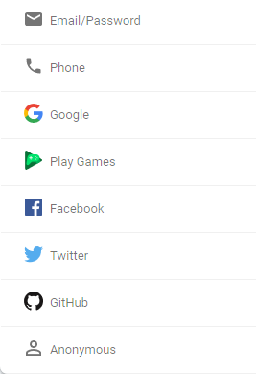
Firebase : Authentication
Firebase provides multiple ways to authenticate users.
Some of these mechanisms rely on communication with identity service providers such as Facebook, Twitter, GitHub etc.
To use any of these mechanisms you need to first enable them within your firebase project through firebase console (dashboard).
Notes:
You can use Firebase Authentication to create and use temporary anonymous accounts to authenticate with Firebase. These temporary anonymous accounts can be used to allow users who haven't yet signed up to your app to work with data protected by security rules. If an anonymous user decides to sign up to your app, you can link their sign-in credentials to the anonymous account so that they can continue to work with their protected data in future sessions.
More at : https://firebase.google.com/docs/auth/web/anonymous-auth

Slide 4
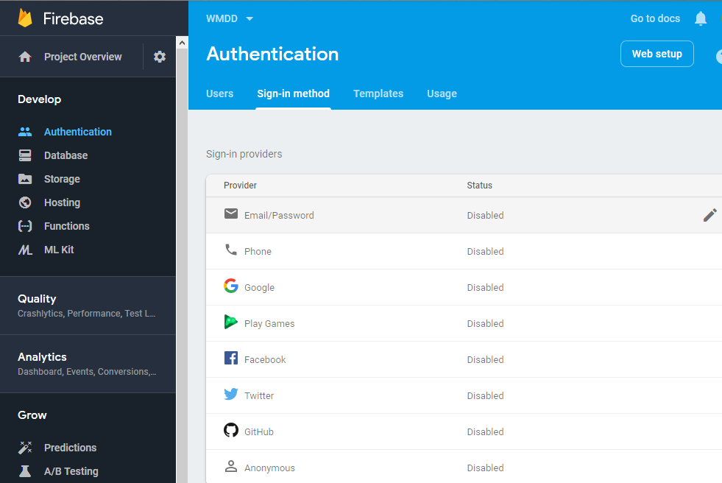
Setup sign-in method
To enable an Authentication mechanism, first select the Authentication from Firebase main menu.
Then select the “Sign-in method” tab.
Then enable any of the authentication mechanisms you like to use in your app.
After that, you can use the firebase Authentication API in your code to manage users & their access (permissions).
NOTE: if you are deploying your app on any custom domain you need to update the list of Authorized domains under Authentication > Settings. Otherwise, the authentication from those domains may not work.

Slide 5
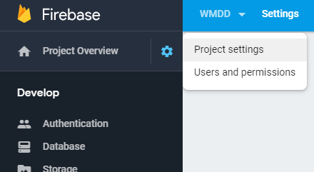


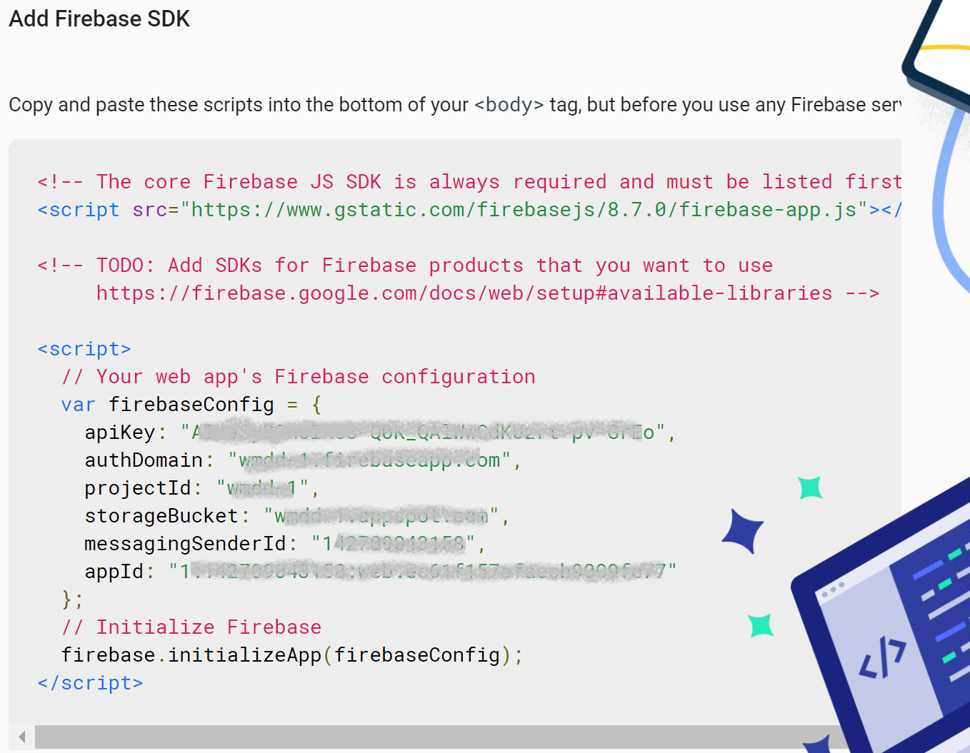
Firebase initialization and API Key
To use any of Firebase APIs (including Authentication API) you will need to load the Firebase client library into your code and initialize it with your project ID & API Key.
Every Firebase project that you create has a unique API Key that can be seen in your Project Settings.
Firebase comes with sample codes in the project settings page on how to import and initialize its client code in a Web or Mobile app.
For web or hybrid apps, simply click on icon & copy the code into your HTML page or JS code.
API key is not for security of your firebase services, although you shouldn’t share it publicly. In practice, you should setup proper access rules for each service. Which can be tied into authentication in your project.
Notes:
Why API Key ? generally cloud services use it to identify and track your usage of their services
So they can cap your usage or charge accordingly .

Slide 6
Initializing Firebase (v.9+) (w. Module)
Here is a basic step to load and initialize firebase in your application using module
Import initializeApp from firebase-app module & any needed functions from firebase-auth module JavaScript client SDK e.g.,
import { initializeApp } from "https://www.gstatic.com/firebasejs/9.12.1/firebase-app.js";
// Import the functions you need from the SDKs you need e.g.
import { getAuth, onAuthStateChanged, … } from "https://www.gstatic.com/firebasejs/9.12.1/firebase-auth.js";
Then initialize the firebase with your project ID and API key e.g.
// copy paste from settings of your project page
const firebaseConfig = { apiKey: "..."
projectId: "..."
. . . };
const app = initializeApp( firebaseConfig ); // Initialize Firebase w. your project settings
app is a reference to your firebase project .
After above initialization, you can use getAuth(app) to use Firebase Authentication API in your JavaScript code.

Slide 7
Email/Password Authentication API V.9+ (w. module)
As mentioned, one of the authentication providers in Firebase is based on email and password.
Firebase Authentication provides API for sign-up & sign-in using email and password as well as sign-out.
You need to import createUserWithEmailAndPassword , signInWithEmailAndPassword and signOut in addition to getAuth from firebase-auth module first.
After you have loaded and initialized firebase SDK (as discussed) you can get a handle to auth service like this:
const auth = getAuth(app) ;
For sign-up use the createUserWithEmailAndPassword function as follow :
createUserWithEmailAndPassword(auth, email, password )
For sign-in use the signInWithEmailAndPassword function as follow:
signInWithEmailAndPassword(auth ,email, password )
For sign-out use the signOut() method:
signOut(auth)
All the above functions return promise
More at : https://firebase.google.com/docs/auth/web/password-auth

Slide 8
Update User Profile (v.9+) (w. Module)
When a user is logged in, you can set or update some properties on the currentUser object that is available by Firebase auth API.
You need to import updateProfile in addition to getAuth and other functions from firebase-auth module. And get the auth handle from getAuth() function (if not already):
const auth = getAuth(app) ;
Then use updateProfile function by passing currentUser object and properties to change. e.g.,
const user = auth.currentUser; // if it’s empty, it means no user is currently logged in
const outcome = updateProfile( user , {
displayName: "John Doe",
photoURL: "https://example.com/john-doe/profile.jpg" } );
Note that updateProfile function also returns a Promise object so to process the outcome:
outcome.then( () => { // Profile update was successful.})
.catch( (error) => { // An error happened. });
More info at : https://firebase.google.com/docs/auth/web/manage-users#update_a_users_profile
https://firebase.google.com/docs/reference/js/auth.user
Notes:
If firebase.auth().currentUser is empty it means no user is logged in

Slide 9
Firebase Authentication events (v.9+) (w. Module)
When user’s status changes (i.e., user logs in or out) an event named onAuthStateChanged is triggered by firebase authentication API.
You need to import , onAuthStateChanged function in addition to getAuth from firebase-auth module. And get the auth handle from getAuth() function (if not already):
const auth = getAuth(app) ;
The proper way to track user status, is by passing a callback to this function in your code e.g.
onAuthStateChanged(auth , ( user ) => { //The callback is passed user parameter from event
if (user) { // if there is a user object it means some user logged in
// show welcome message , redirect to home page etc.
} else { // if user object is null or undefined it means no user is logged in
// redirect browser to login page. e.g. window.location.href="login.html"
}
} );
Additionally, when a user is logged in, you can access the user info using auth.currentUser object.
More at : https://firebase.google.com/docs/reference/js/firebase.auth.Auth
Notes:
If firebase.auth().currentUser is empty it means no user is logged in

Slide 10
Exercise:
Login to Firebase console : https://console.firebase.google.com
Use the project that you created earlier (e.g., “wmdd”)
Select Authentication service and in the sign-in methods tab enable Email/Password mechanism.
Create an HTML page called login.html and load firebase library and initialize it using your project settings
Add two <input> elements, one for Email (type email) and one for Password (type password).
Add two <button>s in the page (sign-up , sign-in)
Import proper firebase modules
Add click handler to each button to call proper firebase authentication firebase API (slide 7) using values from input elements.
After successful sign up or sign in , redirect user to an index page.
On the index page add a Sign out button and when it is clicked, call proper API from firebase to logout.
After successful logout redirect user back to login.html
Use onAuthStateChanged function to track and log user state change. (see slide 9)

Slide 11
Security Rules
Enabling Authentication in your Firebase project app is the first step to secure your backend services.
You also need to add proper access rules for each service (e.g., for Firestore database , Storage etc.), so that only authenticated users with proper permissions are allowed to access protected resources.
To define these security rules, Firebase uses a domain specific language based on Common Expression Language ( CEL ). The basic structure of each access rule definition is as follow:
service << name >> { // Define the service you want to control e.g. cloud.firestore
match << path >> { // Define the resource path pattern to match for rule to apply.
// Define the access rule based on some conditions
allow << methods >> : if << condition >>;
}
}
In this context the << methods >> can be either read or write .
Read itself can be further divided into more granular methods ( list and get )
Write itself can be further divided into more granular methods ( add, update and delete )
For more details visit: https://firebase.google.com/docs/rules/rules-language
https://firebase.google.com/docs/rules/rules-behavior
https://firebase.google.com/docs/rules/basic
https://firebase.google.com/docs/firestore/security/rules-structure
https://firebase.google.com/docs/firestore/security/rules-conditions

Slide 12
Example of Security Rule for Firestore
As an example, the following rule can be applied to all documents inside firestore. This rule allows the read access to everyone but the write access only to logged-in users ( if request.auth != null )
In general, make sure write access is restricted unless you have public facing page that takes anonymous inputs.
To take effect, this code should be added to the Rules section of your Firestore database in Firebase console.
service cloud.firestore { // limit the rules to Cloud Firestore service
match /databases/{database}/documents { // apply the rules to all Firestore DBs in the project (currently a single DB exists)
match /{document=**} { // apply the rules to all documents in the matched Firestore database
allow read; // allow document read to everyone
allow write: if request.auth != null; // allow document write only to authenticated users
}
}
}
For more on Firestore security : https://firebase.google.com/docs/firestore/security/get-started
For more on Storage security: https://firebase.google.com/docs/storage/security/start
For role base access see : https://firebase.google.com/docs/firestore/solutions/role-based-access
Examples of basic rules : https://medium.com/@khreniak/cloud-firestore-security-rules-basics-fac6b6bea18e

Slide 13
More Example of Rule for Firestore
Here are other examples :
This security rule defines separate condition for each sub operation on documents inside Cities collection
match /cities/{city} { // applies to any city document inside cities collection
allow get: if <condition>; //get is a sub operation of read
allow list: if <condition>; //list is a sub operation of read
allow create: if <condition>; //create is a sub operation of write
allow update: if <condition>; //update is a sub operation of write
allow delete: if <condition>; //delete is a sub operation of write
}
This security rule allows any document in users collection to be available only to the user with the same ID.
match /users/{docId} { // applies to any user document inside users collection allow read, write : if request.auth !=null && request.auth.uid == docId; }
For possible conditions see : https://firebase.google.com/docs/firestore/security/rules-conditions

Slide 14

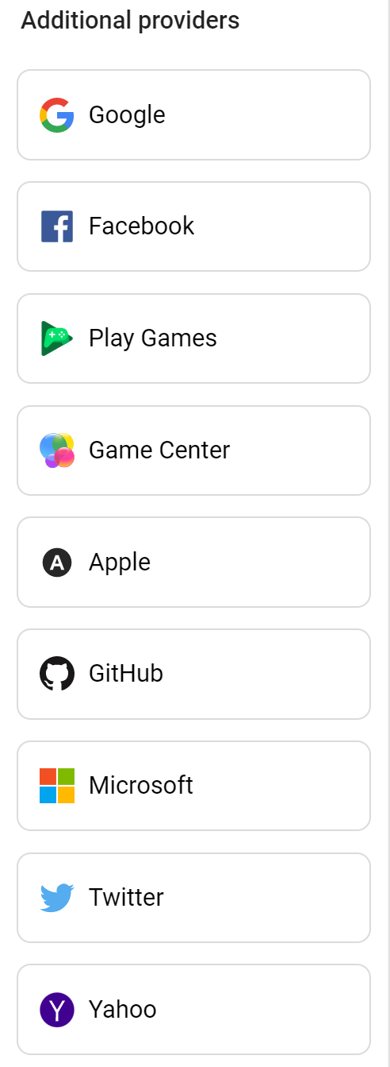
Firebase 3rd Party Authentication API
As mentioned, in addition to username/password, firebase Auth also supports authentication using many 3rd party services.
This includes Google, Facebook, Apple, Twitter, GitHub, Microsoft or Yahoo Accounts:
https://firebase.google.com/docs/auth/web/google-signin
https://firebase.google.com/docs/auth/web/facebook-login
https://firebase.google.com/docs/auth/web/apple
https://firebase.google.com/docs/auth/web/twitter-login
https://firebase.google.com/docs/auth/web/github-auth
https://firebase.google.com/docs/auth/web/microsoft-oauth
https://firebase.google.com/docs/auth/web/yahoo-oauth
It also supports login using SMS (with limited quota for Spark plan):
https://firebase.google.com/docs/auth/web/phone-auth
Notes:
We only discuss user/pass based authentication

Slide 15
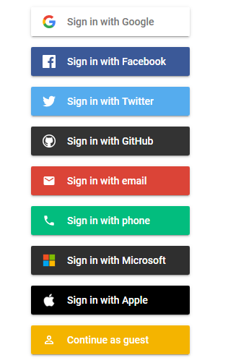
Online Demo
Below is repository on GitHub that demonstrates different Firebase authentications mechanisms (you can clone it)
https://github.com/firebase/firebaseui-web/tree/master/demo
JS code: https://github.com/firebase/firebaseui-web/blob/master/demo/public/app.js
Here is a live demo of above code base https://fir-ui-demo-84a6c.firebaseapp.com/
There is also a good tutorial to build a chat app that uses authentication:
https://codelabs.developers.google.com/codelabs/firebase-web/#0

Slide 16
Admin API
In addition to user API , Firebase has an Admin API that allows you to:
Manage users (add or remove users, update users’ profile, custom claims etc.)
Define custom Authentication mechanism
And more advanced use of Authentication service
This is ideal if you are building a web application that needs to perform high level administration activities (similar to Firebase console)
It is not for use inside a mobile app or customers facing web app.
More at : https://firebase.google.com/docs/auth/admin/

Slide 17
Exercise
Using your exercise code,
For sign up , add an extra logic to validate password length, also ask user to enter password twice (use two inputs) and compare them to eliminate any typo before accepting it.
Also add an “eye” icon next to password input and show the password text when it is clicked
Add a timeout mechanism to automatically sign-out user after certain amount of time inactivity (e.g., after 5 minutes being inactive) (hint use mousemove an touchstart event to reset timer)
Take your TODO solution that you already created with firestore DB, add support for firebase user/password authentication, so that user has to login before being able to add TODO item.
Make sure to add proper Security access rules to your DB, so that only signed-in users are allowed to write into TODO collection.
Similarly update the workshop code to include a login page and only allow logged in users to access the app.

Slide 18
Common Errors with user/pass provider
Firebase: Error (auth/configuration-not-found) : This can happen on brand new project, if you have not yet get started with authentication
Firebase: Error (auth/operation-not-allowed) : This can be caused by not enabling the auth provider in authentication
Error (auth/invalid-login-credentials) : This can happen if username or password is incorrect
Firebase: Error (auth/email-already-in-use) : This can happen if you try to Sign Up twice with the same username
Firebase: Password should be at least 6 characters (auth/weak-password) : This can happen if you provide less that 6 character for password during Sign Up

Slide 19
References
https://firebase.google.com/docs/
https://firebase.google.com/docs/firestore/quickstart
https://firebase.google.com/docs/reference/js/firebase.auth.Auth
https://firebase.google.com/docs/auth/
https://firebase.google.com/docs/rules/rules-behavior
https://firebase.google.com/docs/firestore/security/rules-structure
https://medium.com/@khreniak/cloud-firestore-security-rules-basics-fac6b6bea18e
https://github.com/firebase/firebaseui-web/tree/master/demo
https://codelabs.developers.google.com/codelabs/firebase-web/#0

Slide 20
Older API
Following shows the older API of firebase (before version 9) that was not based on ES Module

Slide 21
Initializing Firebase (V.8-) (w.o. Module)
Here is a basic step to load and initialize firebase in your page. Load firebase app and auth JavaScript libs e.g.
<script src="https://www.gstatic.com/firebasejs/8.10.0/firebase-app.js"></script>
<script src="https://www.gstatic.com/firebasejs/8.10.0/firebase-auth.js"></script>
If you are going to use version 9+ , use the compatibility version for namespace approach
<script src="https://www.gstatic.com/firebasejs/9.8.4/firebase-app-compat.js"></script>
<script src="https://www.gstatic.com/firebasejs/9.8.4/firebase-auth-compat.js"></script>
Then initialize the firebase SDK with your project and API key e.g.
<script> // copy paste from settings of your project page
const firebaseConfig = { apiKey: "..."
projectId: "..."
. . .
};
firebase.initializeApp( firebaseConfig ); // Initialize Firebase w. your project settings
</script>
After that you can use firebase.auth() to access Authentication API.
Notes:
* Note: Firebase provided a module based API in version 9. but here we discuss the earlier API since it is more commonly used. If you want to use version 9 with current API you can use version 9 Compatibility e.g.
https://www.gstatic.com/firebasejs/9.3.0/firebase-app-compat.js

Slide 22
Email/Password Authentication API (V.8-) (w.o. Module)
As mentioned, one of the authentication mechanisms is based on email and password.
Firebase Authentication provides API for sign-up & sign-in actions using email and password as well as sign-out action.
For sign-up use the createUserWithEmailAndPassword() method i.e.:
firebase.auth().createUserWithEmailAndPassword( email, password )
For sign-in use the signInWithEmailAndPassword() method i.e.:
firebase.auth().signInWithEmailAndPassword( email, password )
For sign-out use the signOut() method:
firebase.auth().signOut()
All the above functions return promise
More at : https://firebase.google.com/docs/auth/web/password-auth

Slide 23
Update User Profile (V.8-) (w.o. Module)
When you are logged in, you can set or update other properties on the currentUser object that is available through Firebase authentication API.
To do that, use updateProfile method of the currentUser object. e.g.
const user = firebase.auth().currentUser; // if it’s empty, it means no user is currently logged in
const outcome = user.updateProfile( {
displayName: "John Doe",
photoURL: "https://example.com/john-doe/profile.jpg"
} );
Note that updateProfile method also returns a Promise object so to process the outcome:
outcome.then( () => {
// Update was successful.
}).catch( function(error) {
// An error happened.
});
More info at : https://firebase.google.com/docs/auth/web/manage-users#update_a_users_profile
https://firebase.google.com/docs/reference/js/firebase.User
Notes:
If firebase.auth().currentUser is empty it means no user is logged in

Slide 24
Firebase Authentication events (V.8-) (w.o. Module)
When user status changes (e.g., when user logs in or out) an event named onAuthStateChanged is triggered by firebase authentication API.
The proper way to track user status, is to add a listener for this event in your code e.g.
For example:
firebase.auth().onAuthStateChanged( ( user ) => { //The callback is passed user parameter from event
if (user) { // if there is a user object it means user logged in
// show welcome message , redirect to home page etc.
} else { // if user object is null or undefined it means no user is logged in
// redirect browser to login page. e.g. window.location.href="login.html"
}
} );
Additionally, when a user is logged in, you can access the user info using currentUser object:
firebase.auth().currentUser
More at : https://firebase.google.com/docs/reference/js/firebase.auth.Auth
Notes:
If firebase.auth().currentUser is empty it means no user is logged in

