Slide 1
Using Firebase Storage
Reza Etemadi

Slide 2
Firebase
Firebase is Backend as a Services (BaaS) platform that provides a collection of server-side services that can be used by web or mobile clients.
These services include :
Database
Authentication
Storage
Messaging
Firebase Functions
Hosting
Analytics
Machine Learning Kit
And more
Here we discuss the Storage Service

Slide 3
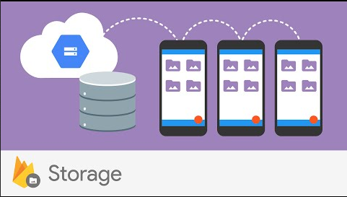
Firebase : Storage
Firebase Storage is a service to manage large contents such as images, audio, video and other files types.
The main reason that these type of data are not stored directly inside databases is the performance*.
You can upload new contents, download or delete existing files from storage.
Notes:
As database gets bigger, its performance reduces. Therefore, it is better to store large files (specially, if they are binary files and not text) outside DB and store their reference (e.g. path, link) inside DB . Also reading and writing large files is faster on file system than inside DB.

Slide 4
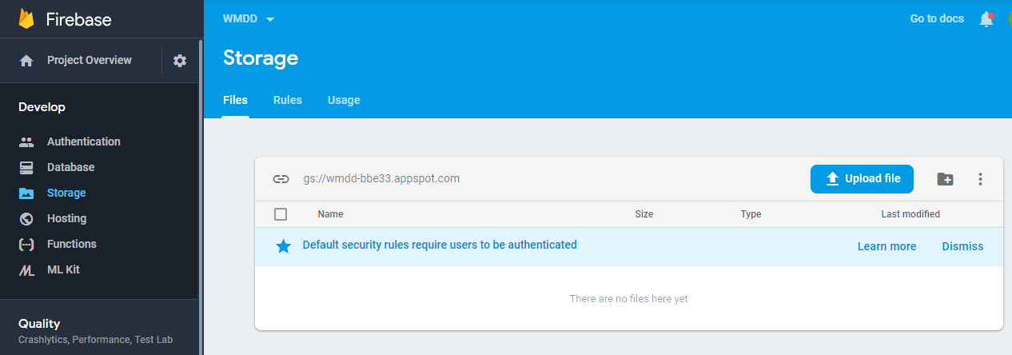
Firebase Dashboard : Storage
To access Firebase Storage from the Dashboard, click on “Storage” in the navigation menu in your Firebase project.
You can update Security Rules to control download & upload access (i.e., read and write)

Slide 5
Security Rules (for Storage)
By default, your rules allow all reads and writes from authenticated users.
service firebase.storage { // the service you want to control (storage)
match /b/{bucket}/o { // the bucket path to match for rule to apply.
match /{allPaths=**} { // the path pattern inside bucket for rule to apply.
// With this rule, only authenticated users can read AND write *
allow read, write: if request.auth != null;
}
}
}
Without proper permission a user will not be able to download or upload file.
This is recommended settings, but for development you can relax those security settings temporarily.
More at : https://firebase.google.com/docs/storage/security/start#sample-rules
https://firebase.google.com/docs/rules/basics#cloud-storage
https://firebase.google.com/docs/reference/security/storage
Notes:
*If you want to allow read to all but restrict write, then use:
match /{allPaths=**} {
allow read;
allow write: if request.auth != null;
}

Slide 6
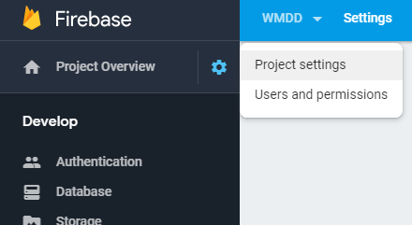

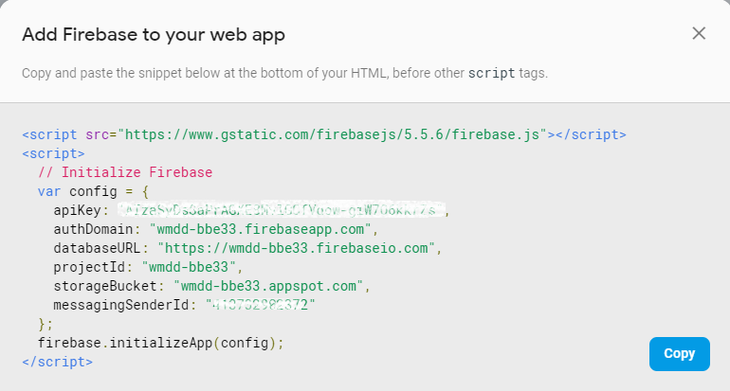

Firebase initialization and API Key
To use any of Firebase APIs (including Storage API) you need to load the Firebase library into your code and initialize it with your project ID and API Key.
Every Firebase project you create has a unique API Key that can be seen in your Project Settings
Firebase comes with a sample code on how to import & initialize it in a Web or Mobile app in the project settings page.
For web or hybrid apps simply click on icon and copy the code into your HTML page.
API key is not for security of your firebase services, although you shouldn’t share it publicly. In practice, you should setup proper access rules for each service. Which can be tied into authentication in your project
Notes:
Why API Key ? Because generally cloud services use it to identify and track your usage of their services
So they can cap your usage or ask you to pay.

Slide 7
Initializing Firebase (v.9+) (w. Module)
Here are the steps to import and initialize firebase in your application with module.
Load initializeApp from firebase-app module & needed functions from firebase-storage module in JavaScript client SDK e.g.
import { initializeApp } from "https://www.gstatic.com/firebasejs/9.12.1/firebase-app.js";
// Import the functions you need from the SDKs you need e.g.
import { getStorage, ref } from "https://www.gstatic.com/firebasejs/9.12.1/firebase-storage.js";
Then initialize the firebase with your project ID and API key e.g.
// copy paste from settings of your project page
const firebaseConfig = { apiKey: "..."
projectId: "..."
. . . };
const app = initializeApp( firebaseConfig ); // Initialize Firebase w. your project settings
app is a reference to your firebase project .
After above initialization you can use getStorage(app) to use Firebase Storage API w. default bucket in your code.

Slide 8
Firebase Storage API (v.9+) (w. Module)
Firebase Storage API provides functions to upload, download and delete files in Storage, after getting a reference to the storage service, e.g.
const storage = getStorage(app); // default bucket
//or if you want to open a custom bucket location
const storage = getStorage(app, "gs://my-custom-bucket"); // custom bucket*
You can create a storage reference to the storage root by calling ref() function. e.g.
const storageRef = ref(storage);
You can also create a reference further inside, by passing the relative path as second parameter to ref() function e.g.
const fileRef = ref(storage, "images/space.jpg" );
To upload a file, you need to import uploadBytes function as well as getStorage & ref from firebase-storage module.
Then you can call uploadBytes and pass the file reference as well as a blob** or file object as 2nd parameter. e.g.
const uploadTask = uploadBytes(fileRef, selectedFile );
uploadBytes function can also overwrite if a file already exists in the given path (i.e., if it’s not a new path)
Note that uploadBytes() method returns a Promise object.
More at : https://firebase.google.com/docs/storage/
Notes:
* https://firebase.google.com/docs/storage/web/start#use_multiple_storage_buckets
**Blob: “Binary Large Object.” In JavaScript, Blobs often represent binary data.

Slide 9
Example of file upload to Storage (v9+)
Here is a sample code, to upload a file into firebase storage. You need an HTML <input> element with type file to select a file from local device e.g., <input type="file" id="file1"> You also need another element (e.g., a button) to invoke the upload action after file selection.
(async () => { // async IIFE
try {
const storage = getStorage(app);
const fileRef = ref(storage, '/mybucket/'+ selectedFile.name);
const uploadTaskPromise = uploadBytes(fileRef , selectedFile ); //selectedFile comes from <file>
const snapshot = await uploadTaskPromise; // or we could use await directly with uploadBytes()
console.log('*** Uploaded a blob or file! : '+ snapshot.metadata.name );
console.log( snapshot.metadata );
const URL = await getDownloadURL(fileRef);
//ideally pass the URL to a UI element e.g., as src attribute of an <img> or <video>
} catch( err) {
console.log('failed to upload blob or file!' ,err);
};
})();
For more on Reference obj see: https://firebase.google.com/docs/reference/js/storage.storagereference

Slide 10
Firebase Storage : Metadata (v.9+)
Every uploaded file to Storage has some metadata (data about the uploaded content)
These metadata are available as part of the Promise object returned by uploadBytes() function ( e.g. snapshot.metadata in previous example ).
You can also access these metadata by calling getMetadata function (need to import it first) and pass a file reference as parameter.
Note that getMetadata() also returns a Promise object. e.g.
// Create a reference to the file whose metadata we want to retrieve
const fileRef = ref(storage ," path to an existing file in storage " );
// Get metadata properties
getMetadata(fileRef)
.then(( metadata ) => { /* the metadata of above path file name */})
.catch(( error ) => { /* handle any potential error occurred! */ });
More at : https://firebase.google.com/docs/storage/web/file-metadata

Slide 11
Firebase Storage : Delete (V.9+)
You can delete an existing file from storage using deleteObject function (once its reference is obtained using ref) and pass a file reference as parameter.
Note that deleteObject also returns a Promise object. e.g.
// Create a reference to the file whose metadata we want to retrieve
const fileRef = ref(storage, " path to an existing file in storage " );
// Get metadata properties
delete(fileRef)
.then( () => { /* file deleted successfully */})
.catch( (error) => { /* handle any error occurred during delete */ });
More at : https://firebase.google.com/docs/storage/web/delete-files

Slide 12
Exercise:
Login to Firebase console : https://console.firebase.google.com
Use the project you created earlier (e.g., “wmdd”)
Select Storage service and under “Rules” tab allow read/write access to all users (temporarily for testing purpose)
Create an HTML page with input file element and a button to invoke a JavaScript function that uses firebase storage API to upload selected file. (see slide 9 example)
Read the metadata of the file after successful upload and show on screen (see slide 10 example)
Later add authentication to your page and only allow authenticated users to upload file in the storage rules.

Slide 13
Firebase Storage : List Bucket Files
You can also list all files, in a given bucket location using listAll function
For details see: https://firebase.google.com/docs/storage/web/list-files
Similar to other functions, listAll also returns a promise.

Slide 14
References
https://firebase.google.com/docs/
https://firebase.google.com/docs/firestore/quickstart
https://firebase.google.com/docs/reference/js/firebase.storage
https://firebase.google.com/docs/storage/
https://firebase.google.com/docs/storage/web/start
https://github.com/firebase/quickstart-js/tree/master/storage

Slide 15
Older API
Following shows the older API of firebase (before version 9) that was not based on ES Module

Slide 16
Initializing Firebase (v.8-) (w.o. Module)
Here is a basic step to load and initialize firebase in your page.
Load firebase app and storage JavaScript libs as shown. (use latest version instead)*
<script src="https://www.gstatic.com/firebasejs/8.10.0/firebase-app.js"></script>
<script src="https://www.gstatic.com/firebasejs/8.10.0/firebase-storage.js"></script>
If you are going to use version 9+ , use the compatibility version for namespace approach. e.g.
<script src="https://www.gstatic.com/firebasejs/9.8.4/firebase-app-compat.js"></script>
<script src="https://www.gstatic.com/firebasejs/9.8.4/firebase-storage-compat.js"></script>
Initialize the firebase with your project and API key e.g.
<script>
const firebaseConfig = {
apiKey: "….. ",
...
messagingSenderId: "…."
};
firebase.initializeApp( firebaseConfig ); // Initialize Firebase
</script>
Then you can use firebase.storage() to access Storage API.
Notes:
If you are using version 9, you have option of namespace or module . If you want to use namespace then load the compatibility lib (add –compat.js to end of each file e.g. firebase-app-compat.js)

Slide 17
Firebase Storage API (v.8-) (w.o. Module)
Firebase Storage API provides options to upload, download and delete files in Storage.
After getting a reference to the storage service, e.g.
const storage = firebase.storage();
You need to create a storage reference by calling storage ref() method. e.g.
const storageRef = storage.ref();
Inside storageRef you can create a reference to each file using its relative path in storage e.g.
const fileRef = storageRef.child( "images/space.jpg" );
To upload a file, you call put() method of the file reference by passing a blob* or file object. e.g.
const uploadTask = fileRef.put( selectedFile );
put() method can also do overwrite if any file already exists in that path (if it’s not a new path)
Note that put() method returns a Promise object.
More at : https://firebase.google.com/docs/storage/
Notes:
Blob: “Binary Large Object.” In JavaScript, Blobs often represent binary data.

Slide 18
Example of file upload to Storage (V8-)
Here is a sample code to upload a file into firebase storage. You need an HTML <input> element with type file to select a file from local device e.g., <input type="file" id="file1"> You also need another element (e.g., a button) to invoke the upload action after file selection.
(async () => { // async IIFE
try {
const storage = firebase.storage();
const fileRef = storage.ref().child('/mybucket/'+ selectedFile.name);
const uploadTask = fileRef.put( selectedFile ); //selectedFile comes from file input element
const snapshot = await uploadTask;
console.log('*** Uploaded a blob or file! : '+ snapshot.state );
console.log( snapshot.metadata );
const URL = await fileRef.getDownloadURL();
//ideally pass the URL to a UI element e.g., as src attribute of an <img> or <video>
} catch( err) {
console.log('failed to upload blob or file!' ,err);
} );
})();
For more on Reference obj see: https://firebase.google.com/docs/reference/js/firebase.storage.Reference

Slide 19
Firebase Storage : Metadata (v.8-)
Every uploaded file into Storage has some metadata (data about the uploaded content)
These metadata are available as part of the Promise object returned by put() method ( e.g. snapshot.metadata in previous example ).
You can also access these metadata by calling getMetadata() on a file reference itself.
Note that getMetadata() also returns a Promise object. e.g.
// Create a reference to the file whose metadata we want to retrieve
const fileRef = storageRef.child( " path to an existing file in storage " );
// Get metadata properties
fileRef.getMetadata()
.then(( metadata ) => { /* the metadata of above path file name */})
.catch(( error ) => { /* handle any potential error occurred! */ });
More at : https://firebase.google.com/docs/storage/web/file-metadata

Slide 20
Firebase Storage : Delete (v.8-)
You can delete an exiting file from storage using delete() method of a file reference.
Note that delete() also returns a Promise object. e.g.
// Create a reference to the file whose metadata we want to retrieve
const fileRef = storageRef.child( " path to an existing file in storage " );
// Get metadata properties
fileRef.delete()
.then( () => { /* file deleted successfully */})
.catch( (error) => { /* handle any error occurred during delete */ });
More at : https://firebase.google.com/docs/storage/web/delete-files

