Slide 1
Apache
By Ivan Wong

Slide 2
Apache
In the open-source world, two web servers are currently in a neck-and-neck race: Apache and NGINX.
Apache is easier to configure and remains the first choice
NGINX is characterized by leaner code and stronger performance for static content.

Slide 3
Installation
A typical Apache installation consists of numerous related packages: the server itself, various libraries, plugins, programming languages, and so forth.
To make the installation easier for you, some distributions allow you to select a whole group of packages for installation.
In some cases, the most important MySQL and PHP packages are installed in addition to Apache:

Slide 4
Installation in Ubuntu
Ensure your system's package index is up to date:
sudo apt update
Install the Apache web server package using the apt command:
sudo apt install apache2
If you are using the Uncomplicated Firewall (UFW), you need to allow Apache traffic. Apache registers profiles with UFW during installation.
sudo ufw app list

Slide 5
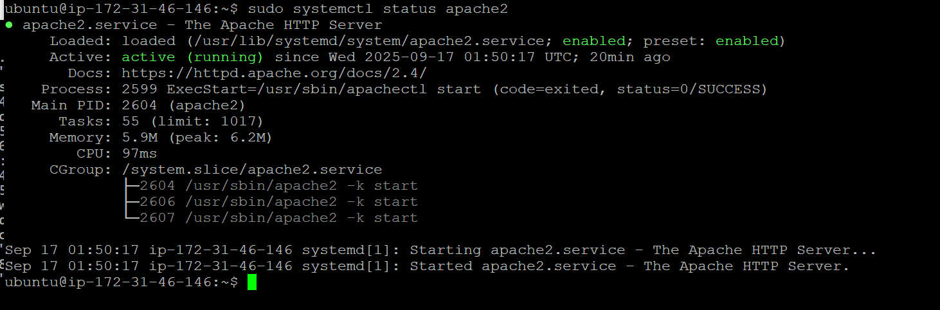
Installation in Ubuntu (Cont.)
sudo systemctl status httpd
Sllow the desired profile (e.g., "Apache Full" for both HTTP and HTTPS):
sudo ufw allow 'Apache Full'
Check the status of the Apache service to ensure it is running:
sudo systemctl status apache2

Slide 6
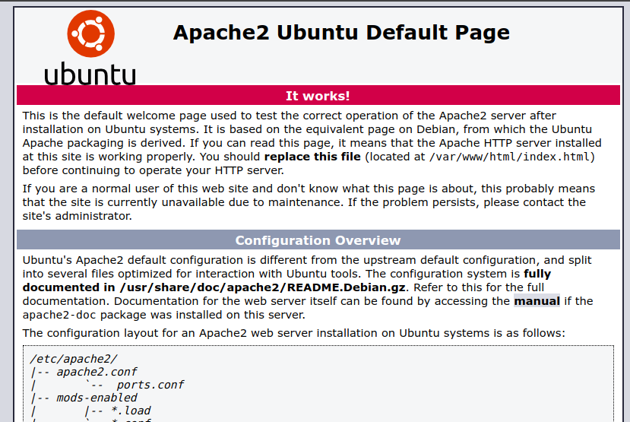
Access Your Web Server

Slide 7
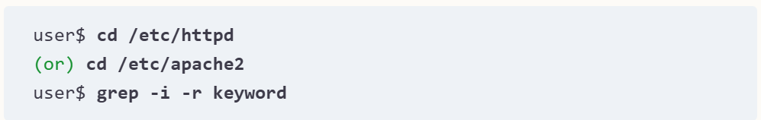
Configuration
Apache used to be configured using a single httpd.conf file, the exact location of which depended on the distribution.
This configuration file became more and more confusing over time.
For this reason, most distributions have moved to distributing the settings to various files that are read by include statements from various directories.
This makes each individual file clearer and enables automated maintenance—for example, activating or deactivating plugins through commands or scripts. If you are looking for a specific keyword in the configuration files, it is best to proceed as follows:

Slide 8
Configuration
On Debian/Ubuntu, the mods-available directory contains a collection of *.load and *.conf files for various Apache modules.
To enable additional modules, you need to set up links to these files in mods-enabled.
The Debian-specific a2enmod and a2dismod commands help you to manage the links.
You can use a2ensite and a2dissite to enable or disable virtual hosts.
By default, sites-available contains only the 000-default.conf and default-ssl.conf files: various basic settings for the /var/www directory can be found there.
The mechanism works in the same way as with the modules:
The sites-available directory contains the configuration files for all hosts, while sites-enabled contains the corresponding links.

Slide 9
Logrotate
Apache's logging files are among the fastest growing files on many servers.
That's why you need to take care of renaming, compressing, and finally deleting the logging files on a regular basis.
This is exactly the task performed by the logrotate program, which is usually installed by default on Linux servers.

Slide 10
Logrotate
The program is started once a day by Cron or by the systemd timer.
In the default configuration, it processes the /var/log/httpd/*.log (Fedora/RHEL) or /var/log/apache2/*.log (Debian/Ubuntu) Apache logging files once a week, renames them to name.nn, and compresses them.
The compressed files are archived for 52 weeks and then deleted.
If you define your own logging directories when configuring virtual hosts, you must modify the first line in the /etc/logrotate.d/apache2 configuration file to specify the locations of the additional logging files.

Slide 11
Access to User Home Directories
Enable the userdir module
sudo a2enmod userdir
Restart apache
sudo systemctl restart apache2
Create a new user to test
sudo adduser newuser
Switch to the new user
su newuser
[Note: You may ssh to the newuser: https://docs.aws.amazon.com/AWSEC2/latest/UserGuide/managing-users.html#create-user-account]

Slide 12
Access to User Home Directories
Now you are in the newuser account.
Create the directory public_html within their home directory and set appropriate permissions.
mkdir ~/public_html
chmod 755 ~/public_html
chmod 711 ~
Create index.html in ~/public_html
Test in your browser:
http://<your_ip>/~newuser/index.html

Slide 13
Reference
Kofler, M. (2025). Linux: The Comprehensive Guide. Packt Publishing Ltd.

Slide 14
Summary
Apache installation
How to set up and test the installation
User home directory
How to configure the home directory access
Logrotate
How to monitory the Webserver

