Slide 1
WMDD 4950 Security & Cloud & Server Administration
Modified by Ivan Wong
Created by Jason Madar

Slide 2
Why Learn DevOps / DevSecOps / SRE?
Modern Web / Mobile apps cannot run without proper infrastructure (back-end)
Services like heroku automates some common use-cases
Services like firebase provides generic backend functions

Slide 3
Deployment
You’ve built a great website / webapp
How do you “deploy” it? What does “deployment” mean?

Slide 4

Reliable Services
No matter how great your website/app is, at the end of the day, you still need to make sure users can access it.
Turns out making sites/apps available to users 24/7 is much harder than it seems.

Slide 5
DevOps
DevOps (a clipped compound of "development" and "operations") is a software development methodology that combines software development (Dev) with information technology operations (Ops). The goal of DevOps is to shorten the systems development life cycle while delivering features, fixes, and updates frequently in close alignment with business objectives
https://en.wikipedia.org/wiki/DevOps
https://www.contino.io/insights/devops-engineer-guide
Notes:
Want to talk about my own personal experience

Slide 6
Themes
Linux
Cloud Providers
Web server administration, HTTP
Authentication / Authorization Protocols and Frameworks
Security and Scalability

Slide 7
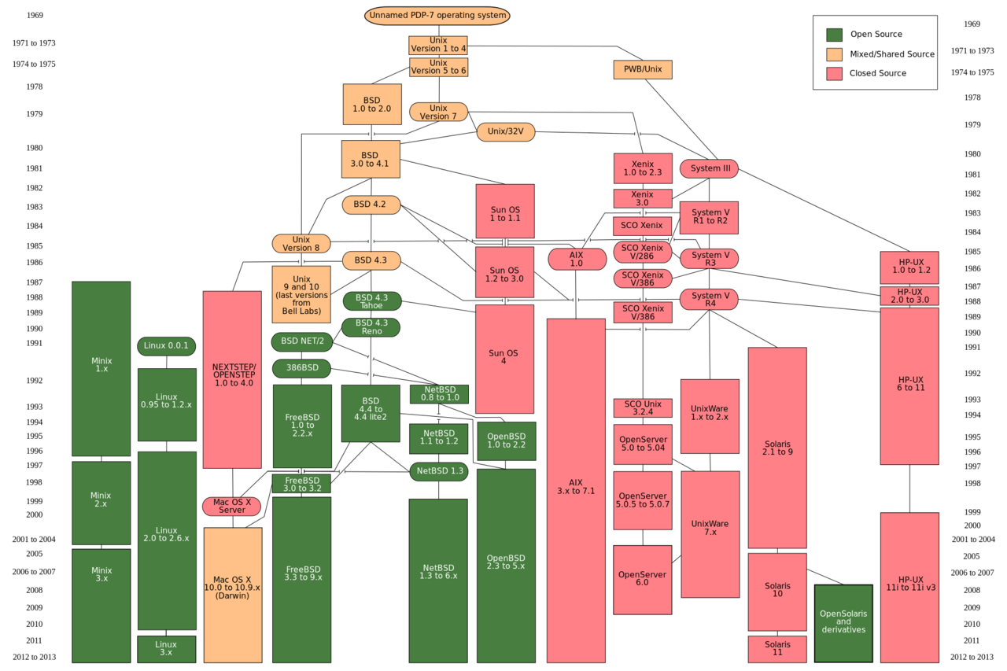

Slide 8
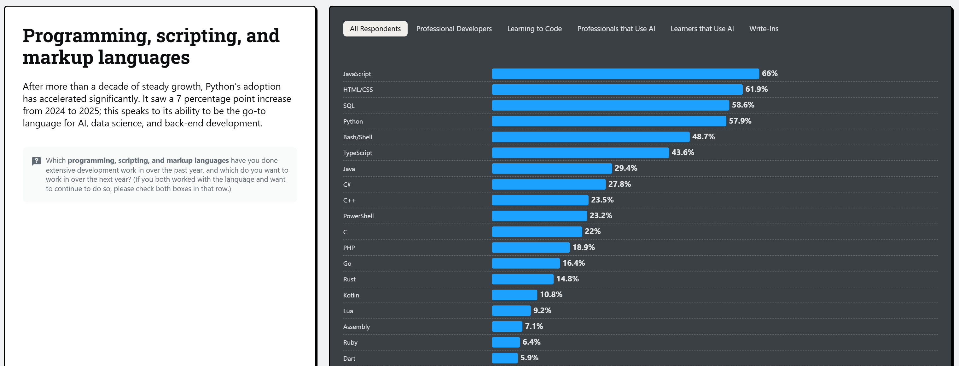
https://survey.stackoverflow.co/2025/technology

Slide 9
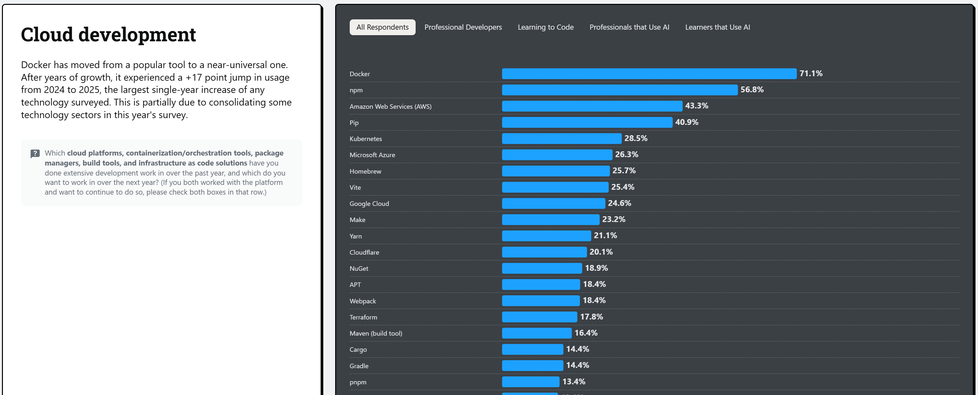

Slide 10
Evaluation
Assignments and Quizzes: 20%
1x Midterm Exam: 30%
1x Final Exam: 35%
Project: 15%
Can be done as part of your Capstone
Will need to detailed how you contributed to the infrastructure of the project
Alternatively, you can also undertake an individual project (take a previous app/webapp you created and deploy on your own server, add authentication, etc.).

Slide 11
How to get help
Class slack channel - feel free to help each other out
My office hours are online via Slack

