Slide 1
Introduction to Linux Operating System
By Ivan Wong

Slide 2
Objectives
Learn what an operating system is and how UNIX is different from other systems.
Understand the role of the system administrator.
Log in and out of a UNIX system.
Run a few commands that report on the system.
Use more commands to view processes and handle files and directories.
Find out how UNIX got steadily fragmented by the emergence of other flavors.
Understand the merging of POSIX and the Single UNIX Specification into a single UNIX standard.
Learn about the emergence of Linux as a strong, viable and free alternative.
Discover the UNIX architecture that includes the kernel and shell.
Discover the two key features—the file and process—that UNIX rests on.
Know the role of system calls in making programs work.
Learn the “do-one-thing-well” philosophy that UNIX uses to solve complex problems.

Slide 3
Why an Operating System (OS)
An operating system is the software that manages the computer’s hardware and provides a convenient and safe environment for running programs.
It acts as an interface between programs and the hardware resources that these programs access (like memory, hard disk and printer).
It is loaded into memory when a computer is booted and remains active as long as the machine is up.

Slide 4
Key Features of an Operating System
The operating system allocates memory for the program and loads the program to the allocated memory.
It also loads the CPU registers with control information related to the program.
The registers maintain the memory locations where each segment of a program is stored.
The instructions provided in the program are executed by the CPU.
The operating system keeps track of the instruction that was last executed. This enables it to resume a program if it had to be taken out of the CPU before it completed execution.
If the program needs to access the hardware, it makes a call to the operating system rather than attempting to do the job itself.
For instance, if the program needs to read a file on disk, the operating system directs the disk controller to open the file and make the data available to the program.
After the program has completed execution, the operating system cleans up the memory and registers and makes them available for the next program.

Slide 5
Running Multiple Programs
Multiprogramming
Multiple programs can be in memory.
Multiuser
Multiple users can run programs.
Multitasking
One user can run multiple programs.

Slide 6
The UNIX Operating System
UNIX is not written in assembler but in C.
C is a high-level language that was designed with portability considerations in mind, which explains why UNIX systems are available on practically every hardware platform.
Apart from handling the basic operating system functions, UNIX offers a host of applications that benefit users, programmers, and system administrators.
For programmers, UNIX offers a rich set of programming tools that aid in developing, debugging, and maintaining programs.
UNIX is also more easily maintained than most systems.

Slide 7
Kernel & Shell
Unix system is described as kernel & shell.
Kernel is a main program of Unix system. it controls hard wares, CPU, memory, hard disk, network card etc.
Shell is an interface between user and kernel. Shell interprets your input as commands and pass them to kernel.
User
input
Shell
Kernel

Slide 8
Kernel & Shell
One of these programs is the system’s command interpreter, called the shell.
You interact with a UNIX system through the shell. Key in a word, and the shell interprets it as a command to be executed.
A command may already exist on the system as one of several hundred native tools, or it could be one written by you.

Slide 9
Knowing Your Machine
Unlike Windows, UNIX can be used by several users concurrently.
In other words, a single copy of the operating system software installed on just one machine can serve the needs of hundreds of users.
Even though workstations and PCs run UNIX and can be used in standalone mode, they are often connected to a larger, more powerful computer in the same way terminals are.
The central computer is administered properly, and you might want to keep all of your valuable files there so they are backed up regularly.
You might want to use a powerful program that your workstation doesn’t have but the central computer does.
All of your incoming and outgoing mail is handled by the central machine, which may be your only link with the outside world, i.e., the Internet.

Slide 10
ASCII
When you press a key, the computer generates a character which represents the smallest piece of information that you can deal with.
It could be a letter, number, symbol, or control sequence (like [Ctrl-f]). The string 10:20 pm contains eight characters (one for the space). Every character is associated with a unique ASCII value (ASCII—American Standard Code for Information Interchange).
The letter A has the ASCII value of 65; the bang (!) has the value of 33. Both take up one byte (eight bits) each on your computer.
Many UNIX programs make use of these ASCII values.

Slide 11
The System Administrator
The administrator is responsible for the management of the entire setup. She allocates user accounts, maintains file systems, takes backups, manages disk space, and performs several other important functions. She is the person to be contacted in case of a genuine problem.
If you are not the administrator, you can use a UNIX machine only after she has opened an account with a user-id and password for your use.
The administrator uses a special user-id to log on to the system: it is called root.
The root user has near-absolute powers.
Some programs can only be run from this account—for instance, the program that creates the user account itself.

Slide 12
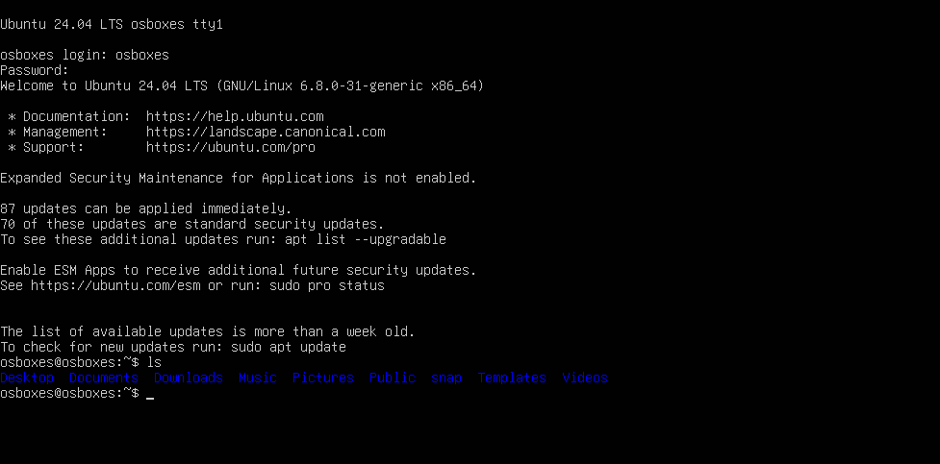
Logging In and Out

Slide 13
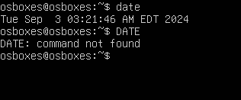
A Hands-On Session
When you key in a word, the system interprets it as a command to do something.
In most cases, the command signifies the execution of a program on disk that has the name you keyed in.
Unlike in DOS, where a command can be run in both lower- and uppercase, UNIX commands are generally in lowercase. Try using the date command, but use DATE instead of date:

Slide 14
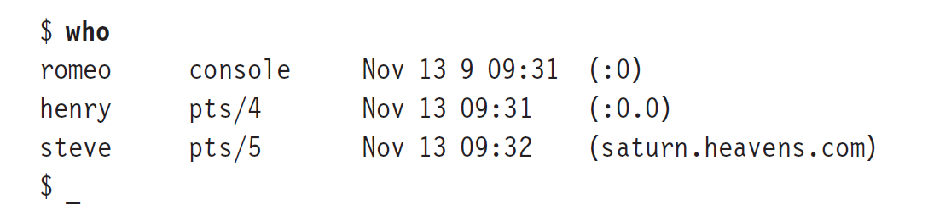
A Hands-On Session
Using who to View the List of Current Users UNIX can be used concurrently by multiple users, and you might be interested in knowing who is using the system when you are. Use the who command:

Slide 15
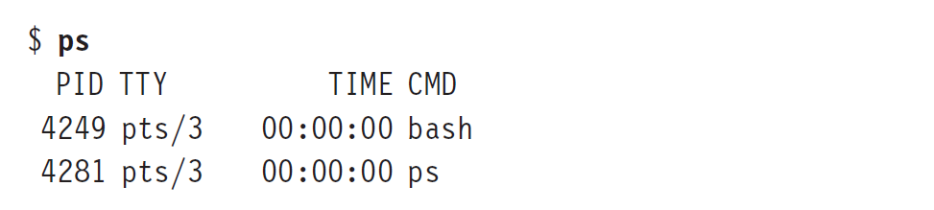
A Hands-On Session
Viewing Processes with ps
The process is a key component of any operating system, so let’s run a command that displays the processes running at our terminal.
The ps command does this job, and the following command shows that currently only one is running:

Slide 16
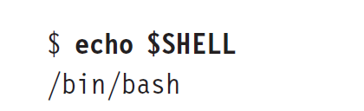
A Hands-On Session
Even though we are using the Bash shell here, you could be using another shell.
Instead of bash, you could see sh (the primitive Bourne shell), csh (C shell—still popular today) or ksh (Korn shell). To know the one that is running for you, use the echo command like this:

Slide 17
Handling Files
UNIX maintains all data in containers called files. These files are assigned names, and a group of filenames are held together in another separate file known as a directory.
Creating a File with echo:
echo date > foo
Displaying a File with cat
cat foo

Slide 18
Handling Files
Copying a File with cp
cp foo foo.sh
Displaying List of Filenames with ls
ls
Renaming a File with mv
mv foo.sh foo.shell
Removing a File with rm
rm foo.shell

Slide 19
Handling Directories
Creating a Directory with mkdir
mkdir scripts
ls -F marks directory with a /
ls –F
Copying a File to a Directory
cp foo scripts
Directory Navigation with pwd and cd
pwd

Slide 20
Handling Directories
Use the cd command to change our location to that directory
cd scripts
Remove an empty directory with rmdir
rmdir scripts
foo, which contains Unix command, is called a script. Run a script with sh
sh foo

Slide 21
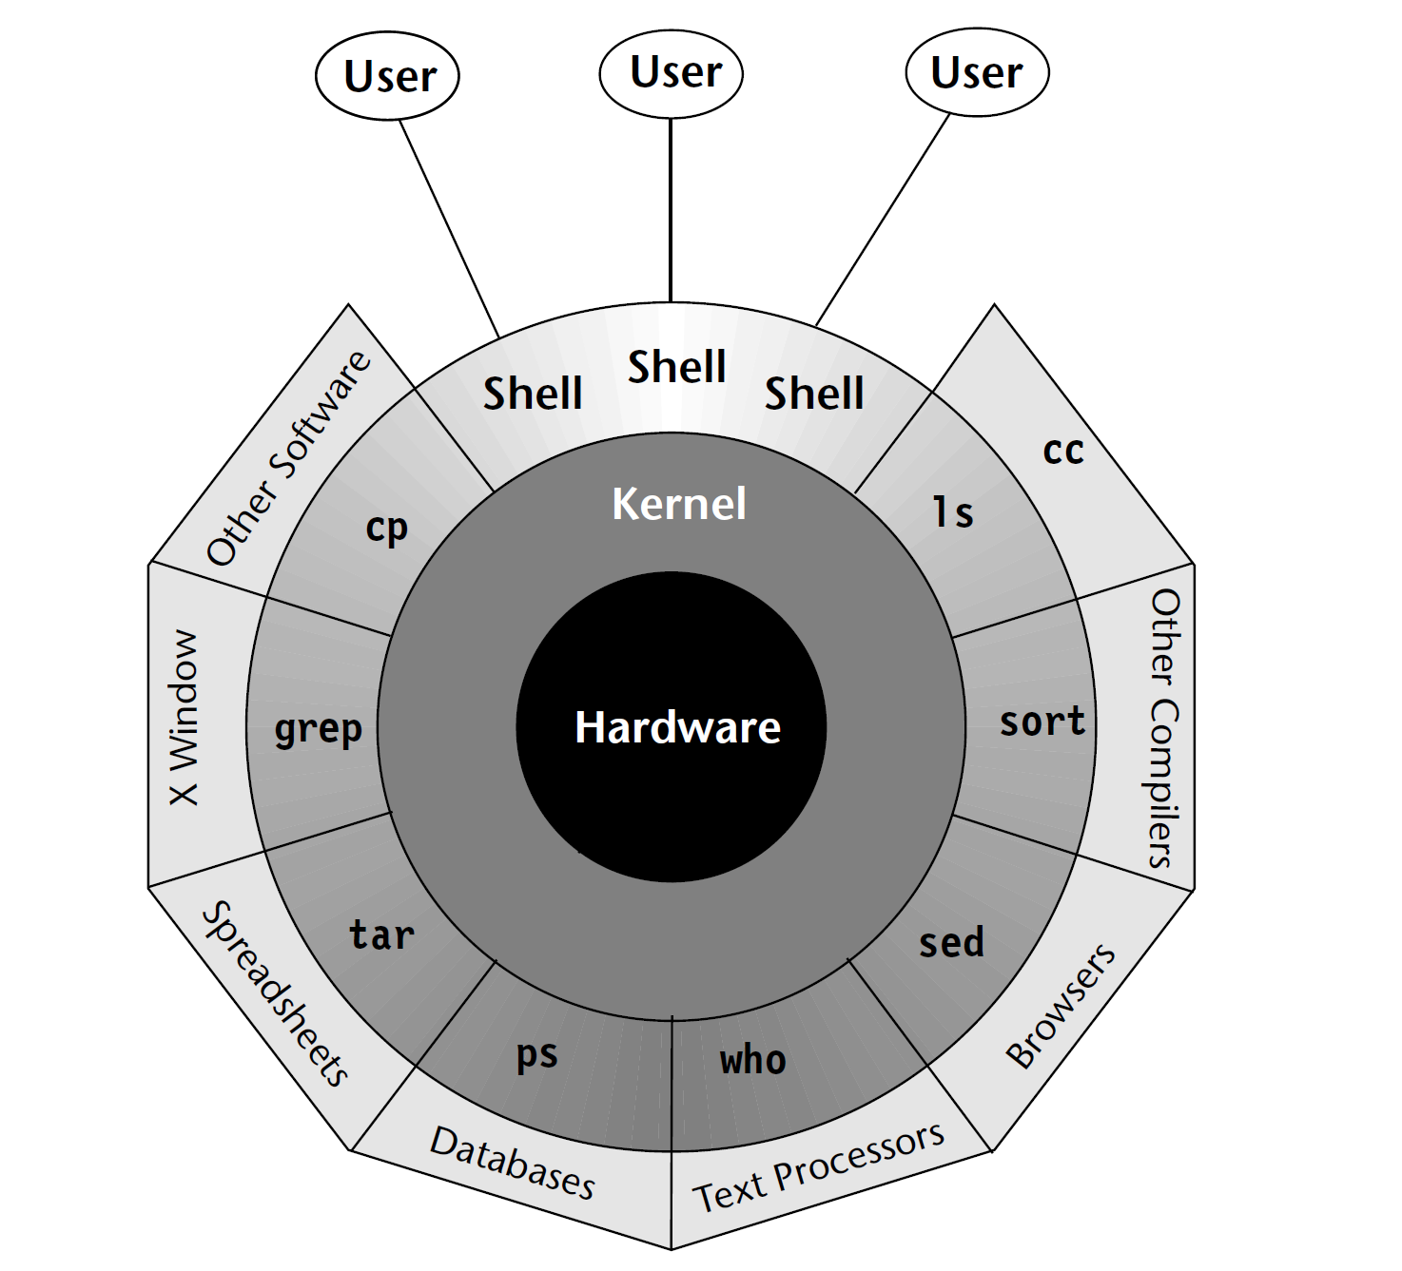
The Kernel-Shell Relationship

Slide 22
Summary
A computer needs an operating system (OS) to allocate memory, schedule programs, and control devices.
The UNIX system also provides a host of applications for the use of programmers and users.
You enter a UNIX system by entering a user-id and a password. You can terminate a session by using the exit or logout command or pressing [Ctrl-d].
UNIX commands are generally in lowercase.
Several commands to handle files/directories are discussed.

