Slide 1

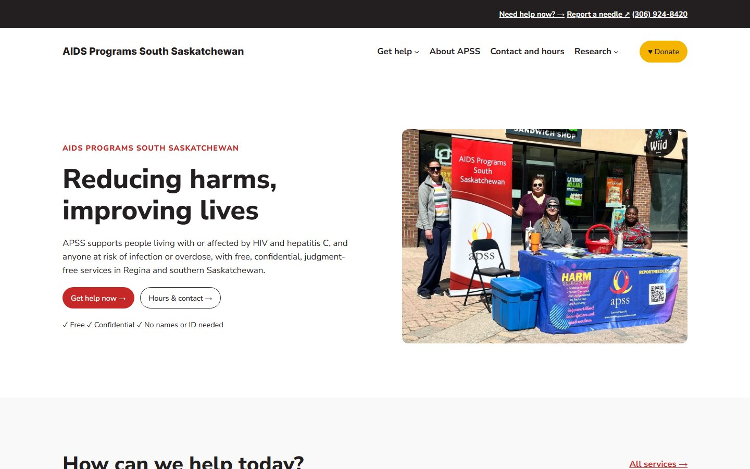
Our proposed
MVP is live
groupb.ursse.ca
ENSE 271 · Group B · Activity 3 check-in
Where we are, then your turn to try it
groupb.ursse.ca
Jacob Liu · Mohammed Saad Shaik
Aubin Chriss Izere · Jesse Ichibor
Wednesday, November 4, 2026

Slide 2
On schedule: our proposed MVP is live
Project status report · November 4, 2026
Status: Green
14
3
12
0
pages published
research update posts
photos and posters, all with alt text
broken internal links
Done in the past week
Planned for next week
WordPress site set up with APSS colours and font
Research section: projects, library, posters, updates
Main site: home, get help, needle exchange, about, contact, donate
Moved the research site link out of the top navbar and into the home page
Service details checked against the current APSS site
Apply today's feedback and write the customer notes
Test on phones and check accessibility
Choose a plugin to search and filter the library
Plan Education pages, FAQs, Volunteer and Events
ENSE 271 · Group B · APSS website work in progress
2 / 6

Slide 3
What is still open
Project status report
The library has search, but no filters yet
1
Phones and accessibility still need full testing
2
Education pages, FAQs, Volunteer and Events are not built
3
ENSE 271 · Group B · APSS website work in progress
3 / 6

Slide 4
How we made the site easy to use
What we learned in class
Links tell you what they do
→ keeps you on our site. ↗ opens another website.
Similar things look alike
Services and projects sit in matching cards, so you can scan a page instead of reading all of it.
You can see where you are
A short trail like "Get help › Needle exchange" shows where you are, and projects are marked Current or Completed.
Affordances and signifiers
Gestalt
Feedback
Help is always close
"Need help now?" and the phone number are at the top of every page, even the research pages.
We show how the work connects
Three simple steps: people report needles, researchers map them, and APSS brings services to those places.
Built with everyone in mind
Every photo has a written description for people using screen readers, and words are real text, not part of a picture.
End-to-end experience
Conceptual model
Accessibility
ENSE 271 · Group B · APSS website work in progress
4 / 6

Slide 5
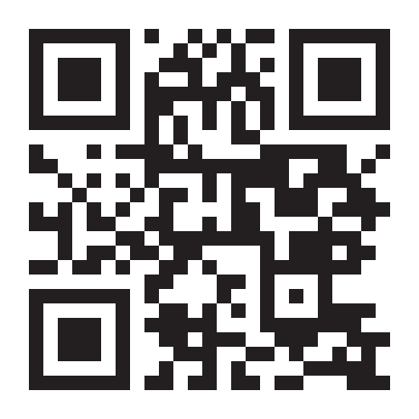
Try the site yourself
Your turn
2 minutes
Find the needle exchange hours
1
Find the latest research paper
2
Then click anything you like. Notice what is easy and what is not.
No phone? Open the site ↗
Scan with your phone camera
groupb.ursse.ca
ENSE 271 · Group B · APSS website work in progress
5 / 6

Slide 6
What do you think?
Your turn
What was hard to find, or what is missing?
1
What should we improve first before December 2?
2
What we are doing next: library filters, Education pages, FAQs, phone and accessibility testing
ENSE 271 · Group B · APSS website work in progress
6 / 6

