Slide 1

ENSE 271 · Group B · Checkpoint #2
APSS hi-fi prototype:
usability session
With Erin Hidlebaugh (AIDS Programs South Saskatchewan) and Dr. Tim Maciag
Wednesday, October 21, 2026 · 11:45 to 12:00
Jacob Liu · Mohammed Saad Shaik · Aubin Chriss Izere · Jesse Ichibor

Slide 2
How today works
Two tests at the same time, one shared screen
A
B
C
Erin tests on laptop A
Tim tests on laptop B
This screen
The prototype is already open on your laptop.
The prototype is already open on your laptop.
Shows each task and question so we all stay on the same step.
0:00
1:00
2:00
9:30
13:30
Welcome and how it works
A quick look at the site (about one minute, no tasks yet)
Six short tasks, about a minute each (four on the laptop, two on your phone)
Four quick questions
Thank you
ENSE 271 · Group B · APSS usability session
2 / 15

Slide 3
Before we start
We’re testing the design, not you
1
2
3
Think aloud as you go, and say “done” when you finish.
You can click but not type. Clicking a search box shows sample results.
Links that leave APSS open a grey stand-in page.
4
5
6
After each task, rate it from 1 (very hard) to 5 (very easy).
If something is hard, that’s ours to fix. There are no wrong answers.
We take notes only. Nothing is recorded on video or audio.
ENSE 271 · Group B · APSS usability session
3 / 15

Slide 4
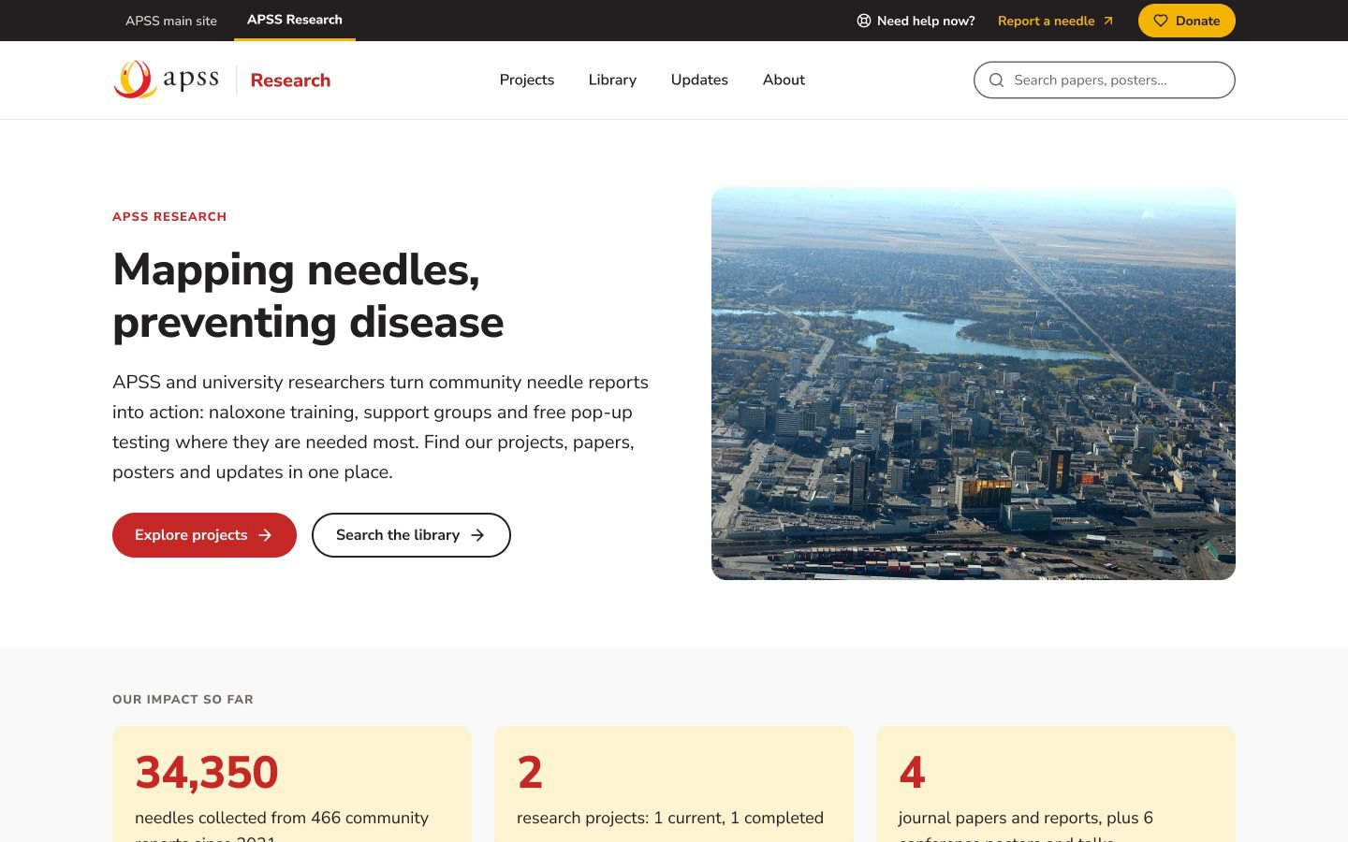
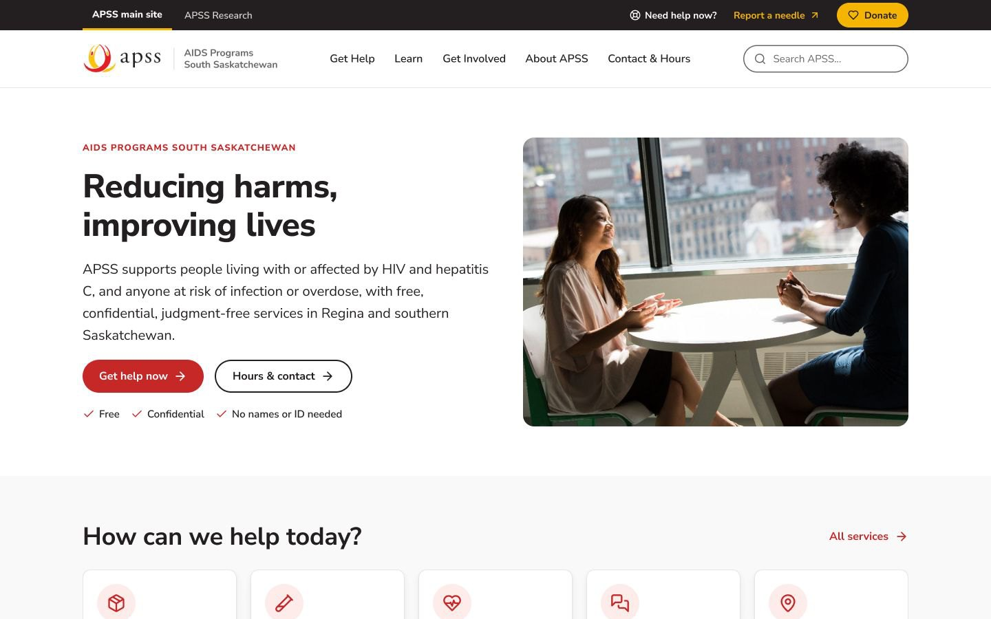
Before the tasks
APSS Research
A quick look
at the site
About one minute to look around. No tasks yet.
The research site, where most of today’s tasks happen
The main APSS site it links to
APSS main site
Open the research site
Open the main APSS site
ENSE 271 · Group B · APSS usability session
4 / 15

Slide 5
Task 1 of 6
On the laptop
“A funder asks which APSS research project is still running. Find it and tell us when it ends.”
Starts on
Open start screen
Research home
Say “done” when you finish, then rate the task from 1 (very hard) to 5 (very easy).
ENSE 271 · Group B · APSS usability session
5 / 15

Slide 6
Task 2 of 6
On the laptop
“You just saw a discarded needle in a park. Report it from here.”
Starts on
Open start screen
Mapping Needles, Reducing Harm (project page)
Say “done” when you finish, then rate the task from 1 (very hard) to 5 (very easy).
ENSE 271 · Group B · APSS usability session
6 / 15

Slide 7
Task 3 of 6
On the laptop
“You’d like to go to the next free pop-up testing event. Find out when and where it is.”
Starts on
Open start screen
Research home
Say “done” when you finish, then rate the task from 1 (very hard) to 5 (very easy).
ENSE 271 · Group B · APSS usability session
7 / 15

Slide 8
Task 4 of 6
On the laptop
“APSS published a paper in the Harm Reduction Journal in 2026. Find it and open it on the journal’s website.”
Starts on
Open start screen
Research home
Say “done” when you finish, then rate the task from 1 (very hard) to 5 (very easy).
ENSE 271 · Group B · APSS usability session
8 / 15

Slide 9
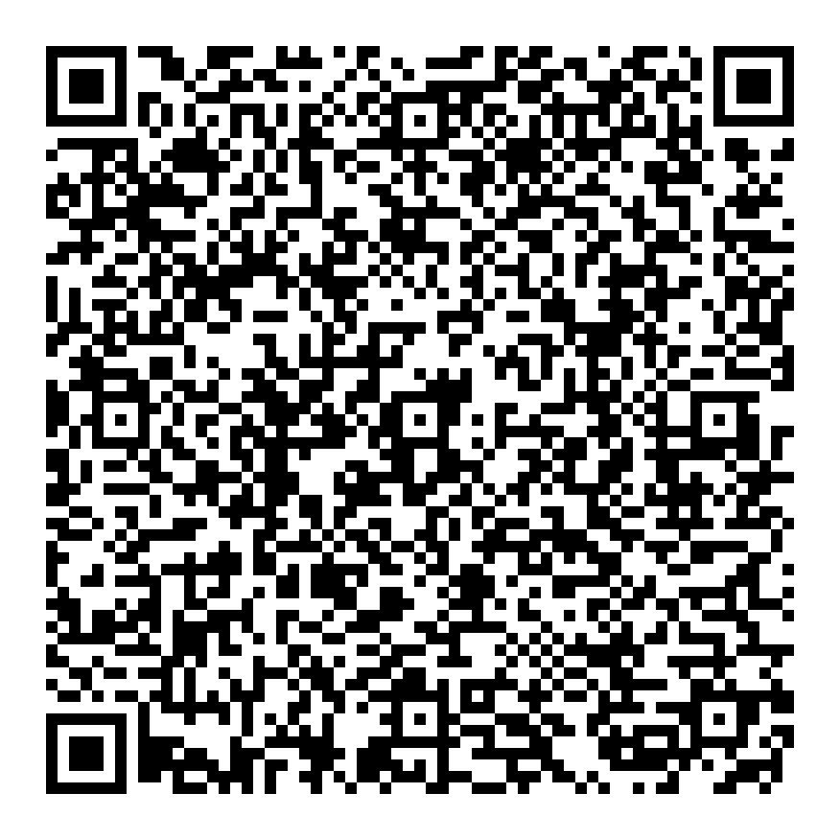
Task 5 of 6
On your phone
“On your phone, find the number to call APSS for help.”
1
Open your phone’s camera
2
Point it at the code
3
Tap the link that pops up
4
If a cookie notice covers the page, tap X
No phone? Open it on the laptop
Scan with your phone camera
Say “done” when you finish, then rate the task
from 1 (very hard) to 5 (very easy).
Opens a project page on your phone
ENSE 271 · Group B · APSS usability session
9 / 15

Slide 10
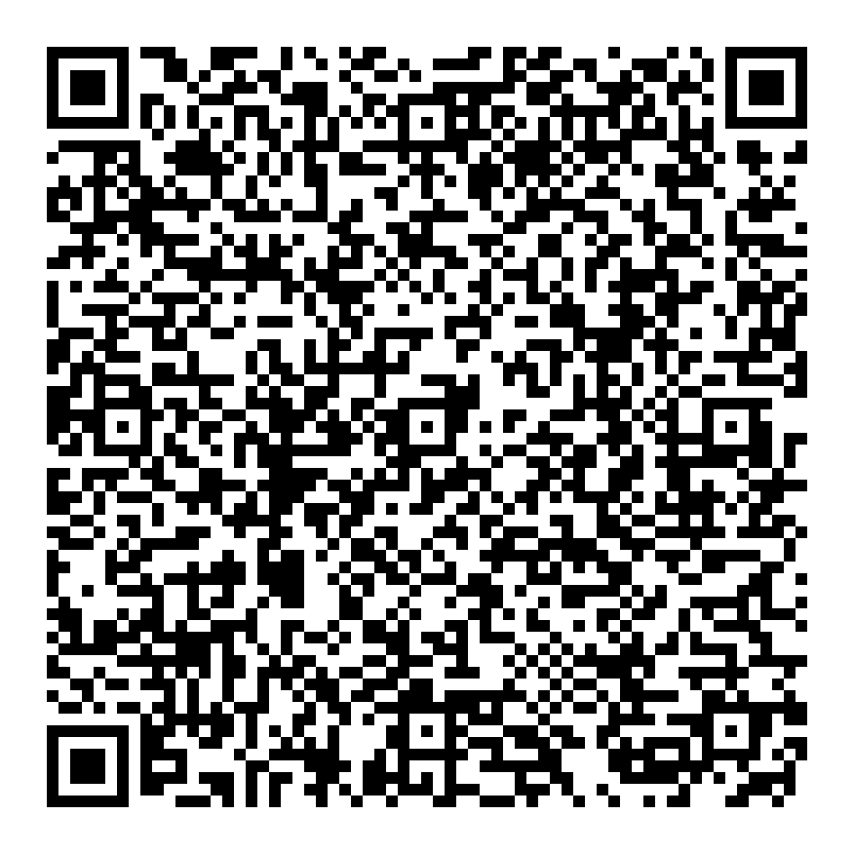
Task 6 of 6
On your phone
“On your phone, find out which days APSS is open, and what time it opens and closes.”
1
Open your phone’s camera
2
Point it at the code
3
Tap the link that pops up
4
If a cookie notice covers the page, tap X
No phone? Open it on the laptop
Scan with your phone camera
Say “done” when you finish, then rate the task
from 1 (very hard) to 5 (very easy).
Opens the APSS home page on your phone
ENSE 271 · Group B · APSS usability session
10 / 15

Slide 11
Question 1 of 4
What three words describe the research site? How does it compare with the current research page?
ENSE 271 · Group B · APSS usability session
11 / 15

Slide 12
Question 2 of 4
Was anything you expected to click not clickable, or did anything take you somewhere unexpected?
ENSE 271 · Group B · APSS usability session
12 / 15

Slide 13
Question 3 of 4
One site or two?
A
B
One combined site
Two linked sites
Research is a section inside the main APSS website.
A separate research site, linked from the main APSS site. This is what you just tested.
Which would work better for APSS and the people who use it?
ENSE 271 · Group B · APSS usability session
13 / 15

Slide 14
Question 4 of 4
Are there any improvements you would suggest? What are they?
ENSE 271 · Group B · APSS usability session
14 / 15

Slide 15
ENSE 271 · Group B
Thank you, Erin and Tim

