Slide 1

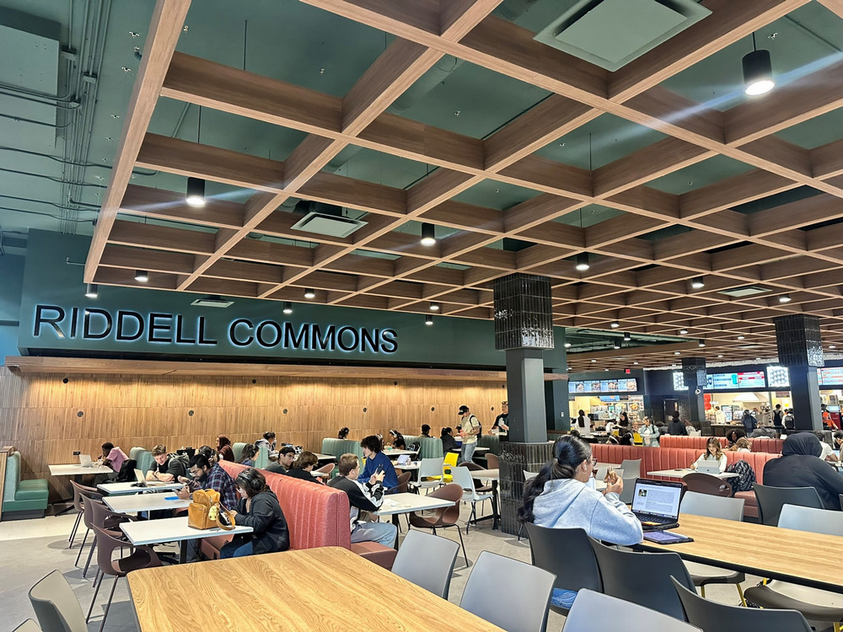
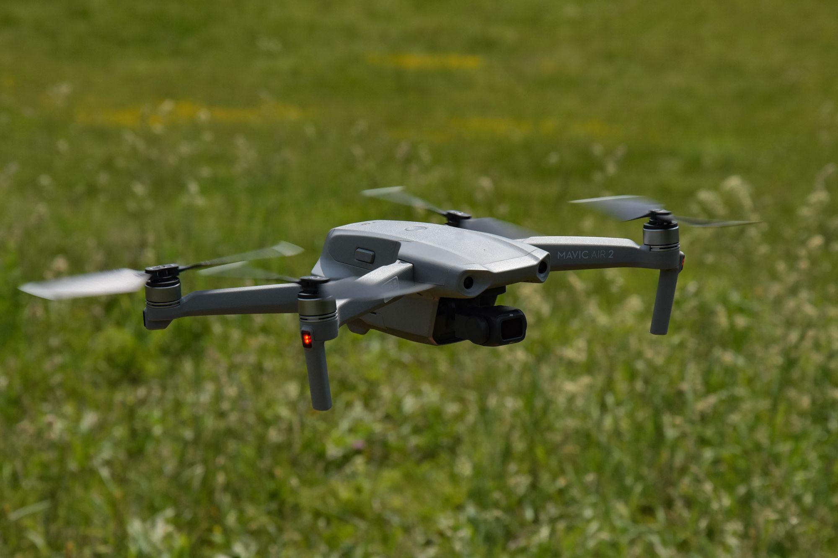
ENSE 400 / FINAL PITCH
AI Learning Environment
Study help on the page you’re reading
A desktop app that explains the course PDF you’re reading, shows the page each answer came from and makes flashcards and quizzes from it.
Software Systems Engineering capstone, University of Regina
Aubin Chriss Izere / 200490675
Chop Kur / 200497265
October 13, 2026
Cultivator HQ
Notes:
Aubin. Target 15 seconds.
Hi, I’m Aubin and this is Chop. Our capstone is the AI Learning Environment: a desktop app that explains the course PDF you’re reading, shows you the page each answer came from, and makes flashcards and quizzes from it.
Whole pitch: about 4 minutes, so we stay inside the 5-minute limit.
Sources and photo credits:
Student photo: Charlotte May / Pexels. https://www.pexels.com/photo/multiracial-students-with-tablet-and-laptop-5965678/

Slide 2

Studying with AI still starts with an upload
WHY
Student interview: Linda
SETUP, EVERY SESSION
Files are uploaded and the course explained again.
“Asking ChatGPT questions can feel awkward when I have to upload files for context. It would be smoother if it could see the file I am studying and explain it.”
ANSWERS YOU CAN’T CHECK
Answers don’t point back to the page they came from.
Linda, U of R student
PRACTICE BY HAND
Interview summary, paraphrased from team notes
Flashcards and quizzes are made in another app.
Built for university students who study from course PDFs, starting at the U of R
Illustrative photo, not Linda: Charlotte May / Pexels
2
Notes:
Aubin. Target 50 seconds.
This started with an interview with Linda, a U of R student. She already studies with ChatGPT, but before she gets any help she has to upload her files and explain what she’s looking at. Chop and I study the same way, so we know this problem well.
Three things get in the way. Setup: the same files get uploaded and the course explained again every session. Trust: the answer doesn’t point back to a page, so you can’t check it. Practice: flashcards and quizzes are made by hand in another app, so most students skip them until exam time.
We’re building this for university students who study from course PDFs, starting here at the U of R.
Sources and photo credits:
Linda interview summary from team notes. The quote is a paraphrase, not a verbatim transcript.
Illustrative photo, not Linda: Charlotte May / Pexels. https://www.pexels.com/photo/faceless-woman-using-tablet-in-campus-5965545/

Slide 3
From the page to practice, in one app
WHAT + HOW
How a study session works
Your course folders
PDFs on your laptop
Open a PDF
Select a page or passage
Ask a question
Answer with its page number
You choose which
folders it can see
Plan review
Before each exam
Practise
Flashcards and a quiz
Your files stay on your laptop. Only the passage you select goes to the AI.
Desktop app for Windows and macOS first. iPad version in winter 2027.
3
Notes:
Aubin. Target 45 seconds.
Here’s a study session in our app. You add the course folders already on your laptop. You open a PDF and select a passage or a whole page. You ask a question, and the answer comes back with the file and page number. Click it and you’re on that page, so checking an answer takes one click.
From the same passage, the app makes flashcards and a short quiz. In the winter release it also plans your review before each exam.
Your files never leave your laptop. Only the passage you select is sent to the AI model. We start on Windows and macOS, and the iPad version comes in winter.
Sources:
Project Requirements and User Story Map (Workshop 3).

Slide 4
What makes it different
VALUE + STRATEGY
Existing tool | What it does well | What’s missing
NotebookLM | Cited answers, quizzes and flashcards | Every file has to be uploaded first
Adobe Acrobat AI | Questions about a PDF, with citations | One file at a time, no practice
ChatGPT and Gemini | Strong explanations, free to start | Context set up again every session
Anki and Quizlet | Proven spaced repetition | Cards made by hand, no explanations
OUR UNIQUE VALUE
Explains the page you’re reading, cites it and turns it into practice
Strategy: win on setup time, not raw answer quality. No uploads and no re-explaining the course.
4
Notes:
Chop. Target 45 seconds.
Students already have good tools, and each one does part of the job. NotebookLM gives cited answers and quizzes, but every file has to be uploaded first. Acrobat answers questions about one PDF at a time and has no practice. ChatGPT and Gemini explain well, but you set up the context again every session. Anki and Quizlet work for review, but you make every card by hand.
Our unique value: it explains the page you’re reading, cites it and turns it into practice, straight from your own files. We’re not trying to beat these tools on answer quality. We win on setup time.
Sources:
Competitor Analysis (Workshop 1) and Business Case (Workshop 3).

Slide 5
Free to start, Pro pays for itself
BUSINESS MODEL
MODEL PICKER
Free
$0 for every student
One course
Explanations, flashcards and quizzes
Free AI models
Weekly usage limit
Pro
Monthly or per term
Paid AI models for explanations
Unlimited courses
Voice input, iPad and planned review
Monthly usage limit
Cost of one explanation, cheapest first
Model | Cost
Free model (default) | $0
Claude Haiku 4.5 | about 0.5¢
Claude Sonnet 5.5 | about 1¢
Claude Opus 5.5 | about 2.5¢
Paid models unlock with Pro.
Self-funded: up to US$150 over two terms. Free-tier requests cost us nothing.
5
Notes:
Chop. Target 45 seconds.
It’s a freemium model. The free tier runs on free AI models, like the Gemini free tier, Groq and OpenRouter, so students start at no cost and each request costs us nothing.
Pro is a monthly or per-term subscription. It unlocks paid models in the model picker, sorted from cheapest to most expensive, so students choose their own trade-off. One explanation costs us about half a cent on Haiku and about two and a half cents on Opus, and a monthly usage limit keeps every Pro plan covered by what the student pays.
We’re self-funded, with a budget of up to 150 US dollars over the two terms.
Sources:
Business Model Analysis (Workshop 2), Business Case and Project Charter (Workshop 3). Costs at current Claude prices per million input / output tokens: Haiku 4.5 US$1 / US$5, Sonnet 5.5 US$2 / US$10, Opus 5.5 US$4 / US$20.

Slide 6
What we will deliver, and when
NEXT STEPS
Oct 20
Nov 24
Dec 1
Apr 2027
PROTOTYPE
DEMO
RELEASE 1
RELEASE 2
Prototypes tested with at least 5 students.
Work-in-progress demo at bazaar day.
Reader, cited explanations, model picker, flashcards and quizzes.
Accounts and Pro, review before exams, voice input and iPad. Pilot with 15 students.
MINIMUM TARGETS
85%
50%
20%
of answers accurate to the page
less time to a useful answer than uploading to a chatbot
of pilot students would pay for Pro
6
Notes:
Chop. Target 40 seconds.
Next week, on October 20, we test our low- and high-fidelity prototypes with at least five students. We show a work-in-progress demo at bazaar day on November 24, and Release 1 ships on December 1 with the reader, cited explanations, the model picker, flashcards and quizzes. In the winter we add accounts and Pro, review before exams, voice input and the iPad version, then run a pilot with 15 students.
We hold ourselves to three numbers: at least 85% of answers accurate to the page, a first useful answer in at least half the time it takes with a chatbot, and at least 20% of pilot students saying they’d pay for Pro.
Sources:
Project Charter objectives and KPIs, Milestone-Based Schedule (Workshop 3). Winter dates are tentative.

Slide 7
Any questions?
Aubin Chriss Izere / 200490675
Chop Kur / 200497265
https://github.com/Binborg1/Final-2027.git
Notes:
Both. Thank you. Open the floor for questions.
Likely questions:
Isn’t this NotebookLM? NotebookLM needs every file uploaded into a notebook. We work from the folders already on your laptop, on the page you’re reading, and build practice from that passage.
What gets sent to the AI? Only the selected text, its page number, the file name and the question. Files are never uploaded or stored on a server. Before first use, the app says which provider gets the text and whether that provider may use it to improve its models.
What if the free AI tiers change? The AI layer works with any model, so we can switch providers. If one free provider fails, the app retries on another.
How much will Pro cost? Not set yet. We test willingness to pay in the winter pilot. Monthly usage limits stop the most expensive models from costing more than a subscription brings in.
What about copyright? Course files stay on the student’s device. We send only the selected passage and never store or share course files.
Why desktop first? Students study on laptops, and two people can deliver one platform well this term. The iPad version follows in winter.
Any other revenue? Campus or department licences are an option for later. We are not building that during the capstone.

