Slide 1
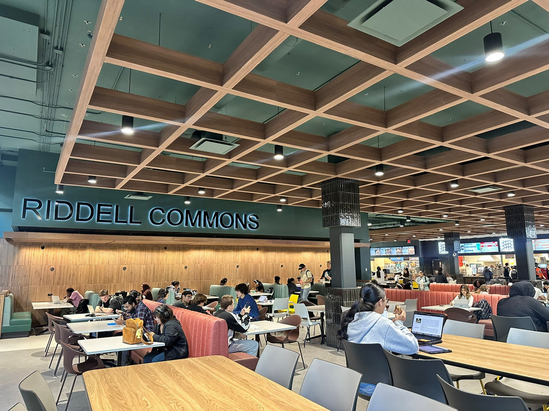

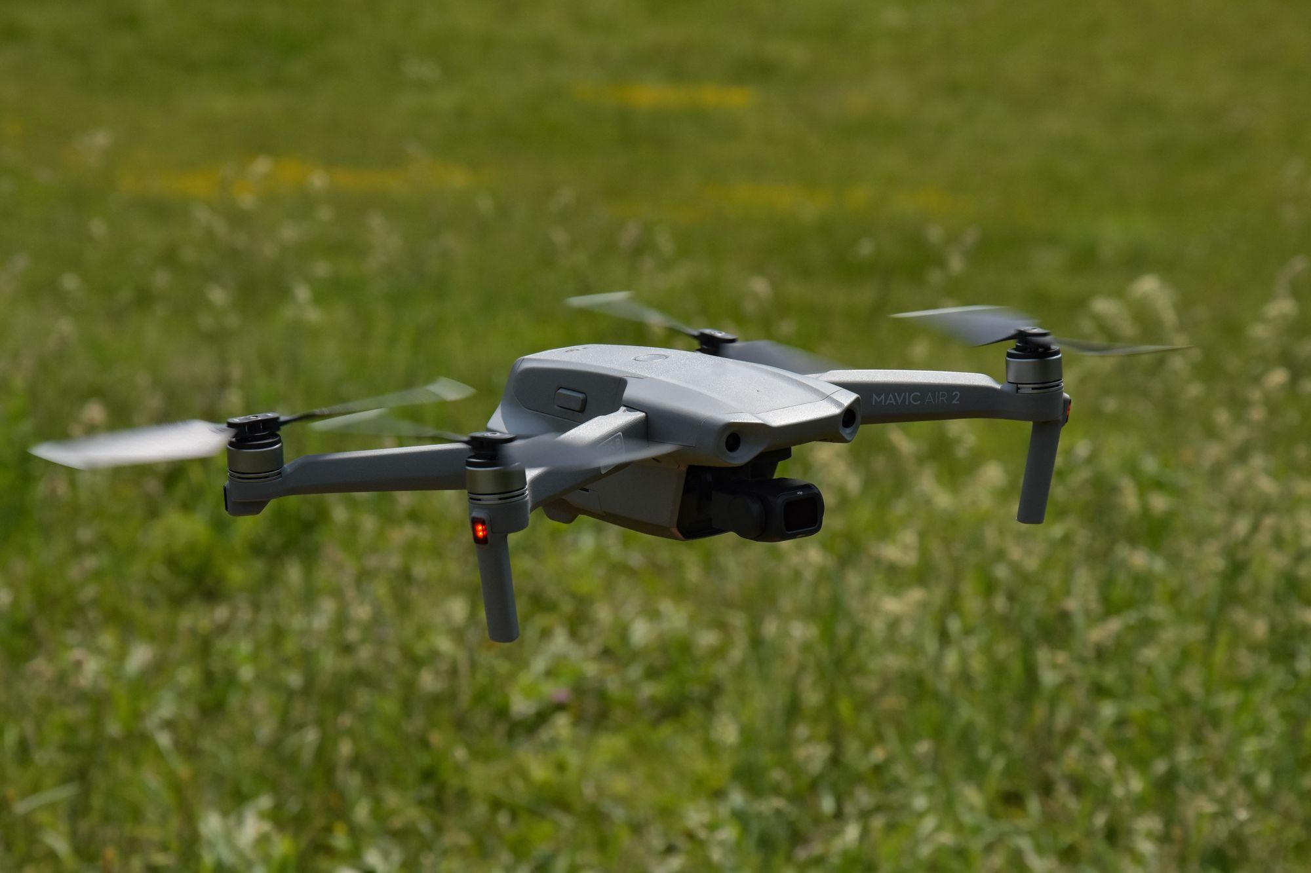
ENSE 400 / PROJECT PITCHES
Three ideas. One capstone.
uofrEats
AI Learning Environment
AI-Assisted Drones
Campus ordering and pickup
Learning with your course files
Crop scouting and fire detection
Aubin Chriss Izere / 200490675
Chop Kur / 200497265
September 15, 2026
Research phase
Notes:
Aubin. Target 25 seconds.
We are Aubin Chriss Izere and Chop Kur. These are our three capstone alternatives: campus food ordering, a student-designed AI learning environment, and AI-assisted drones for crop scouting and fire detection. We are in the research phase. For each idea we will explain the problem, the people, the proposed experience and what we need to test.
Sources and photo credits:
Riddell Commons photo: University Communications & Marketing. https://www.uregina.ca/stories/2025/09/so-many-options-find-your-new-favourite-spot-on-campus.html
Student photo: Charlotte May / Pexels. https://www.pexels.com/photo/multiracial-students-with-tablet-and-laptop-5965678/
Drone photo: Will S. / Pexels. https://www.pexels.com/photo/close-up-shot-of-a-flying-drone-8170183/

Slide 2
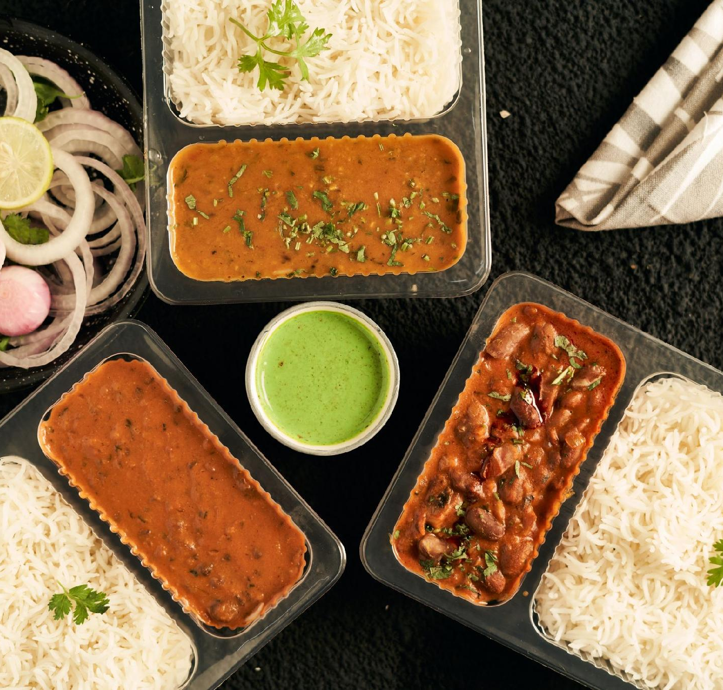
What is uofrEats?
DEFINITION + WHY
A campus food-ordering platform
Students order from campus vendors, pay per order and choose an available pickup time.
WHY THIS PROBLEM?
Students have short breaks. Long ordering lines can cost them a meal and cost vendors a sale.
Campus pickup designed around class breaks. No meal plan required.
Illustrative food photo: dhiraj jain / Pexels
2
Notes:
Aubin. Target 40 seconds.
uofrEats is a proposed campus food-ordering platform for the University of Regina. Students would scan a campus QR code, choose a vendor, pay for an order and select an available pickup time. Limited breaks and uncertain queues can make students walk away, costing the restaurant a purchase. We want a pickup experience for students who commute and pay as they go, as well as residents. A meal plan would not be required.
Sources and photo credits:
Project definition and problem from team discussions and Manmeet interview.
Illustrative takeaway food: dhiraj jain / Pexels. https://www.pexels.com/photo/ready-made-indian-meals-12737920/

Slide 3

Who is uofrEats for?
WHO
First people interviewed: restaurant owners/managers and students
“During peak rush hours, some students leave without buying food because the line is too long.”
STUDENTS
Commuters and residents
who need food between classes
RESTAURANT TEAMS
Manmeet, Da India Curry House Xpress manager
Owners, managers and staff
handling the lunch rush
Interview summary, paraphrased from team notes
Illustrative queue photo: Vitaly Gariev / Pexels
3
Notes:
Aubin. Target 45 seconds.
Our first conversations focused on restaurant management and students, the two sides of this service. Manmeet, associated with Da India Curry House Xpress, described students leaving because of the queue during peak hours. His quote here is a paraphrase of our interview notes. Students need predictability during a short break, while staff need an order flow they can manage without becoming overloaded. The earlier shared notes record willingness to try a pilot, with operating details still to be agreed. We will involve campus Food Services as we investigate a pilot. Contact from the team: uofr@dishsk.ca.
Sources and photo credits:
First-interview groups supplied in the latest user request. Named quote is from Manmeet, a manager. No additional student food-ordering quote was supplied.
Earlier pilot willingness recorded on pages 22-23 of the team-supplied Defence Drone Pitch Structure.pdf.
Illustrative photo, not the interviewed restaurant: Vitaly Gariev / Pexels. https://www.pexels.com/photo/queue-of-diverse-customers-waiting-in-modern-cafe-36729753/

Slide 4
Two interfaces, two experiences
WHAT + HOW
1. Student interface: order and collect
Scan campus QR
Choose vendor
and food
Select available
pickup time
Pay and track
order status
Collect when
ready
2. Vendor interface: manage preparation
Card payment routing
uofrEats
order service
Vendor dashboard
Accept / prepare / ready
Stripe
Connect
Vendor
connected account
Orders and status updates
Restaurant receives funds
Pickup capacity follows the kitchen. Ordering ahead must not overload it.
4
Notes:
Aubin. Target 50 seconds.
The proposal has two interfaces and two experiences. The student interface handles browsing, ordering, pickup-time selection, payment and status tracking. The vendor interface handles incoming orders and preparation. Staff can accept an order, mark it preparing, and mark it ready. Pickup slots need to match the kitchen capacity. Vendors would connect a Stripe account so card payments route through their connected account. We must design payment confirmation, acceptance and refunds together. The first demonstration can use one vendor and test payments before any live transactions.
Sources and photo credits:
Proposed architecture and workflow, not an existing implementation.
Stripe Connect account onboarding and payment routing: https://docs.stripe.com/connect/how-connect-works

Slide 5
uofrEats value and competitors
VALUE + STRATEGY
Selected comparison | Existing experience | uofrEats proposed focus
UofR Dining / UR OneCard | Dining information and prepaid meal-plan payments | Order and pay per purchase, including students without meal plans
Uber Eats | Many local restaurants, delivery and scheduled pickup | A campus-only vendor view shaped around class breaks and kitchen capacity
PROPOSED UNIQUE VALUE
One campus ordering space, with pickup capacity controlled by each vendor
Strategy: start with one vendor, test pickup reliability, then expand campus coverage.
Coverage check: the campus curry outlet is on Uber Eats. Other outlets need verification.
5
Notes:
Aubin. Target 45 seconds.
Our selected comparisons are UofR Dining and UR OneCard, and Uber Eats. OneCard is a prepaid meal-plan account and is mandatory for certain dorm residents. We have not verified that commuters are excluded, so our point is that uofrEats would let students order without buying a meal plan. Campus vendors already accept regular card or cash payments. Uber Eats serves a broader restaurant market and already supports scheduled pickup. The campus Da India Curry outlet is listed there. Our research will test whether a campus-only view, vendor-controlled pickup capacity and close local collaboration improve the experience. We still need to map coverage vendor by vendor.
Sources and photo credits:
https://www.uregina.ca/foodservices/residence-meal-plans.html
https://www.uregina.ca/foodservices/where-to-eat.html
https://help.uber.com/en-AU/merchants-and-restaurants/article/preguntas-frecuentes-de-los-restaurantes-sobre-los-pedidos-%E2%80%9Cpara-llevar?nodeId=e19f6abb-20c7-4768-99a0-69c27efd00cb
https://www.ubereats.com/ca/store/da-india-curry-xpress-university-of-regina/g7os2NJKVTip6tjqQl9CeQ

Slide 6
uofrEats research phases
HOW / PDSA
01
02
03
04
PLAN
DO
STUDY
ACT
Interview students and map Manmeet's peak-hour workflow.
Test an ordering prototype and a vendor order screen.
Compare pickup wait, readiness and staff handling time.
Adjust slot capacity, order acceptance and pickup details.
QUESTION TO TEST
Can scheduled orders reduce waiting without increasing staff workload?
First prototype
One vendor, short menu, pickup slots, test payments and order status.
6
Notes:
Aubin. Target 45 seconds.
Our first phase is to observe how orders move through the restaurant and interview students about their time between classes. Then we will test a clickable workflow with Manmeet and a small set of students. We will study where people get stuck before building the full system. If we later run a pilot, we will compare pickup waiting time, on-time readiness and staff handling time against a baseline. We would also observe purchase walkaways where practical. Those are proposed measures, not results. The first prototype is deliberately limited to one vendor, a short menu and test payments.

Slide 7

AI Learning Environment
DEFINITION + WHY
A student-designed learning workspace
Learn from your local course files through explanations, conversation, practice and planned review.
WHY THIS PROBLEM?
Repeated uploads and switching between tools can interrupt a study session.
Goal: a smoother path from reading a PDF to understanding the concept
Illustrative study photo: Yan Krukau / Pexels
7
Notes:
Chop. Target 40 seconds.
Our second alternative is a student-designed learning workspace for desktop and iPad. Students keep their course files in local folders and use a learning environment that understands the material they choose to open. The goal is to connect explanation, conversation, practice and review. We want to reduce the effort of uploading context and switching tools while a student is trying to learn. Existing applications already have AI PDF features, so our research must demonstrate a better study experience and useful learning support, not just another chat panel.
Sources and photo credits:
Problem and proposed definition from team discussions and the Linda interview.
Illustrative photo: Yan Krukau / Pexels. https://www.pexels.com/photo/students-in-a-library-looking-at-a-tablet-screen-8199599/

Slide 8

Who is the learning workspace for?
WHO
Student interview: Linda
“Asking ChatGPT questions can feel awkward when I have to upload files for context. It would be smoother if it could see the file I am studying and explain it.”
PRIMARY USERS
Students learning from PDFs
on desktop and iPad
DESIGN PARTNERS
Students testing explanations,
practice and ease of use
Linda, student interview participant
Interview summary, paraphrased from team notes
Illustrative photo, not Linda: Charlotte May / Pexels
8
Notes:
Chop. Target 40 seconds.
Linda described a study experience that feels interrupted when asking ChatGPT questions. Before she can get help, she has to establish the file context and explain what she is looking at. We summarized her interview here, so the wording is a paraphrase rather than a transcript. Our primary users are students who learn from PDFs on desktop and iPad. Students will also be our design partners. We will watch real study sessions and ask them to test whether page-aware explanations and follow-up practice make the experience easier and help them understand the material.
Sources and photo credits:
Linda interview summary supplied by the team. Quotation is a paraphrase, not a verbatim transcript.
Illustrative study photo, not Linda: Charlotte May / Pexels. https://www.pexels.com/photo/faceless-woman-using-tablet-in-campus-5965545/

Slide 9
A study session with your material
WHAT + HOW
Proposed workflow
Local course folders
PDFs on your device
Open a PDF
Select a page or passage
Ask by text or voice
Explanation + page reference
Students control
folder access
Plan review
Calendar and exam dates
Practise
Flashcards and quizzes
Original files stay on the device.
Research question: which on-device AI can deliver useful explanations on desktop and iPad?
9
Notes:
Chop. Target 50 seconds.
Students grant access to a local course folder, open a PDF and select a page or passage. The AI explains the material and points back to the source. Text and voice questions are part of the vision, followed by flashcards, quizzes and review reminders alongside exam dates. Original files remain on the device. We must still test which AI models can run locally, especially on iPad. Local storage alone does not guarantee offline inference. On-device processing is our first research option. Any alternative that transmits course content would require a separate, explicit design decision with users.
Sources and photo credits:
Proposed workflow and local-storage requirement from the team. Model architecture and device performance remain research questions.

Slide 10
Learning value and competitors
VALUE + STRATEGY
Existing option | What it already offers | Our research focus
NotebookLM | Source-based explanations, quizzes and flashcards | Less setup around local course folders
Goodnotes AI | AI questions across notes/PDFs and quizzes | A complete study-to-review workflow
Adobe Acrobat AI | PDF questions, citations and mobile voice | Practice and course planning together
PROPOSED UNIQUE VALUE
Help with the file in front of you, followed by practice and planned review
Adoption question: would students pay for a smoother workflow and local file control?
10
Notes:
Chop. Target 40 seconds.
The main features already exist in different forms. NotebookLM offers source-based learning tools including quizzes and flashcards. Goodnotes adds AI to notes and PDFs, while Acrobat supports PDF questions, citations and voice interactions on mobile. We would compare against these tools rather than claiming to invent AI tutoring. Our proposed value is the whole study session: local folders, the page already open, an explanation, practice and a reminder. The business pain is a crowded market where a feature list alone does not justify another subscription. We need evidence of a smoother workflow, useful learning support and willingness to use or pay for it.
Sources and photo credits:
https://blog.google/innovation-and-ai/models-and-research/google-labs/notebooklm-student-features/
https://www.goodnotes.com/ai
https://helpx.adobe.com/acrobat/mobile/acrobat-ai/ask-questions.html
https://helpx.adobe.com/in/acrobat/mobile/acrobat-ai/voice-commands.html

Slide 11
Learning environment research phases
HOW / PDSA
01
02
03
04
PLAN
DO
STUDY
ACT
Interview students and observe one real PDF study session.
Prototype page explanation, source references and a short quiz.
Test setup time, explanation accuracy and delayed recall.
Improve the study flow and narrow device requirements.
QUESTION TO TEST
Does this workflow improve understanding and reduce context-setting effort?
First prototype
One desktop workflow and one course. Extend to voice, calendar and iPad.
11
Notes:
Chop. Target 45 seconds.
We will begin with Linda and additional students, watching how they currently study a PDF. We will prototype one lesson workflow and compare it with an existing document-aware study tool. We want to measure how much effort it takes to establish context, whether explanations accurately reference the source, and whether students can explain or recall the concept after a delay. A usability score alone would not prove better learning. For two people, the first implementation should cover one desktop workflow and one course. Voice, calendar support and the broader iPad experience can follow once that core workflow proves useful.

Slide 12
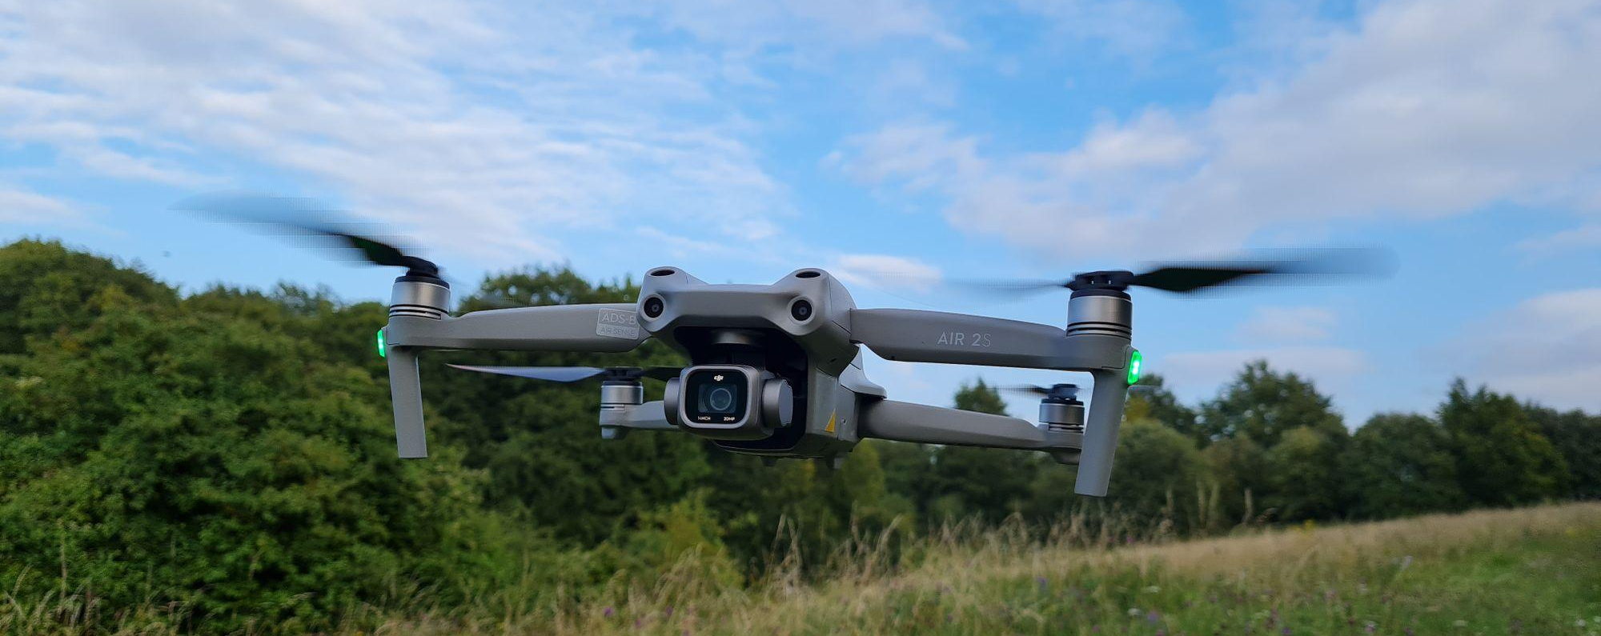
AI-Assisted Drones
DEFINITION + WHY
Crop disease screening and fire detection in Saskatchewan
Existing hardware shown as a concept reference
DEFINITION
WHY
An aerial system that flags crop problems
and signs of fire for human review.
Large areas take time to inspect.
Useful alerts need a location to investigate.
Photo: Altaf Shah / Pexels
12
Notes:
Aubin. Target 40 seconds.
Our third alternative is an AI-assisted drone system for Saskatchewan. It would flag suspicious crop areas for closer inspection, with fire or smoke detection as a second application. Large areas take time to inspect, and useful alerts need a location. Saskatchewan Polytechnic is researching drone and hyperspectral approaches to earlier clubroot detection in canola. This supports the regional relevance and highlights the importance of sensor choice. The photo shows existing compact drone hardware as a reference.
Sources and photo credits:
Saskatchewan crop research context: https://saskpolytech.ca/news/posts/2026/drone-technology-offers-earlier-detection-of-clubroot-in-canola.aspx
Photo: Altaf Shah / Pexels, compact DJI Air 2S above a field. https://www.pexels.com/photo/gray-drone-flying-on-green-grass-field-9405571/

Slide 13

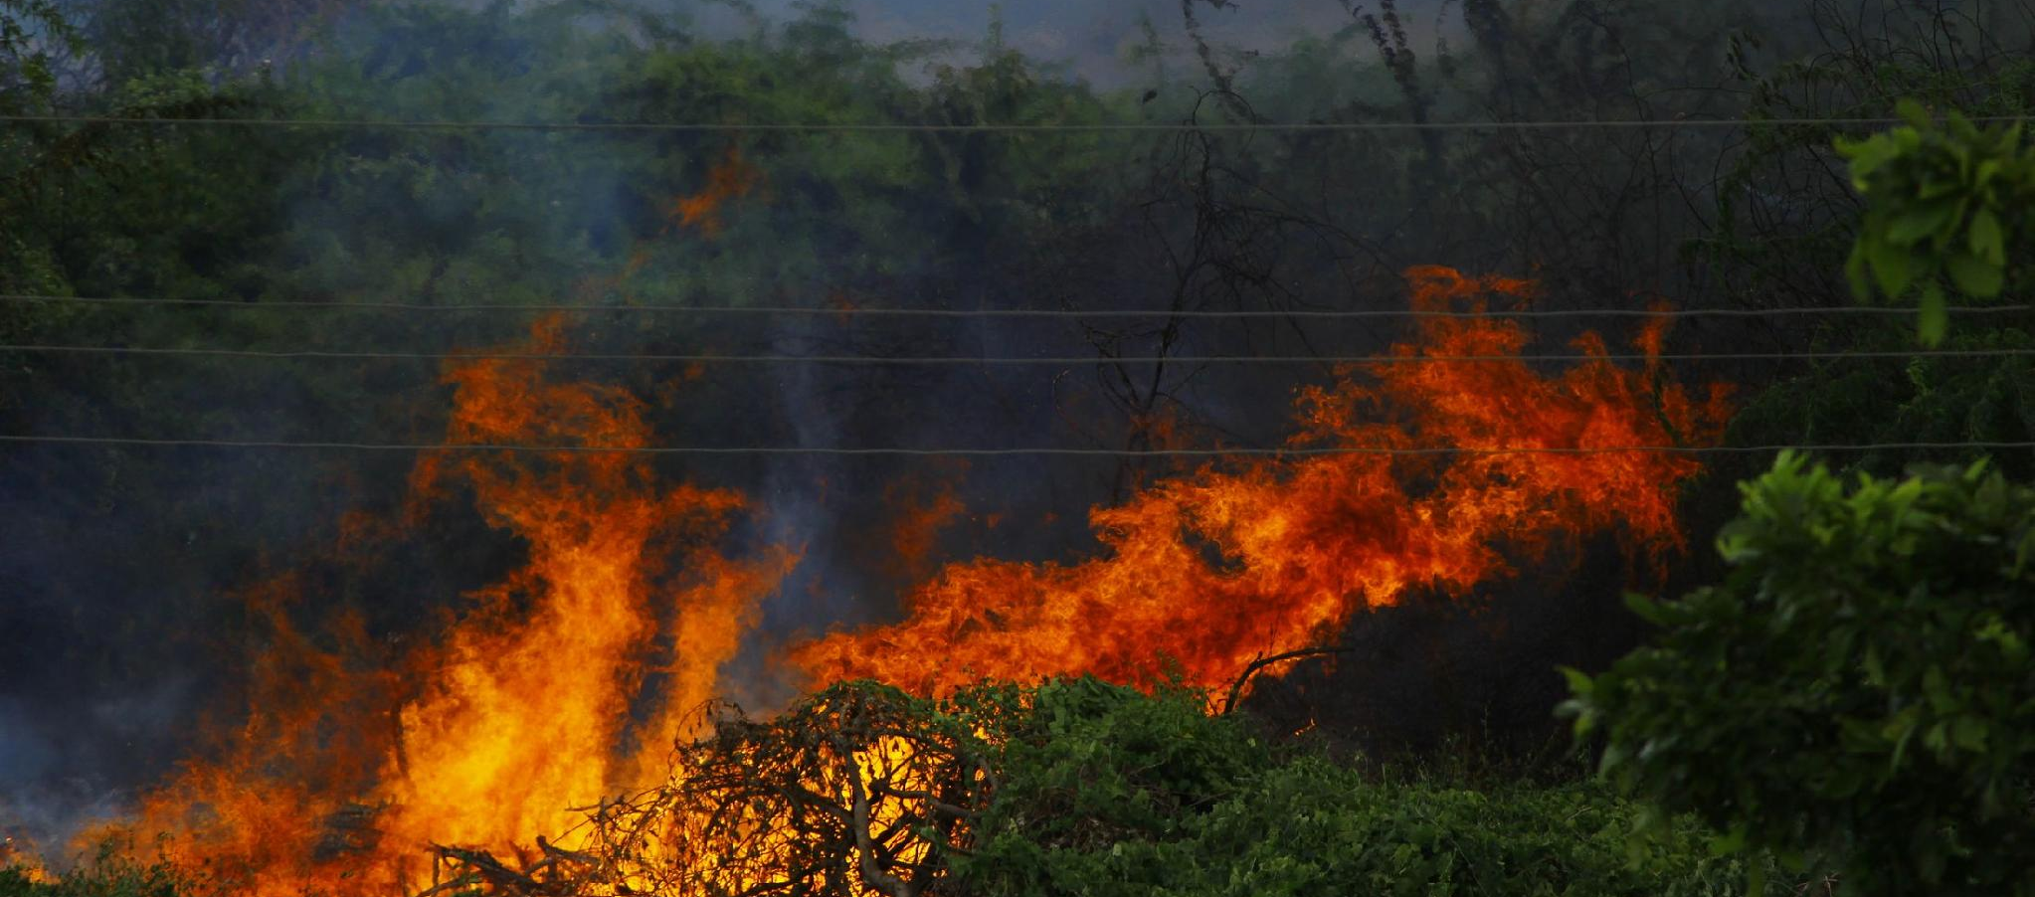
Who could use the drone system?
WHO
Farmers and agronomists
Land and fire-monitoring teams
Need to know where to inspect crops
and which suspicious areas to prioritize.
Need timely observations with a location
and imagery they can review.
Stakeholder interviews are next. Crop scouting leads the first research phase.
Farmer: Gustavo Fring / Pexels
Fire: Saravanan Narayanan / Pexels
13
Notes:
Aubin. Target 35 seconds.
Our proposed users are farmers and agronomists, followed by land or fire-monitoring teams. We have not interviewed these groups yet. We need to learn how they choose areas to inspect, what makes an alert useful and how false alarms affect their work. Crop scouting leads the first research phase. Fire detection remains a separate imagery experiment. These photographs illustrate the use cases and are not verified Saskatchewan locations.
Sources and photo credits:
Proposed stakeholder needs to validate through interviews.
Farmer photograph: Gustavo Fring / Pexels. https://www.pexels.com/photo/a-man-standing-with-a-notepad-in-a-field-4975400/
Fire photograph: Saravanan Narayanan / Pexels. https://www.pexels.com/photo/wildfire-burning-forest-9633007/

Slide 14
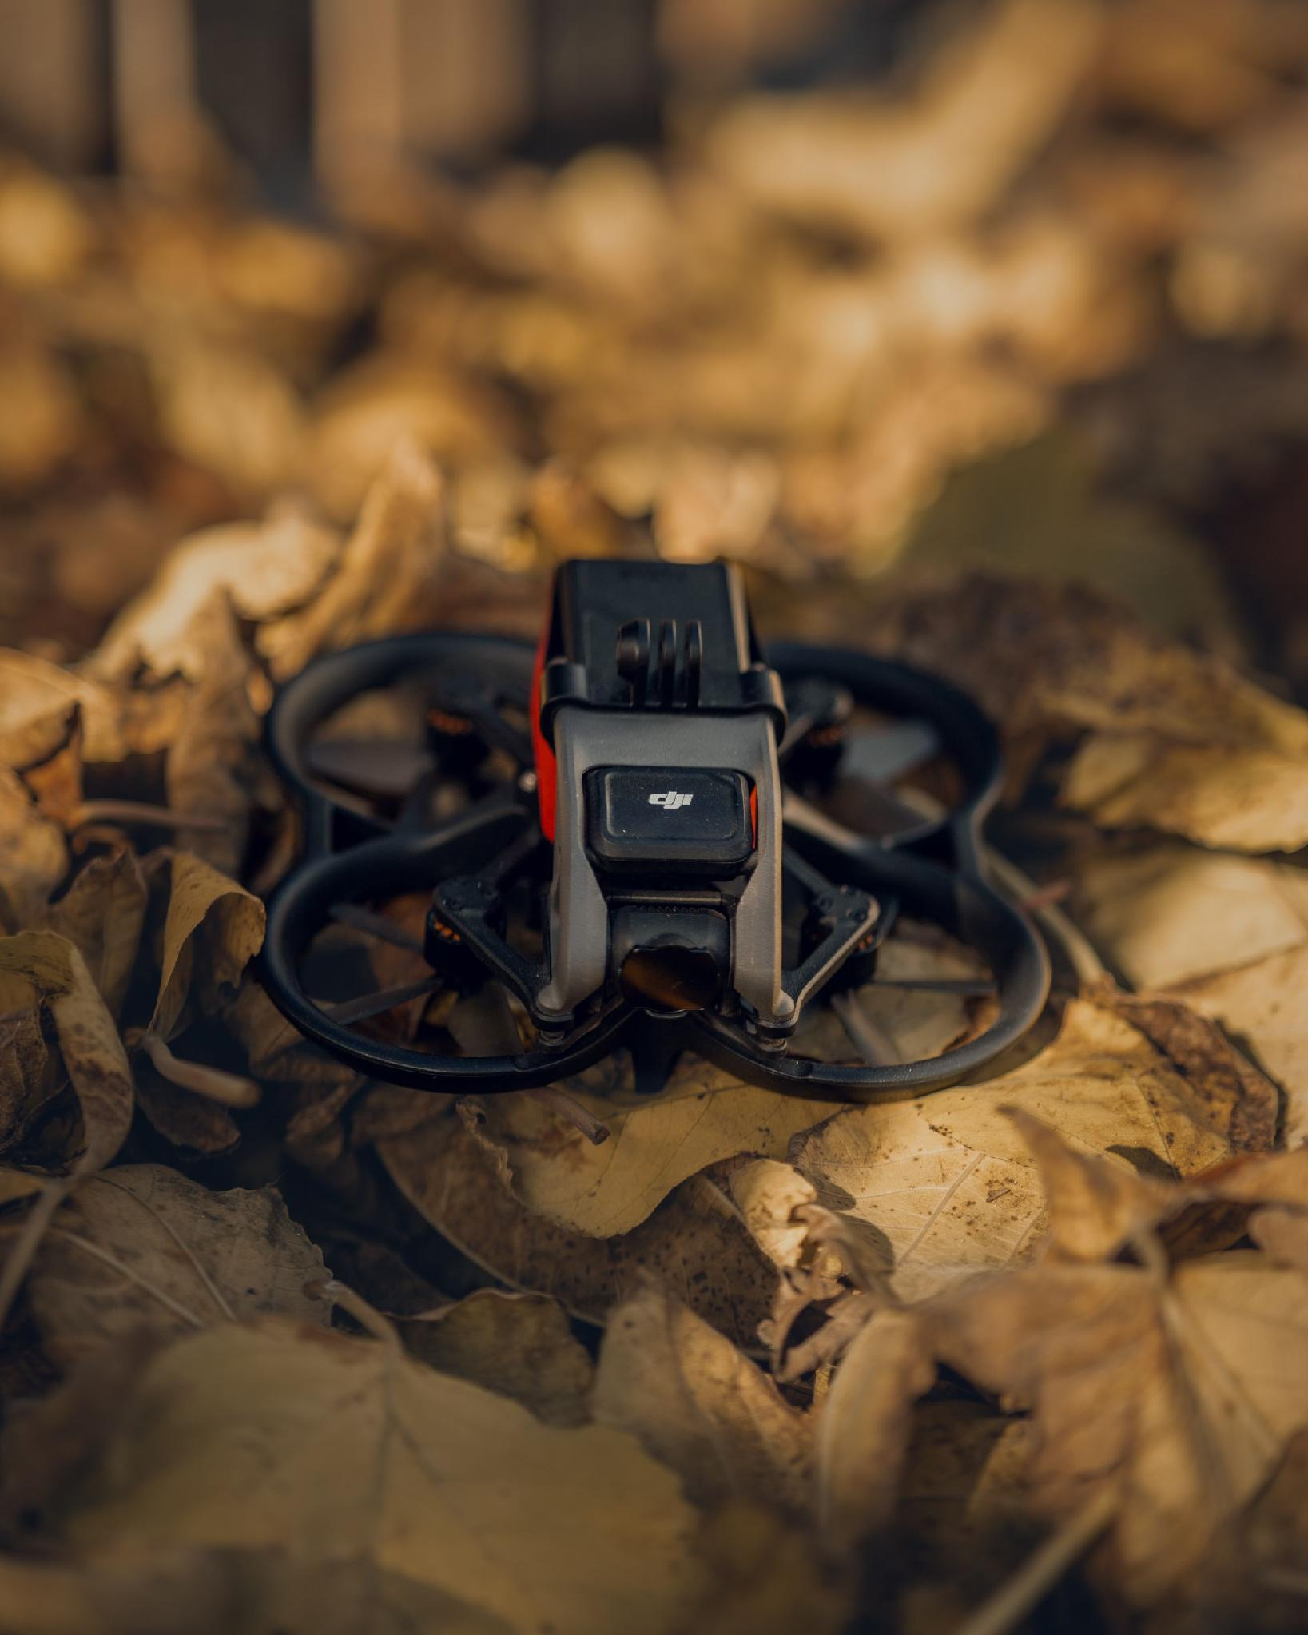
Aerial observations and human review
WHAT + HOW
Flight imagery
+ location
AI screening
+ confidence
Mapped alert
Human verification
CROP DISEASE SCREENING
FIRE DETECTION
Flag suspicious crop areas
for ground inspection
Flag smoke or thermal cues
for a person to review
FPV form factor reference
Existing DJI Avata hardware
Manual control stays available
Pilot-assisted flight first. Autonomous missions are later scope.
14
Notes:
Aubin. Target 45 seconds.
The drone supplies imagery and location. AI screens the images and raises a mapped alert with confidence information for human review. Crop alerts initially mean an area needs inspection, rather than a confirmed diagnosis. Fire alerts could use smoke or thermal cues, depending on the sensor. An ordinary RGB camera cannot measure heat. Manual control remains available, with pilot-assisted flight first and autonomous missions as later scope. This real FPV drone illustrates the form factor. The final hardware remains a research choice.
Sources and photo credits:
Proposed architecture. Hardware, crop condition and sensing modality are undecided.
Crop sensing context: https://saskpolytech.ca/news/posts/2026/drone-technology-offers-earlier-detection-of-clubroot-in-canola.aspx
Thermal platform example: https://enterprise.dji.com/matrice-4-series
Photo: UMUT RAW / Pexels. Existing DJI Avata FPV hardware. https://www.pexels.com/photo/dji-avata-drone-on-fallen-leaves-19659883/

Slide 15
Drone value and competitors
VALUE + STRATEGY
Existing option | What it already offers | Our research focus
PIX4Dfields / DroneDeploy | Field mapping and plant-health analysis | A narrow condition with validated alerts
DJI Mavic 3M | RGB and multispectral crop imaging | Software integration and human review
DJI Matrice 4T | Thermal imaging and inspection tools | A small fire/smoke screening experiment
PROPOSED UNIQUE VALUE
Locations to investigate, with the image and confidence behind each alert
Business question: can a focused scouting service justify its equipment and review costs?
15
Notes:
Chop. Target 40 seconds.
Existing tools already map farms and analyse plant-health imagery. PIX4Dfields and DroneDeploy are direct workflow comparators. DJI sells multispectral agricultural drones and thermal inspection platforms. Our capstone would explore a narrow intelligence and review workflow using suitable existing hardware. The differentiation must come from useful, validated alerts for a specific crop condition or fire cue. We should not promise to outperform these platforms or undercut their cost without evidence. For a farmer or service provider, missed observations, false alarms and the cost of equipment and review all affect the value. We need stakeholder interviews before making a commercial claim.
Sources and photo credits:
https://www.pix4d.com/product/pix4dfields/
https://help.dronedeploy.com/hc/en-us/articles/1500004860861-Plant-Health
https://ag.dji.com/mavic-3-m
https://enterprise.dji.com/matrice-4-series

Slide 16
Drone research phases
HOW / PDSA
01
02
03
04
PLAN
DO
STUDY
ACT
Interview an agronomist and define one crop condition and sensor.
Test recorded imagery, one detector and a mapped alert.
Measure false alerts, missed cases, location error and latency.
Improve field reliability, then assess a supervised flight trial.
QUESTION TO TEST
Can a narrow detector produce alerts a real user can trust and act on?
First prototype
Crop scouting first. Fire detection starts as a separate imagery experiment.
16
Notes:
Chop. Target 45 seconds.
This is the most hardware-dependent option. We would first find a stakeholder, identify one crop and condition, and establish what imagery and labels we can access. The first demonstration can use recorded images with known locations, a detector and a mapped alert. We would test images from different fields or dates separately from training data. Then we would measure false alerts, missed cases, latency and location accuracy. We would also check aircraft access, sensor cost, field permission and applicable operating requirements before planning a supervised flight. Fire detection begins as a separate offline experiment so it does not double the initial field workload. Autumn and winter timing also affects crop data access.

Slide 17
Comparing the three alternatives
SELECTION
Decision factor | uofrEats | AI Learning | AI Drones
Early evidence | Manmeet interview | Linda interview | Interviews pending
First prototype | One-vendor pickup workflow | One-PDF study session | One detector and mapped alert
Main dependency | Vendor access and kitchen workflow | Device performance and student testing | Labelled imagery, hardware and field access
Biggest unknown | Pickup reliability and adoption | Learning benefit and ease of use | Reliability on unseen field conditions
Selection criteria: validated need, access to users and a scope two people can deliver
17
Notes:
Chop. Target 50 seconds.
The three projects are at different stages of evidence. uofrEats has a manager interview and a possible local pilot workflow. The learning environment has Linda's interview and access to students for testing. The drone project has relevant regional research, but we still need our own stakeholder and a realistic route to imagery, hardware and field access. Each option has a manageable first demonstration, but a different main uncertainty. We are seeking feedback on which problem is worth pursuing and what proof we should gather next. We will use validated need, user access and a scope that two people can deliver to choose one capstone. The table reflects our present assessment, not quantitative rankings.
Sources and photo credits:
Team interviews and proposed research plans. No comparative performance has been measured.

Slide 18
Any questions?
Aubin Chriss Izere / 200490675
Chop Kur / 200497265
https://github.com/Binborg1/Final-2027.git
Notes:
Both. Target 180 seconds.
Invite classmates and the instructor to challenge the problem, the proposed value and the first prototype.
Likely questions:
Why not existing campus apps? Campus ordering is established. We need to prove a UofR vendor workflow improves pickup reliability and staff workload.
Will preordering remove all queues? No. Kitchen capacity and pickup handling remain constraints.
Is the learning AI completely offline? Local file storage is required. We must test local model quality and device limits before making a fully offline promise.
Are AI PDF features new? No. We are evaluating a smoother student workflow and learning outcomes.
Which drone or crop disease? Those are research decisions. Start with one crop condition and suitable imagery.
Are the interview quotes exact? They summarize team interview notes and are labeled as paraphrases.
Why three alternatives? We will select one based on validated need, access and feasible scope.

