Slide 1




NEXT GEN EMPLOYABILITY PROGRAM
Creating a future-ready workforce
Team Members
College Name
Student Name : Bincymol.S.V
Student ID : au960221104044
Arunachala College of Engineering for Women

Slide 2

CAPSTONE PROJECT SHOWCASE
Project Title
Car Rentals Application with Django Framework
Abstract | Problem Statement | Project Overview | Proposed Solution | Technology Used | Modelling & Results | Conclusion

Slide 3
Abstract > A web application on Car Rental Application with Django Framework is created which aims in creating a user-friendly platform where customers can easily browse available cars, make migrations, and manage their bookings. > It uses Django’s MVT(Model View Template) architecture. It uses python, html, CSS, JavaScript and Django for implementing the software. > It provides the features including, -- user authentication (registration, login, logout), -- car details (model, year, price, availability), -- booking system ( reserving date, vehicle), -- admin panel, -- search & filter, -- responsive design.
Source :

Slide 4
Problem Statement -- In the real-time world, car rental services are widely used for individual as well as business for mobility purposes. However the existing rental services lack efficiency, transparency and user friendliness leading to inconvenience of customers and rental providers. -- The challenges faced by the customers are limited accessibility, complex booking procedures, lack of transparency, security and trust. Give a solution satisfying all the needs for the customer, in-order to solve all challenges.
Source :

Slide 5
Project Overview >The car rental application goals to create a platform that simplifies the work of renting vehicles for the customers and rental administrator. It uses MVT architecture. The technologies used for front-end are – HTML, CSS, JavaScript and back-end technologies are python, Django. The database used is MySQL. >The features of the application include, -- User authentication ( registration, login, logout) -- Car Listing ( catalogue of cars – model, year, rental price, availability status) -- Booking System (Reserving vehicles by customers) -- Admin Dashboard (managing bookings, profiles) -- Payment Integration (handling payment – online) -- Email Notification (sending confirmation, remainder details by email) -- User Ratings and Reviews (customers experience promoting transparency & accountability) > This car rental application aims to deliver a user-friendly, scalable and secure application that meet the needs of modern car rental services.
Source :

Slide 6
Proposed Solution
Developing a car rental application using Django framework providing a vehicle renting platform with, enhanced accessibility, narrow booking procedures, efficient management, user satisfaction and trust in payment.
The features of the Car Rental Application include,
User Management:
> User Registration and Authentication: Allow users to create accounts, verify their identities, and securely log in using email or social media credentials.
> User Profiles: Enables users to manage personal information, payment methods, and preferences for a personalized experience,
Car Listings:
> Search and Filter Options: Based on location, date/time, car type, price range – allow users to find cars,
> Detailed Car Information: Display details including photos, make, model, year, mileage, availability status and owner reviews/ratings.
Booking System:
> Reservation Workflow: Provides seamless booking process with clear steps for selecting a car, choosing rental dates, and reviewing total costs.
Source :

Slide 7
> Real-Time Availability: Ensure real-time car availability.
> Instant Booking and Confirmation: Offer instant booking options with immediate confirmation.
Payment Integration:
> Secure Payment Gateway: Integrates a trusted payment gateway for secure transactions.
> Multiple Payment Methods: Support various payment methods ( credit/debit cards, digital wallets)
Review and Rating System:
> User Feedback: Allow giving review and rating by the customers.
> Rating Aggregation: Aggregate ratings helping users make informed decisions.
Owner Dashboard:
> Car Management: Enable owners to list the cars, manage availability, set pricing and view bookings.
> Booking Management: Provide tools to approve or reject booking requests, communicate with customers.
Notification and Alerts:
> Booking Remainders: Send reminders about upcoming bookings and deadlines.
> Notifications: Notify owners of new booking requests, confirmations, and cancellations.
Admin Panel:
> User Support: Provide tools to handle user inquires, disputes, and technical issues efficiently.
Source :

Slide 8
Scalability and Security:
> Cloud Infrastructure: Host the application on a scalable cloud infrastructure.
> Data Protection: Implements robust security measures including data encryption, secure API integration and regular security audits to protect user data and transactions.
Source :

Slide 9


Technology Used
Front-end
Back-end
Source :

Slide 10
Modelling & Results
Database Design:
Users (renters and owners)
Cars (with attributes like make, model, year, availability status)
Bookings (connecting users to specific cars for defined rental periods)
Payments (tracking transactions and payment status)
Ratings /Reviews (allowing users to provide feedback on rentals)
System Architecture:
Frontend: User interface for browsing cars, making bookings and managing accounts
Backend: Handles business logic, communication with database and integrating external services.
API Layer : Interface between frontend and backend supporting RESTful endpoints for data exchange.
User Interface:
Car booking search based on filters, Booking flow with clear steps till payment confirmation,
user profile management including booking history, ratings and reviews.
Key Performance Metrics:
Conversion Rate, Availability Rate, Response Time. Customer Satisfaction.
Source :

Slide 11
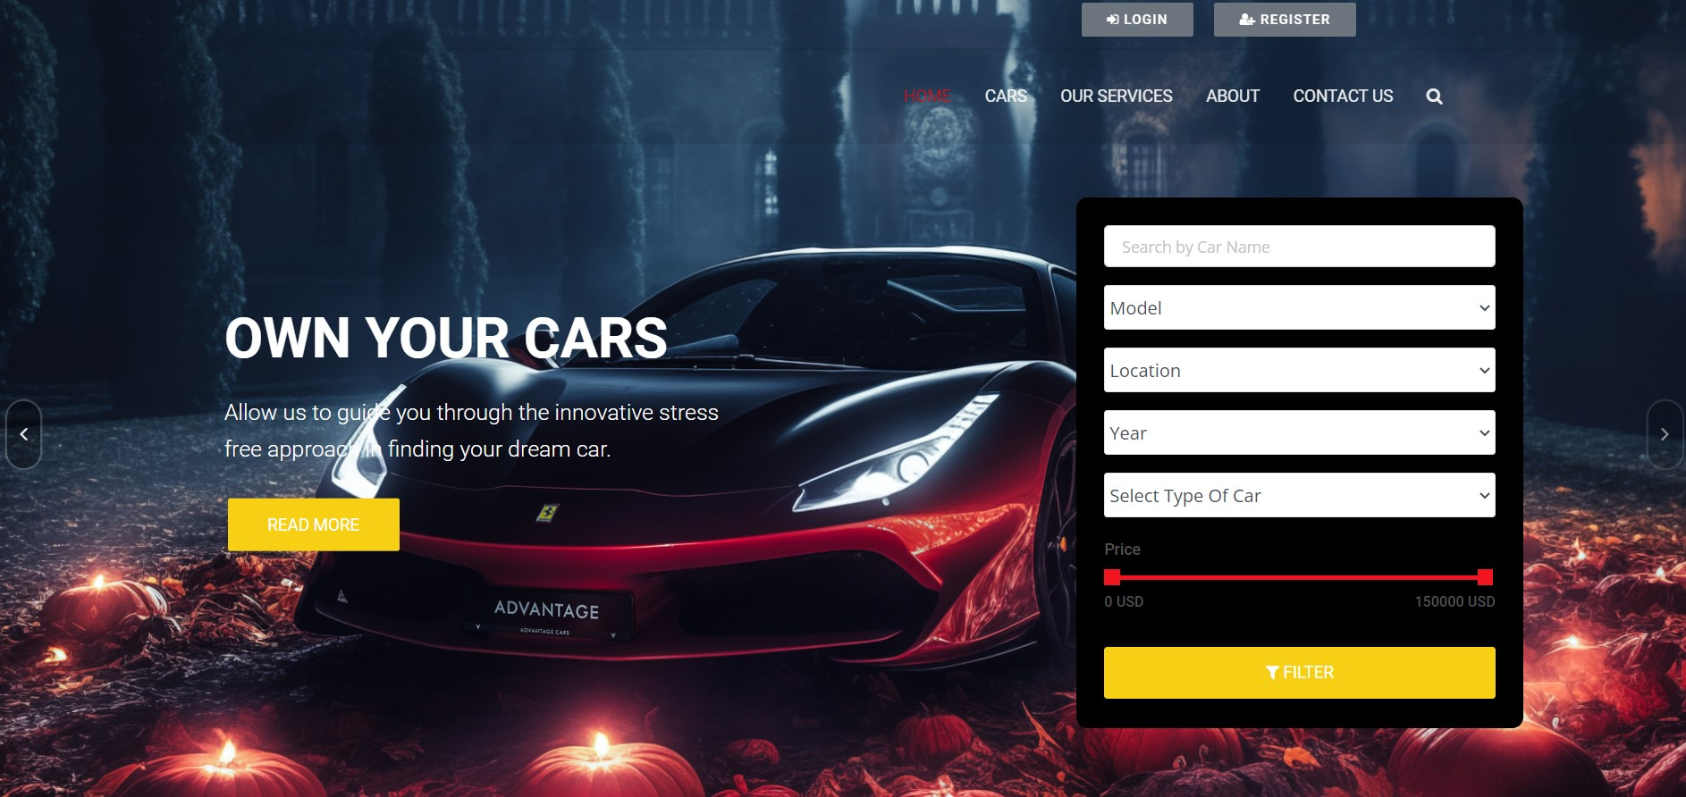
Homepage

Slide 12
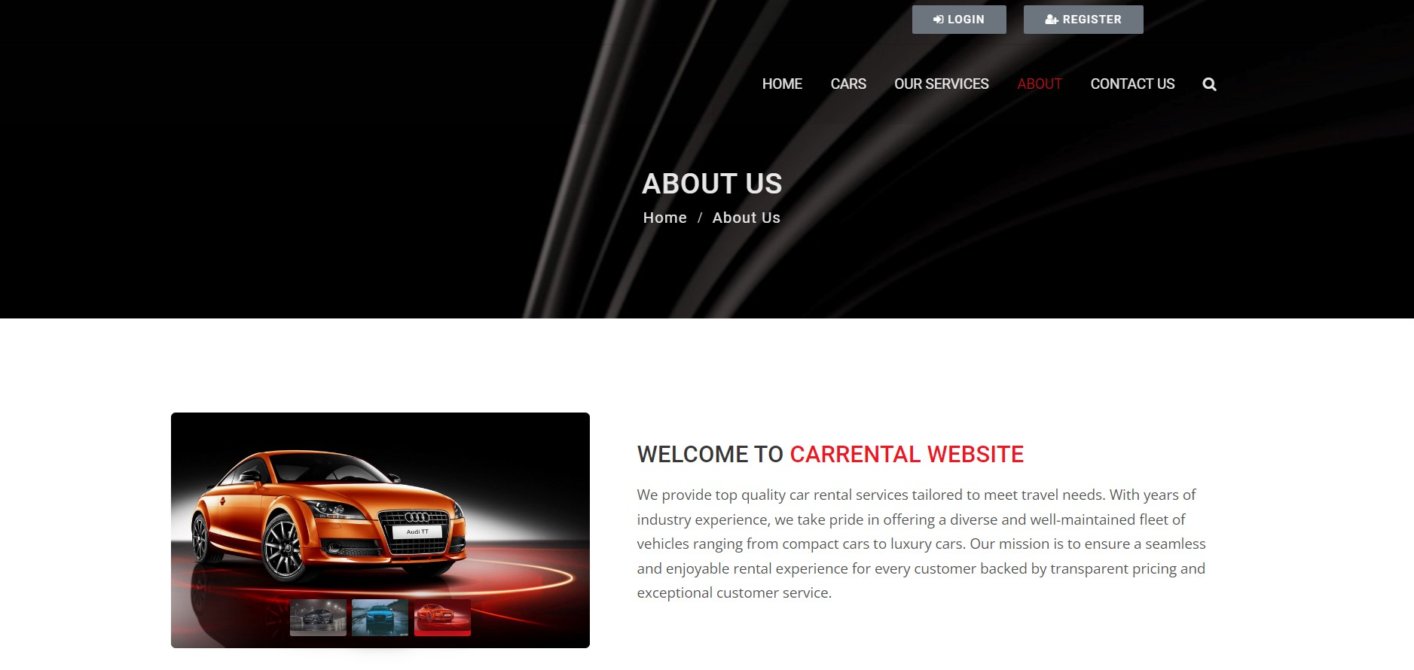
About-Us-Page

Slide 13
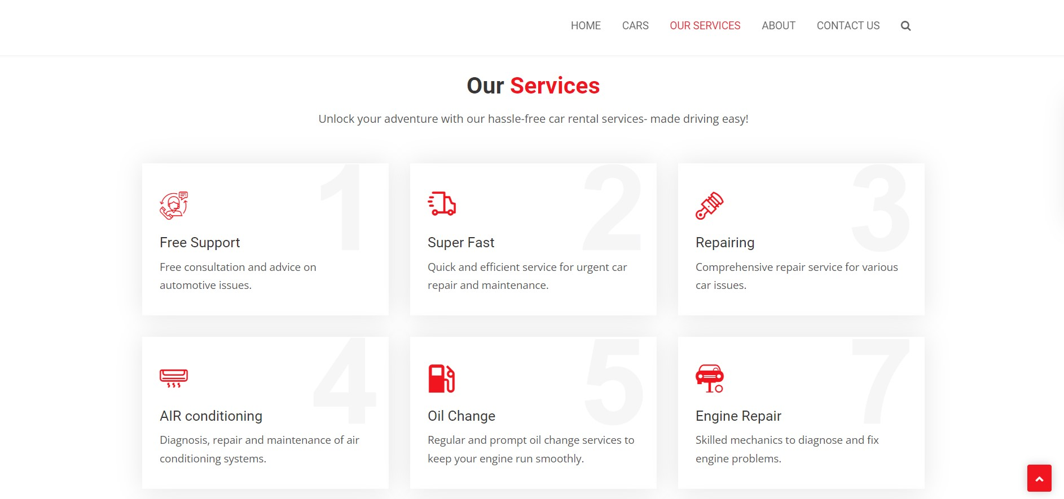
Service-Page

Slide 14
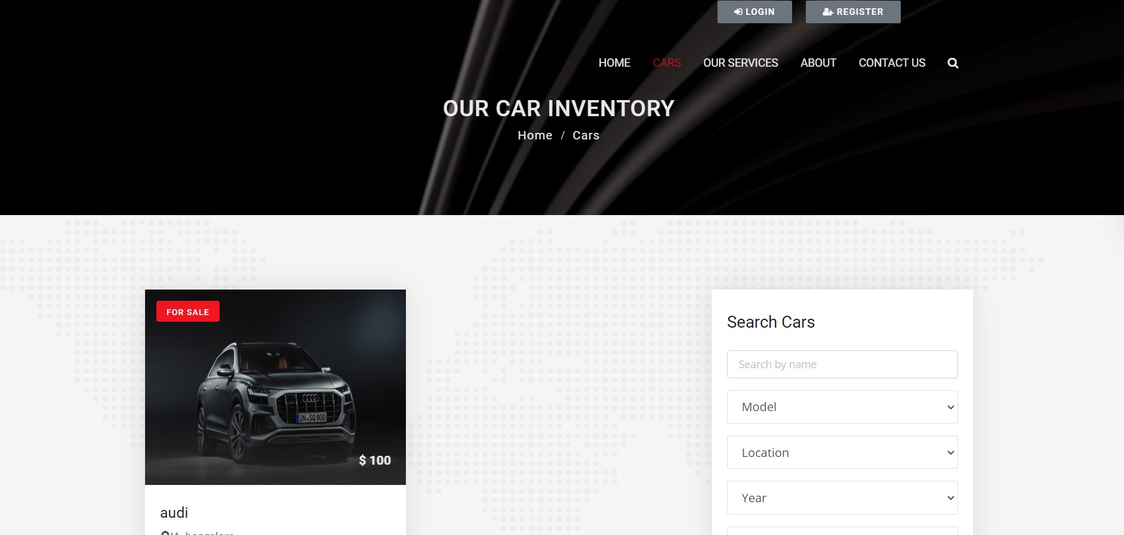
Cars Details Page

Slide 15
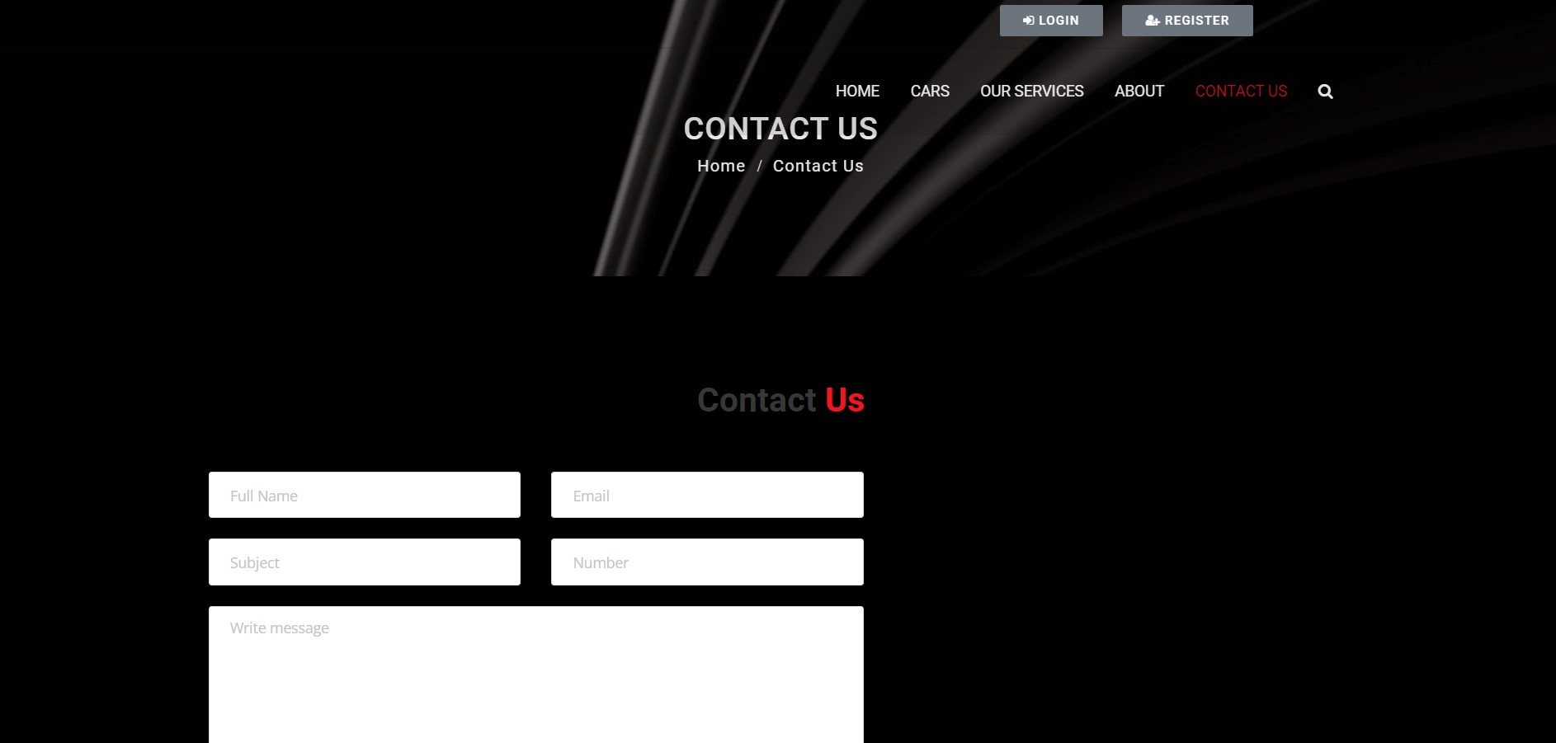
Contact Us Page

Slide 16
Future Enhancements:
Mobile App Development – improve accessibility and convenience for users on the go.
Enhanced Search and Filtering options – choose car by features, price range, car models.
Integration of Realtime GPS tracking – on rental period.
AI Powered Recommendations – based on use preferences and browsing history.
In-car Connectivity and Services – Wi-Fi connectivity.
Customer feedback and Review Systems
Integration of Smart Home Assistants.

Slide 17
Conclusion
Developing a Car Rental Application using Django Framework gives a robust and scalable solution creating a platform that meets the needs of both rental providers and customers. Django’s powerful features and ecosystem facilitate efficient development and deployment of web applications, ensuring security, performance, and maintainability. Through seamless booking processes, secure transaction and robust user management features, the application aims to revolutionize the car rental experience. With continuous improvement and customer feedbacks, we are committed to delivering a reliable and innovative solution that sets new standards in the car rental industry.
Source :

Slide 18
Thank You!
Notes:
Thank You !!

