Slide 1

How can attendance and enrolment data prevent dropout in school?
How can technology play a role in solving this issue?
ING-02
Notes:
Introduksjon – hvem er vi og studie

Slide 2

Inspiration
Right to education
Security
Intuitive data-collection
Inspire and prevent dropout

Slide 3
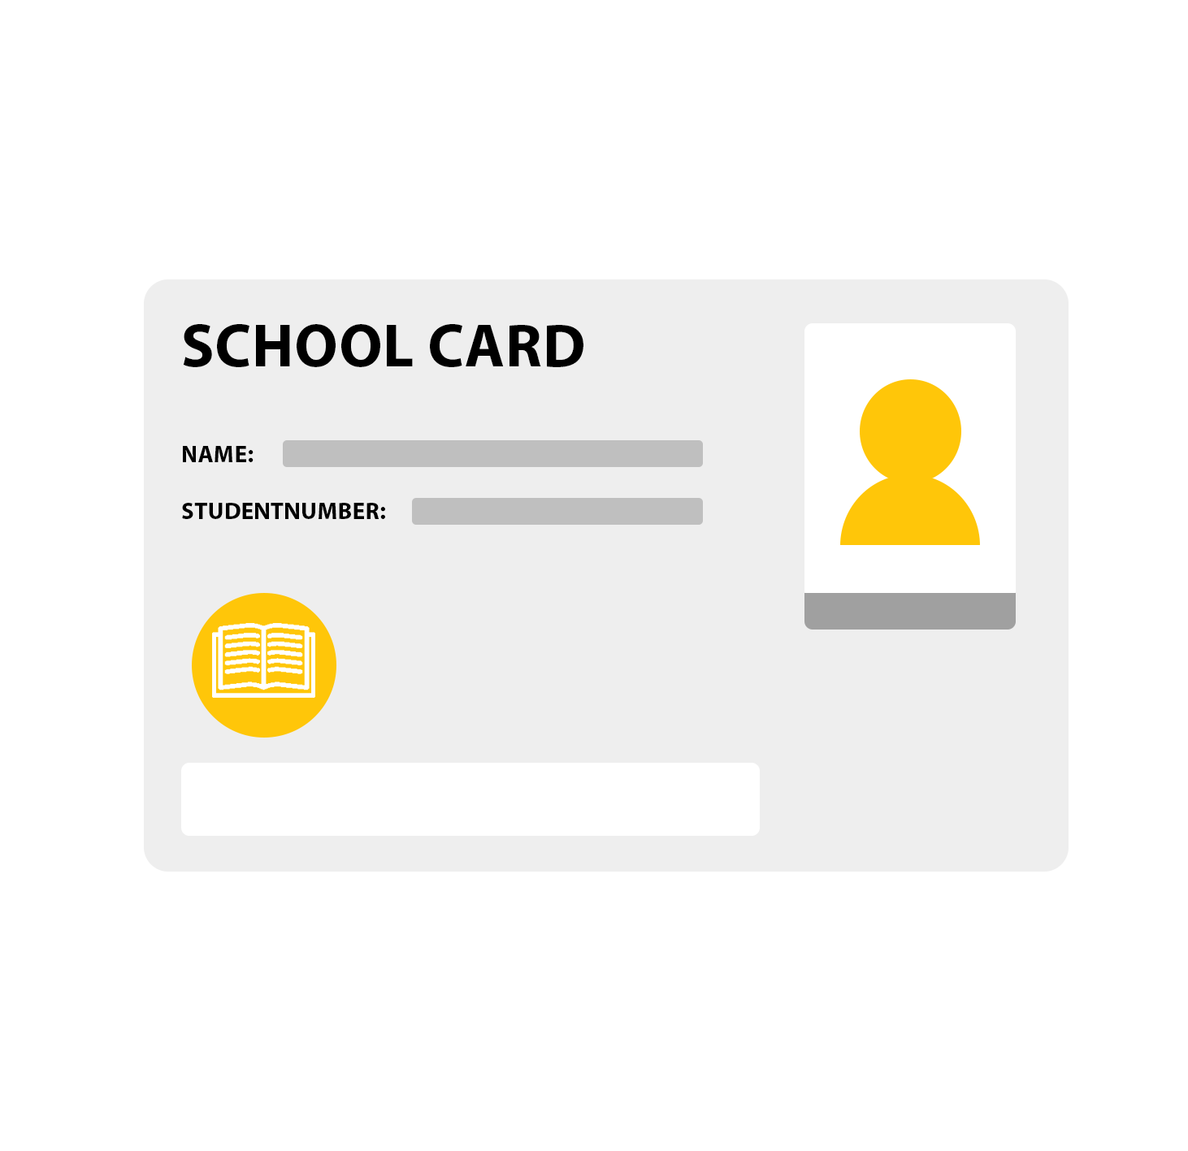
Keycard for data-collection
NFC-technology
Average 0,25$ per chip
Access-cards will make it easier to track attendance

Slide 4
Benefits of implementation
Cheap installation and printing of keycards
Easy access
Reward system
Competition points
Security
Parental benefits

Slide 5
Summary
Our idea will make registration of attendance easier
The reward system will keep the students motivated
Access cards will, in other words, prevent dropout in schools

