Slide 1

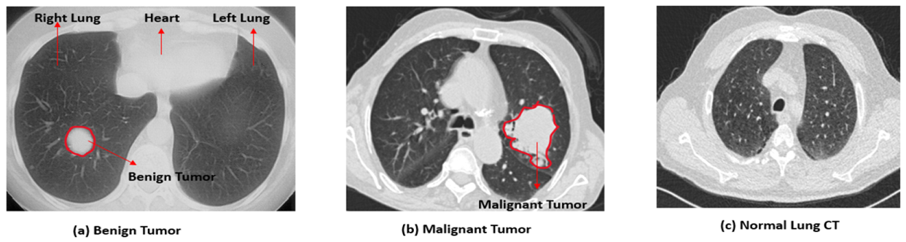
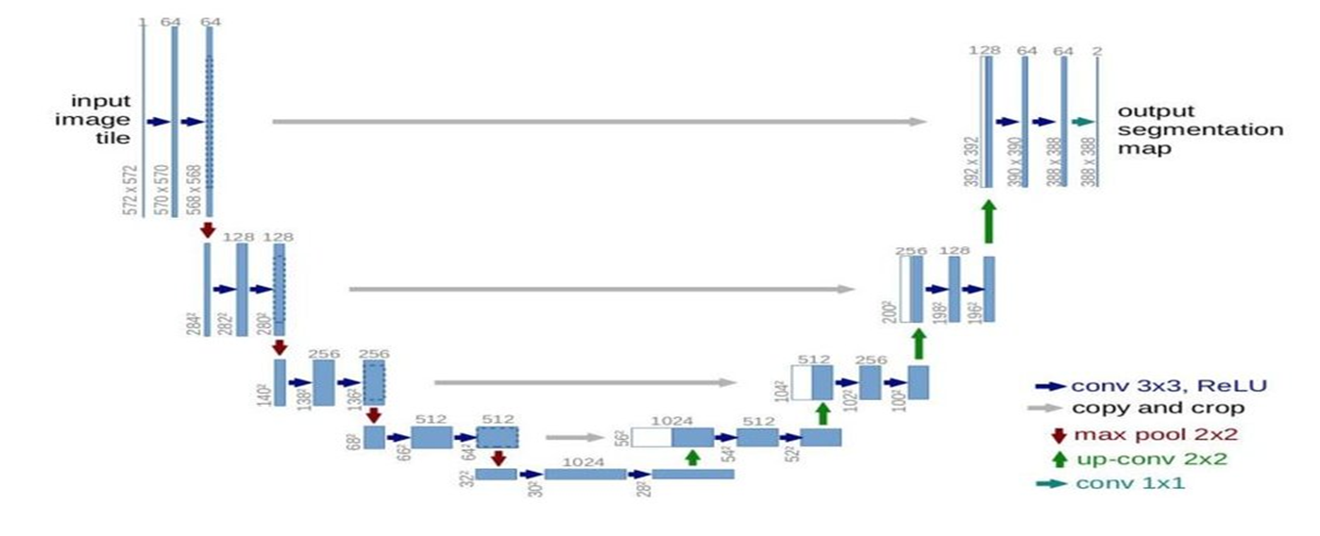
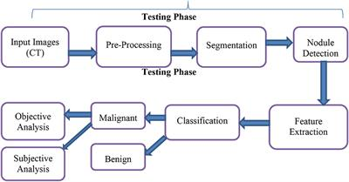
Image Segmentation in Lung Region Using U-net and Attention Mechanisms for Cancer Prognosis
INTRODUCTION
Image Segmentation:
The process of partitioning an image into meaningful segments or regions.
Essential for medical image analysis, enabling precise localization of anatomical structures and lesions.
Lung cancer is the leading cause of cancer-related deaths globally.
Early detection is crucial for improving patient outcomes. However, manual segmentation of lung nodules from CT images is time-consuming and prone to human error.
To address these challenges, automated image segmentation techniques are useful as they aim to precisely delineate the lung regions and identify potential cancerous lesions.
In this project, we propose a hybrid deep neural network approach for image segmentation in the lung region.
U-net and Attention Mechanisms:
The model integrates the U-Net architecture, known for its effectiveness in medical image segmentation, with attention mechanisms.
This combination allows the model to capture detailed spatial information and also to focus on the most relevant parts of the image.
RESULTS:
The Attention U-Net model achieved a remarkable binary accuracy of 99.56% at epoch 20.
This high accuracy underscores the model’s effectiveness in binary classification tasks, highlighting its robustness and precision in segmentation tasks.
CONCLUSION:
The Hybrid model outperforms existing state-of-the-art methods in terms of accuracy, robustness, and efficiency.
Useful for early lung cancer detection, ultimately aiming to improve patient outcomes and assist clinicians.
Bindhiya T – 1GA21AI013)

