Slide 1
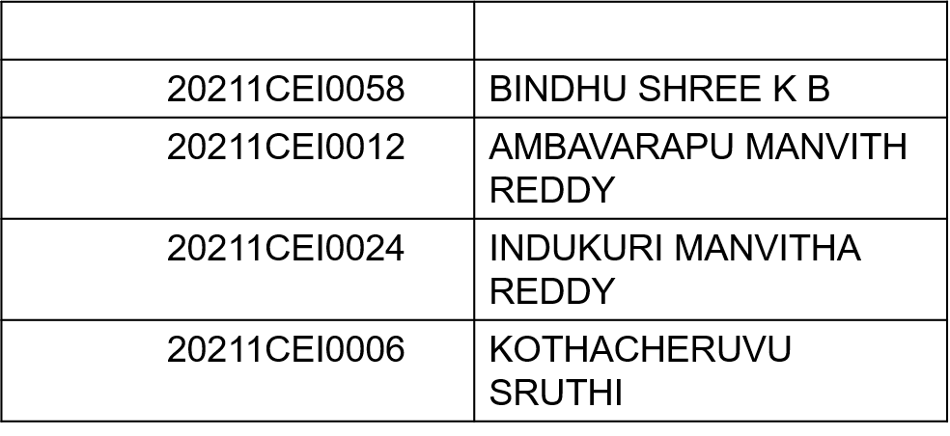
“Forecasting Stock Prices with Machine Learning and Real-time Data“
VIVA-VOCE
Batch Number: CEI - 25
Under the Supervision of,
Ms. VIJAYLAKSHMI P
Associate Professor
School of Computer Science and Engineering
Presidency University
Roll Number | Student Name
Name of the Program: computer engineering in AI ML
Name of the HoD: Dr Gopal Krishna Shyam
Name of the Program Project Coordinator: Sandeep Albert Mathias
Name of the School Project Coordinators: Dr. Sampath A K / Dr. Abdul Khadar A / Mr. Md Ziaur Rahman

Slide 2
Introduction
Stock market is one of the most important parts of any country's economy. It is the biggest way for a company to raise capital for its working Nowadays with the booming popularity of the stock market, not only investors but common people are starting to see stock market as a great investment tool and are taking more interest in Stock markets have a significant function as the gateway for financing private businesses. Access to private cash through stock markets enables businesses to finance their expansion and improvement as well as the acquisition of new assets Businesses would be more limited in the projects they could fund if they did not have access to private investment, and they would be unable to fully capitalize on their company's equity Similarly, stock markets allow business owners to profitably cash out their positions by selling their shares on the open market.

Slide 3
The economic advantages of stock exchanges and stock trading are unmeasurable, and businesses would find it much harder to expand if there were no infrastructure for this type of equity trading. The operation of stock markets is a crucial component of what makes shares and equities investable, and traders seeking to make any significant amount of profit should take pains to get as knowledgeable as possible with the markets operation and the different elements that influence market pricing. It may be feasible to find more trading possibilities for profit for people who have a thorough understanding of the stock markets and their behavior It may also be simpler to highlight trends and the underlying movement of a particular market. So, people who are more familiar with the stock market have a better chance of spotting profitable trades.

Slide 4
Literature Review
This section highlights key studies on stock market price prediction using machine learning techniques :
"Prediction of Stock Price Based on LSTM Neural Network“.
"Regression techniques for the prediction of stock price trend“.
"Recurrent Neural Networks based on LSTM for Predicting Geomagnetic Field“.
"Study on Machine Learning Techniques In Financial Markets”.
ML techniques, especially LSTM models, offer promising results for stock price prediction, though challenges like time lag and model complexity remain ,leaving room for future improvements.

Slide 5
Research Gaps Identified
All previous learning systems are limited and simple in nature, where learning a simple algorithm for a computational mean is insufficient, which can be done by the human brain itself. The main learning motto was limited, and the learning model was inefficient. Existing models can't cope with the vulnerabilities and remove the rarest information that they can't process, resulting in significant data loss and a forecasting problem. Observation is an essential component of resource and prediction management. If the outcome cannot be observed, the point of time estimation is harmed, making it less reliable in the market. Monitoring is not possible with the current system.
Due to the fact that it only considers one source point as a data source, the current approach for stock market predictions appears to be biased. A straight forward data retrieval should be created and tested on the training data set, which are more adaptable and versatile in nature, before the data set is predicted. As the stock changes every day and the loss margin might increase with time, sight loss is a serious issue in the current system. A first occurrence is used to make a forecast.

Slide 6
Proposed Method
By using LangChain and Large Language Models (LLMs), the tool will analyze and interpret stock data, including historical prices, company financial statements, and recent news, to provide accessible and meaningful insights.
The development process will involve several key stages:
Data Collection
Data Processing and Preprocessing
Integration of LangChain and LLM
Investment Analysis and Insights Generation
User Interaction and Output Delivery
Performance and Stability Testing

Slide 7
Objectives
The main objectives of the proposed study are:
To simplify stock market analysis for retail investors by developing an AI-based tool that makes complex financial data accessible and easy to understand.
To automate the collection and processing of real-time and historical stock data, financial statements, and news for comprehensive stock analysis.
To utilize LangChain and Large Language Models (LLMs) for intelligent data analysis.
To empower retail investors to make informed investment decisions.
To create a user-friendly and stable platform that provides consistent, accurate outputs, ensuring a smooth and efficient user experience.

Slide 8
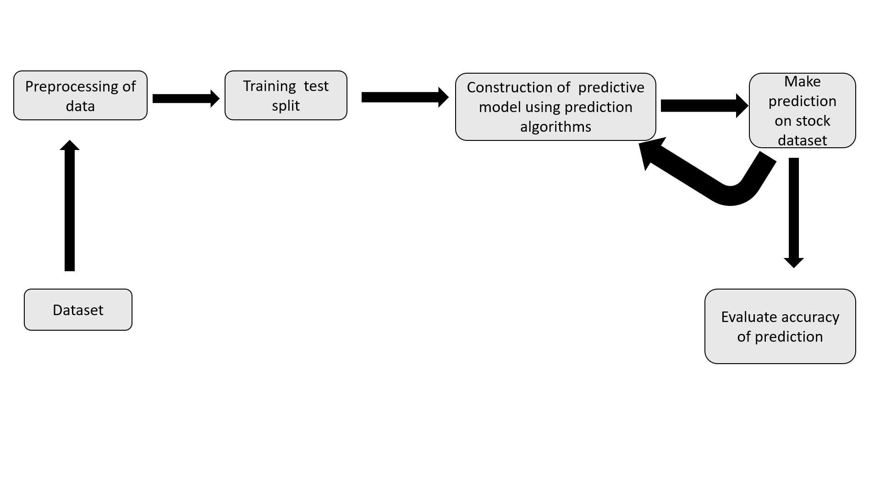
System Design & Implementation
Architecture Design

Slide 9
Implementation
Data Collection & Preprocessing
Use yfinance for stock data and news Api for sentiment analysis.
Normalize data, handle missing values, and create features like moving averages and sentiment polarity.
2. LSTM Model Development
Split data and build a stacked LSTM model in Keras with dropout layers.
Train with MSE and evaluate using RMSE, R-squared, and MAE.
3. Lang Chain & LLM Integration
Use Lang Chain with React agents for user queries and generate insights via structured prompts.
Return results as JSON for frontend display.
4. Dashboard Development
Build a responsive React/Angular dashboard, integrate with backend APIs for real-time data.
5. Testing & Optimization
Test with real-world data, fix issues, and fine-tune the LSTM model for better accuracy.

Slide 10
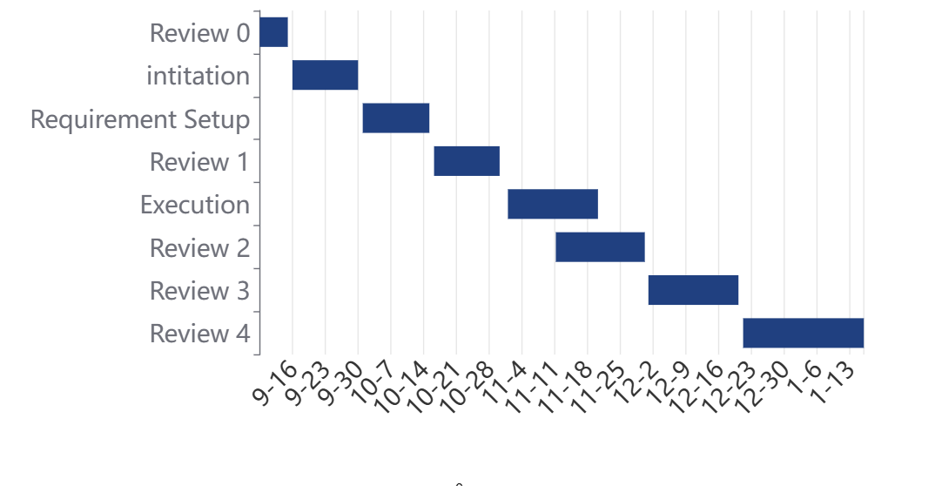
Timeline of Project

Slide 11
Outcomes / Results Obtained
Accurate Stock Predictions: The LSTM model will predict future stock prices based on historical data and market sentiment, providing reliable forecasts.
Sentiment-Enhanced Insights: Integration of sentiment analysis from Google News will enhance stock predictions by incorporating market mood and external factors.
Interactive Financial Insights: The Lang Chain powered LLM integration will allow users to query the system in natural language and receive personalized financial insights, like stock forecasts and market analysis.
User-Friendly Dashboard: A responsive web dash board will present stock trends, sentiment analysis, and predictions in a visually intuitive manner, accessible for real-time interactions.
Optimized, Robust System: The system will be stable, with accurate predictions, fast response times, and continuous improvements from testing and optimization efforts.
Real-Time Data Interaction: By integrating APIs for real-time data fetching, users will get up-to-date insights and forecasts as stock markets evolve.

Slide 12
Conclusion
Recurrent neural networks, in which LSTMs ("long short-term memory")are most powerful and well-known subset, are a type of artificial neural network designed to recognize patterns in data sequences like numerical time series data from sensors, stock exchanges, and government agencies. RNNs and LSTMs differ from other neural networks in that they consider time and sequence; they have a temporal dimension.
A discussion of stock market fundamentals is followed by a discussion of the need for price forecasting. Non-linear regression analysis, Hidden Markov models, artificial neural networks, naive bayes classifiers, decision tree classifiers, random forest methods, support vector machines, PCA(principal component analysis), WB-CNN (word embeddings input and convolutional neural network prediction model), and CNN(convolutional neural network) are a few methods that may be used for stock market prediction.

Slide 13
The outcomes of this study help us to draw the conclusion that LSTM (Long Short-Term Memory) neural networks produce superior outcomes to other approaches. The integration of Lang Chain and advanced machine learning models like LSTMs offers a transformative approach to stock price prediction and analysis. By leveraging the power of Lang Chain, the system can process and generate natural language insights, making complex financial data accessible to retail investors and professionals alike.

Slide 14
References
N. Naik and B. R. Mohan, "Novel Stock Crisis Prediction Technique—A Study on Indian Stock Market," in IEEE Access, vol. 9, pp. 86230-86242, 2021, doi: 10.1109/ACCESS.2021.3088999. https://ieeexplore.ieee.org/document/9453777
K. Alam, M. H. Bhuiyan, I. U. Haque, M. F. Monir and T. Ahmed, "Enhancing Stock Market Prediction: A Robust LSTM-DNN Model Analysis on 26 Real-Life Datasets," in IEEE Access, vol. 12, pp. 122757-122768, 2024, doi: 10.1109/ACCESS.2024.3434524. https://ieeexplore.ieee.org/document/10613029
S. Wang, "A Stock Price Prediction Method Based on BiLSTM and Improved Transformer," in IEEE Access, vol. 11, pp. 104211-104223, 2023, doi: 10.1109/ACCESS.2023.3296308. https://ieeexplore.ieee.org/document/10185006
M. Nabipour, P. Nayyeri, H. Jabani, S. S. and A. Mosavi, "Predicting Stock Market Trends Using Machine Learning and Deep Learning Algorithms Via Continuous and Binary Data; a Comparative Analysis," in IEEE Access, vol. 8, pp. 150199- 150212,2020,doi: 10.1109/ACCESS.2020.3015966 https://ieeexplore.ieee.org/document/9165760
V. G. Mu, N. Gao, Y. Wang and L. Dai, "A Stock Price Prediction Model Based on Investor Sentiment and Optimized Deep Learning," in IEEE Access, vol. 11,pp.51353-51367,2023,doi: 10.1109/ACCESS.2023.3278790 https://ieeexplore.ieee.org/document/10130578

Slide 15
R. Zhang and V. Y. Mariano, "Integration of Emotional Factors With GAN Algorithm in Stock Price Prediction Method Research," in IEEE Access, vol. 12, pp. 77368-77378, 2024, doi: 10.1109/ACCESS.2024.3406223 https://ieeexplore.ieee.org/document/10539967
X. Wang, K. Yang and T. Liu, "Stock Price Prediction Based on Morphological Similarity Clustering and Hierarchical Temporal Memory," in IEEE Access, vol. 9, pp. 67241-67248, 2021, doi: 10.1109/ACCESS.2021.3077004 https://ieeexplore.ieee.org/document/9420698/
Luo, L. Zhong, J. Wang, Y. Wang, S. Li and W. Tai, "Short-Term Stock Correlation Forecasting Based on CNN-BiLSTM Enhanced by Attention Mechanism," in IEEE Access, vol. 12, pp. 29617- 29632, 2024, doi: 10.1109/ACCESS.2024.3369419 https://ieeexplore.ieee.org/document/10444524/
J. Choi, S. Yoo, X. Zhou and Y. Kim, "Hybrid Information Mixing Module for Stock Movement Prediction," in IEEE Access, vol. 11, pp. 28781- 28790,2023, doi: 10.1109/ACCESS.2023.3258695. https://ieeexplore.ieee.org/document/10075550/
W. Li and G. S. Bastos, "Stock Market Forecasting Using Deep Learning and Technical Analysis: A Systematic Review," in IEEE Access, vol. 8, pp. 185232-185242,2020,doi: 10.1109/ACCESS.2020.3030226 https://ieeexplore.ieee.org/document/9220868/

Slide 16
Publication Details
https://www.ijprems.com/

Slide 17
M. E. Mahjouby, M. T. Bennani, M. Lamrini, B. Bossoufi, T. A. H. Alghamdi and M. E. Far, "Predicting Market Performance Using Machine and Deep Learning Techniques," in IEEE Access, vol. 12, pp. 82033-82040, 2024, doi: 10.1109/ACCESS.2024.3408222 https://ieeexplore.ieee.org/document/10545565/
T. Kabbani and E. Duman, "Deep Reinforcement Learning Approach for Trading Automation in the Stock Market," in IEEE Access, vol. 10, pp. 93564- 93574, 2022, doi: 10.1109/ACCESS.2022.3203697 https://ieeexplore.ieee.org/document/9877940/

Slide 18
Thank You

