Slide 1
Fake News Detection Using Machine Learning Algorithms
Project Presentation
Group-12

Slide 2
Team Member
Student ID | Student Name
11724307 | Himabindu Chunduri
11656632 | Vijayalakshmi Pepala
11696413 | Jaswanth Nalluri
11700315 | Sandeep Chowdary Ari

Slide 3
Introduction
The proliferation of misinformation in social media has created an urgent need for automated fake news detection systems
Recent studies indicate that false information spreads six times faster than factual news on social platforms
Machine learning approaches offer promising solutions for identifying and filtering misleading content in real-time scenarios
Natural Language Processing techniques combined with deep learning models provide powerful tools for content authenticity verification
The impact of fake news on public opinion and decision-making necessitates development of robust detection systems

Slide 4
Introduction (Cont.)
The COVID-19 pandemic highlighted the critical importance of combating health-related misinformation in social media platforms
Our project leverages state-of-the-art machine learning algorithms to classify news content with high precision and recall
Integration of multiple feature extraction techniques ensures comprehensive analysis of textual content for accurate classification
The system utilizes both statistical and semantic features to capture various aspects of fake news patterns
Implementation of cross-validation and hyperparameter optimization ensures robust and generalizable model performance

Slide 5
—Problem Statement
Problem:
The rapid spread of fake news on social media poses significant risks to public information integrity.
Expected Solution:
An automated multi-modal system that accurately identifies fake news content, with high accuracy.

Slide 6
Methodology - Proposed Solutions
Comprehensive text preprocessing including URL removal, special character handling, and lemmatization for improved feature quality
Multi-feature extraction approach combining TF-IDF (5000 features), statistical metrics (5), and Word2Vec embeddings (100 dimensions)
Implementation of multiple classification models: Logistic Regression, Linear SVC, Passive Aggressive, and Decision Tree classifiers
Hyperparameter optimization using GridSearchCV with 5-fold cross-validation for each model to ensure optimal performance
Feature importance analysis for model interpretability and understanding key indicators of fake news

Slide 7
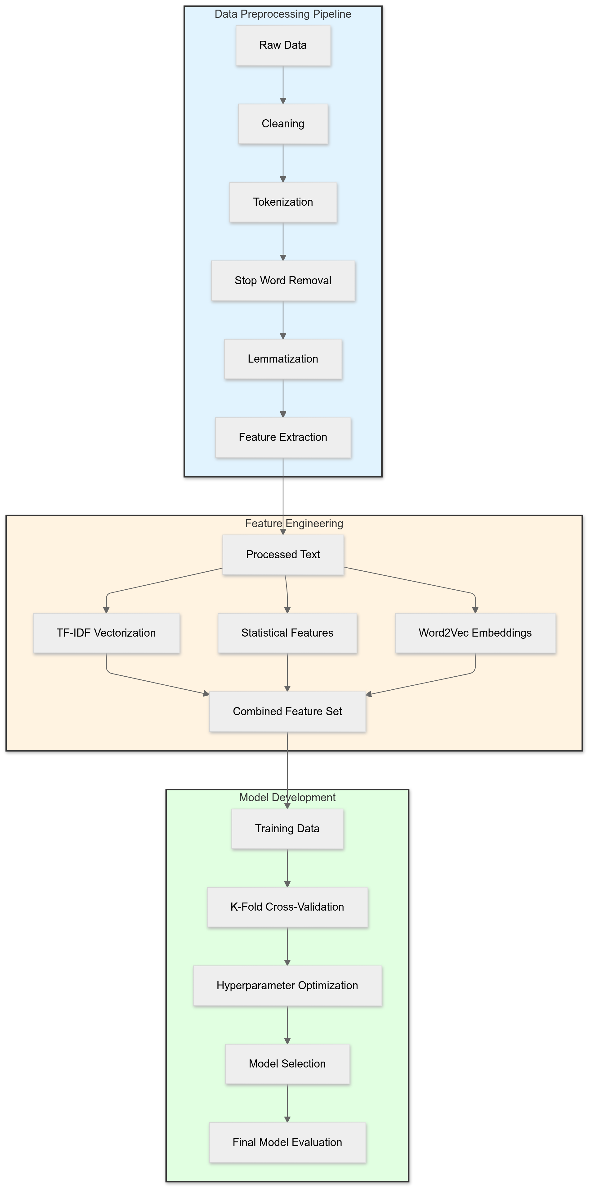
Methodology - Workflow
Data preprocessing pipeline:
cleaning → tokenization → stop word removal → lemmatization → feature extraction
Feature engineering workflow:
TF-IDF vectorization → statistical feature extraction → Word2Vec embedding generation
Model development process:
training → cross-validation → hyperparameter optimization → model selection
Implementation of k-fold cross-validation (k=5) to ensure robust model evaluation and prevent overfitting
Final model selection based on validation accuracy and generalization performance across different metrics

Slide 8
Dataset Description
Characteristic | Description
Dataset Size | Training: 6420, Validation: 2140, Test: 2140
Features | TF-IDF: 5000, Statistical: 5, Word2Vec: 100
Class Distribution | Real: 52.34%, Fake: 47.66%
Text Length | Mean: 181.61, Median: 169.0, Std: 150.55
Word Count | Mean: 27.0, Median: 25.0, Std: 24.58
Dataset Link: https://www.kaggle.com/datasets/csmalarkodi/covid-fake-news-dataset

Slide 9
Data Analysis Results
Word distribution analysis reveals significant differences in vocabulary usage between fake and real news
Statistical analysis shows fake news tends to have shorter text length (mean: 144.89) compared to real news (mean: 215.06)
Top bigrams analysis identifies distinct phrase patterns: "covid 19" appears 1018 times in fake vs 711 in real
Feature importance analysis highlights key discriminative words and phrases for classification
Visualization of Word2Vec embeddings shows clear clustering patterns between fake and real news

Slide 10
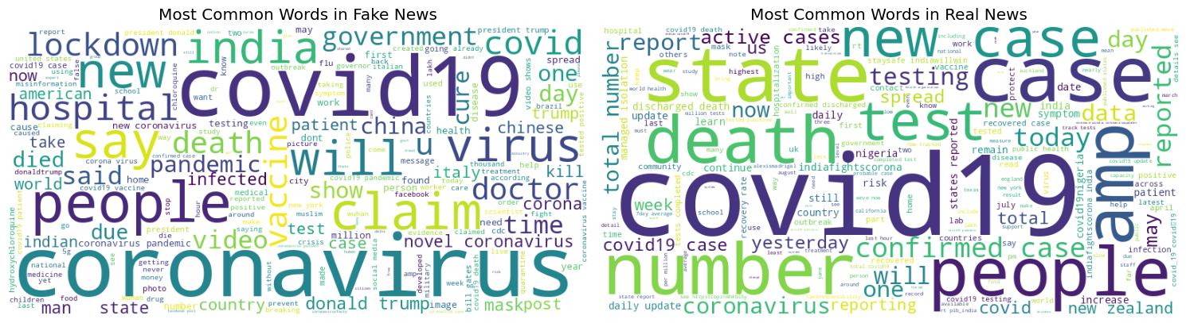
Data Analysis Results - Visualization
Other than Covid19, the most common words in Fake News included words like india, new, hospital, vaccine, say, coronavirus etc. For the Real News, they included state, death, people, today, case among others.

Slide 11
Implementation Details
Libraries: scikit-learn, NLTK, Gensim, pandas, numpy for comprehensive machine learning pipeline implementation
TF-IDF Vectorization: max_features=5000, handling sparse matrix for efficient computation
Word2Vec Configuration: vector_size=100, window=5, min_count=1, workers=4 for optimal embedding generation
GridSearchCV parameters: {'C': [0.1, 1, 10], 'loss': ['hinge', 'squared_hinge']} for SVM optimization
Model Architecture: Linear SVC with squared_hinge loss and L2 regularization (C=1) achieved best performance

Slide 12
Results and Evaluation
Precision-Recall curves demonstrate robust model performance across different operating thresholds
Confusion matrix analysis shows balanced performance for both fake and real news classification
F1-Score: Training (0.988), Validation (0.987), Test (0.930) indicating consistent model performance
Error analysis reveals common misclassification patterns in health-related and statistical news content
Cross-validation scores demonstrate model stability with low variance across different data splits

Slide 13
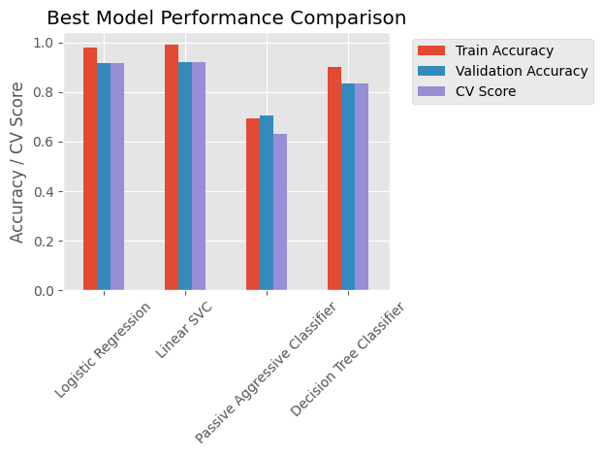
Results and Evaluation - Visualization
From the visualization, it is evident that Linear SVC and Logistic Regression were the better performing models followed by Decision Tree Classifier and lastly Passive Aggressive Classifier.
Best performing model turned out to be Linear SVC, with an accuracy of 0.9271 (~93%)

Slide 14
Project Management
Sprint Planning and Execution (Two-Week Cycles): Jaswanth Nalluri.
  Tasks include defining features and goals, breaking down features into tasks, prioritizing them, conducting daily standups, and leading sprint reviews and retrospectives.
Regular Code Reviews and Documentation : Sandeep Chowdary Ari.
  Tasks include organizing code review schedules, updating documentation for new features, ensuring coding standards, and maintaining documentation structure.
Version Control (Git) Integration: Himabindu Chunduri.
  Tasks include setting up the Git repository, defining commit and branching guidelines, tracking branches and commits for each feature, and cleaning up the repository weekly.
Continuous Integration (CI) Pipeline for Automated Testing and Deployment: Vijayalakshmi Pepala.
  Tasks include setting up the CI/CD pipeline, adding automated test cases, monitoring pipeline issues, and updating CI/CD configurations as needed.

Slide 15
References
Shu, K., et al. (2017). Fake News Detection on Social Media: A Data Mining Perspective
Devlin, J., et al. (2019). BERT: Pre-training of Deep Bidirectional Transformers for Language Understanding
Yang, Y., et al. (2018). TI-CNN: Convolutional Neural Networks for Fake News Detection
Scikit-learn: Machine Learning in Python, Pedregosa et al., JMLR 12, pp. 2825-2830, 2011
Mikolov, T., et al. (2013). Efficient Estimation of Word Representations in Vector Space

Slide 16
QUESTIONS??
THANK YOU!

