Slide 1
CSE 528 Computer Graphics Paper Presentation
Instructor: Hong Qin
TA: Hieu Le
QUADRILATERAL MESH SIMPLIFICATION TECHNIQUES
Hima Bindhu Busiredy
110747994

Slide 2
Mesh Simplification Techniques
Quadrilateral Mesh Simplification - Joel Daniels, Claudio T. Silva , Jason Shepherd and Elaine Cohen
ACM SIGGRAPH Asia 2008
Localized Quadrilateral Coarsening -Joel Daniels , Claudio T. Silva and Elaine Cohen
Eurographics Symposium on Geometry Processing 2009

Slide 3
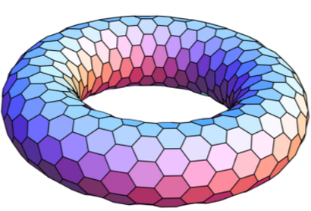
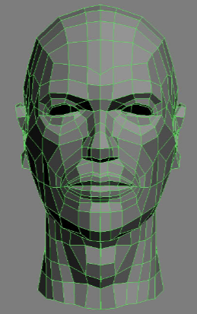
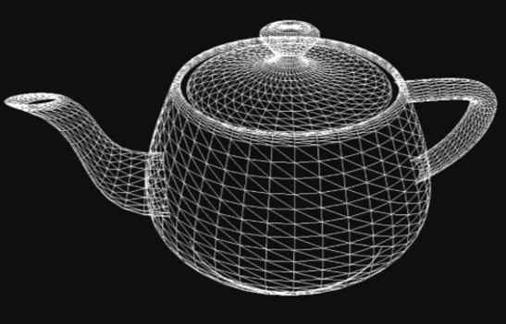
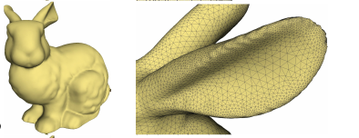
Introduction
Mesh
A mesh is a discretization of a geometric domain into
small simple polygon shapes
Any object in computer graphics is rendered as mesh

Slide 4
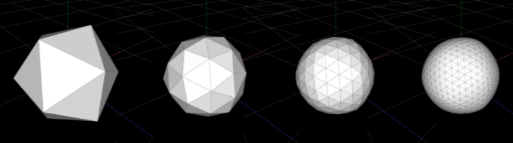
Overview
Mesh Simplification
Geometry processing operation used in
Mesh compression
Rendering
Editive operations

Slide 5
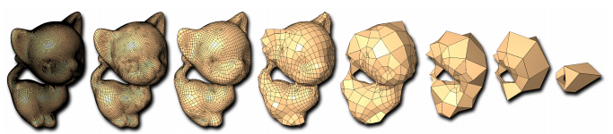
Quadrilateral Mesh Simplification
Challenge with quadrangulation?
Not every model can be represented with a quad mesh
ex: simple model with odd number of vertices

Slide 6
Quadrilateral Mesh Simplification
Addressing challenge with quadrangulation:
Maintains quadrilateral connectivity at all levels of detail with quad only meshes
Used for re-meshing tri- and quad dominant meshes into fully quad meshes
Set of unit operations are applied on quad only dual of a mesh

Slide 7
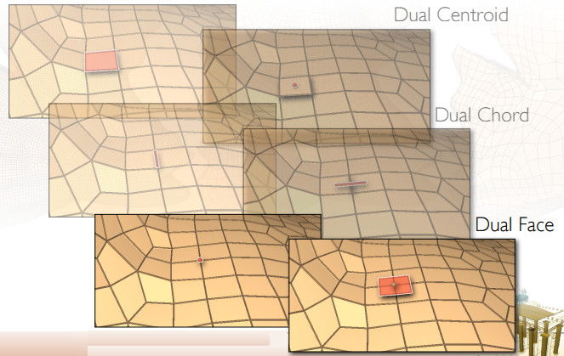
Dual Representation

Slide 8
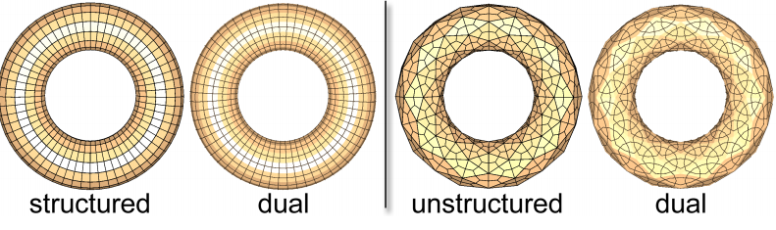
Dual Representation
The dual structure of a highly structured mesh is itself highly structured (left); whereas, a non-structured mesh contains a complex dual representation (right).

Slide 9
Global QMS
Simplification Operations
Poly-Chord Collapse
Quadrilateral Collapse
Doublet Collapse

Slide 10
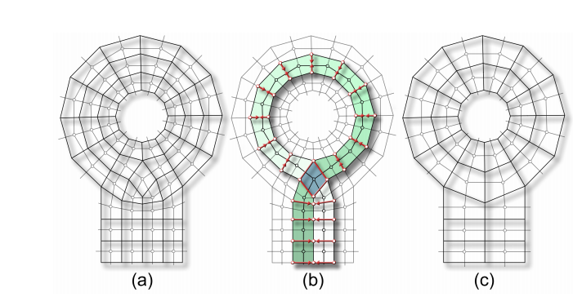
Poly Chord Collapse
The original mesh and its dual representation (a), the chosen polychord (b) and the resulting mesh after the polychord collapse (c)

Slide 11
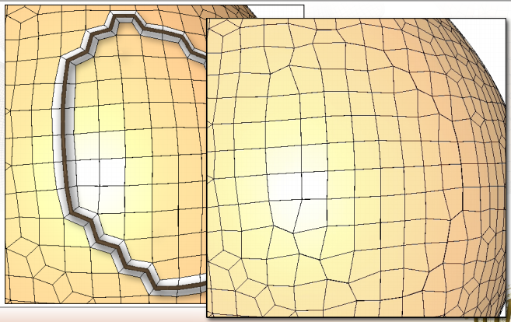
Poly Chord Collapse

Slide 12
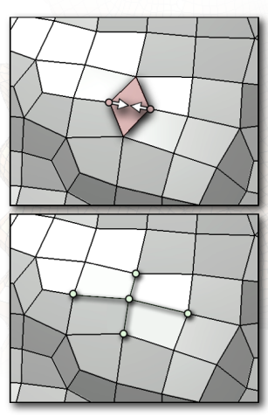
Quadrilateral Collapse

Slide 13
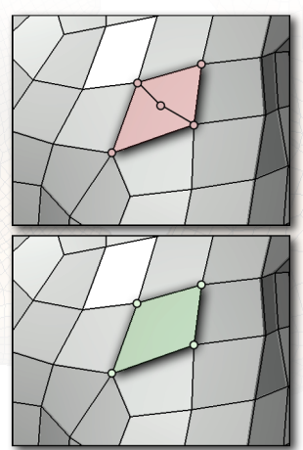
Doublet Collapse

Slide 14
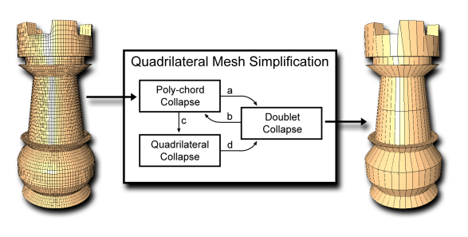
Approach
Prioritizing Operations

Slide 15
Challenges with QMS
Polychord deletion has a global effect.
These structures may describe a significant portion of the model with complex knots
Cause the deletion of important features

Slide 16
Local QMS
Simplification Operations
Quad – Edge Merge (qeMerge)
Quad – Vertex Merge (qvMerge)
Doublet Collapse

Slide 17
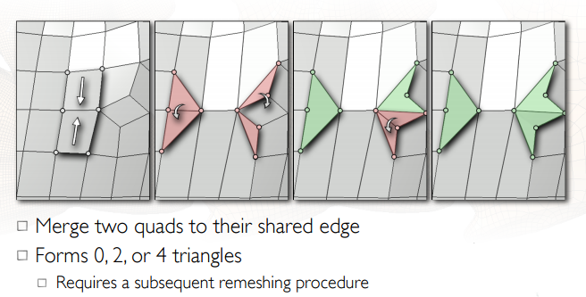
Quad – Edge Merge

Slide 18
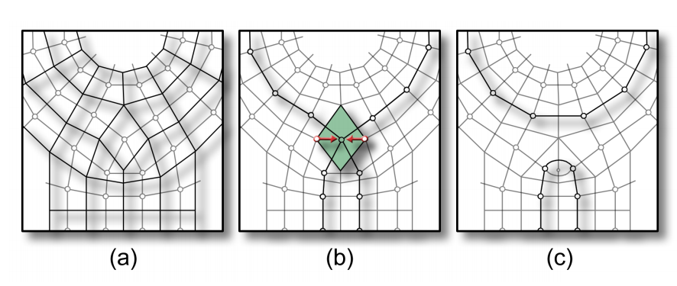
Quad-Vertex Merge
The original mesh and its dual representation (a), the chosen quadrilateral (b) and the resulting mesh after the quadrilateral-vertex merge (qvMerge) (c)

Slide 19
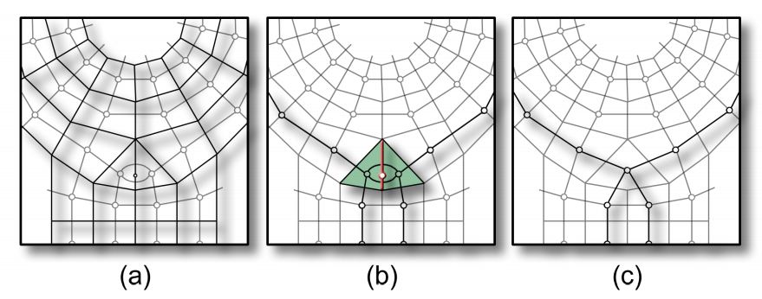
Doublet Collapse
The original mesh and its dual representation (a), the chosen doublet (b) and the resulting mesh after the doublet collapse (c)

Slide 20
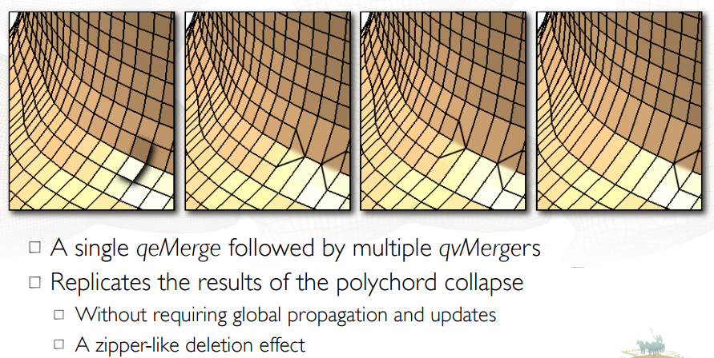
The Zipper Effect

Slide 21
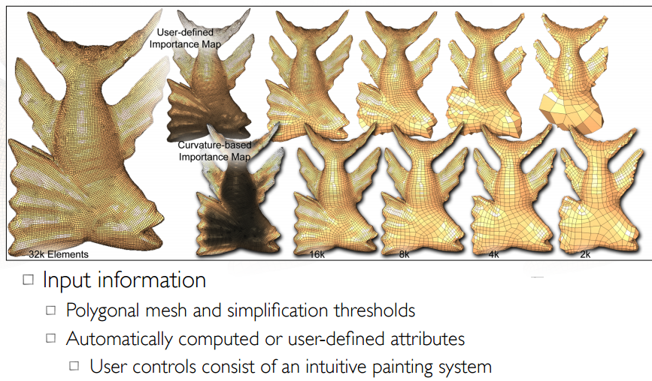
Approach

Slide 22
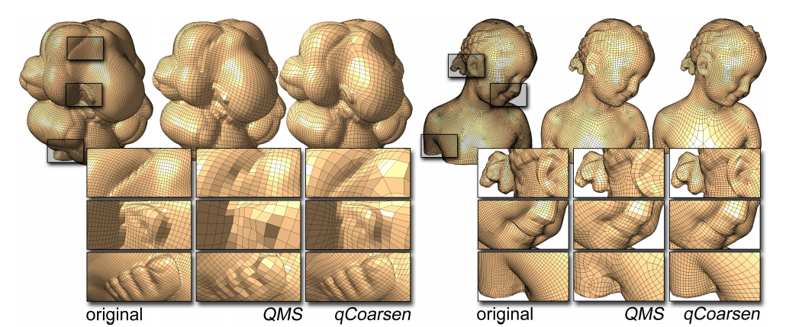
QMS vs qCoarsen
Comparison of QMS, a quad simplification algorithm, and qCoarsen results at the same number of elements. QMS maintains high structure on semi-regular models On other models, qCoarsen generates better simplification results in every aspect.

