Slide 1
CSE 525 Introduction To Robotics
Final Project
Implementation and Evaluation of Geometric Motion Planners RRT and RRTConnect
Hima Bindhu Busireddy
110747994

Slide 2
Problem Statement
To implement and evaluate geometric motion planners like RRTConnect and RRT in a simple environment based on different evaluation parameters and application of path simplifiers.

Slide 3
Geometric Motion Planners Chosen:
RRT (Rapidly Exploring Random Trees)
RRTConnect (Bi-directional RRT)
Evaluation Parameters:
Planning Time
Trajectory Length
Simplified Path Length
Number of nodes in Random Tree

Slide 4
RRT (Rapidly Exploring Random Trees)
Planner typically grow a tree of states connected by valid motions. These valid
motions randomly reach the goal state giving a path.
RRTConnect (Bi-directional RRT)
bidirectional version of RRT which grow two trees: one from the start and
one from the goal and then attempts to connect a state in the start tree
with another state in the goal tree.

Slide 5
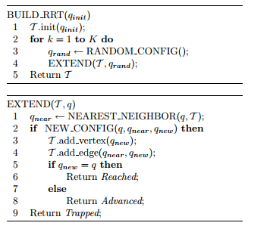
RRT Algorithm

Slide 6
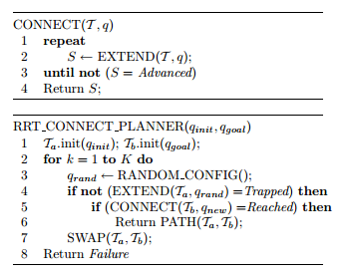
RRTConnect Algorithm

Slide 7
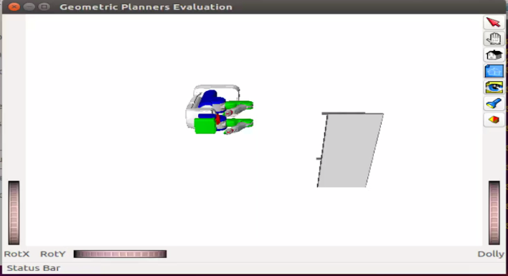
Simulation Environment

Slide 8
Demo

Slide 9
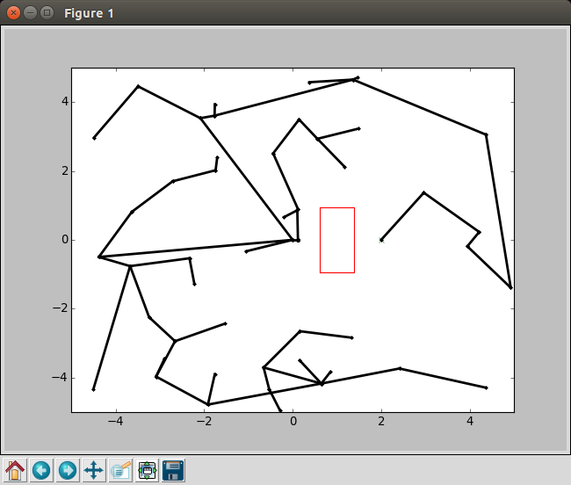
RRT Tree Visualization

Slide 10
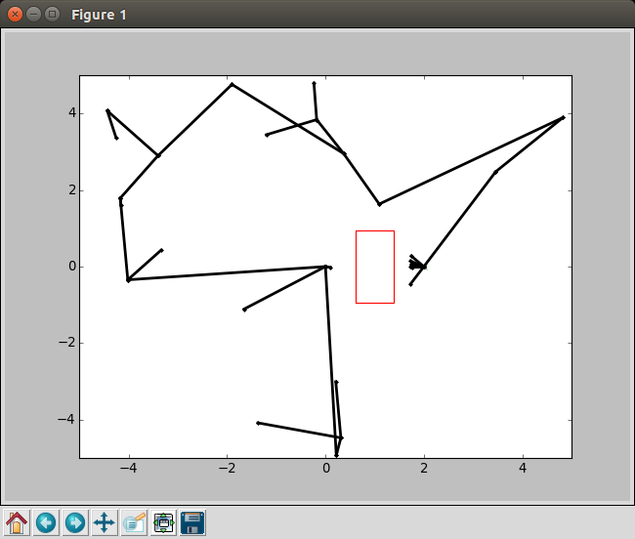
RRTConnect Tree Visualization

Slide 14
Conclusion
RRTConnect algorithm outperforms the original RRT algorithm

Slide 15
References
http://ompl.kavrakilab.org/planners.html
https://en.wikipedia.org/wiki/Rapidly_exploring_random_tree
http://msl.cs.uiuc.edu/~lavalle/papers/Lav98c.pdf
http://coecsl.ece.illinois.edu/ge423/spring13/RickRekoskeAvoid/rrt.html

