Slide 1
Text Detection and Localization in Natural Images
Project team:
B.Hima Bindhu-02098069
B.Praveena-02098080
Project Guide:
Mr. M . Swamy Das
Associate Professor

Slide 2
Problem statement
To Detect textual regions and localize the Information present in the natural images using a texture based method.
In particular, Telugu and English text present in the image.
To compare the results with existing methods

Slide 3
Approaches
Over the past years, so many algorithms are published. Mainly All the algorithms can be classified into three categories:
Connected Component Based Detection
Edge Based Detection
Texture Based Detection

Slide 4
Why Texture Based Method?
Out of the three methods, we preferred Text Based method due to following reasons:
As the texture features don’t capture any language dependent features, the Texture Based method is language independent.
The Edge method and connected component method gives poor results when applied to Indian languages like Telugu and Hindi

Slide 5
Design
Texture Based Method Block Diagram
F(x,y)
Background removal/suppression in the DCT domain
G(x,y)
Features Extraction
Classification
Merging of text blocks into text regions
Refinement of identified text regions
Text regions

Slide 6
Texture Based Method
Background removal/suppression in the DCT domain
Suppress the background from the image by Dividing the image into 8x8 blocks.
Apply DCT for every 8x8 block and suppress the background using high pass filter.
Obtain processed image by performing inverse DCT on every 8x8
block
DCT on
every8x8
block
G(u,v)
H (u, v)
High pass
filter
P(u,v)
Inverse
DCT on
P(u,v)
G(x,y)
F(x,y)
Figure 2: High Pass Filter for Background Removal using DCT
Where,
G(u,v) is DCT matrix of input image f(x,y).
P(u,v) is Processed DCT matrix.
g(x,y) is background suppressed image.

Slide 7
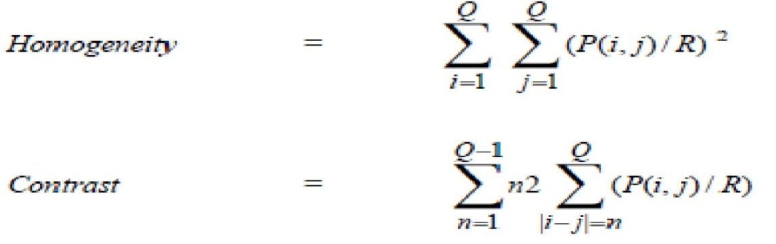
Texture Based Method (contd..)
Features Extraction
Extract the texture features like homogeneity and contrast for each block in all four orientations 0, 45, 90and 135 degrees
D = [ X1, X2, X3…………………… XN] T is a 50*50 block
Xi = [rmin, rmax, cmin, cmax, f1,f2,f3,f4,f5,f6,f7,f8]
f1,f3,f5,f7 are Homogeneity at 0,45,90,135 degree orientations
f2,f4,f6,f8 are Contrast at 0,45,90,135 degree orientations
P corresponds to cooccurrence matrix at a given degree.
R is normalized value of cooccurrence matrix P.
N is total number of blocks.
QxQ is dimension of block size which is chosen as 50x50.

Slide 8
Texture Based Method (contd..)
The blocks, having lesser homogenity and higher contrast are possible text blocks
Class w1 if d1(Xi) is satisfied, and d2(Xi) is satisfied
Class w2 otherwise
Where,
d1(Xi) is a discriminant function which defines/specifies constraint on homogeneity value.
d2(Xi) is a discriminant function which defines/specifies constraint on Contrast value.
d1(Xi)= satisfied if Xi (fj) <= T1, ∀ i=1, N and j = 1,3,5,7
Not satisfied otherwise
d2(Xi)= satisfied if Xi(fj) >=T2 ∀ i=1,N and ,j = 2,4,6,8 (11)
Not satisfied otherwise
Where,
T1 corresponds to threshold on homogeneity (T1 = 0.4), chosen empirically.
T2 corresponds to threshold on contrast T2 = (50), chosen empirically.
Classification

Slide 9
Texture Based Method (contd..)
Merging of text blocks
Merging the adjacent text blocks (to a bigger rectangular block)
Algorithm:
Input: Vector B which contains coordinates of identified text
blocks
Output: Vector R which records text regions
Begin
1. Choose the first block Cs from vector B.
2. Initialize coordinates of a new text region ri to coordinates of
block Cs.
3. Select next block Cp from the vector B.
4. if (the block Cp is connected to ri in row or column) then
begin
Merge and update coordinates rmin, rmax, cmin, cmax of block ri.
rmin = min{ ri [rmin ], Cp[rmin] } rmax = max{ ri [rmax ], Cp[rmax] }
cmin = min{ ri [cmin ], Cp[cmin] } cmax = max{ ri [cmax ], Cp[cmax] }
else
Store text region ri into vector R.
Initialize coordinates of a new text region ri to coordinates of
current block Cp.
end
5. Repeat steps 2 -5 until p=N1.

Slide 10
Texture Based Method (contd..)
Texture Based Method (contd..)
Refinement of Text Regions
Adjacent undetected blocks processing
Combining unprocessed regions

Slide 11

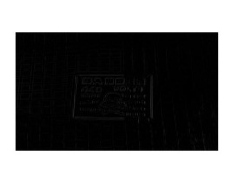
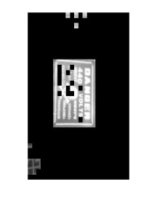
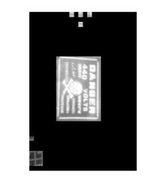
Results and Observations
a)Original Image b)Background Suppressed image
c)Image after Classification d) Final image after merging

Slide 12
Results and Observations(contd…)
Detection Rate = (Number of text blocks correctly detected/ Number of text blocks tested)
False Acceptance Rate (FAR) = (Number of text blocks falsely detected/ Number of text blocks tested)
False Rejection Rate (FRR) = (Number of missed text blocks / Number of text blocks tested) * 100

Slide 13
Results and Observations(contd…)

Slide 14

Results and Observations(contd…)
a) Original image b)Edge based method
c) Connected component based method d)Texture based method

Slide 15
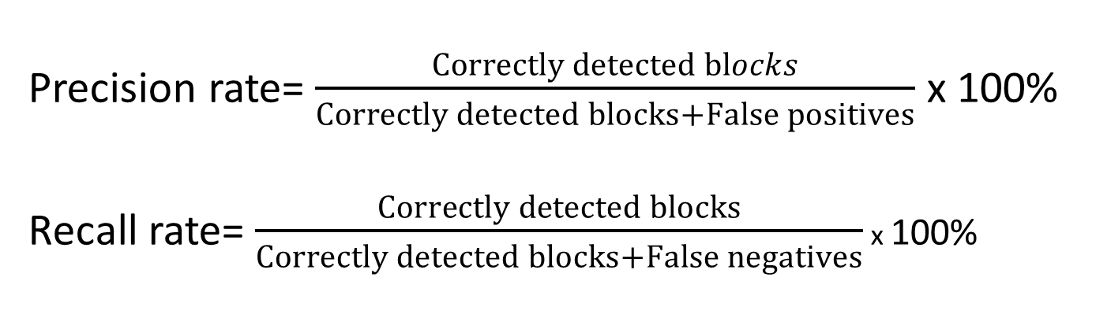
Results and Observations(contd…)
Precision rate= $\frac{Correctly detected blocks}{Correctly detected blocks+False positives}$ x 100%
Recall rate= $\frac{Correctly detected blocks}{Correctly detected blocks+False negatives}$ x 100%
Notes:
Precision rate= $\frac{Correctly detected blocks}{Correctly detected blocks+False positives}$ x 100%...................................(6.1)

Slide 16
Results and Observations(contd…)
Performance Measure of three Methods

Slide 17
Applications
Key word based Image search
Automatic Video Logging
Automatic Text-based Image Indexing
Tourists Guide

Slide 18
Conclusion
The implemented system detects text regions with an overall Precision (47 %) Recall (93 %) and average run time (7 sec) is more efficient compared to that of the performance obtained with edge based method and connected component based method.
We observed that none of the methods, texture based and Edge detection based methods are not good enough to detect the text regions.
One possible way to reduce the false positives is, if we apply edge detection based method in the detected regions, we may reduce the false positives.

Slide 19
Future Scope
Combining the edge, connected component based and texture based algorithms
Morphological cleaning of images
Testing on different kind of images
Testing for hidden text region extraction in a cluttered scene

Slide 20
References
1. Angadi, S.A. and Kodabagi, M.M, Text region extraction from low resolution natural scene images using texture features, Advance Computing Conference (IACC), 2010 IEEE 2ndInternational
2. Xiaoqing Liu and Jagath Samarabandu, An Edge-based text region extraction algorithm for Indoor mobile robot navigation, Proceedings of the IEEE, July 2005.
3. Xiaoqing Liu and Jagath Samarabandu, Multiscale edge-based Text extraction from Complex images, IEEE, 2006.
4. Julinda Gllavata, Ralph Ewerth and Bernd Freisleben, A Robust algorithm for Text Detection in images, Proceedings of the 3rd international symposium on Image and Signal Processing and Analysis, 2003.
5. Anoual, H. and Aboutajdine, D. and Elfkihi, S. and Jilbab, A, Features extraction for text detection and localization, I/V Communications and Mobile Network (ISVC)
6. Sushma, J. and Padmaja, M. Intelligent Agent & Multi-Agent Systems, Text detection in color images, 2009, IAMA 2009
7. Partio, M. and Cramariuc, B.and Gabbouj, M. and Visa, A, Rock texture retrieval using gray level co-occurrence matrix, Proc. of 5th Nordic Signal Processing Symposium

