Slide 1

Advance SAS Project
Dataset - Heart Disease
(Classification Model)
Instructor: Sun Makosso Kallyth
Presented by: Bindiya Singh

Slide 2
Index
Introduction
Description of Dataset
Business Questions and Hypothesis
Data Analysis
Correlation Matrix
Model Building , Evaluation and Selection
ROC-AUC Curve
Confusion Matrix
Feature Importance
Conclusion

Slide 3
Introduction
Heart disease is one of the biggest cause of mortality among the population of the world. Prediction of cardiovascular disease is regarded as one of the most important subjects in the section of clinical data analysis. The amount of data in the healthcare industry is huge. Data mining turns the large collection of raw healthcare data into information that can help to make informed decisions and predictions.
Dataset Attributes:
Age (Num) : age of the patient [years]
Sex (Char): sex of the patient [M: Male, F: Female]
ChestPainType (Char): chest pain type [TA: Typical Angina, ATA: Atypical Angina, NAP: Non-Anginal Pain, ASY: Asymptomatic]
RestingBP (Num): resting blood pressure [mm Hg]
Cholesterol (Num): serum cholesterol [mm/dl]
FastingBS (Num/Discrete): fasting blood sugar [1: if FastingBS > 120 mg/dl, 0: otherwise]
RestingECG (Char): resting electrocardiogram results [Normal: Normal, ST: having ST-T wave abnormality (T wave inversions and/or ST elevation or depression of > 0.05 mV), LVH: showing probable or definite left ventricular hypertrophy by Estes' criteria]
MaxHR (Num): maximum heart rate achieved [Numeric value between 60 and 202]
Exercise Angina (Char): exercise-induced angina [Y: Yes, N: No]
Oldpeak (Num): oldpeak = ST [Numeric value measured in depression]
ST_Slope (Char): the slope of the peak exercise ST segment [Up: upsloping, Flat: flat, Down: down sloping]
Heart Disease (Target Variable) : output class [1: heart disease, 0: Normal]

Slide 4
Objective
To review the current landscape of heart disease prediction: We will examine existing risk assessment tools, clinical guidelines, and predictive models utilized in cardiovascular risk stratification.
To explore predictive analytics methodologies: We will delve into the principles of predictive modeling, including data preprocessing, feature selection, model development, and evaluation techniques specific to heart disease prediction.
To evaluate the performance of predictive models: Through a comparative analysis of various machine learning algorithms and predictive models, we will assess their accuracy, sensitivity, specificity, and clinical utility in predicting heart disease risk.
To discuss implications for clinical practice and future directions: We will discuss the implications of predictive analytics in preventive cardiology, clinical decision support, and population health management, as well as potential avenues for future research and innovation
To generate list of variables impacting target variable.
Business Questions and Hypothesis
What factors (such as age, sex, chest pain type, blood pressure) are associated with the presence of heart disease (Heart Disease = 1)?
Can we predict the likelihood of heart disease based on the given patient characteristics (Age, Sex, ChestPainType)?
How does exercise-induced angina (Exercise Angina) relate to the presence of heart disease?
Is there a correlation between resting electrocardiogram results (RestingECG) and the occurrence of heart disease?

Slide 5
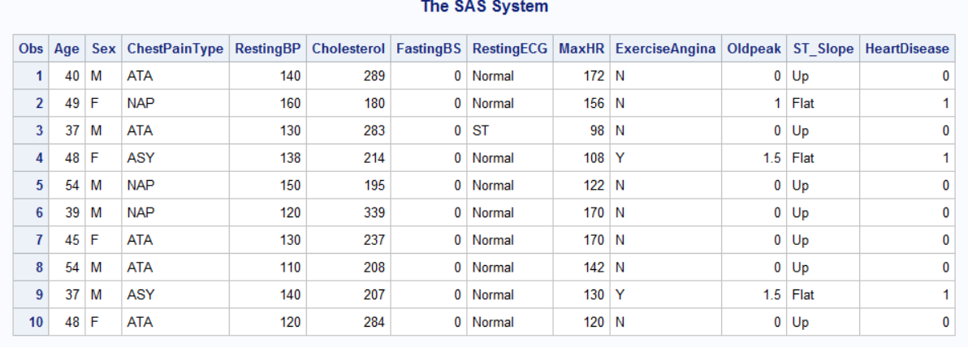
Dataset Imported in SAS Environment

Slide 6
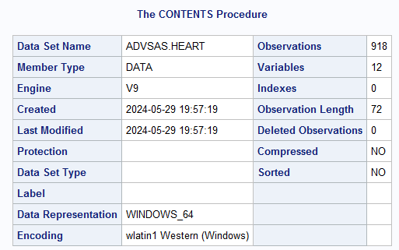
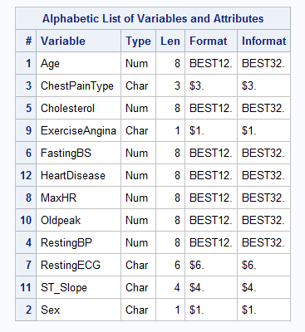
Descriptive Portion of Dataset

Slide 7
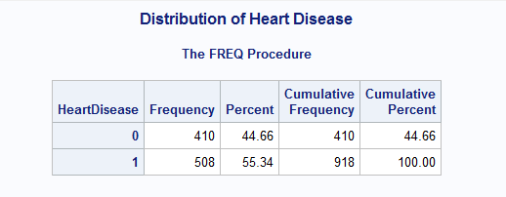
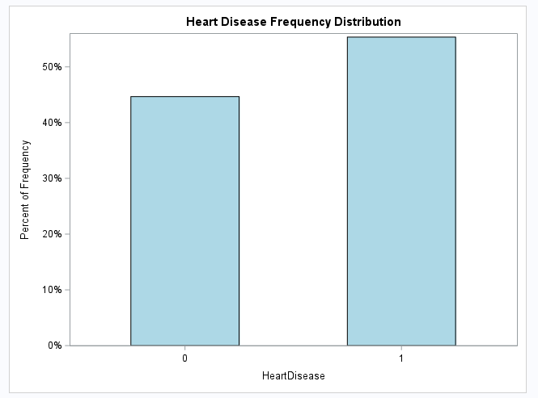
Data Analysis
Target Variable – Heart Disease
0- Individuals without Heart Disease
1- Individuals with Heart Disease

Slide 8
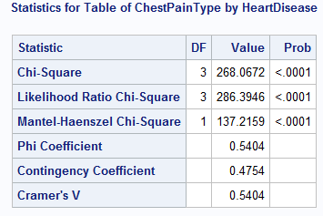
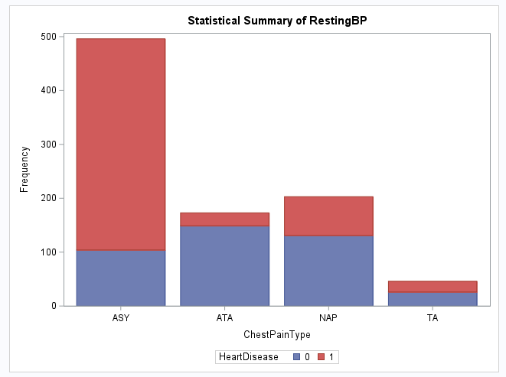
Data Analysis
Heart Disease v/s RestingBP
Insights:
The statistical analysis shows a significant association between Heart disease and RestingBP and are highly associated with each other. The chart indicates that individuals who fall in "ASY“ category have higher percentage of heart disease as compared to other categories.

Slide 9
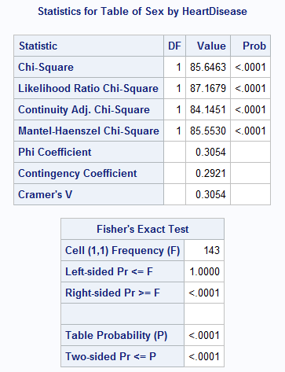
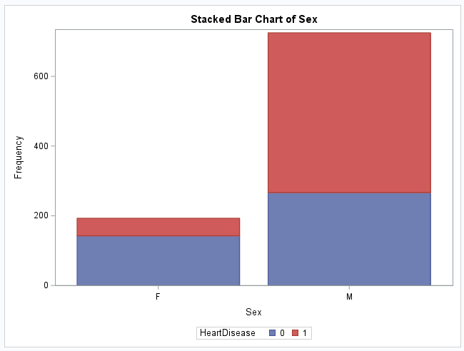
Data Analysis
Heart Disease v/s Sex
Insights:
The statistical analysis shows a significant association between sex and heart disease, with males having a higher observed frequency of heart disease compared to females.

Slide 10
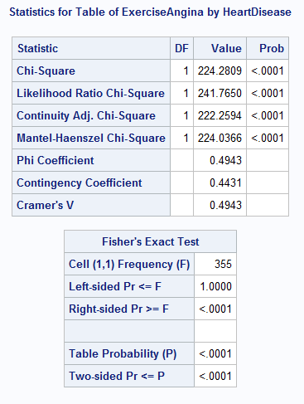
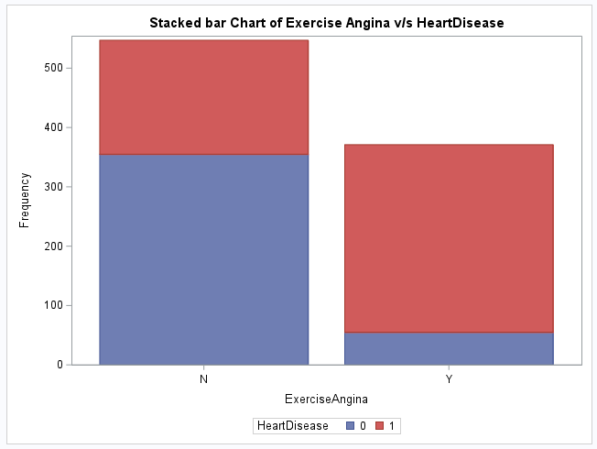
Data Analysis
Heart Disease v/s ExerciseAngina
Insights:
The statistical analysis shows a significant association between Exercise Angina and heart disease. Individuals with Exercise Angina are likely to get Heart Disease.

Slide 11
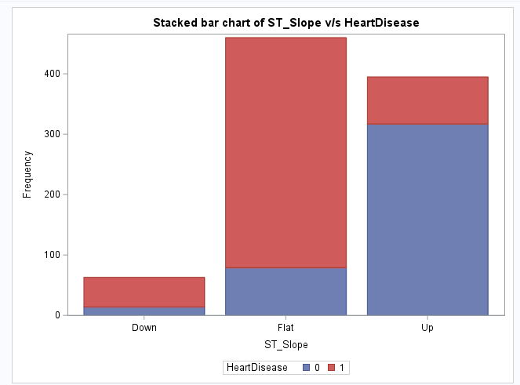
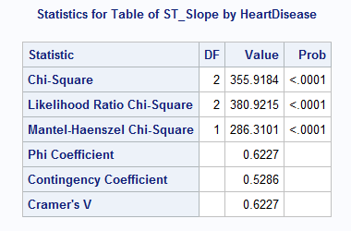
Data Analysis
Heart Disease v/s ST_Slope
Insights:
The statistical analysis shows a significant association between Heart disease and ST_Slope and are highly associated with each other. The chart indicates that individuals who fall in “Flat“ category have higher percentage of heart disease as compared to other categories.

Slide 12
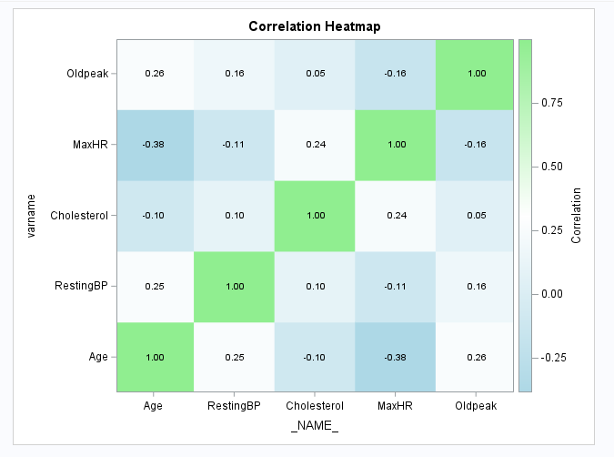
Data Analysis
Correlation Heatmap
Insights:
Low correlation of Age with RestingBP and Oldpeak, but moderate inverse correlation with MaxHR.
Low correlation of Cholesterol with MaxHR and RestingBP.
Overall none of the variables are highly correlated with each other.

Slide 13
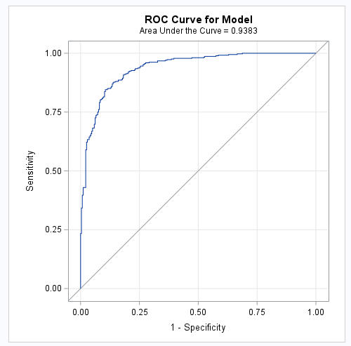
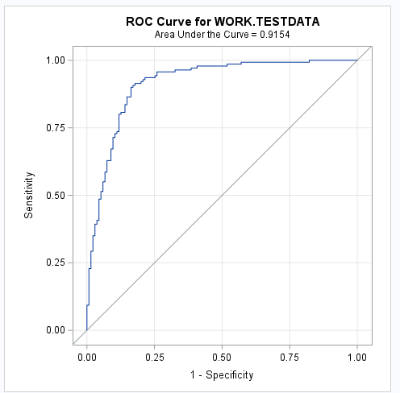
Model Building, Evaluation and Selection
Logistic Regression
Insights:
The higher AUC value of 0.9383 for your model indicates that, on average, it has a stronger ability to correctly classify individuals compared to the work test data. The scores are close to each other is a good sign to go ahead with the model.

Slide 14
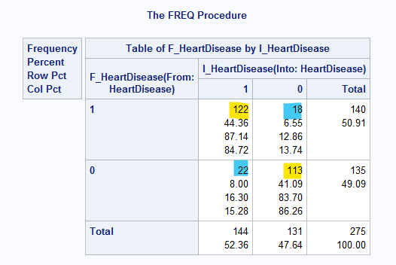
Model Building and Evaluation
Logistic Regression
Confusion Matrix
Precision: 0.8472
Recall: 0.8714
Accuracy: 0.8873
F1 Score: 0.8591
Insights: Overall, the performance metrics collectively suggest that the model is performing reasonably well in predicting heart disease, with a good balance between precision and recall, and a high overall accuracy

Slide 15
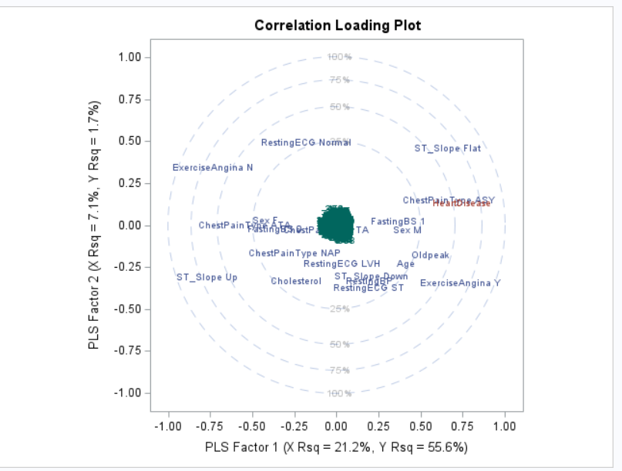
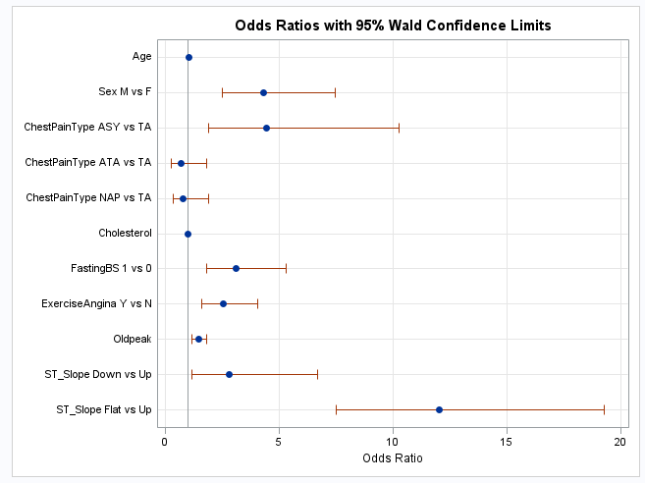
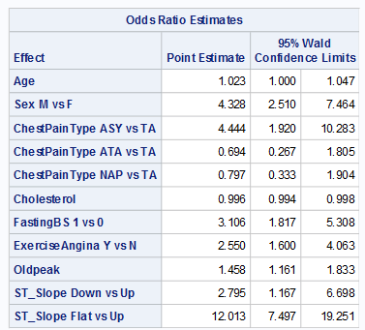
Feature Importance
Important Features impacting target variable ( Heart Disease = 1):
ST_Slope – Flat and Down
ChestPainType(ASY) - Asymptomatic
Sex - Male
FastingBS
Exercise Angina
Oldpeak (ST depression)
Age
Cholesterol

Slide 16
Conclusion
Based on the findings, it's evident that various factors play a crucial role in the likelihood of developing heart disease. Older age, being male, asymptomatic chest pain, elevated fasting blood sugar levels, experiencing exercise-induced angina, higher levels of oldpeak (ST depression), and flat ST segments are all associated with increased odds of heart disease. These findings underscore the importance of considering multiple risk factors when assessing an individual's risk of developing heart disease. By addressing these factors through preventive measures and targeted interventions, it may be possible to mitigate the risk and improve cardiovascular health outcomes. Additional research and clinical studies are needed to delve into the complex interactions among these factors and devise more efficacious approaches for preventing and treating heart disease.

Slide 17
Recommendations
Heading | Description
Risk Assessment and Screening Programs | Implement comprehensive risk assessment and screening programs to identify individuals at higher risk of heart disease based on factors such as age, sex, chest pain type, cholesterol levels, fasting blood sugar levels, and exercise-induced angina. Regular screenings can help detect risk factors early and initiate appropriate interventions.
Patient Education and Lifestyle Modifications | Provide education to patients about the modifiable risk factors for heart disease, such as maintaining a healthy diet, regular physical activity, smoking cessation, and managing blood sugar and cholesterol levels. Encourage lifestyle modifications to reduce the risk of developing heart disease.
Tailored Treatment Plans | Develop personalized treatment plans for patients based on their specific risk factors and medical history. Consider integrating multidisciplinary approaches involving cardiologists, endocrinologists, dietitians, and exercise physiologists to provide comprehensive care.
Monitoring and Follow-Up | Implement systems for ongoing monitoring and follow-up of patients with known risk factors for heart disease. Regular check-ups, lab tests, and diagnostic procedures can help track changes in risk factors and adjust treatment plans accordingly
Research and Innovation | Support research initiatives aimed at better understanding the mechanisms underlying heart disease and identifying novel therapeutic targets. Invest in innovative technologies and diagnostic tools for early detection and prevention of heart disease.
Collaboration and Partnerships | Foster collaborations with community organizations, primary care providers, and other healthcare institutions to promote cardiovascular health initiatives, raise awareness, and reach underserved populations

Slide 18
Thank you

