Slide 1

Machine Learning and
Deep Learning Project
Bank’s Churn Dataset
-By Bindiya Singh

Slide 2
INDEX
Business Problem
Data Preprocessing
Exploratory Data Analysis
Correlation Matrix
Model Training and Hyperparameter Tuning
Model Evaluation
Recommendation
Conclusion

Slide 3

Bank’s Churn Dataset
Business Problem: ABC Multistate bank is concerned about customers leaving their Banking services.
The goal of this analysis is to create a model that returns the probability of a customer to churn. This prediction will help the bank proactively engage with at-risk customers, provide better services, and ultimately reduce customer churn.
Sr no | Name | Description
1 | CustomerID | Identity number of each customer
2 | RowNumber | Identity number of each row
3 | Surname | Last name of customer
4 | CreditScore | Credit Score of customer
5 | Geography | Country of Residence
6 | Gender | Gender of the customer
7 | Age | Age of the customer
8 | Tenure | How long they have been using account
9 | Balance | Amount in account
10 | NumOfProducts | The number of bank products used
11 | HasCrCard | Has a credit Card
12 | IsActiveMember | Is actively operating with the Bank
13 | EstimatedSalary | Salary estimated by bank
14 | Exited | Terminated their Banking relationship

Slide 4
Data Preprocessing and Feature Engineering
Data Cleaning
14 Features
Data Normalization
Data Binning
4 Features
4 Features
Data Transformation
2 Features
Dropped Irrelevant Features
3 Features
4 Features | 3 Features | 4 Features | 2 Features
Balance | RowNumber | Balance | Gender
Age | CustomerID | Age | Geography
CreditScore | Surname | CreditScore
EstimatedSalary |  | EstimatedSalary

Slide 5
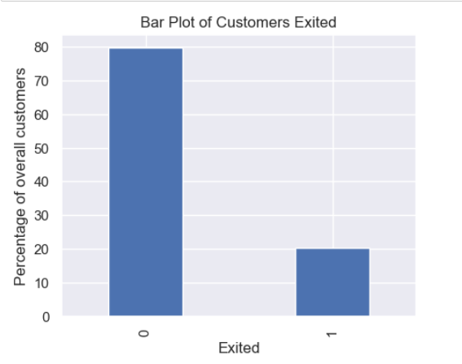

Exploratory Data Analysis
Comparison of Independent Variables with Dependent Variable ( ‘Exited’)
Distribution of Target Variable - Exited
This data represents the distribution of customer churn (Exited) in the dataset. About 20% of customers have churned (Exited = 1), while approximately 80% are banking with the Bank(Exited = 0). It shows the distribution is highly imbalanced.

Slide 6
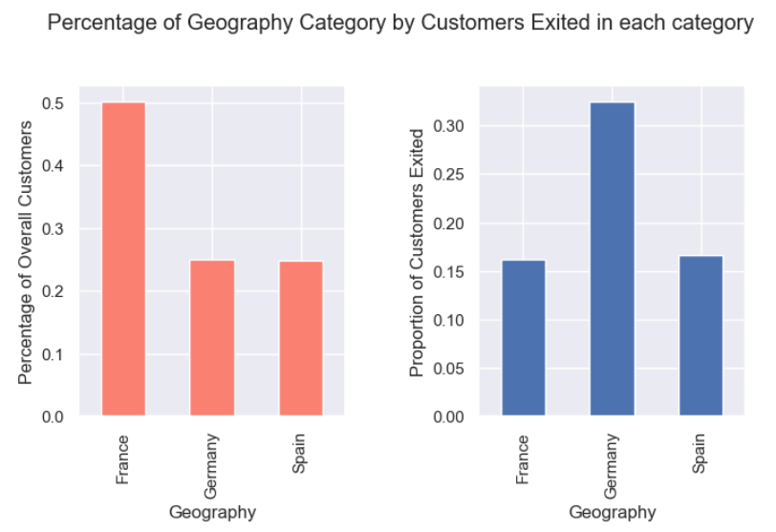
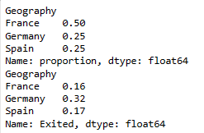
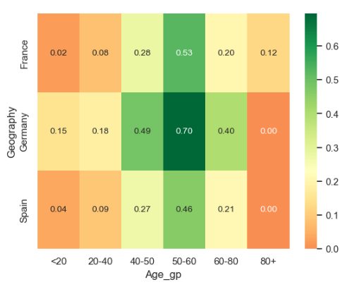
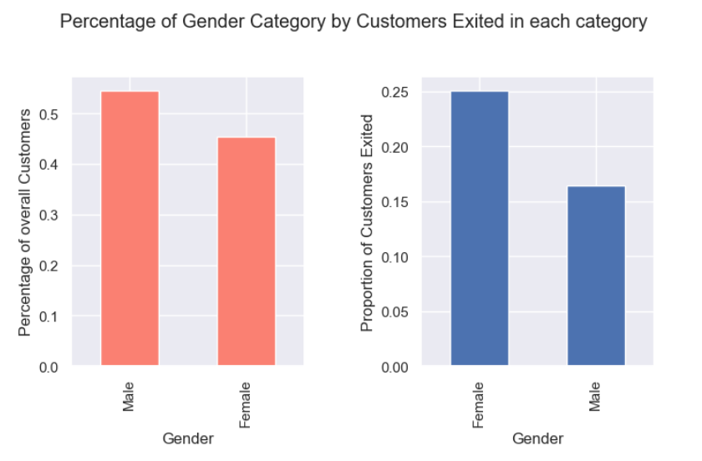
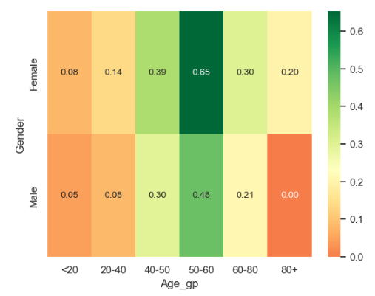
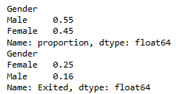
Exploratory Data Analysis
Comparison of Independent Variables with Dependent Variable ( ‘Exited’)
Geography – Exited Status
Geography , Age by Exit status
Conclusion :
Customers from Germany are more likely to Exit as compared to France and Spain. In Germany , maximum customers between age group 50-60 have churned . (Chi-square test)
Gender – Exited Status
Gender , Age by Exit status
Conclusion :
Female customers are more likely to exit compared to males. 65% of the total female customers are between 50-60 age group.
(Chi-square test)

Slide 7
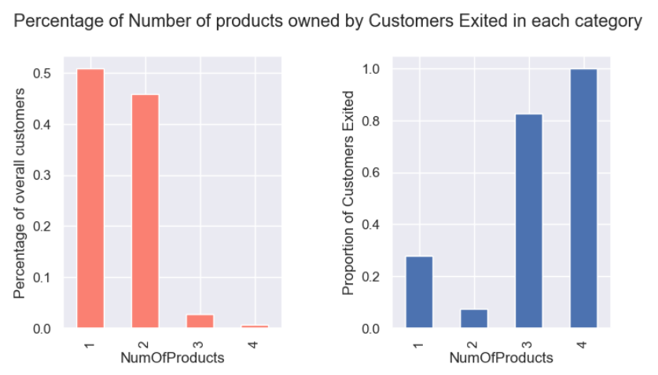
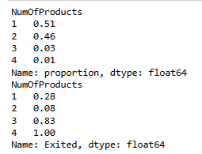
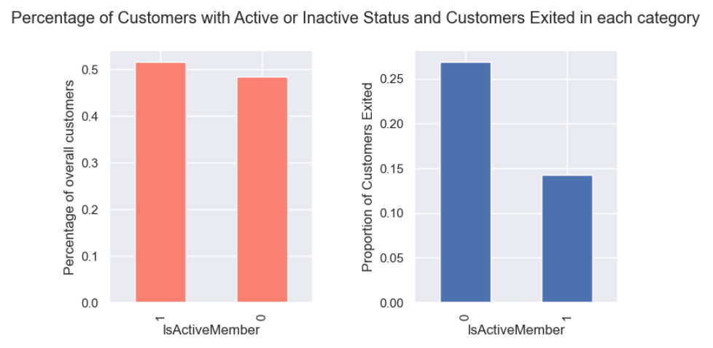
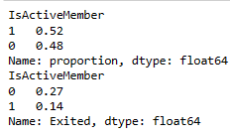
Exploratory Data Analysis
NumOfProducts – Exited Status
Conclusion :
The customers holding 3 to 4 Bank products are more likely to churn .
(Chi-square test)
IsActiveMember– Exited Status
Conclusion :
The customers with inactive status are more likely to churn.
(Chi-square test)

Slide 8
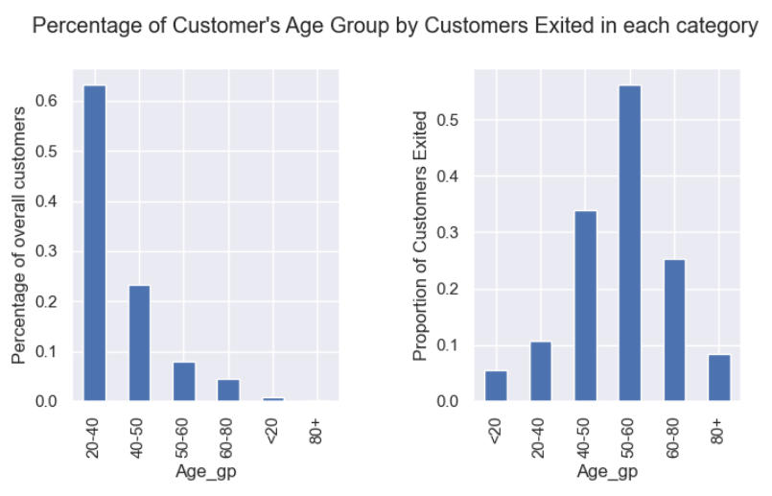
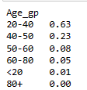
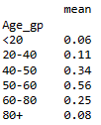
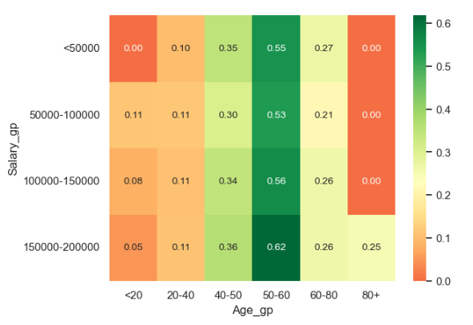
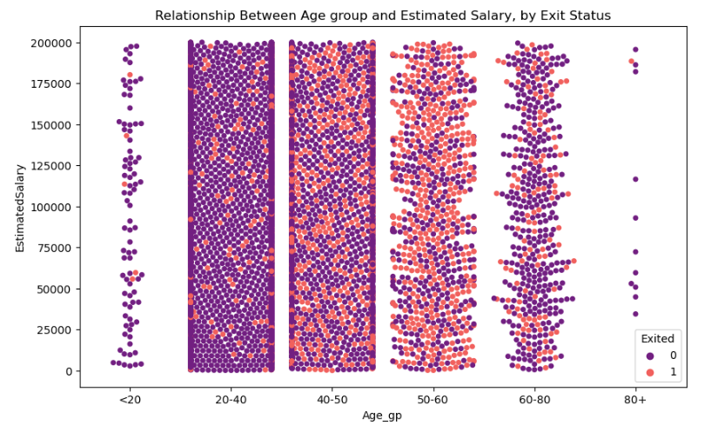
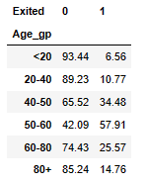
Exploratory Data Analysis
Age Group – Exited Status
The analysis shows that the customers, particularly those in the 40-50 and 50-60 age groups, have higher exit rates compared to younger age groups.
Age , Salary by Exit Status

Slide 9
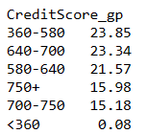
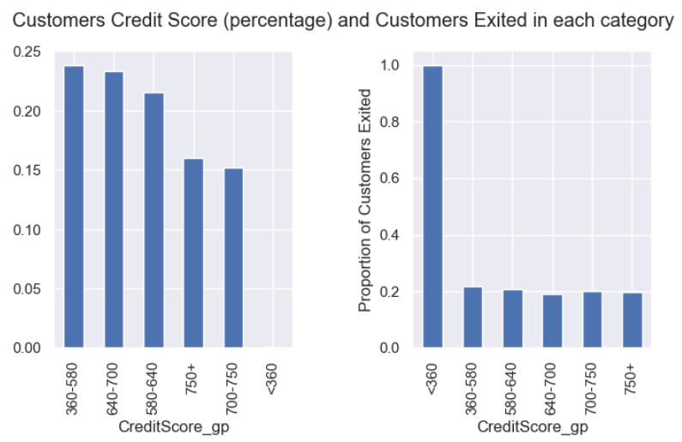
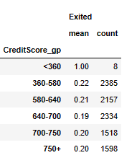
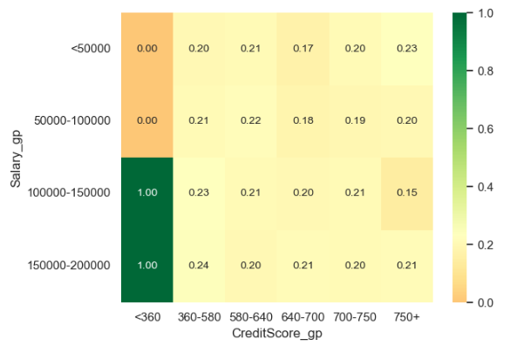
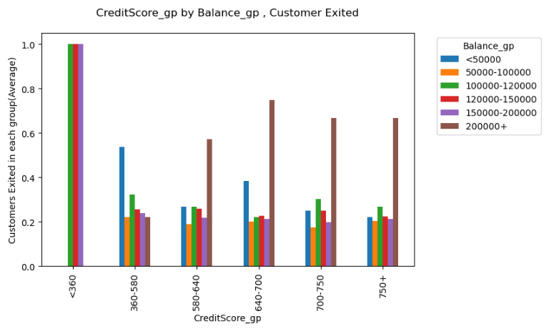
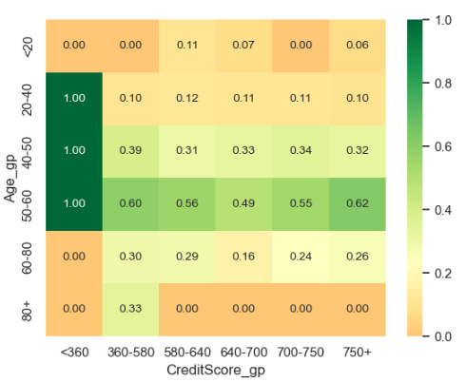
Exploratory Data Analysis
Credit Score – Exited Status
Customers having credit score below 360 with estimated salary and balance between 100k to 200k and age between 50-60 have exited the bank .
Credit Score and Age by Exit Status
Credit Score and Salary by Exit Status

Slide 10
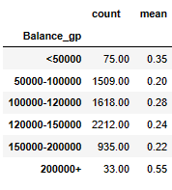
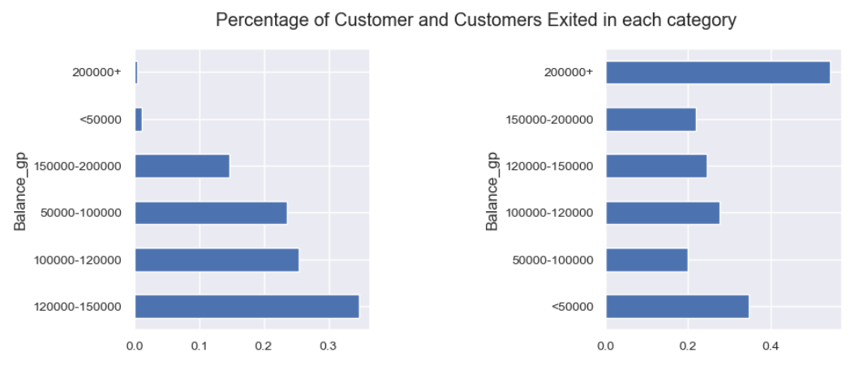
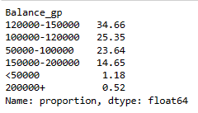
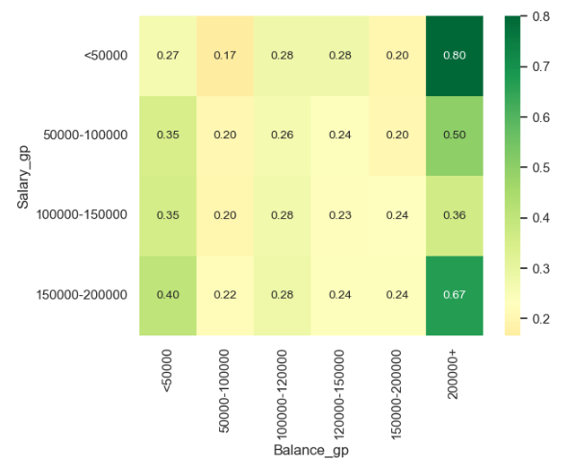
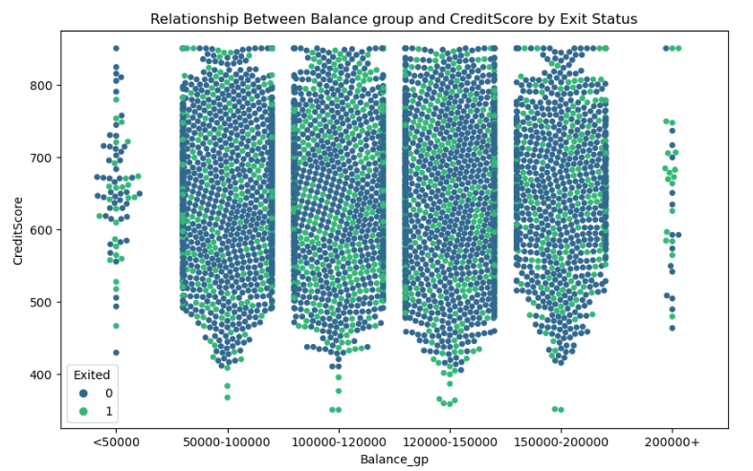
Exploratory Data Analysis
Balance-Exited Status
Conclusion:
The customers holding balance more than $200k are more likely to churn as compared to others.
From the above category, maximum customers had their estimated salary either less than 50k and more than 150k.
(Chi-square test)
Balance, Salary by Exit Status

Slide 11
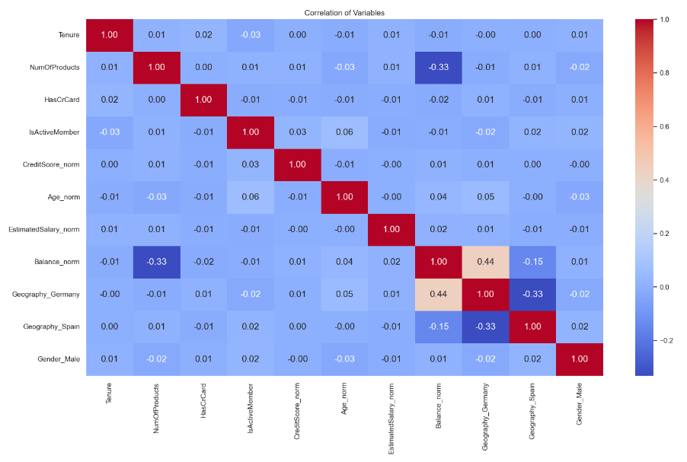
Correlation Matrix
Interpretations:
Geography_Germany and Balance_norm:
Moderate positive correlation (0.44): There is a significant moderately positive correlation between the variables and indicates customers from Germany to have higher account balance as compared to others.
Balance_norm and NumOfProducts:
Moderate negative correlation(-0.33): These two variables are inversely related. The customers with a higher number of products have lower account balances and vice versa.

Slide 12
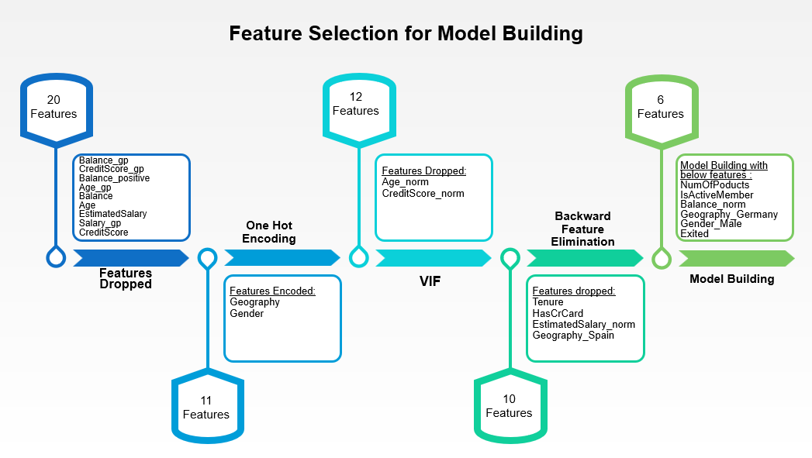

Slide 13
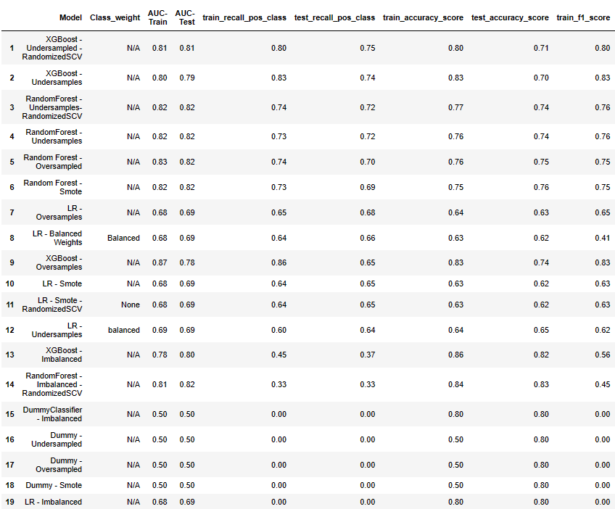
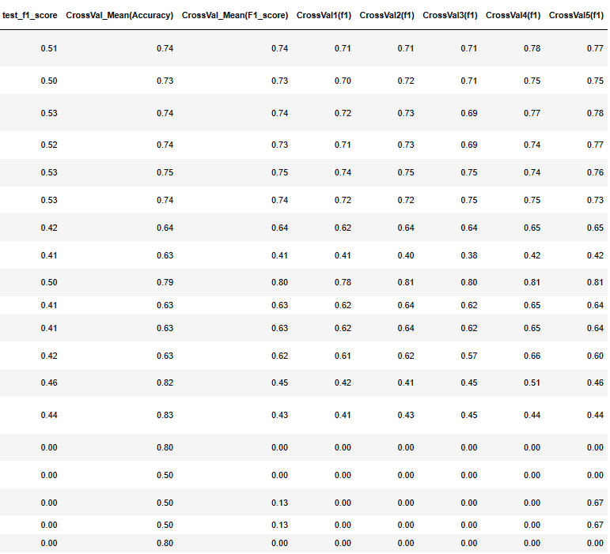
Model Training and Hyperparameter Tuning

Slide 14
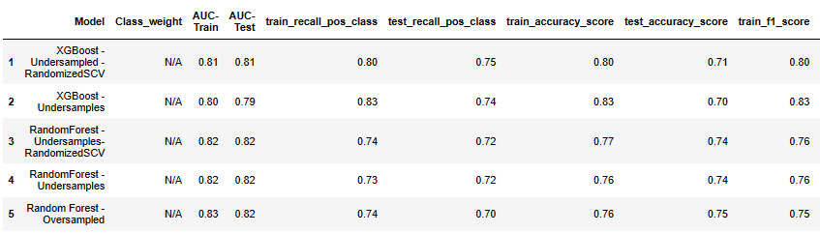
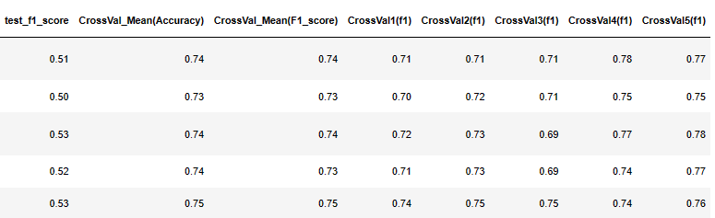
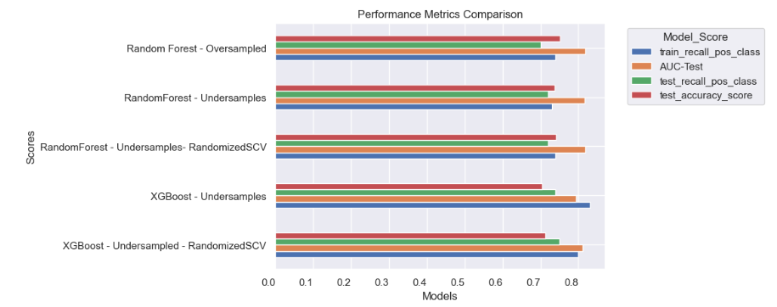

Model Evaluation
Based on the evaluation metrics, RandomForest – Under samples - RandomizedSCV model and XGBoost - Under samples - RandomizedSCV model seems to perform the best. Both have relatively high AUC scores, recall rates, accuracy scores, F1 scores, and cross-validation mean scores compared to other models.
Out of these two RandomForest - Under samples - RandomizedSCV Model is likely the best choice among the given options.

Slide 15
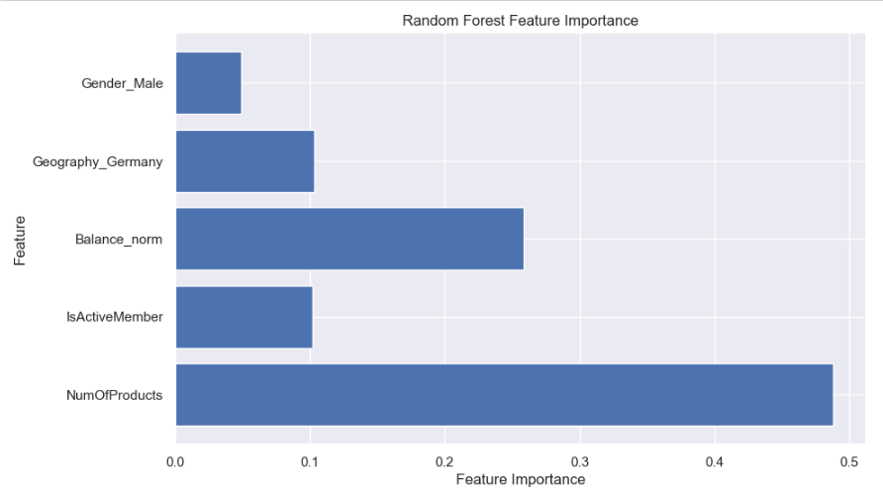
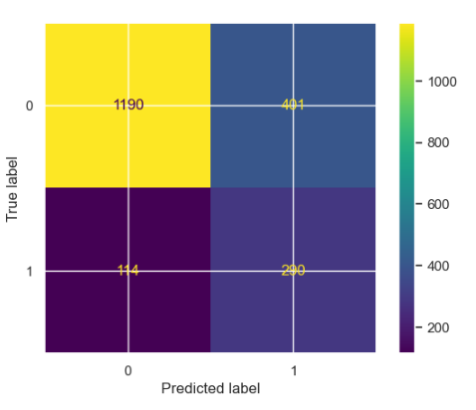

Model Evaluation
RandomForest – Under samples - RandomizedSCV model
Confusion Matrix
NumOfProducts
IsActiveMember
Balance_norm
Geography_Germany
Gender_Male

Slide 16
Recommendations
Cross-Selling Strategy: Focus on cross-selling additional products to customers who have fewer products. Identify customers with only one or two products and offer them tailored promotions or incentives to encourage them to acquire more banking products.
Customer Segmentation: Segment customers based on the number of products they currently own. Develop targeted marketing campaigns for each segment to address their specific needs and encourage them to expand their product portfolio.
Product Bundling: Offer bundled packages that combine multiple products at a discounted rate. This strategy can incentivize customers to consolidate their banking services with the bank and increase the number of products they own.
Customer Retention: Pay special attention to customers who own multiple products and implement retention strategies to keep them satisfied and engaged. Offer exclusive benefits or rewards to loyal customers to prevent attrition and maintain a strong relationship with the bank.
Targeted Product Offerings: Offer premium banking products or investment opportunities to customers with higher balances.

Slide 17
Conclusion
The number of products availed by customers emerges as a significant factor influencing churn within the bank. Understanding this relationship underscores the importance of strategic initiatives aimed at enhancing customer retention. By addressing the needs and preferences of customers with varying product portfolios, the bank can implement targeted measures to mitigate churn, thereby fostering stronger, more enduring relationships and bolstering overall customer satisfaction and loyalty.

Slide 18
Thank you

