Slide 1
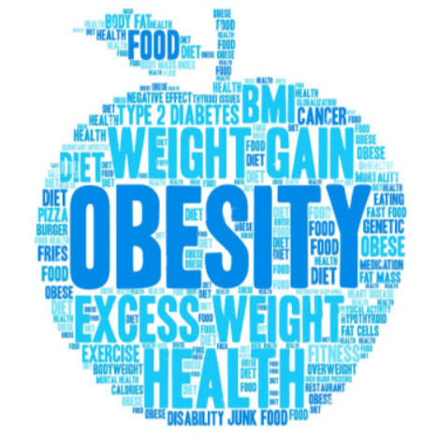
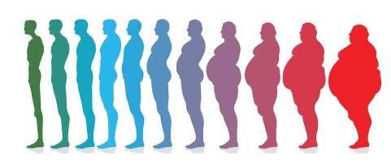
OBESITY CATEGORY PREDICTION
Instructor :Vijay Kumar
Python Project
Bindiya Singh

Slide 2
INDEX
Introduction
Business Problem
Objective
Business Questions and Hypothesis
Data Preprocessing Steps Covered
Exploratory Data Analysis
Correlation Matrix
Model Training and Hyperparameter Tuning
Model Evaluation
Conclusion

Slide 3
Obesity Dataset
Introduction
Description of Dataset :
The Analysis presents data for the estimation of obesity levels in individuals from the countries of Mexico, Peru, and Colombia, based on their eating habits and physical condition. The data contains 17 attributes and 2132 records, the records are labeled with the class variable NObesity (Obesity Level), which allows classification of the data using the values of Insufficient Weight, Normal Weight, Overweight Level I, Overweight Level II, Obesity Type I, Obesity Type II and Obesity Type III Height
S No | Feature Name | Description | Variable Type | Values
1 | Gender | Gender of the person | Categorical | Male or Female
2 | Age | Age in years | Integer | 14 to 61
3 | Height | Height in meters | Float | 1.45m to 1.98m
4 | Weight | Weight in kilograms | Float | 39kgs to 173 kgs
5 | Family History with Overweight | Family history of Obesity | Categorical | Yes or No
6 | FAVC | High Caloric Food Consumption | Categorical | Yes or No
7 | FCVC | Frequency of Vegetable Intake | Ordinal | 1 to 3
8 | NCP | Number of Primary Meals | Ordinal | 1 to 4
9 | CAEC | Consumption of food between meals | Ordinal | Sometimes , Frequently, Always, No
10 | Smoke | Smoking habit | Categorical | Yes or No
11 | CH2O | Water consumption per day | Ordinal | 1 to 3
12 | SCC | Tracking Calorie Consumption | Categorical | Yes or No
13 | FAF | Frequency of Physical Activity | Ordinal | 0 to 3
14 | TUE | Time spent on electronic gadgets | Ordinal | 0 to 2
15 | CALC | Alchohol Consumption | Categorical | Sometimes , Frequently, Always, No
16 | MTRANS | Type of transportation used | Categorical | Public_Transportation, Automobile, Walking, Motorbike, Bike
17 | Nobeyesdad |  | Target | Obesity_Type_I, Obesity_Type_III, Obesity_Type_II Overweight_Level_II, Normal_Weight, Overweight_Level_I, Insufficient_Weight

Slide 4
Obesity Dataset
Introduction
Business Problem:
Obesity is a growing concern worldwide, and its prediction is crucial for preventing and managing related health problems. Obesity is one of the biggest risk factors for a variety of chronic diseases, including heart disease and cancer. The World Health Organization (WHO) defines obesity as an abnormal or excessive deposition of fat that has the potential to severely impact health. Obesity can have a detrimental impact on health (BMI)
Objective:
The analysis aims to develop a reliable and accurate model for predicting obesity levels based on various demographic and lifestyle factors
Business Questions and Hypothesis:
- Which all features are statistically associated with Obesity levels?
- Is there a significant difference in obesity prevalence between genders?
- Is Family history of overweight influence an individual's obesity status?
- Is Monitoring Calorie Consumption reduces the chance of obesity?
- Is Family History with Overweight and Consumption of High Caloric Food are highly associated?
- Which features are important for the prediction?
- What is the Accuracy, Recall, Precision, and F1 score of the model?

Slide 5
Data Preprocessing and Feature Engineering
Data Exploration
Data Cleaning
Feature Engineering
Model Building
Dataset Shape
Variable Datatype
Variable Description
Missing Values
Duplicate Values
Outliers
Univariate, Bivariate and Multivariate Analysis
Outliers
Duplicate Data
Transformed Variable Type
Missing Values
One Hot Encoding
New Feature Created
6 Models Built

Slide 6
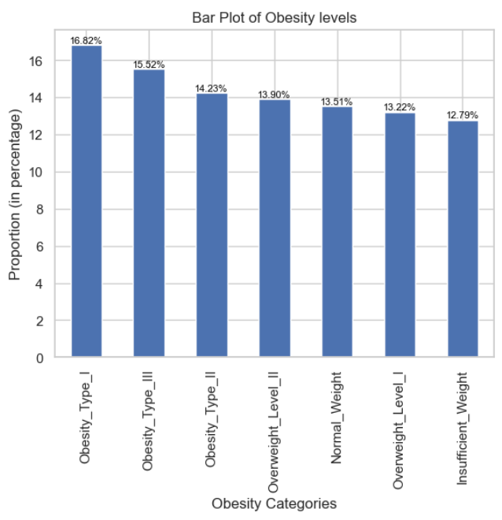
Exploratory Data Analysis
Target Variable – Obesity Categories (‘Nobeyesdad’)
Obesity Categories Proportion
Obesity_Type_I 16.82
Obesity_Type_III 15.52
Obesity_Type_II 14.23
Overweight_Level_II 13.90
Normal_Weight 13.51
Overweight_Level_I 13.22
Insufficient_Weight 12.79

Slide 7
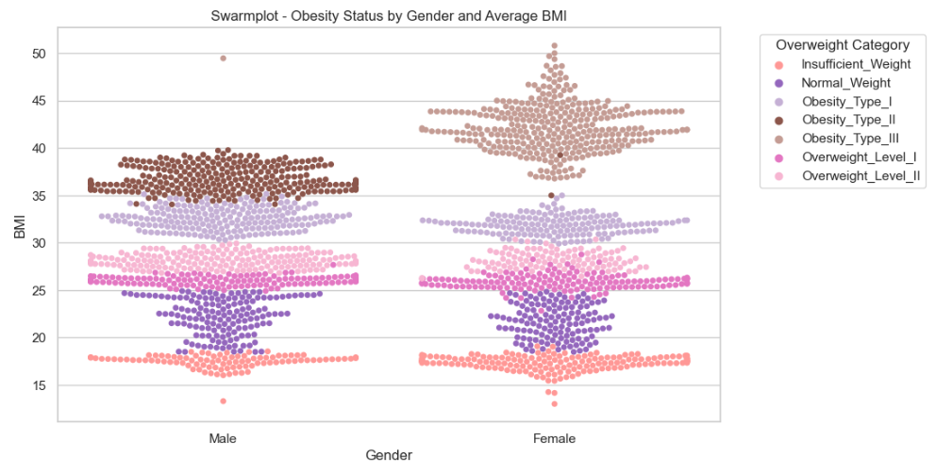
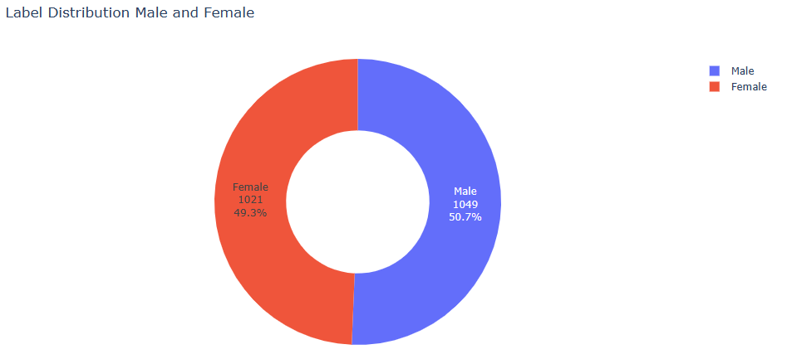
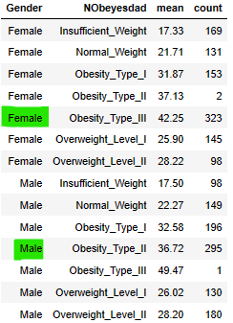
Exploratory Data Analysis
Obesity Category by Gender and Average BMI
Conclude :
Male tend to have higher rate of Obesity Type II as compared to Females who are more prone to Obesity Type III .

Slide 8
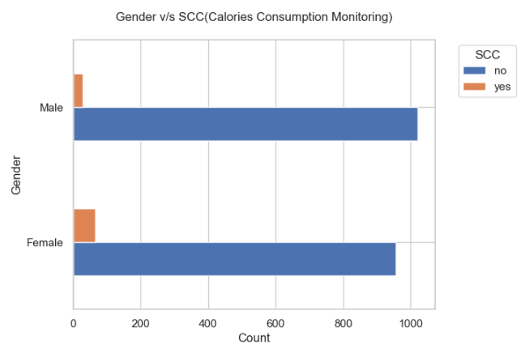

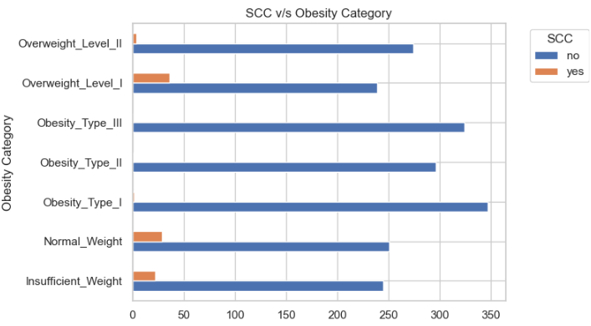
Exploratory Data Analysis
Gender and SCC ( Calories Consumption Monitoring )
Conclude :
There is a statistical significant correlation between Gender and SCC at 0.05 significance level.
Females are more likely to monitor calorie consumption. Individuals who do not monitor their calorie intake are more likely to have either Obesity Type I or Obesity Type III.

Slide 9
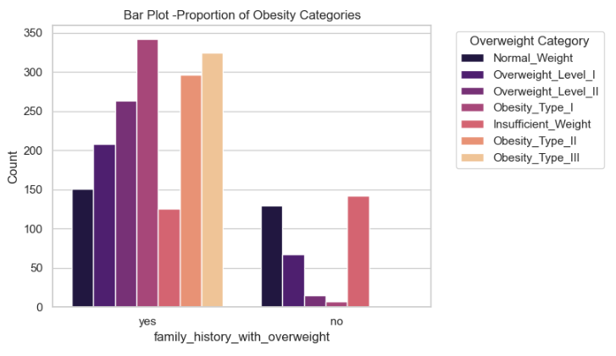
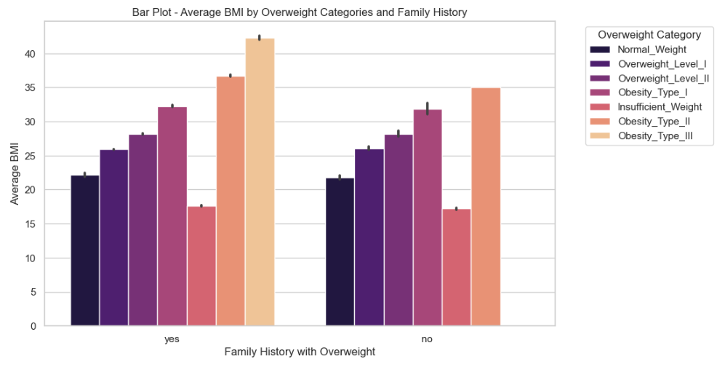
Exploratory Data Analysis
Family History with Overweight and Obesity Categories by Average BMI
Conclude:
There is statistically significant association between Obesity Category and individuals having family history of overweight.
Responders having family history with overweight status are more likely to have Obesity_Type_I or Obesity_Type_III

Slide 10
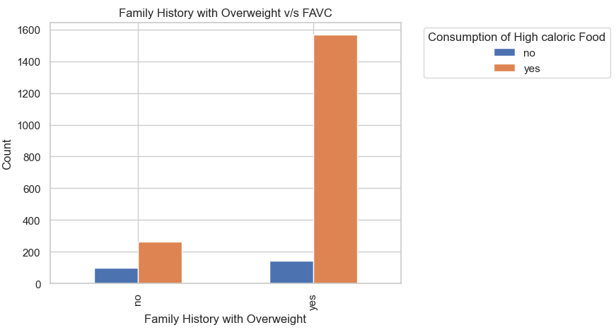

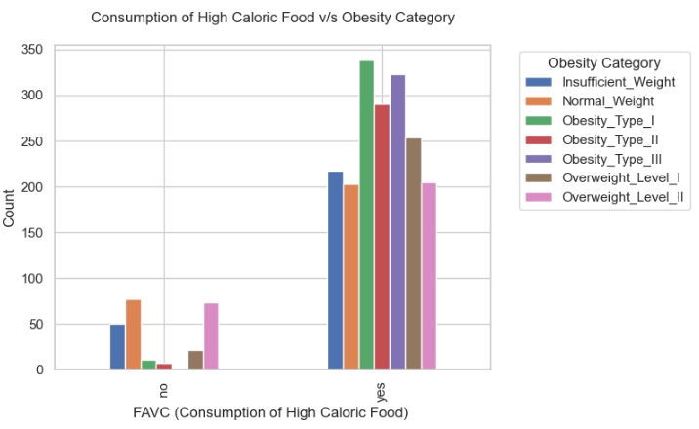
Exploratory Data Analysis
Family History of Overweight and Consumption of High Caloric Food (FAVC)
Conclude :
There is statistically significant correlation between respondents consuming High Caloric Food and family history of overweight.
Individuals with a family history of overweight are more likely to exhibit frequent consumption of high-caloric food and likely to fall in Obesity Type I or Obesity Type III category.

Slide 11
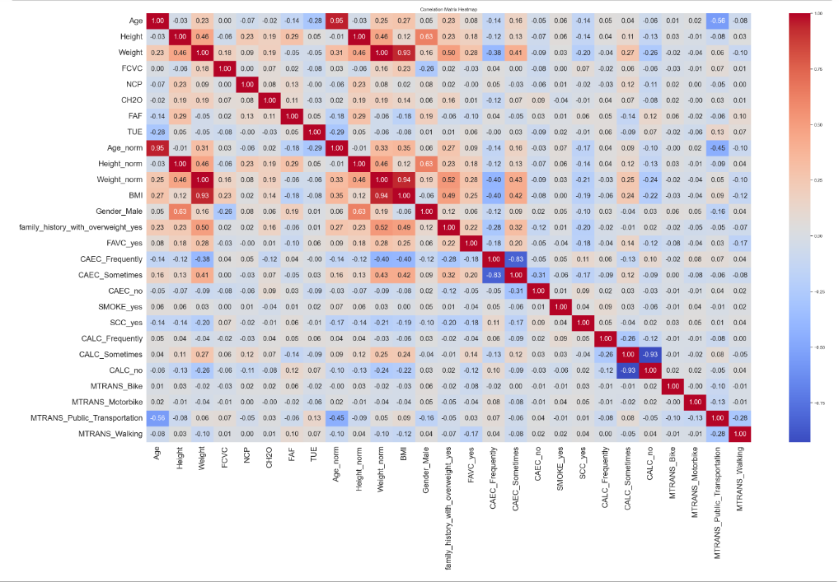
Correlation Matrix
Columns Dropped:
Features Normalised and dropped:
Age
Height
Weight
New Feature Created “BMI”:
Weight norm
Height norm
Inverse Relationship between
CALC_Sometimes(Consumption of Food) and CAEC Frequently(-0.83):
CALC_Sometimes dropped
Inverse Relationship between
CALC_Sometimes( Alcohol Consumption )and CALC_no(-0.93):
CALC_no Dropped

Slide 12
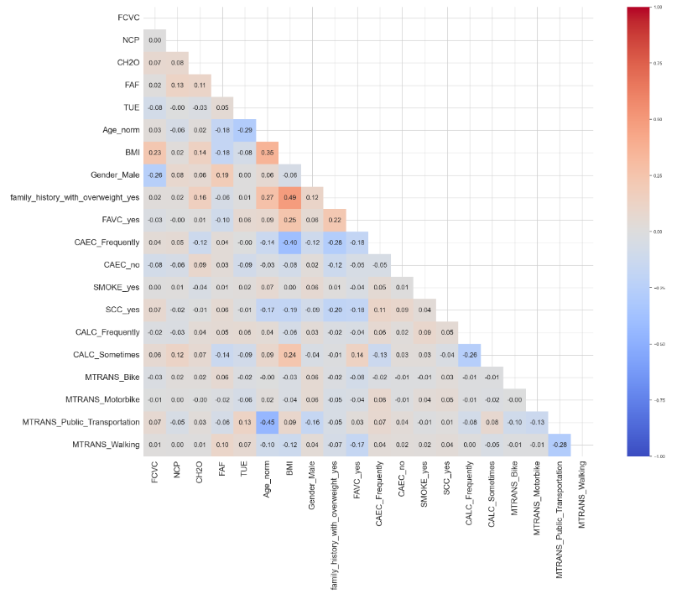
Correlation Matrix
Features selected for Model Building:
FCVC (Frequency of Vegetable Intake)
NCP (Number of Primary Meals)
CH2O (Water Consumption per day)
FAF (Frequency of Physical Activity)
TUE (Time spent on Electronic Gadgets)
Age_norm (Normalized Age)
BMI (Body Mass Index)
Gender_Male (Male Gender)
Family_history_with_overweight_yes
FAVC_yes (High caloric Food Consumption)
CAEC_Frequently (Consumption of Food between meals)
CAEC_no (Consumption of Food between meals)
SMOKE_yes
SCC_yes (Tracking Calorie Consumption)
CALC_Frequently (Alcohol Consumption)
CALC_Sometimes (Alcohol Consumption)
MTRANS_Bike (Mode of Transport)
MTRANS_Motorbike (Mode of Transport)
MTRANS_Public_Transportation (Mode of Transport)
MTRANS_Walking (Mode of Transport)

Slide 13
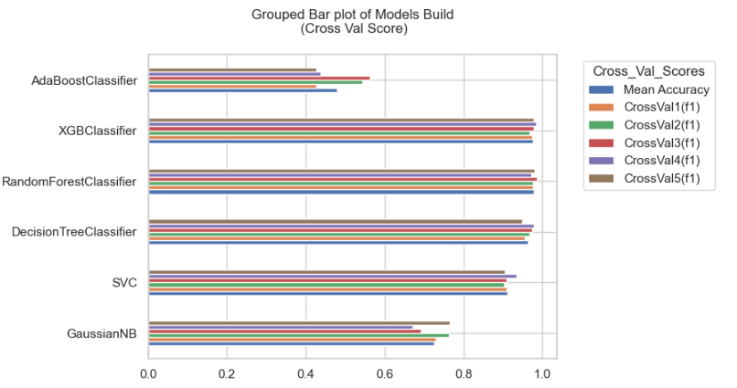
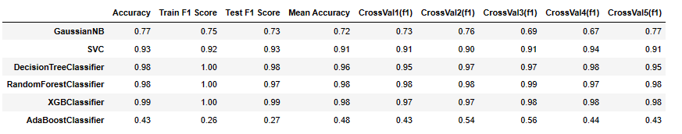
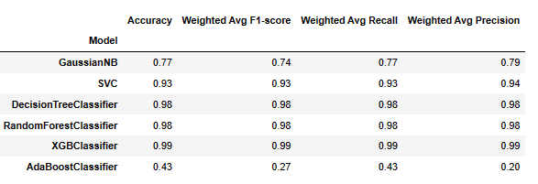
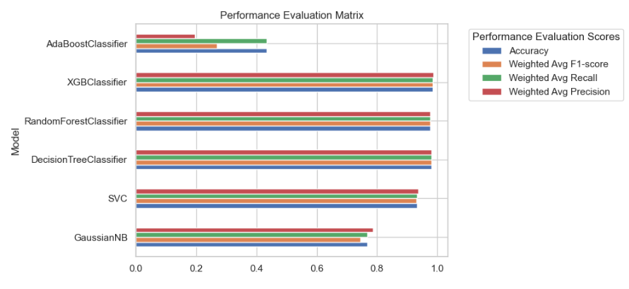
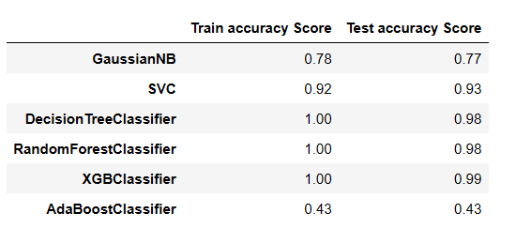

Model Training and Hyperparameter Tuning
(Model Building)

Slide 14
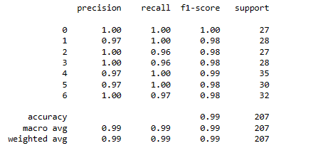
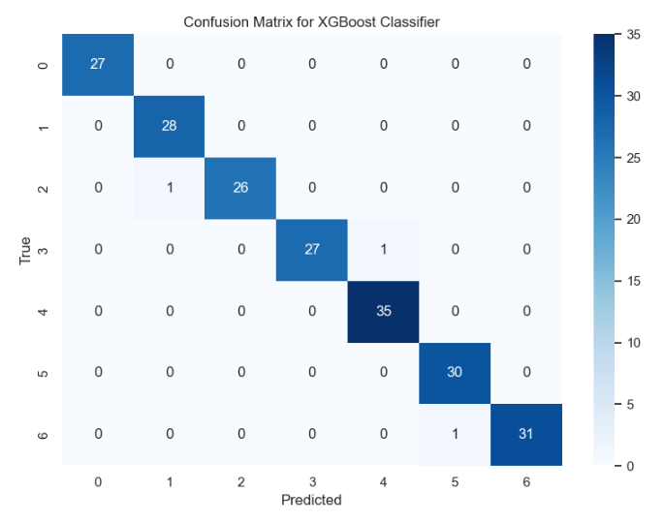
Model Evaluation
XGBoost Classifier - Confusion Matrix
Obesity Categories
0 : Insufficient_Weight
1 : Normal_Weight
2 : Overweight_Level_I
3 : Overweight_Level_II
4 : Obesity_Type_I
5 : Obesity_Type_II
6 : Obesity_Type_III

Slide 15
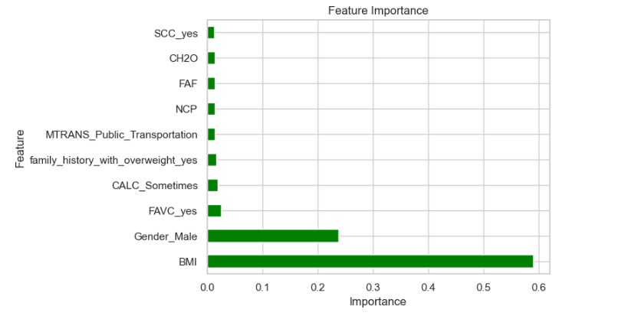
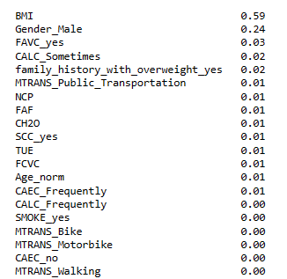
Feature Importance
( XGBoost Classifier Model )

Slide 16
Conclusion
BMI (Body Mass Index): With a high importance score of 0.57, BMI plays a significant role in predicting obesity. BMI is calculated using an individual's weight and height, providing a measure of body fatness. Higher BMI values indicate higher levels of body fat, which are associated with increased risk of obesity.
Gender_Male: Gender_Male has a substantial importance score of 0.24, indicating its notable influence on the prediction of obesity. Male gender is associated with different body composition and metabolic rates compared to females, contributing to differences in obesity risk between genders.
FAVC_yes (Consumption of High Caloric Food): With an importance score of 0.03, FAVC_yes suggests that the consumption of high-caloric foods significantly impacts obesity prediction. High-caloric foods are often associated with weight gain and increased body fat, contributing to the development of obesity.
CALC_Sometimes (Alcohol Consumption): While less impactful compared to other features, CALC_Sometimes, representing alcohol consumption, still holds some influence (importance score of 0.02) on obesity prediction. Excessive alcohol consumption can contribute to weight gain and obesity due to its high calorie content and effects on metabolism.
family_history_with_overweight_yes (Family History with Overweight): Family history of overweight has an importance score of 0.02, indicating its role in obesity prediction. Genetic predispositions inherited from family members can influence body weight and fat distribution, contributing to the development of obesity.
MTRANS_Public_Transportation (Transportation Used): This feature, with an importance score of 0.02, suggests that the mode of transportation used by individuals influences obesity prediction. Public transportation use may be associated with lower levels of physical activity, potentially increasing the risk of obesity.
NCP (Number of Main Meals): NCP has a lower importance score of 0.01 but still contributes to obesity prediction. Dietary habits, including the number of main meals consumed per day, can impact calorie intake and weight management, influencing the risk of obesity.
FAF (Physical Activity Frequency): Similarly, FAF with an importance score of 0.01 indicates that physical activity frequency influences obesity prediction. Regular physical activity helps burn calories, maintain muscle mass, and control weight, reducing the risk of obesity.
CH2O (Consumption of Water Daily): With an importance score of 0.01, CH2O suggests that daily water consumption plays a minor role in obesity prediction. Adequate hydration can support weight management by promoting satiety and reducing calorie intake.
SCC_yes (Calories Consumption Monitoring): Lastly, SCC_yes with an importance score of 0.01 indicates that monitoring calorie consumption influences obesity prediction. Awareness of calorie intake can help individuals make informed dietary choices and maintain a healthy weight.
In summary, the analysis indicates that BMI, gender, and certain dietary behaviors are the most important factors influencing the target variable, while other lifestyle factors such as transportation mode and snacking habits also contribute to a lesser extent.

Slide 17
Thank you

