Slide 1

Tableau Project
Data Visualizations with Tableau
(Sales Dataset)
Instructor:
Mr. Rahul Gurnani
Presented by :
Group 4
Notes:
Hello everyone , Today I am here to present my analysis on Obesity dataset .

Slide 2
Index
Introduction
Business Objective
Exploratory Data Analysis
Profitable sub-categories
Non-Profitable sub-categories
Conclusion & Recommendations

Slide 3
Introduction
With growing demands and cut-throat competitions in the market, a Superstore Giant is seeking knowledge in understanding what works best for them. They would like to understand which products, regions, categories and customer segments they should target or avoid. The sales database contained 8390 columns and 21 columns.
Business Objective :
The objective of analyzing the Superstore dataset in Tableau is to uncover insights into sales performance and market trends, identify opportunities for growth and operational efficiency, and make data-driven recommendations to drive strategic decision-making and improve overall business performance.
Methodology:
Initially, we conducted a thorough cleaning of the dataset, which was sourced from an open-source platform.
Upon thorough examination, we confirmed that the dataset was indeed clean and ready for further examination.
Subsequently, we imported the cleaned dataset into Tableau for in-depth analysis.
Utilizing Tableau's capabilities, we analyzed the dataset comprehensively and developed interactive dashboards and stories to present our insights effectively.
Notes:
Obesity dataset consist of information on the obesity levels of the individuals from Mexico, Peru, and Columbia, based on their eating habits and physical conditions. It consist of 17 attributes and 2132 observations.

Slide 4
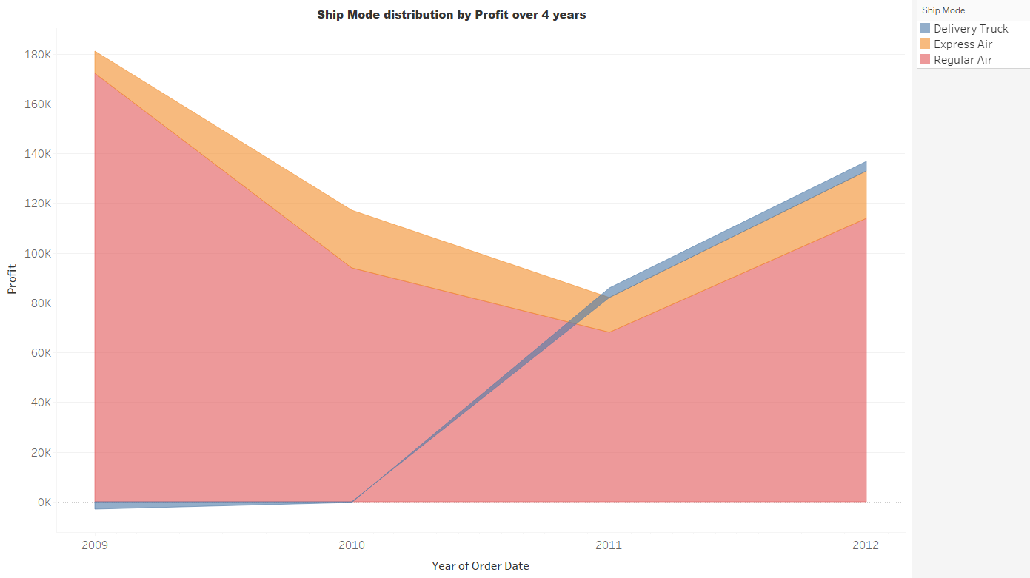
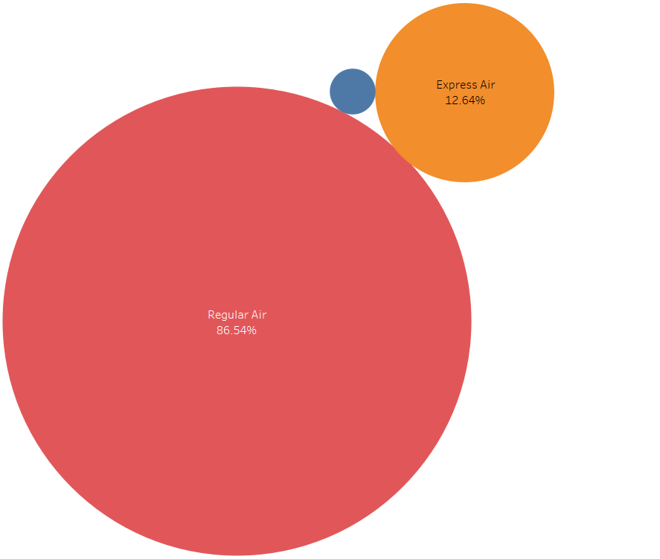
Ship Mode Distribution by Profit
Notes:
Obesity is a widespread health issue, which is caused by an imbalance between calorie intake. It leads to excess body fat and increases the risk of various health problems like diabetes, heart disease and Cancer. Addressing obesity requires lifestyle changes such as healthy eating and regular exercise.

Slide 5
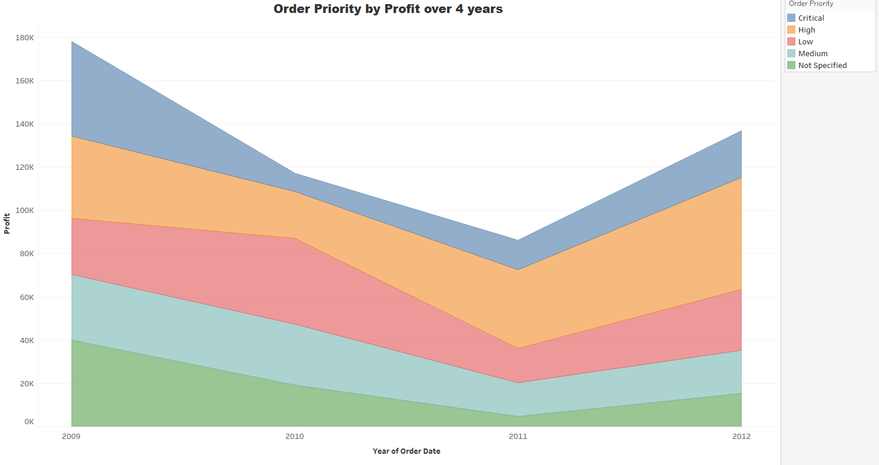
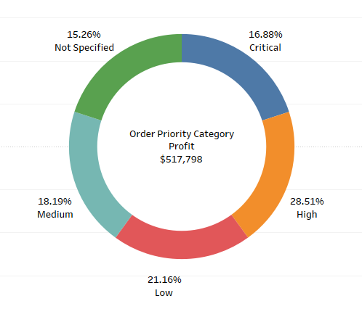
Order Priority Distribution by Profit
Notes:
Obesity is a widespread health issue, which is caused by an imbalance between calorie intake. It leads to excess body fat and increases the risk of various health problems like diabetes, heart disease and Cancer. Addressing obesity requires lifestyle changes such as healthy eating and regular exercise.

Slide 6
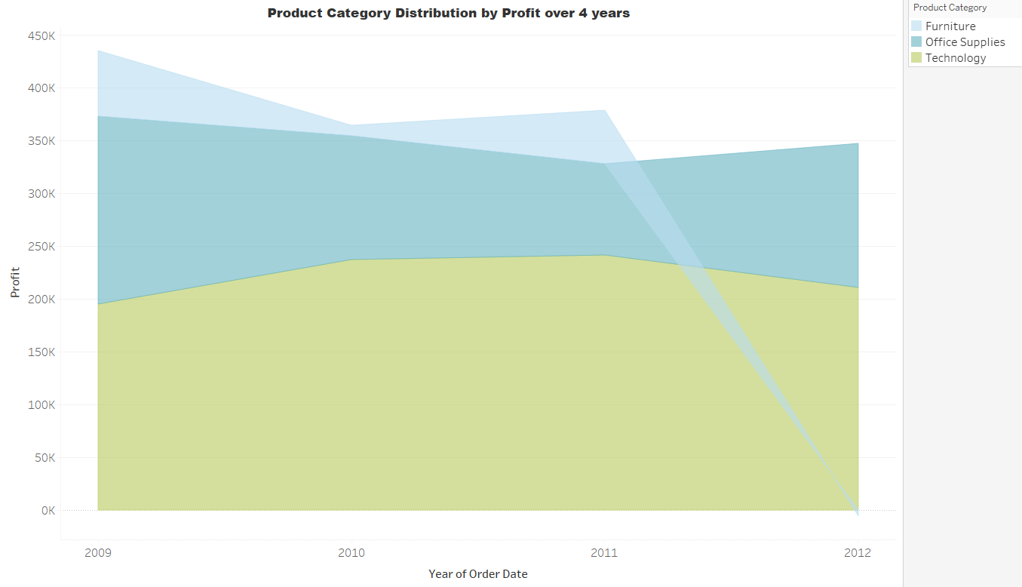
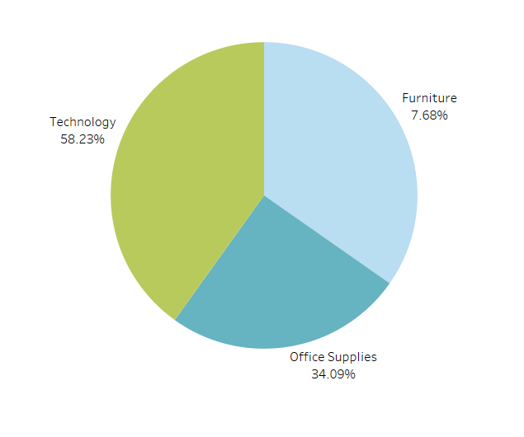
Product Category Distribution by Profit
Notes:
Obesity is a widespread health issue, which is caused by an imbalance between calorie intake. It leads to excess body fat and increases the risk of various health problems like diabetes, heart disease and Cancer. Addressing obesity requires lifestyle changes such as healthy eating and regular exercise.

Slide 7
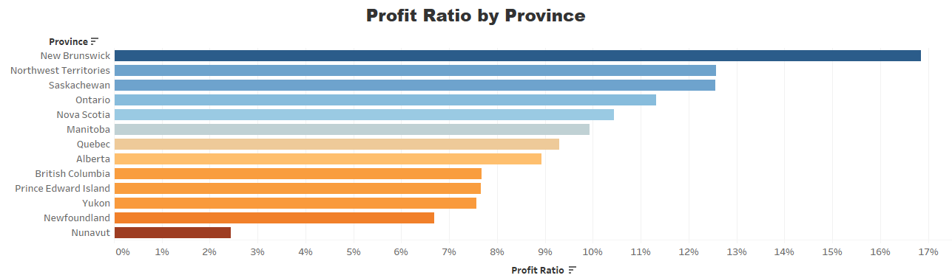
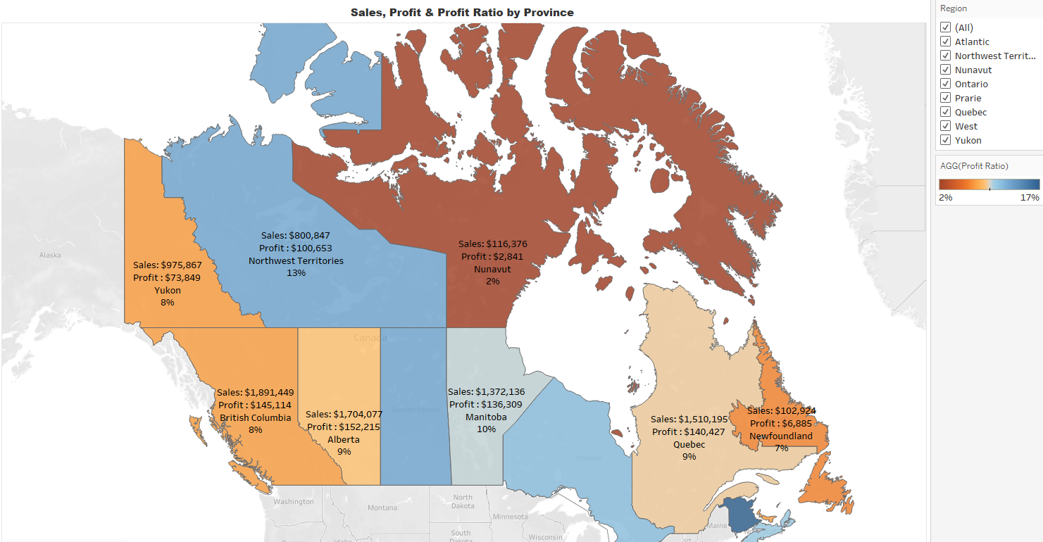
Ontario has the highest Sales with more than three million dollars, but New Brunswick has the highest profit ratio as compared to other provinces
Notes:
Obesity is a widespread health issue, which is caused by an imbalance between calorie intake. It leads to excess body fat and increases the risk of various health problems like diabetes, heart disease and Cancer. Addressing obesity requires lifestyle changes such as healthy eating and regular exercise.

Slide 8
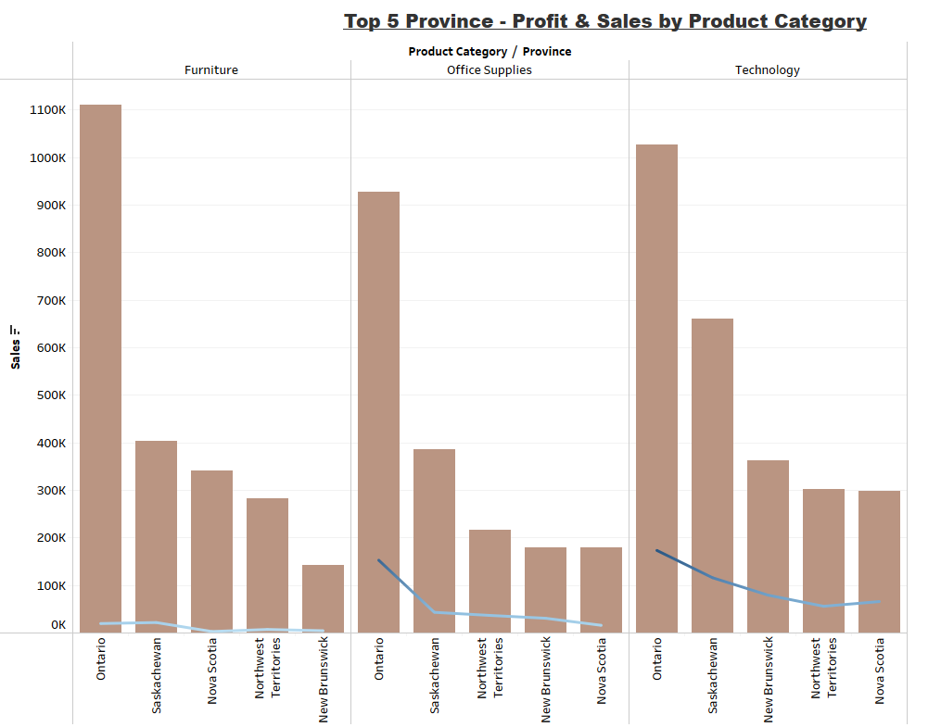

Notes:
Obesity is a widespread health issue, which is caused by an imbalance between calorie intake. It leads to excess body fat and increases the risk of various health problems like diabetes, heart disease and Cancer. Addressing obesity requires lifestyle changes such as healthy eating and regular exercise.

Slide 9
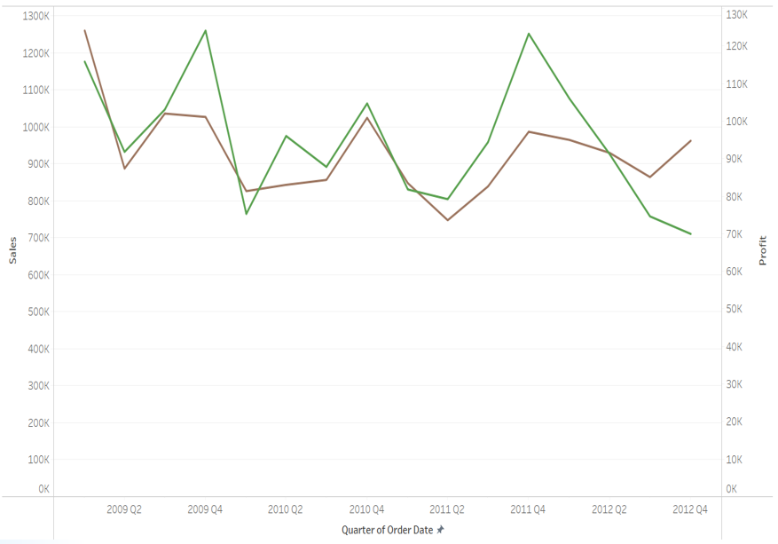

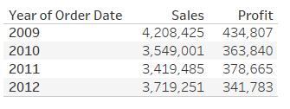
Sales and Profit Over 4 years
Company has consistently generated profits until fourth quarter of 2011. Starting in 2012, both sales and profits began to decline. Third quarter of 2012 shows an increase in sales, but profitability continued to show a downward trend.
Notes:
Obesity is a widespread health issue, which is caused by an imbalance between calorie intake. It leads to excess body fat and increases the risk of various health problems like diabetes, heart disease and Cancer. Addressing obesity requires lifestyle changes such as healthy eating and regular exercise.

Slide 10
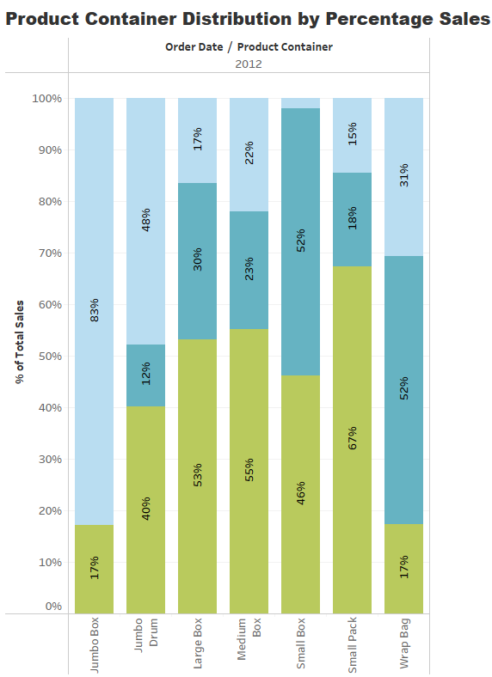
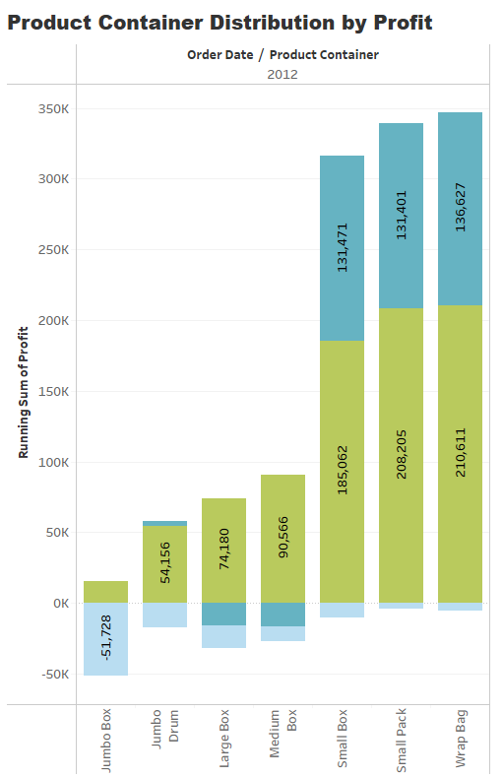

Product Container Distribution
Notes:
I have covered below steps for data preprocessing and feature engineering: in Data preprocessing I have analysed the shape of dataset, variable type , its description , missing values, duplicate values, outliers , performed univariate, bivariate and multivariate analysis.
In Data cleaning I have removed Outliers, duplicate data, transformed variable type , replaced missing values either with mean or mode.
In feature engineering , I have used one hot encoding for nominal variable and created one new feature named” BMI”.
Finally in Model building , I have created 6 models.

Slide 11
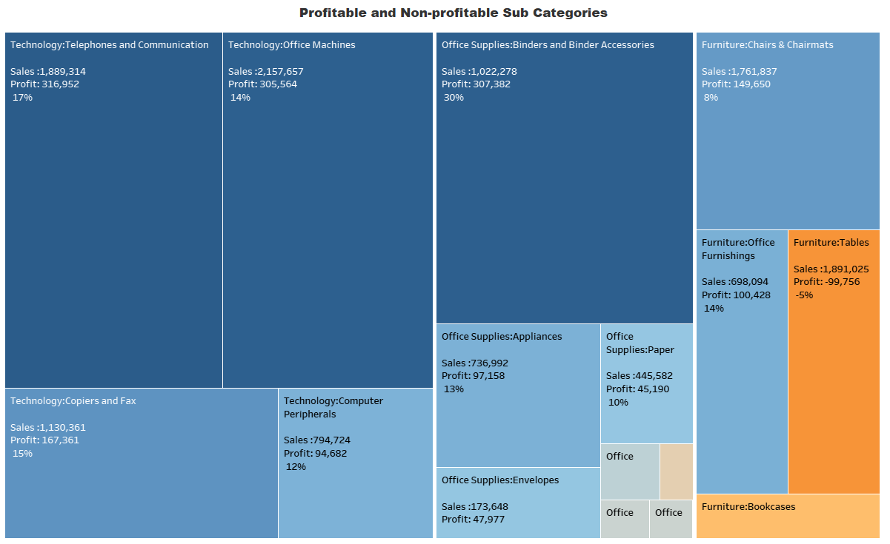
Profitable and Non-Profitable Sub-Categories
As we can see that Binders are at top in profit ratio, followed by telephones and copiers. On the other hand, tables and bookcases are amongst the negative profitable products.

Slide 12
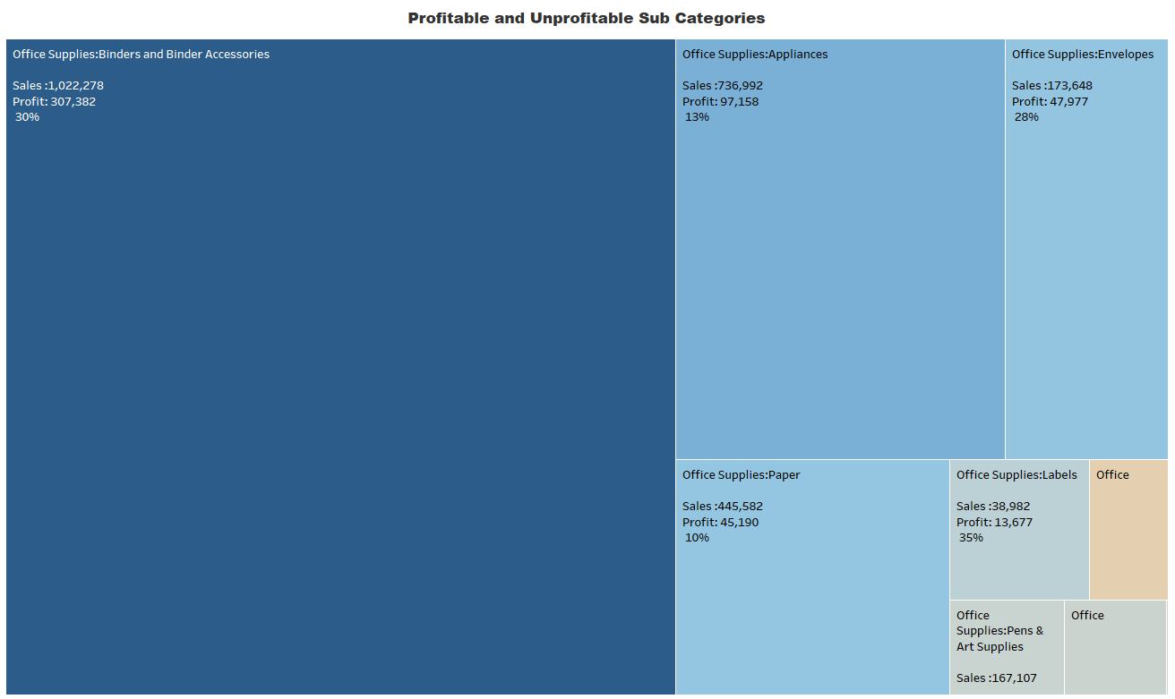
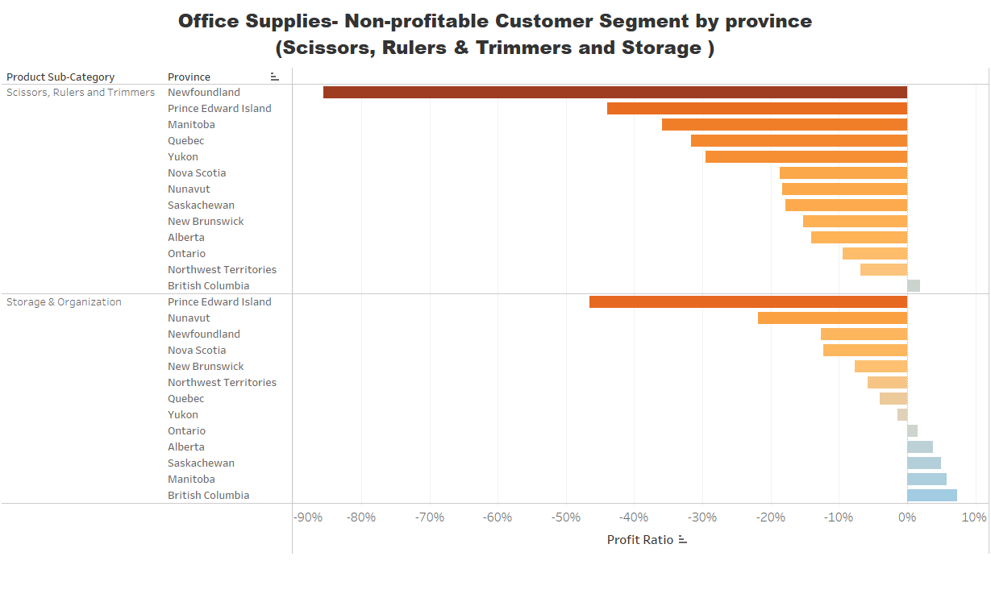
Product Category – Office Supplies
(Non-profitable - Scissors, Rulers and Trimmers)
Unprofitable Province
Scissors, Rulers generated negative profits in all provinces except BC. Storage generating positive and negative profits in few provinces.
Notes:
Coming to EDA, In the dataset , “ Obesity Categories” is my target variable . It has 7 different classes. From the bar plot we can visualize that Obesity Type I has the highest proportion of aprox 17% of the entire dataset followed by Obesity Type 3 and obesity type 2 . Rest all classes fall between 12.79 to 13.90% of the dataset.

Slide 13
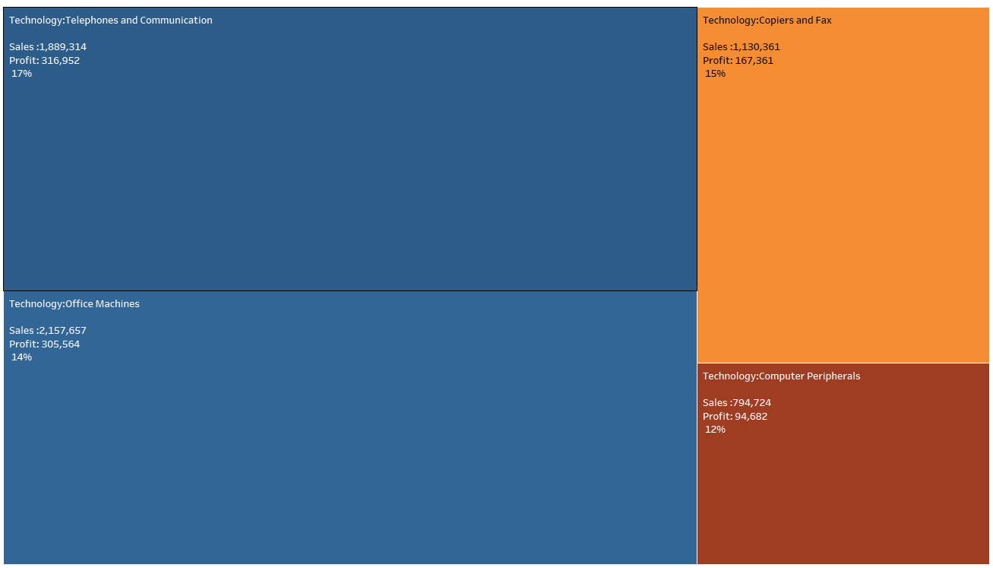
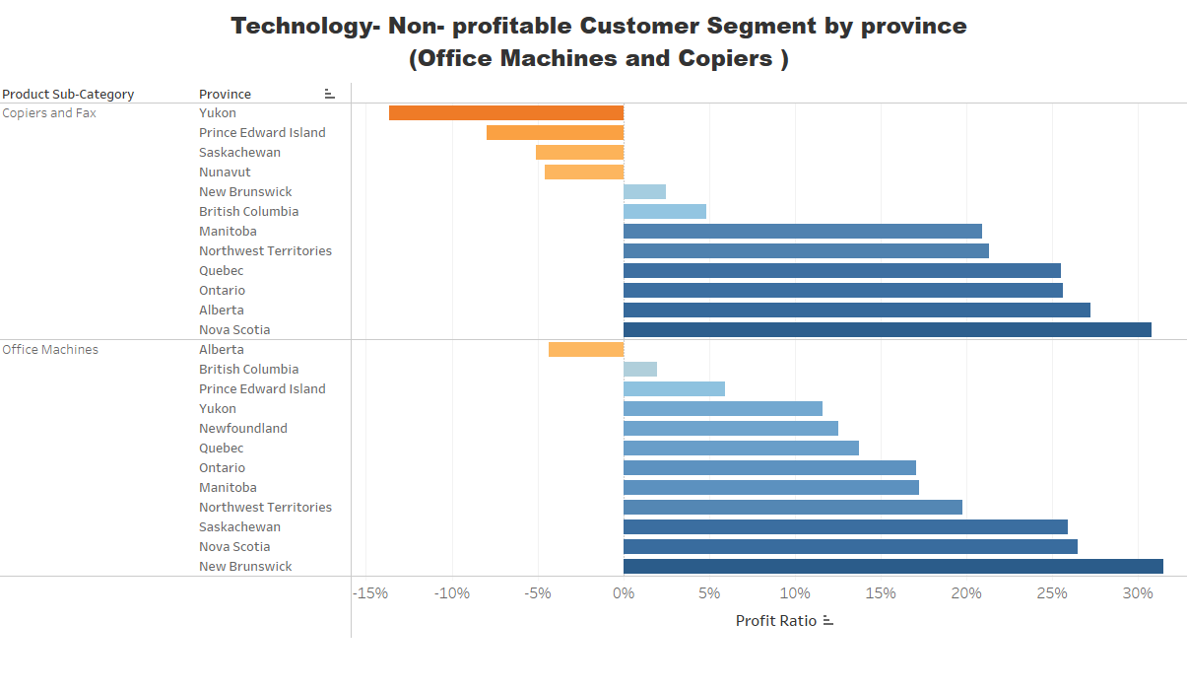
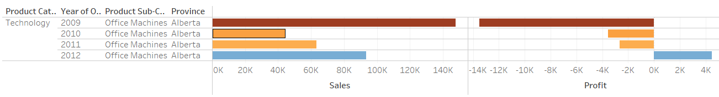
Product Category – Technology
( Non-profitable –Office Machines and Copiers )
Although Office machines are in profitable products, but in Alberta it was generating negative profits from 2009-2011, but gradually it generated positive profit in 2012.
Notes:
Coming to EDA, In the dataset , “ Obesity Categories” is my target variable . It has 7 different classes. From the bar plot we can visualize that Obesity Type I has the highest proportion of aprox 17% of the entire dataset followed by Obesity Type 3 and obesity type 2 . Rest all classes fall between 12.79 to 13.90% of the dataset.

Slide 14
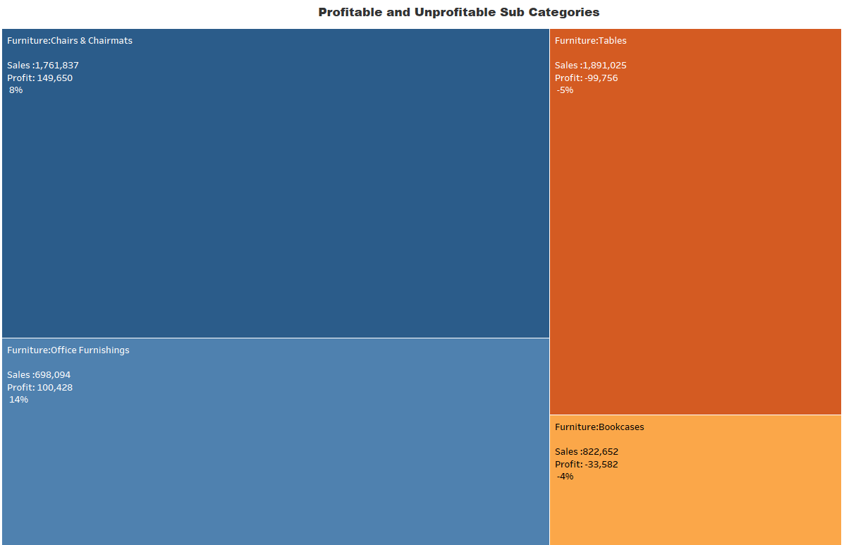
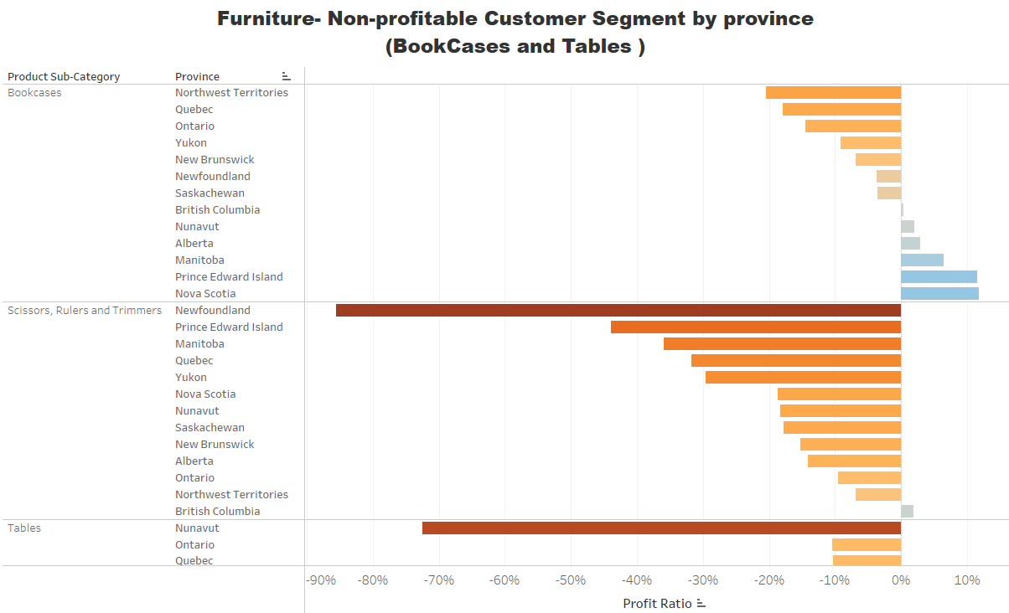
Product Category – Furniture
( Bookcases and Table )
Tables are generating negative profits in almost every province except British Columbia. In the case of bookcases, it generated positive and negative profits in half of the provinces.
Notes:
Coming to EDA, In the dataset , “ Obesity Categories” is my target variable . It has 7 different classes. From the bar plot we can visualize that Obesity Type I has the highest proportion of aprox 17% of the entire dataset followed by Obesity Type 3 and obesity type 2 . Rest all classes fall between 12.79 to 13.90% of the dataset.

Slide 15
Conclusion and Recommendations
Product Container Optimization: The store could consider optimizing the use of product containers. For instance, the “Jumbo Box” container type for “Office Machines” in Alberta shows high sales but also a significant loss in profit. This could indicate that the cost of using such large containers for this product might be resulting in a net loss. The store could explore using different container types or renegotiating supplier contracts to reduce costs.
Profitable Subcategories: Focus on subcategories that show high profitability. For example, “Chairs & Chair mats” and “Office Furnishings” show high sales and a good profit percentage. Increasing the inventory and promotion of these items could boost profits.
Address Unprofitable Subcategories: Some subcategories like “Tables” and “Bookcases” show high sales but negative profit. It would be worth investigating why these items are not profitable despite good sales. This could be due to high costs, pricing issues, or other factors. Strategies could include renegotiating supplier contracts, adjusting pricing, or improving operational efficiencies.
Sales and Profit Trends: Keep a close eye on sales and profit trends over time. If sales are increasing but profits are not, this could indicate issues with cost management. Regularly review financial reports and adjust strategies as needed.
Regional Sales Strategy: The store could develop a regional sales strategy based on the sales and profit performance in different provinces. For example, “Copiers and Fax” in Yukon with “Large Box” shows high sales and high profit, indicating a successful product-region-container combination.
Notes:
Here we trying to analyse the gender that monitors calorie consumption and is there any association with Obesity levels.. From the plot we can visualise that females monitor their calories consumption quite frequently then male and Individuals who do not monitor their calorie intake are more likely to have either Obesity Type I or Obesity Type III followed by Obesity Type ii.

Slide 16
Thank you

