Slide 1

ANT Risk Analysis
Group 1

Slide 2
Business Problem
To identify risky truck drivers and analyze the causal factors.
To identify the best truck model to use based on MPG usage data.

Slide 3






Data Processing

Slide 4
Analysis of Truck drivers
The following causal factors were analyzed to identify the riskiest truck drivers:
Risk Rating of each driver
Number of violations per driver
Types of violations
Number of miles driven by drivers

Slide 5
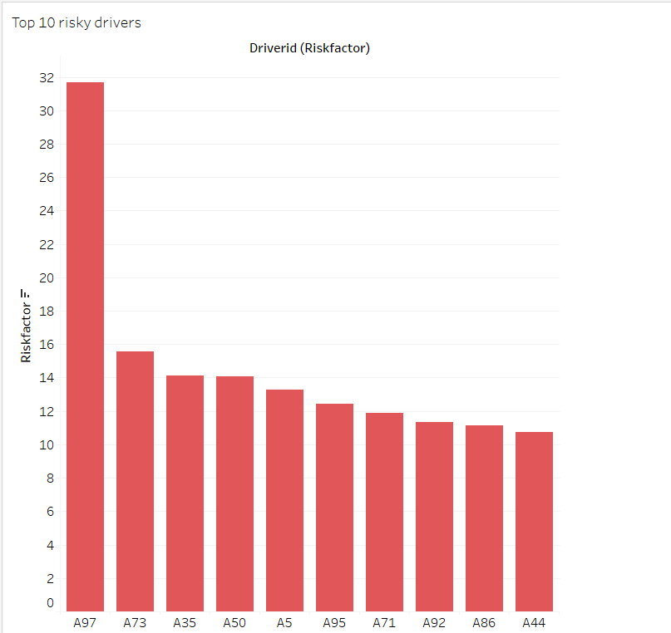
Risk Rating of drivers
Based on the Risk factor calculated by the company, we can see that the riskiest Driver is Driver “A97”, with a risk factor of 31. 69.
This is significantly higher than the second riskiest driver “A73” who had a risk rating of 15.57, thus implying that “A97” is more than twice as risky as “A73”.

Slide 6
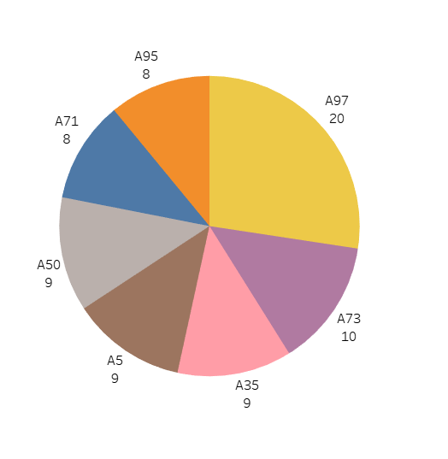
Violations per drivers
Based on number of violation events captured per driver:
“A97” has 20 violations captured which is twice the amount for “A73” who has 10 violations
An interesting observation is that drivers “A5” and “A50” have slightly different risk factors even though they have the same number of violations

Slide 7
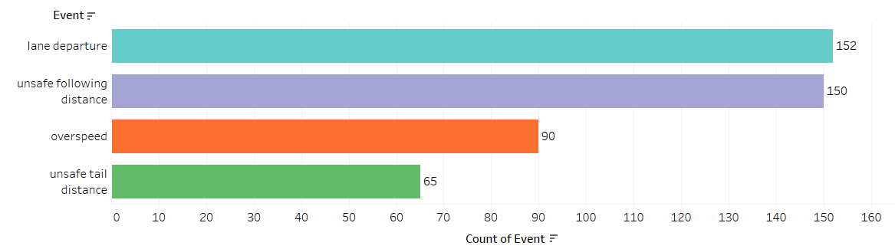
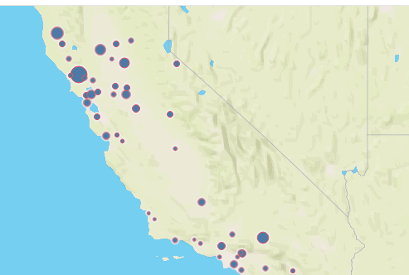
Violations events captured
Based on the various events captured by devices on the truck:
It can be observed the top two common violation occur when drivers are changing lanes or following some other vehicles
It can also be observed that most of the violations occurred in northwest part of California. Thus, truck drivers who drive in those locations, should be provided additional trainings

Slide 8
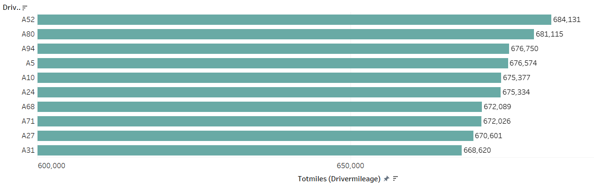
Total miles driven by each driver
Based on the number of miles driven by each driver:
It can be observed that the driver “A52”, drove the greatest number of miles “684,131 miles”
The top 3 drivers who drove the greatest miles for the organization are not in the top 10 riskiest drivers list based on Risk rating and number of violation events captured
Thus, we can conclude that Total miles driven by each driver might not be a causal condition in identifying risky drivers

Slide 9
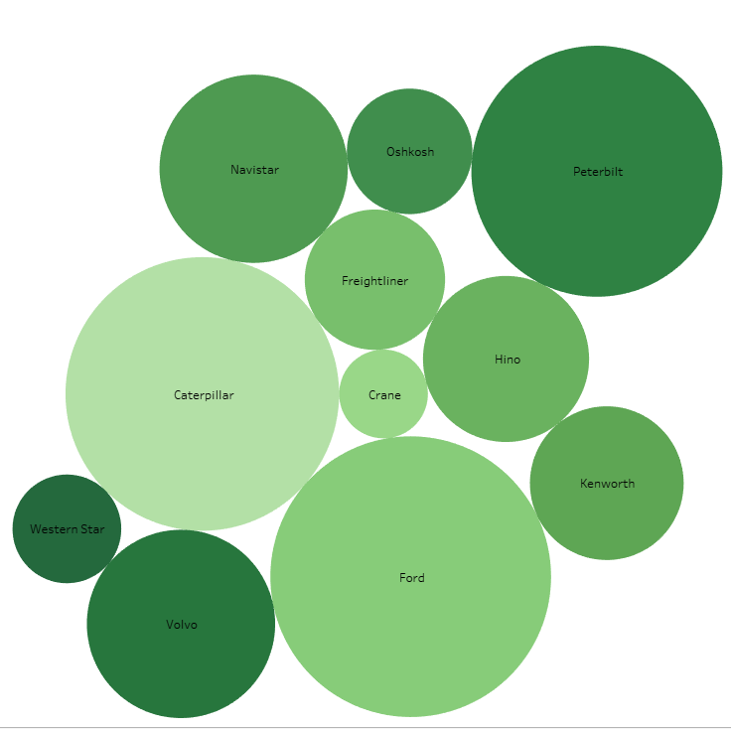
Total of risk factors by Model
The color shows details about the model and the size shows the count of Model:
By observation, Ford Caterpillar and Peterbilt add up not only the most count of our truck park but also the most of Risk factors listed [Ford; 20], [Caterpillar; 18], [Peterbilt; 16].
As Ford and Caterpillar appear to be on the top list for the total of Risk factors according to our data analysis, these 3 top models hold more than 50% of our truck parking lot, which is weighting on every single decisions
By testing other variables like the MPGs we helps to draw some management decisions and confirm assumptions listed above.

Slide 10
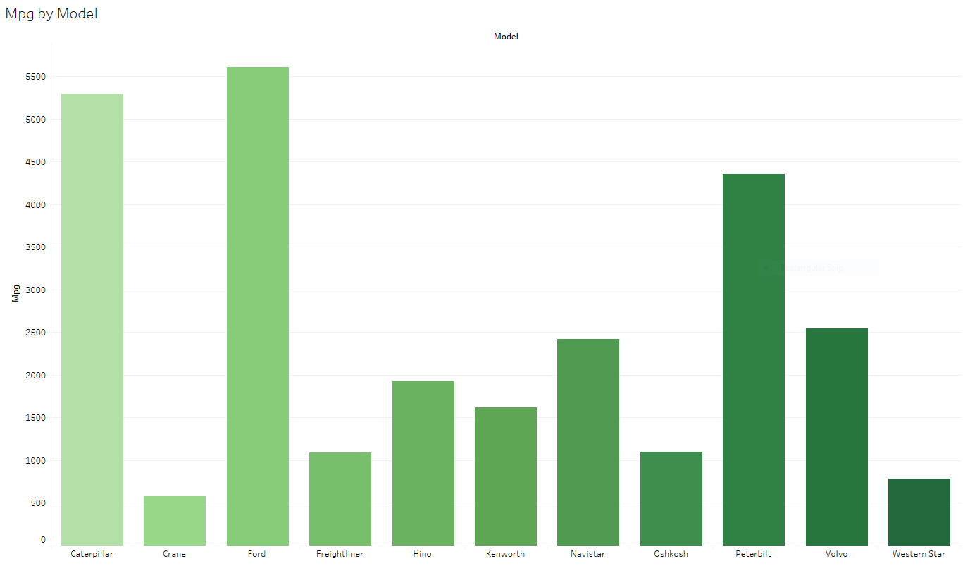
Total of Milage per Gallons by Model
The color shows details about MPGs and the height shows the sum of the MPGs per Model:
As the following bar charts show, the top 3 models of truck that drive the most of Milage per Gallons, Ford appears to be the top one.
The 3 models involved above are the same holding the top list in the risk factors we previously observed which make more understandable the correlation between Risk Factor and Milage per Gallons per model.
If the risk factors are significantly correlated with the Mileage per Gallons, we can be tempted to think that some models have some features which make drivers riskier.

Slide 11
Analysis of Truck drivers - Observations and Conclusions
Hence, we should focus on the following to identify and mitigate the riskiest drivers:
Providing training to drivers with highest Risk factors
Creating awareness for drivers who drive on routes in northwest California on violations and safe driving might mitigate risk
Trainings provided to high-risk drivers should be given by drivers who have driven the greatest number of miles

Slide 12
Truck Model Analysis
We will be analyzing the different models of trucks based on their fuel avg (i.e., MPG) to identify which truck model would be more beneficial to use.
We will be using ANOVA to test the relevance of each truck model

Slide 13
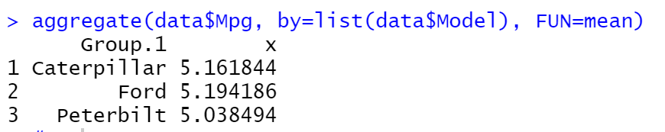
Truck Model Analysis
Model | Count
Ford | 20
Caterpillar | 19
Peterbilt | 16
The table shows the highest 3 number of trucks models currently in the company.
On initial analysis using MPG as a factor, Ford seems to have the highest mileage. However, we will need to verify this using statistical models.

Slide 14
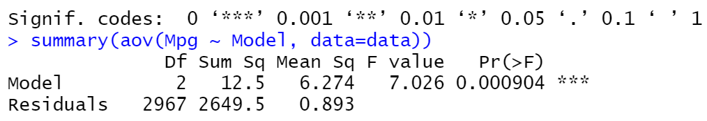
Truck Model Analysis – ANOVA test
We are conducting ANOVA test to determine if the three models identified are significantly different or not at 99% Confidence Interval.
Based on the p-value, we reject null hypothesis, and thus can conclude that at least two models are significantly different

Slide 15
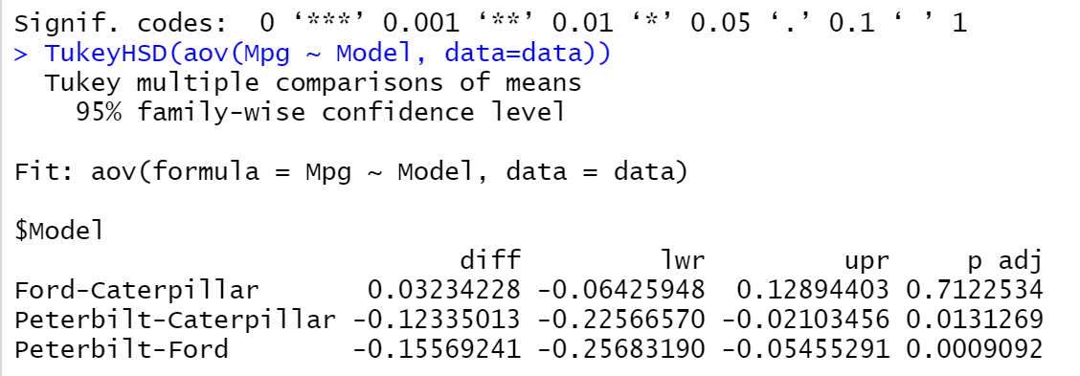
Truck Model Analysis – TukeyHSD()
Based on the TukeyHSD Test, when we look at p-values:
Ford v/s Caterpillar:- There is no significant difference observed
Peterbilt v/s Caterpillar:- There is no significant difference at 99% Confidence Interval. However, at 95% Confidence Interval there is significant difference between these models
Peterbilt v/s Ford:- There is significant difference between Peterbilt and Ford.

Slide 16
Truck Model Analysis - Observations and Conclusions
Hence, based on the above analysis:
ANT should invest more in truck models from either Ford or Caterpillar, since there was no significant difference observed between them from the statistical tests
ANT should also try to reduce its inventory of Peterbilt trucks to get more mileage, thereby reducing operational costs and maybe get more profits.

Slide 17
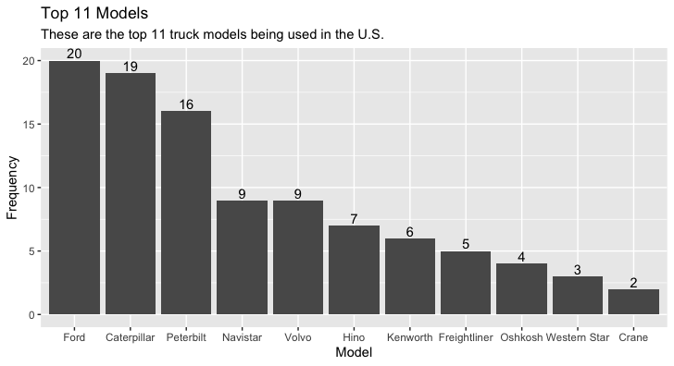
Other Data Visualizations – Exploration in R - 1
After extracting the 7 csv files from Hadoop, we showed the top 11 car models from the trucks_mg.csv dataset
As we can see on the right, Ford, Caterpillar, and Peterbuilt are leading the pack

Slide 18
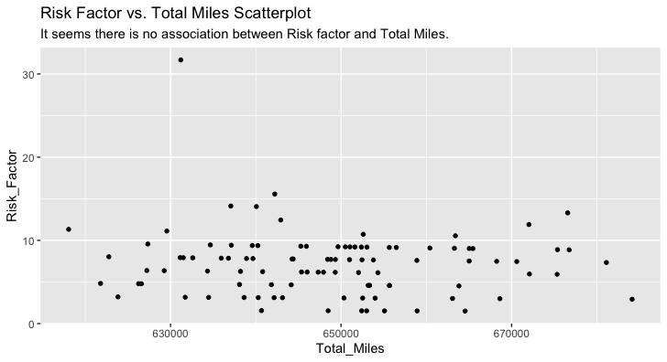
Other Data Visualizations – Exploration in R - 2
In this experiment, we wanted to check if there is a correlation between risk factor and total miles
As we can see, there wasn't any correlation

Slide 19
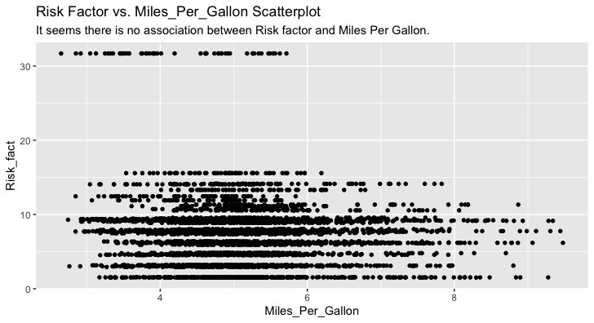

Other Data Visualizations – Exploration in R - 3
Next, we wanted to check if there is a correlation between risk factor and mpg
As we can see, there wasn't any correlation either

Slide 20
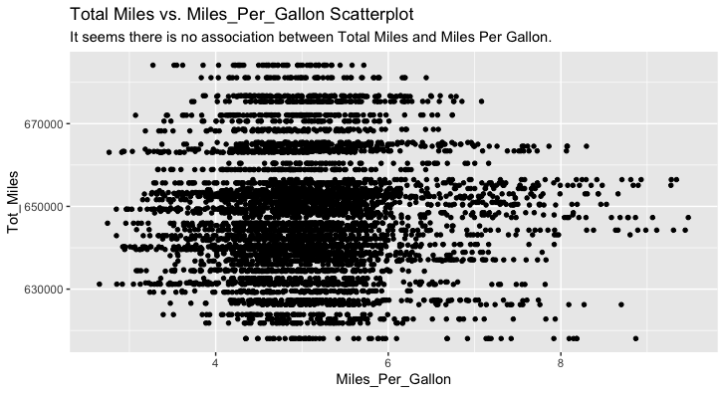

Other Data Visualizations – Exploration in R - 4
Lastly, we wanted to check if there is a correlation between total miles and mpg
As we can see, there wasn't any correlation either

