Slide 1
BLUESTOCK MUTUAL FUND ANALYTICS CAPSTONE PROJECT
Prepared By: Bindu Madhavi Manthi
Project Duration:
01 June 2026 – 12 June 2026
Tools Used:
Python, Pandas, NumPy, SQLite, Power BI, GitHub
Submitted To:
Bluestock Internship Team

Slide 2
PROJECT OVERVIEW
Objective
• Analyze mutual fund performance
• Evaluate investor behavior
• Assess portfolio risk
• Generate actionable insights
Outcome:
• Data-driven investment analysis
• Interactive Power BI dashboard

Slide 3
DATA SOURCES
Datasets Used
Mutual Fund Datasets
Fund Master Data
Historical NAV Data
Scheme Performance Data
AUM by Fund House
SIP Inflow Data
Category Inflow Data
Industry Folio Data
Investor Transactions
Portfolio Holdings
Benchmark Indices
Purpose
These datasets provide information on fund performance, investor participation, asset allocation, and market trends.

Slide 4
ETL PIPELINE ARCHITECTURE
ETL Workflow
Raw Data
↓
Ingestion
↓
Cleaning
↓
Transformation
↓
SQLite DB
↓
Analytics
↓
Dashboard
Description
The ETL pipeline automates the extraction, transformation, and loading of mutual fund datasets. Data quality checks, validation, and standardization ensure reliable analytical outputs.

Slide 5
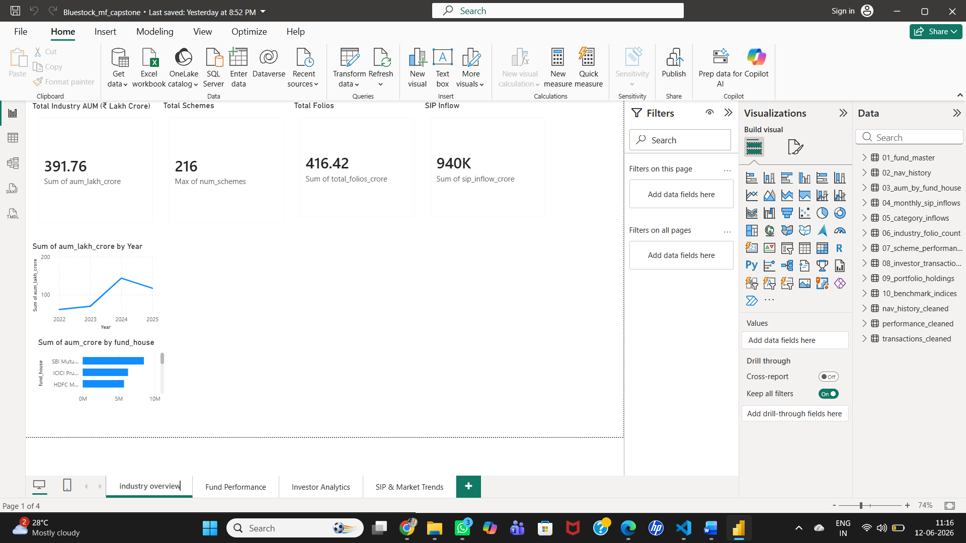
EXPLORATORY DATA ANALYSIS
Industry Overview Analysis
EDA was performed to identify trends and patterns within the mutual fund industry.
Key Areas Analyzed
Fund Category Distribution
AUM Trends
Industry Growth
Market Participation
Key Finding Industry_Overview.png
Equity-oriented schemes dominated the industry in terms of assets and investor participation.

Slide 6
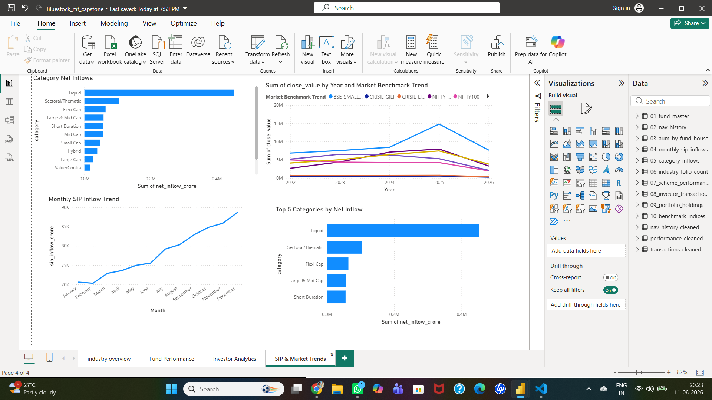
SIP MARKET TRENDS
SIP Growth Analysis
Monthly SIP inflow data was analyzed to understand long-term investment behavior.
Key Findings
Consistent growth in SIP investments.
Increasing investor participation.
Strong preference for disciplined investing.
Business Insight SIP_Market_Trends.png
Growing SIP inflows indicate increasing investor confidence in mutual funds.

Slide 7
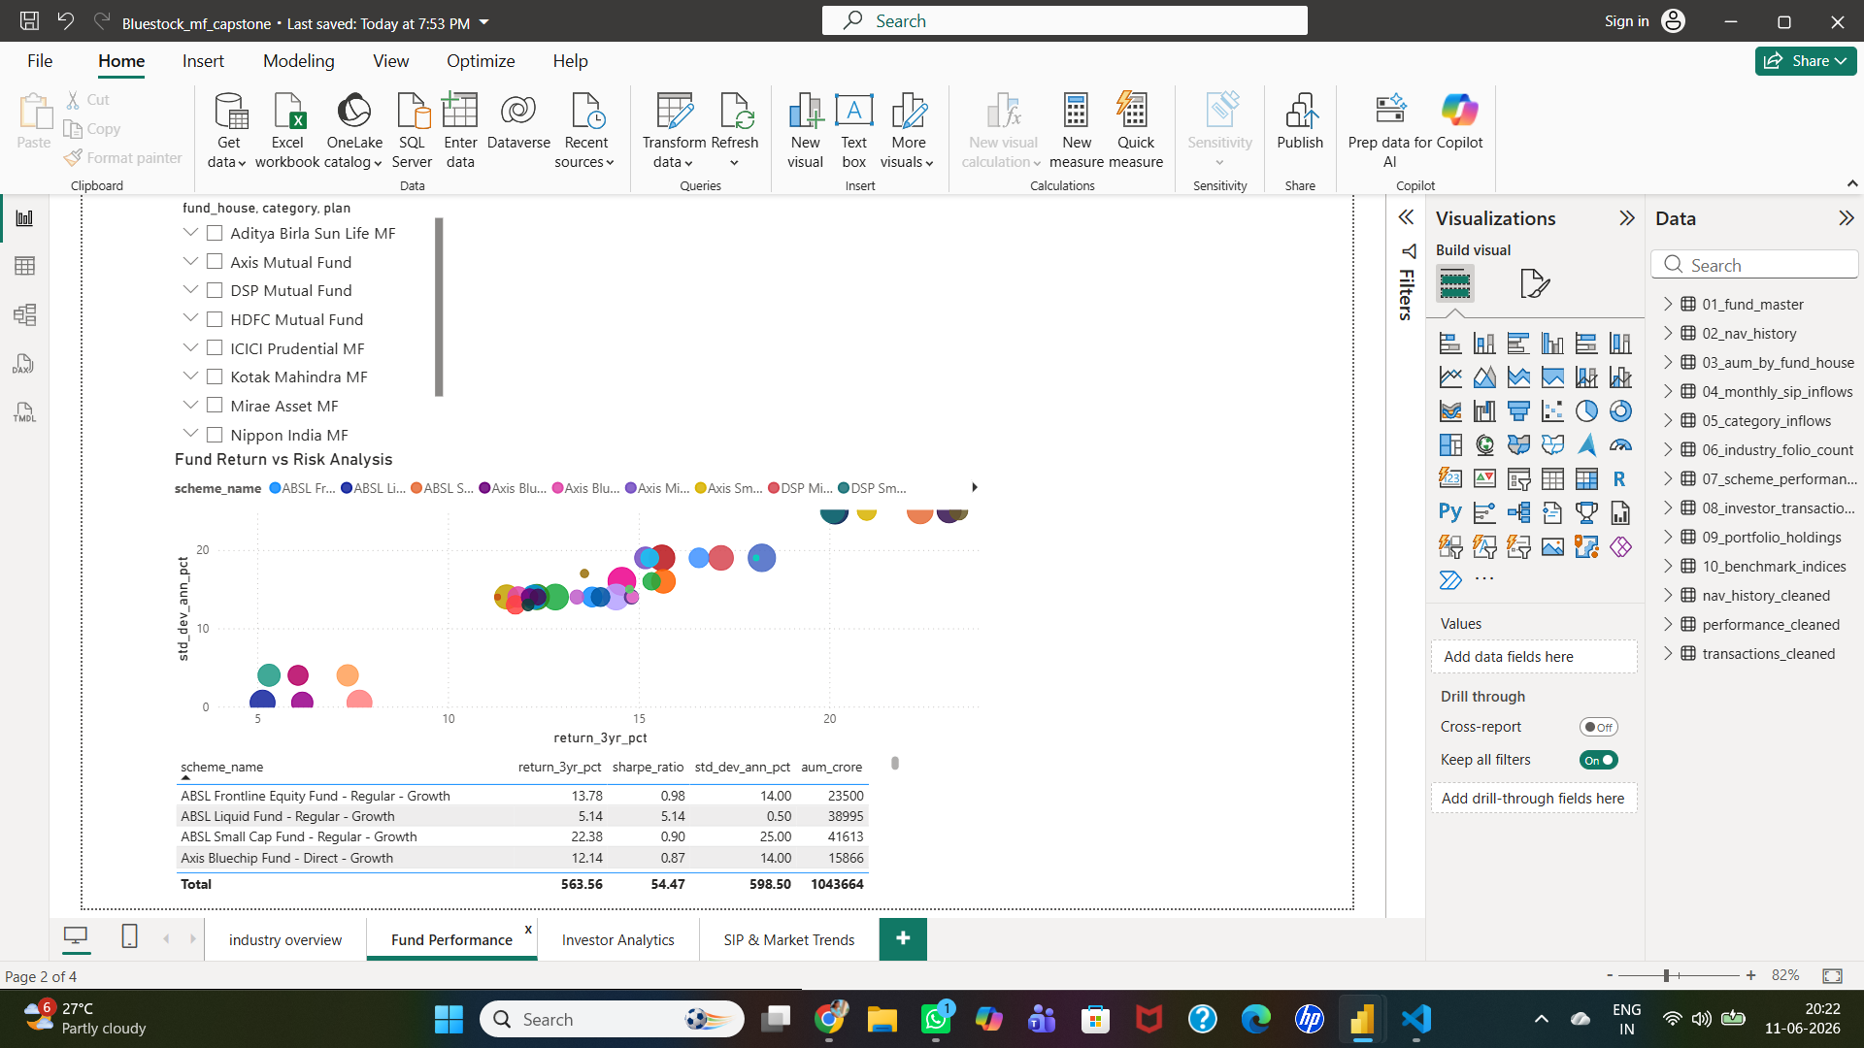
PERFORMANCE ANALYTICS
Performance Evaluation Metrics
The following metrics were used to evaluate fund performance:
Annual Returns
Benchmark Comparison
Alpha
Beta
Sharpe Ratio
Key Observation Fund_Performance.png
Several mutual fund schemes generated superior risk-adjusted returns compared to benchmark indices.

Slide 8
ADVANCED ANALYTICS
Advanced Risk Analytics
Alpha Analysis
Measures excess return generated relative to benchmark performance.
Beta Analysis
Measures fund sensitivity to market fluctuations.
Historical VaR
Estimates potential downside risk under normal market conditions.
Conditional VaR
Measures expected losses beyond the VaR threshold.
Rolling Sharpe Ratio
Evaluates changing risk-adjusted performance over time.
Generated Outputs
alpha_beta.csv
fund_scorecard.csv
final_fund_scorecard.csv
var_cvar_report.csv

Slide 9
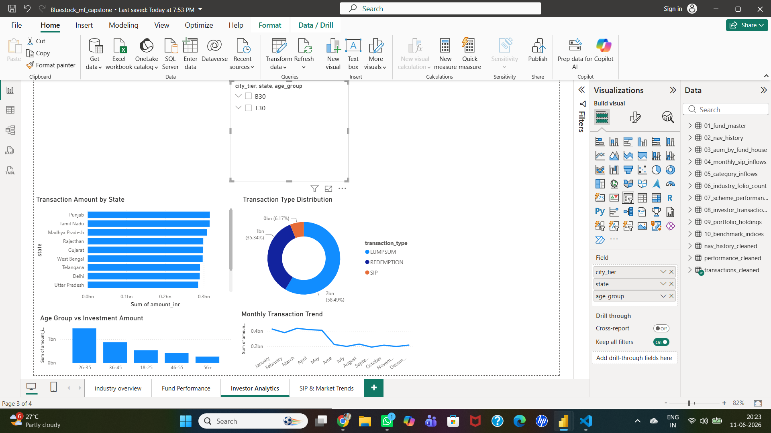
INVESTOR ANALYTICS
Investor Behavior Analysis
Investor transaction data was analyzed to understand participation patterns and investment behavior.
Key Findings
Growth in investor participation.
Increased adoption of SIP investments.
Positive long-term engagement trends.
Business Value Investor_Analytics.png
Investor analytics helps identify participation trends and potential retention opportunities.

Slide 10
DASHBOARD DEVELOPMENT
Power BI Dashboard
The dashboard was developed to provide a consolidated view of mutual fund performance and market trends.
Dashboard Pages
Industry Overview
Fund Performance
Investor Analytics
SIP & Market Trends
Features
Interactive Filters
Dynamic Visualizations
Drill-Down Analysis
Category Comparisons
Performance Tracking

Slide 11
KEY FINDINGS
Major Insights
Industry Insights
Equity funds dominate the market.
SIP inflows show continuous growth.
Performance Insights
Several schemes outperform benchmarks.
Risk-adjusted metrics provide better evaluation than absolute returns.
Investor Insights
Investor participation continues to increase.
Long-term investing behaviour is strengthening.
Risk Insights
Portfolio concentration varies across schemes.
VaR and CVaR effectively identify downside risk.

Slide 12
CONCLUSION
The Bluestock Mutual Fund Analytics Capstone Project successfully developed an end-to-end analytics framework covering data engineering, exploratory analysis, performance evaluation, risk assessment, and dashboard visualization.
The project demonstrates the practical application of data analytics techniques in the financial services domain and provides actionable insights for investors and analysts.

Slide 13
THANK YOU

