Slide 1
NIFTY100 FINANCIAL INTELLIGENCE PLATFORM
Sprint 1 – Data Foundation Prepared By: Bindu Madhavi Manthi Data Analyst Internship June 2026

Slide 2
Project Overview
Project Objective
Build a robust data foundation for Nifty100 analytics.
Create an ETL pipeline for financial datasets.
Design a validated SQLite database.
Perform data quality validation and testing.

Slide 3
Data Sources
Company Data | Financial Data
Companies | Profit & Loss
Documents | Balance Sheet
Pros & Cons | Cash Flow
Analytics | Market Data
Analysis | Stock Prices
Financial Ratios | Sectors
Peer Groups

Slide 4
Technology Stack
Category | Technology
Language | Python
Data Processing | Pandas
Database | SQLite
Testing | Pytest
Version Control | Git, GitHub
IDE | VS Code

Slide 5
ETL Architecture
Raw Excel Files
↓
Data Extraction
↓
Normalization
↓
Validation
↓
SQLite Database
↓
Reports & Audit Files

Slide 6
Database Design
Database Tables
• companies
profitandloss
balancesheet
cashflow
analysis
documents
prosandcons
financial_ratios
peer_groups
sectors
stock_prices

Slide 7
Data Quality Framework
DQ Checks Implemented
✓ DQ-01 Primary Key Validation
✓ DQ-02 Company-Year Validation
✓ DQ-03 Foreign Key Validation
✓ DQ-04 Null Value Analysis
✓ DQ-05 Negative Value Analysis
✓ DQ-06 Data Type Validation
✓ DQ-07 Range Validation
✓ DQ-08 Date Validation

Slide 8
Database Loading Results
Table | Records
companies | 92
profitandloss | 1276
balancesheet | 1312
cashflow | 1187
analysis | 20
documents | 1585
stock_prices | 5520
All datasets were successfully loaded into the SQLite database without data loss.

Slide 9
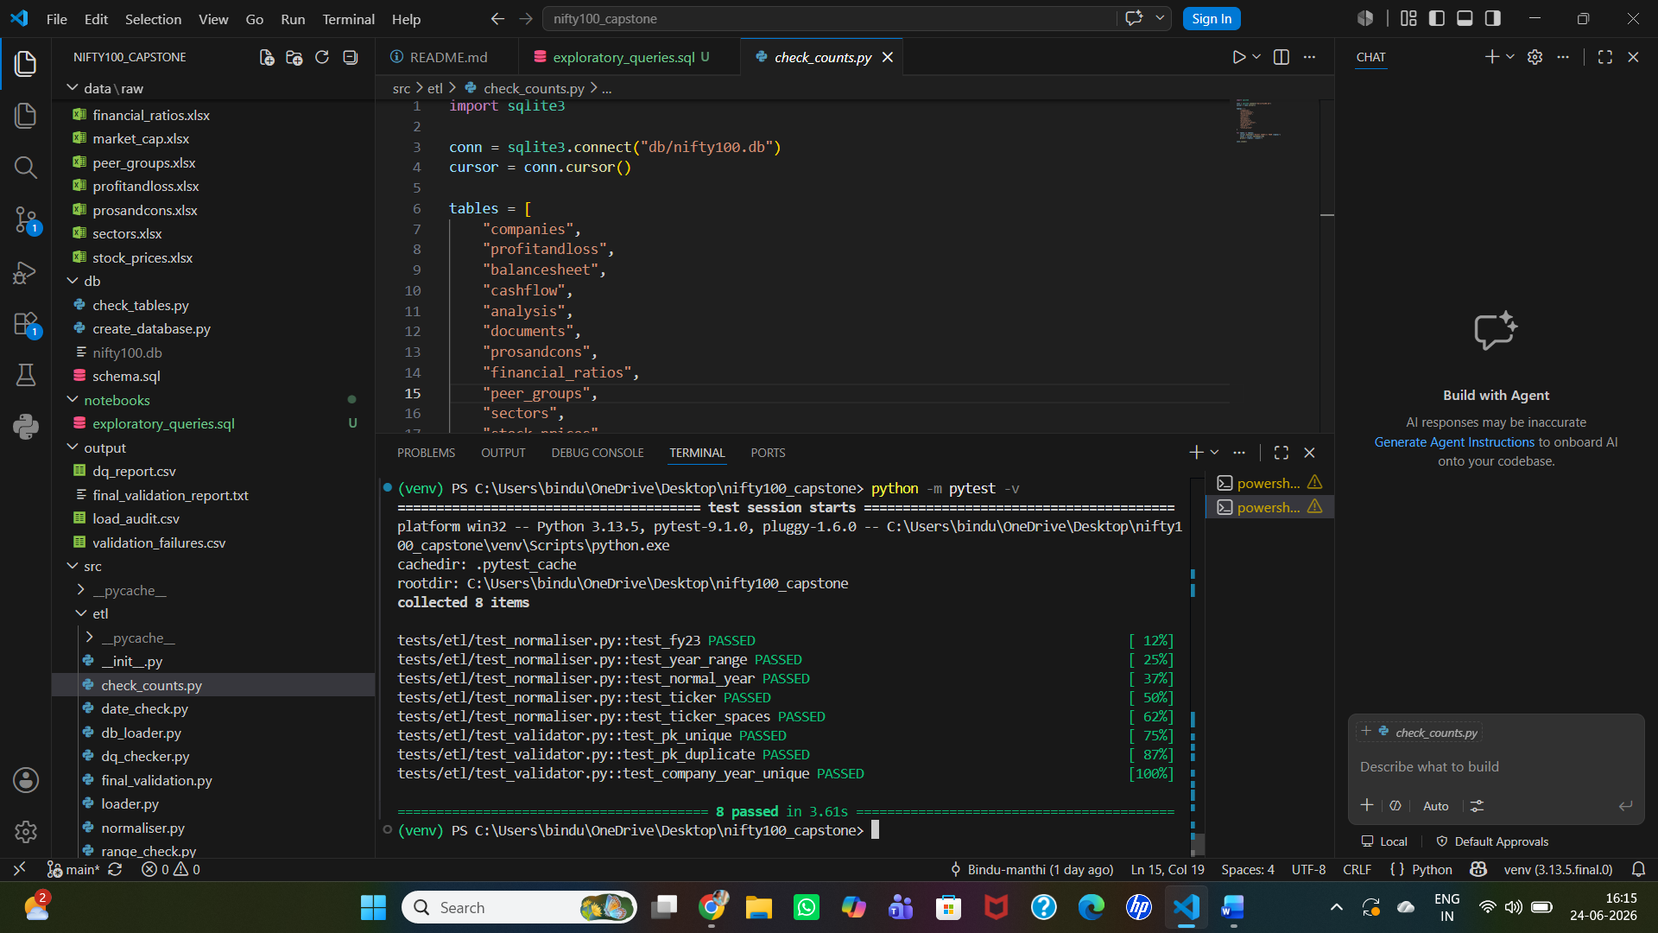
Project Validation & Evidence
Figure 1: Successful execution of unit tests.

Slide 10
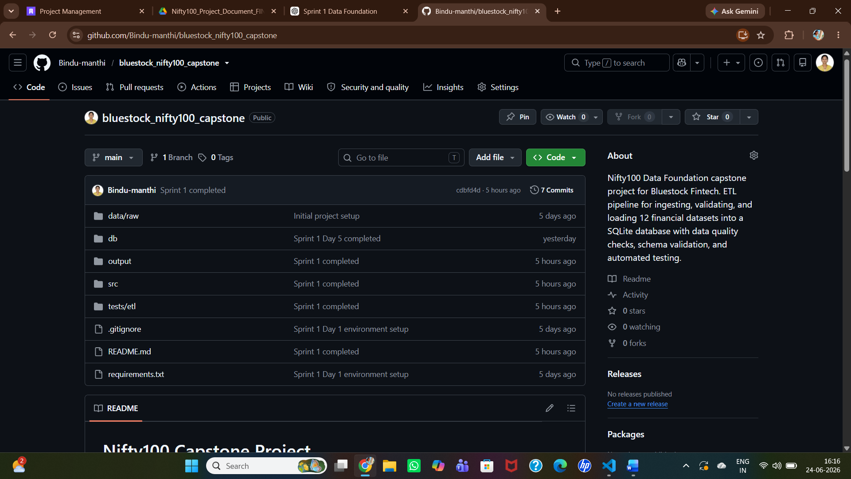
Project Validation & Evidence
Figure 2: GitHub repository with project source code and documentation.

Slide 11
Conclusion
Sprint 1 Completed Successfully
Achievements:
✓ ETL Pipeline Developed
✓ SQLite Database Created
✓ Data Quality Checks Completed
✓ Validation Reports Generated
✓ Project Documentation Completed
Ready for Future Analytics Modules
Project Status: Sprint 1 Completed Successfully ✅

