Slide 1
The Transition Academy: Assistive Career Guidance
Done by
Sai Divya Chennupati
Bindu Madhumanchi
Rishitha Chowdary bobba
Niteesha kothinti

Slide 2
The Transition Academy fills this void by serving as a one stop shop resource hub that provides an online listing of college, job, employment training and life skills programs for high school students with disabilities.
The Transition Academy will serve as a post-secondary navigation tool to help families research and explore college and career opportunities
The ultimate goal is for The Transition Academy to be a national model that will be replicated and franchised across the country.

Slide 3
We have developed a website prototype that is user friendly and we have used following features:
comprehensive list of college
About the transition academy.
Services offered medicine administered, toileting assistance, behavior support, Medicaid waiver, private pay, etc.
Tours of college
calendar of events
Contact us

Slide 4
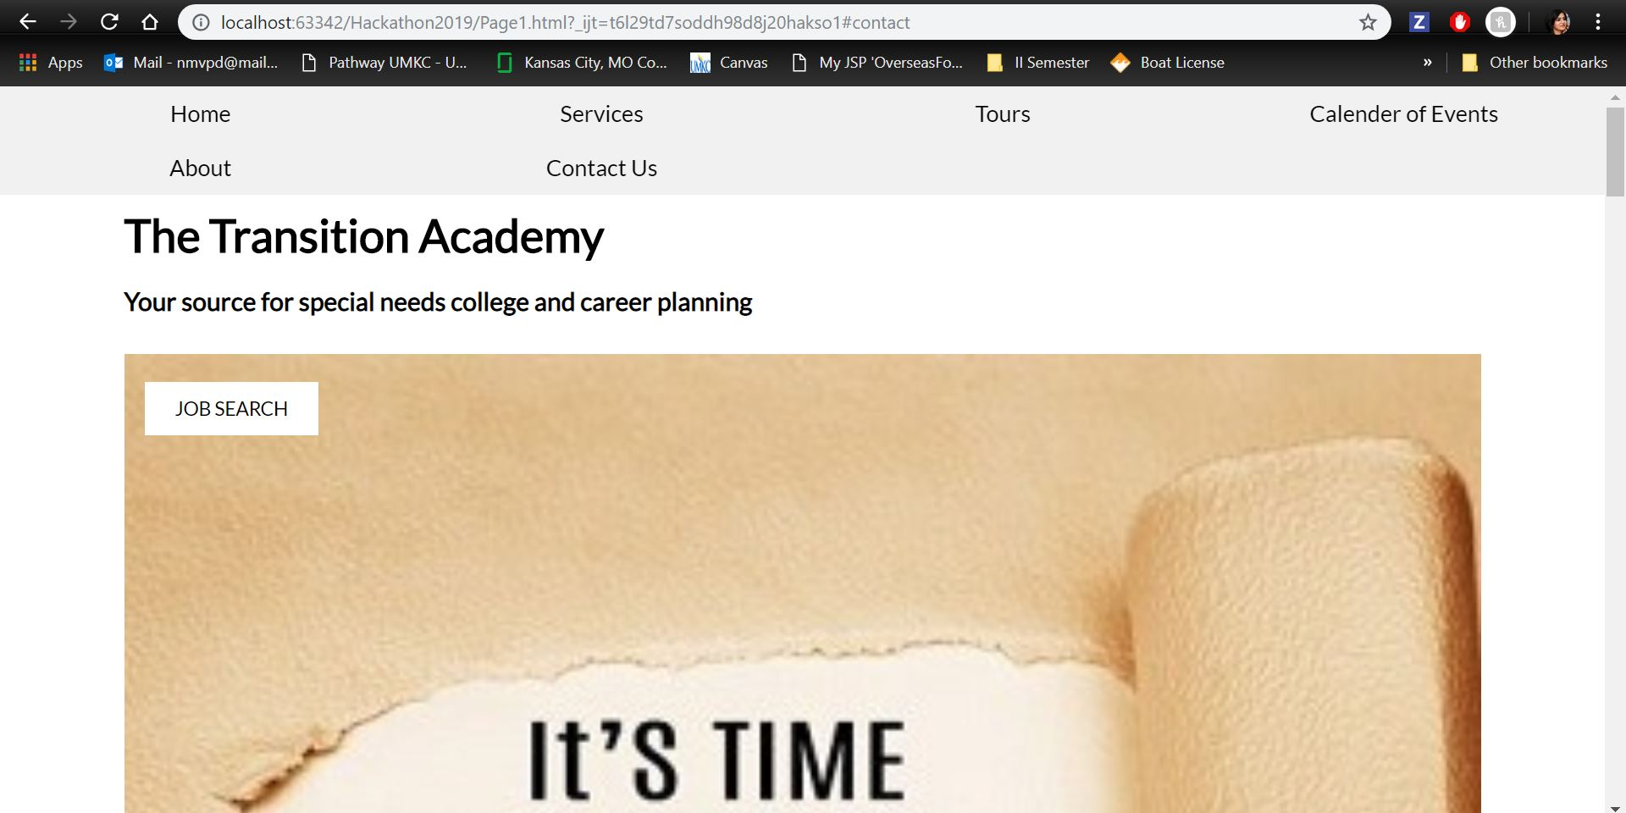
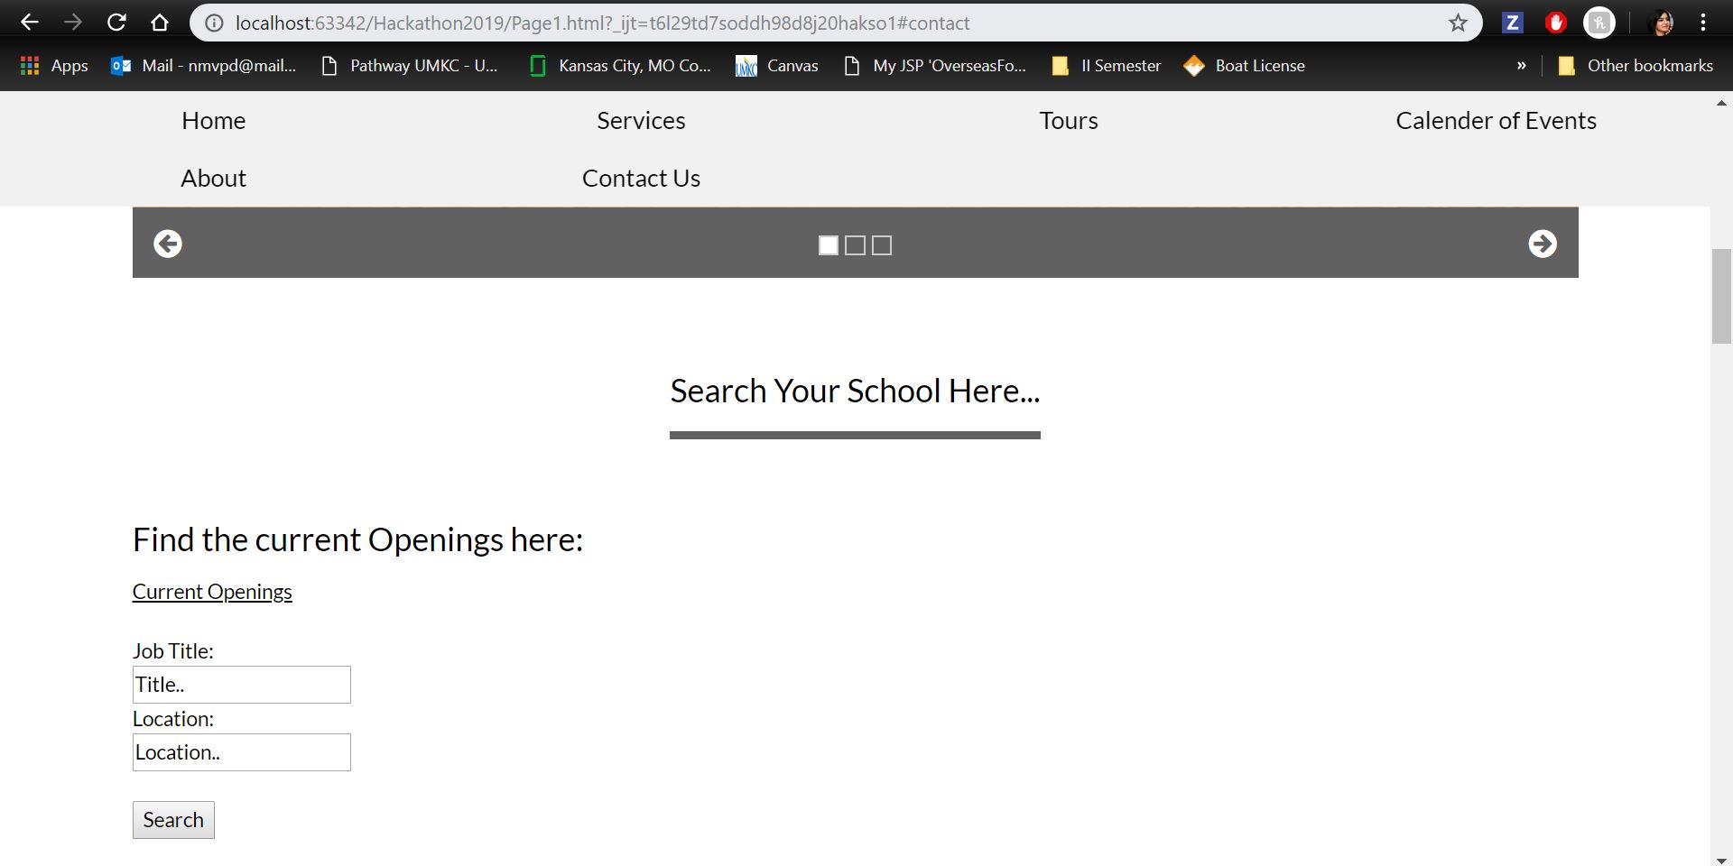

Slide 5
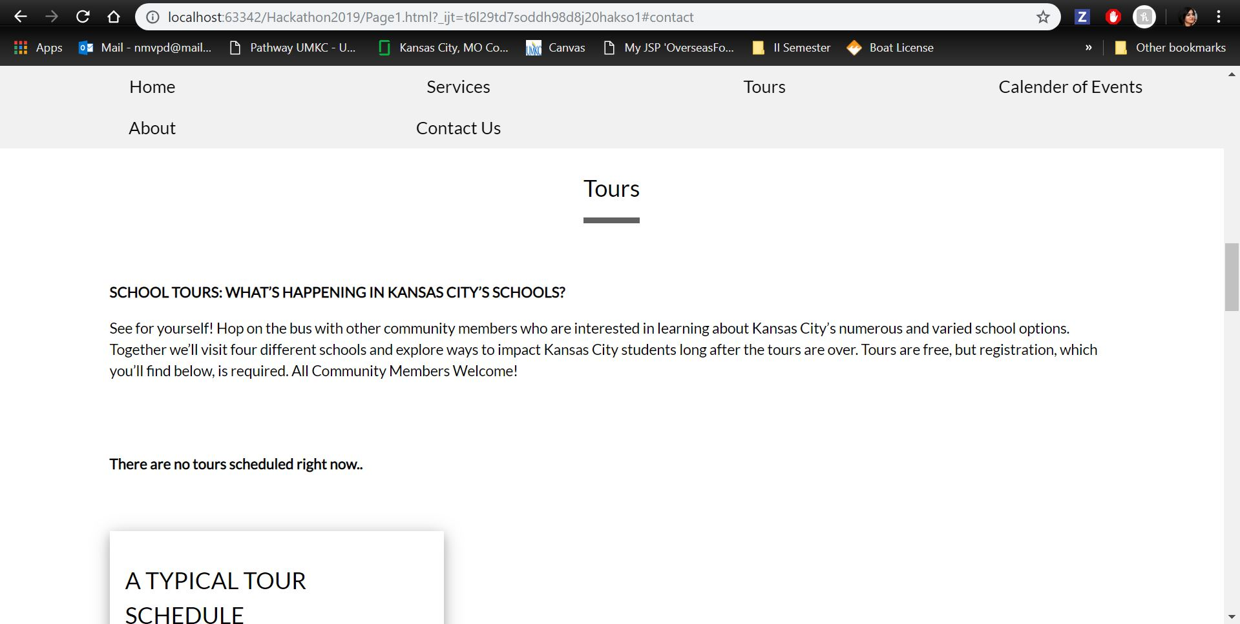
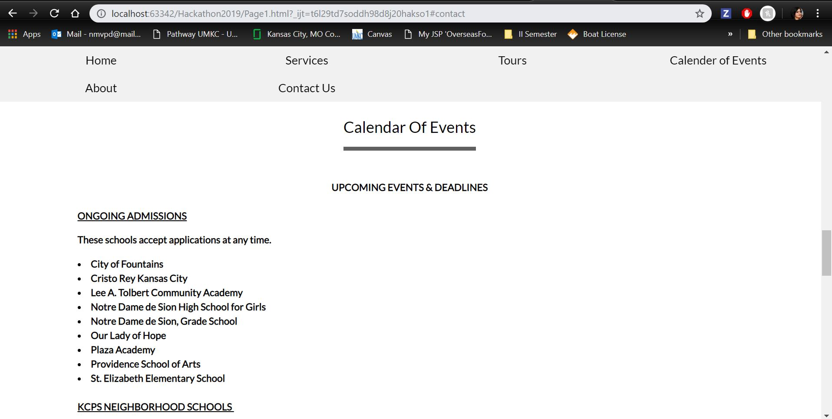

Slide 6
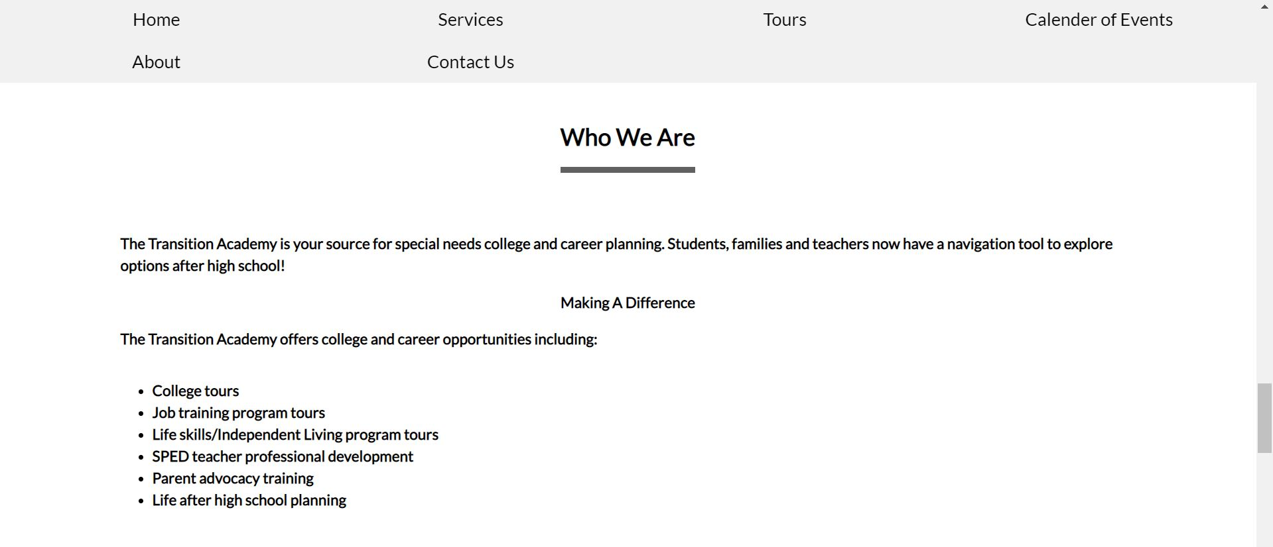
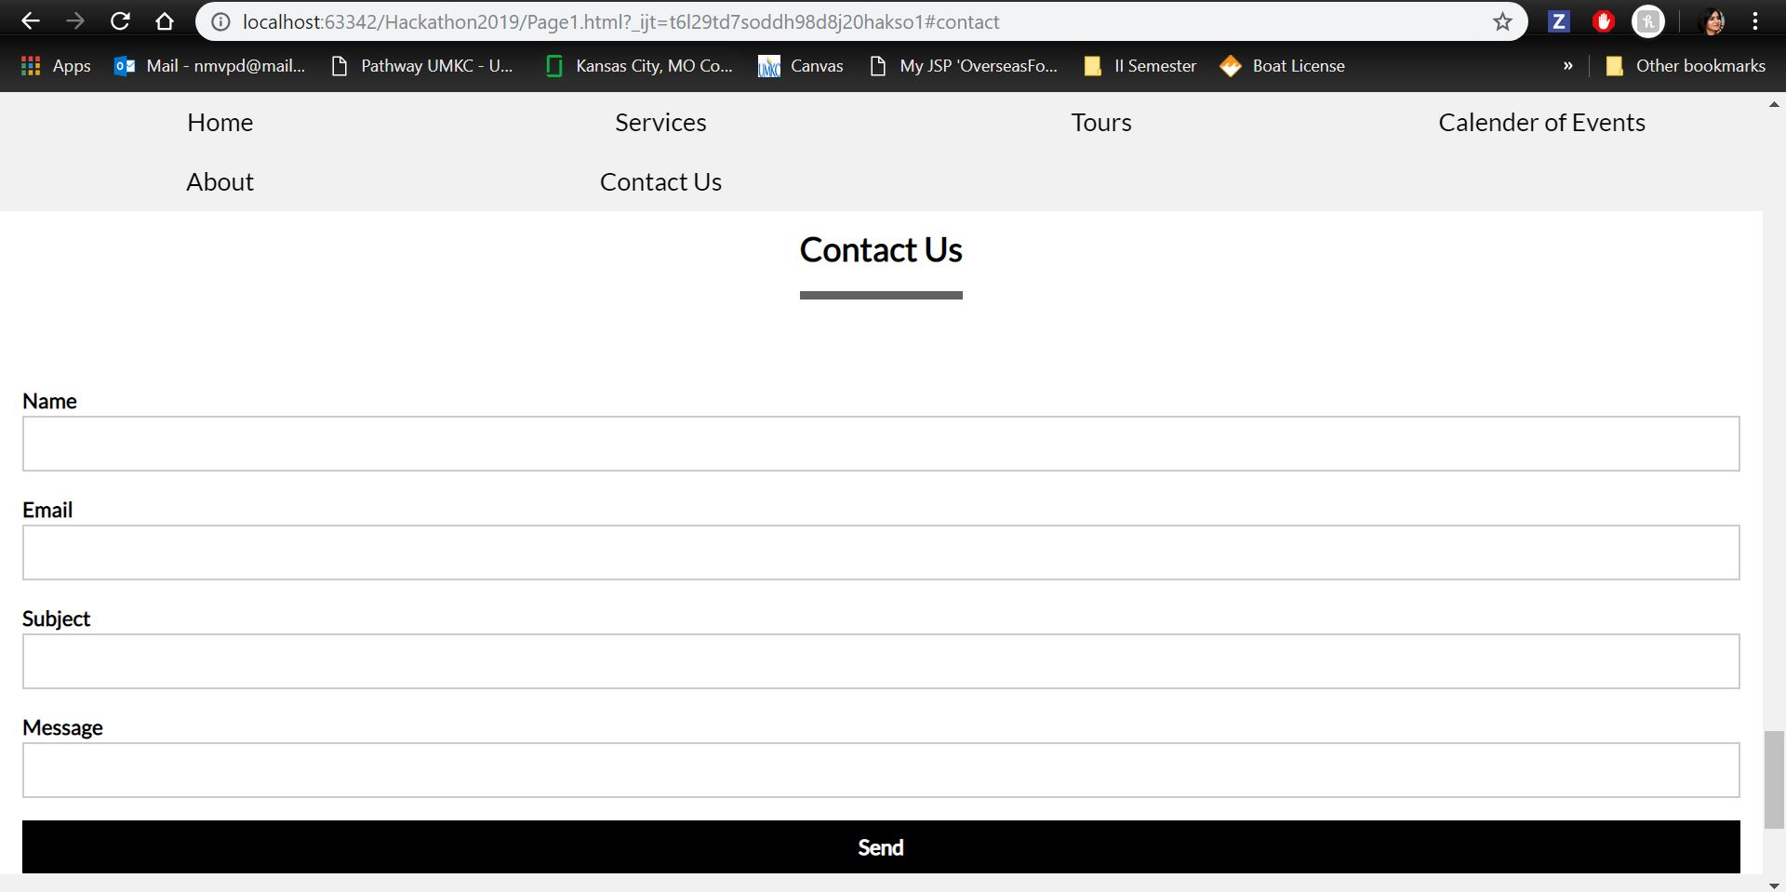

Slide 7
THANK YOU

