Slide 1
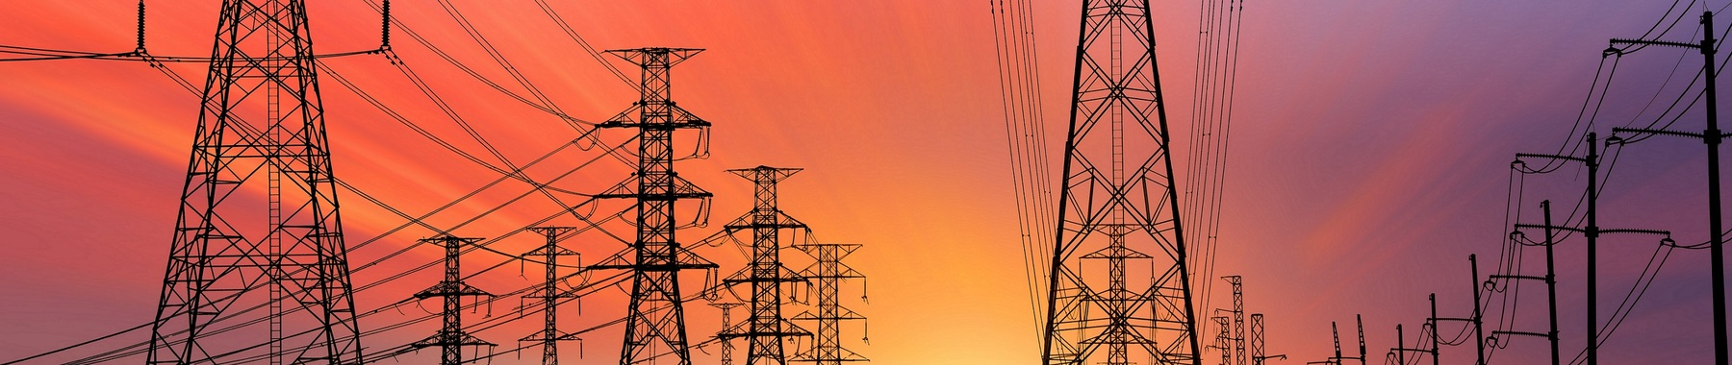
Applied Econometrics and Time Series Analysis
Forecasting Energy Demand

Slide 2

Introduction
PJM Interconnection LLC, a regional transmission organization in the U.S.Coverage: Electric system operations across 13 states and
D.C.Data Details: Hourly electricity consumption in MW, sourced from PJM's website.

Slide 3
Objective
"The aim of this study is to perform a comprehensive regression analysis on time series data of electricity demand.“
"Objective 1: To accurately predict hourly electricity consumption using historical data.“
"Objective 2: To identify key patterns and trends in energy usage over time.“
"Objective 3: To evaluate the impact of temporal features on consumption patterns."

Slide 4
Methodology
Data Preparation
Feature Engineering
Model Training
Model Evaluation

Slide 5
Data Preparation
"Data Source: PJME Hourly Energy Consumption Data from kaggle“
"Missing Values: Identified and filled using forward fill method.“
"Stationarity Check: Performed using Augmented Dickey-Fuller test.“
"Resampling Technique: Hourly data resampled to mean values to reduce variance.“
"Data Cleaning: Removed duplicates, handled anomalies, and normalized timestamps."

Slide 6
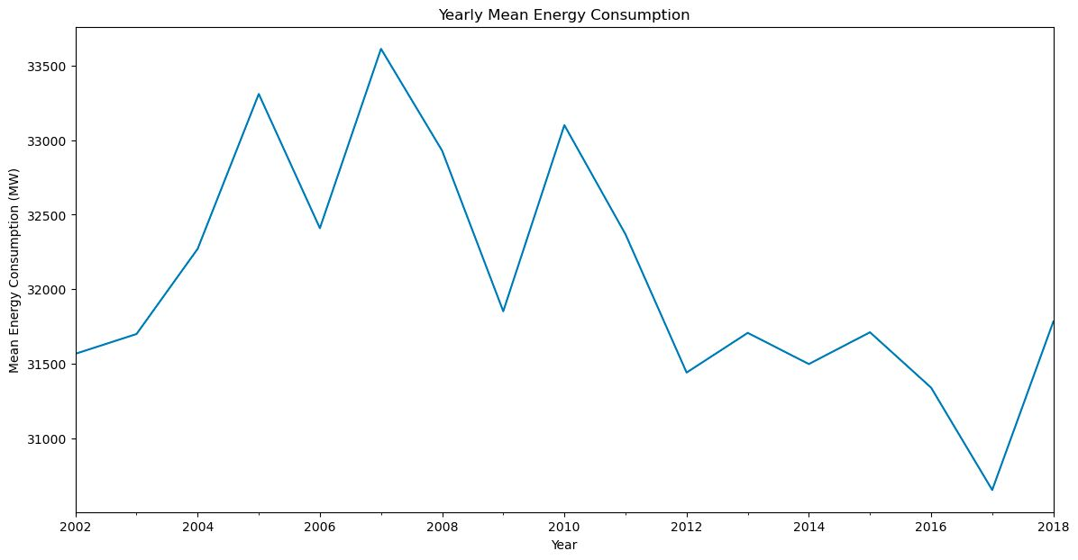
Exploratory Data Analysis (EDA)
Yearly Energy Consumption: A line chart illustrating the trend in yearly mean energy consumption, indicating an overall increase with some fluctuations.""Seasonal Decomposition: Visual representation of the original data broken down into trend, seasonality, and residuals to understand underlying patterns."

Slide 7
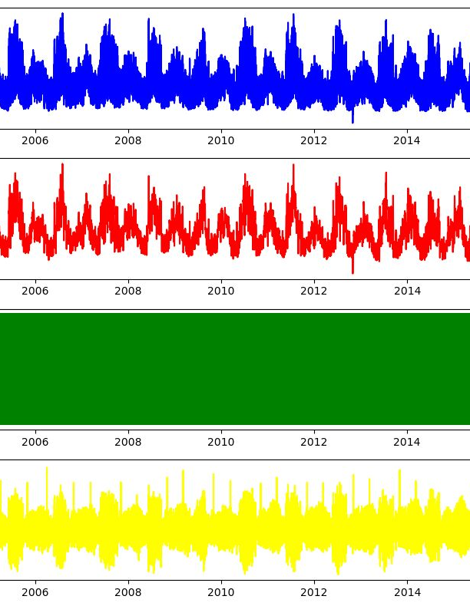
Original : Displays the full time series data for context.
Trend : Reveals the long-term movements in data, indicating stability with minor variations.
Seasonality : Illustrates the predictable, cyclical patterns in electricity usage.
Residuals: Shows the random, unexplained fluctuations in the data after trend and seasonal adjustments.

Slide 8
Feature Engineering
Why?
Enables the model to recognize and utilize patterns that occur over different time frames, such as daily cycles, weekly routines, seasonal effects, and annual trends.
It involves creating new features or transforming existing ones to improve the performance of predictive models
What?

Slide 9

Significance of Feature Engineering
Improved Model Performance
Information Extraction
Dimensionality Reduction

Slide 10
Feature Engineering
Introduction of temporal features
Hour, DayOfYear, WeekOfYear, Quarter, Month, Year.
Creation of lag features PreviousHourConsumption.
Impact
Improved model's capacity to capture patterns and make accurate prediction

Slide 11
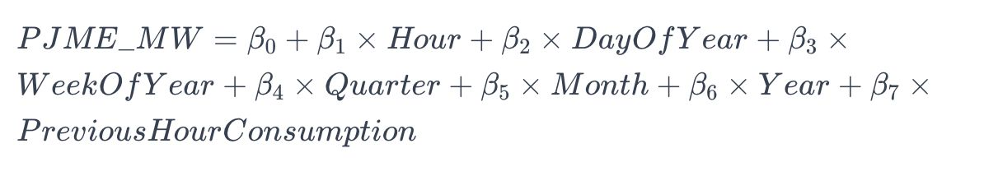
Empirical Method

Slide 12

Model Training
Used Models:
Linear Regression
Linear Regression for its simplicity and interpretability.
Ordinary Least Squares (OLS)
OLS for in-depth statistical analysis.

Slide 13
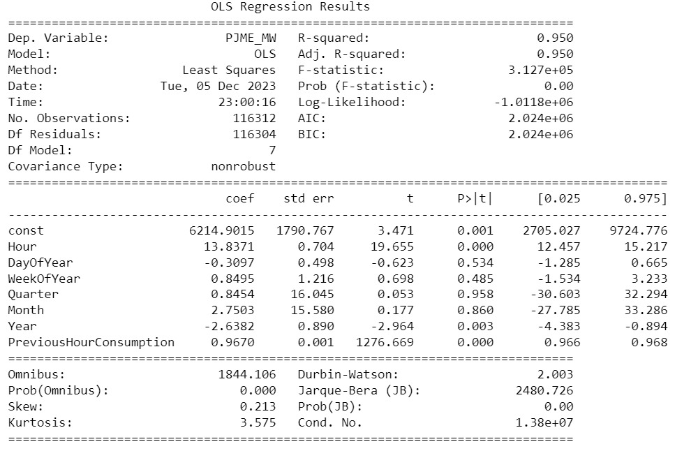
Model Evaluation
High R-squared Value - (0.950)
Mean Squared Error (MSE) - 2,087,411.78

Slide 14
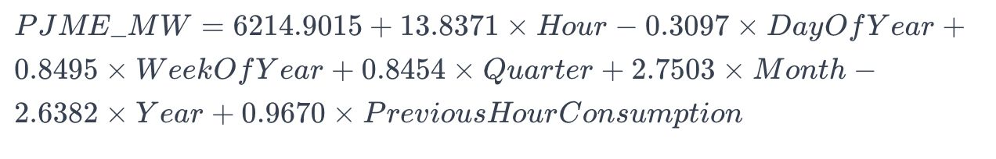
Resulted OLS Equation

Slide 15
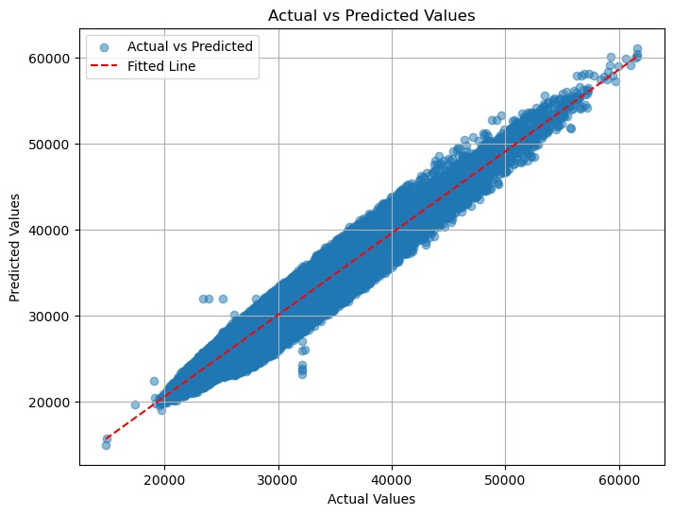
Model Performance and Accuracy
The scatter plot shows a strong positive correlation between actual and predicted electricity consumption values, with most data points clustered around the fitted line, indicating a generally good model fit.

Slide 16

Conclusion
Significant Drivers: Hourly intervals and previous consumption are key predictors, underscoring the importance of temporal patterns in demand forecasting.
Effective Forecasting Tool: The model accurately captures 95% of the variability in electricity demand, proving to be a robust forecasting tool.

Slide 17
Future Scope
Future research will focus on addressing multicollinearity and testing the model's adaptability to external factors.

Slide 18

Thank You
Presented By:
Bindu Sree Bura

