Slide 1
DTC

Slide 2
DTC
It is an error code stored in the ECU when a fault is detected
Accessed using diagnostic protocols like UDS
DTC testing means:
Inject a faults -- Verify ECU detects it -- Check correct DTC is set -- Validate system response
How DTC Testing is Performed (Step-by-Step)
Example:
Temperature Sensor Fault
Provide normal signal → system works fine
Inject fault (e.g., short to ground)
ECU detects abnormal condition
ECU sets DTC (e.g., sensor failure)
Verify:
DTC is stored
Warning message triggered
System goes to safe mode
Mapping Example UDS (3-byte hex) | OBD Format
0x012345 | P2345
0x0A1234 | B1234

Slide 3
Examples:
U0100 → Lost communication with ECU
U0121 → Lost communication with ABS
U1000 → CAN communication fault
P0123 power train generic Fuel/Air system Throttle Position Sensor issue
B0020 → Airbag deployment circuit fault
B0100 → Crash sensor fault
B1000 → ECU internal fault
C0035 → Wheel speed sensor fault (ABS) behavior =ABS disabled, Warning lamp ON
1st Character (Letter): System
P → Powertrain (engine, transmission)
B → Body (airbags, doors)
C → Chassis (ABS, steering)
U → Network (CAN communication)
2nd Digit: Code Type
0 → Generic (standard OBD)
1 → Manufacturer-specific
2/3 → Additional definitions
3rd Digit: Subsystem
Example (for Powertrain):
1 → Fuel/Air
2 → Injector
3 → Ignition
Last 2 Digits: Fault Number
Specifies exact fault
3-Byte Format (UDS Internal)
0x01 0x23 0x45 → 0x012345
Total = 24 bits
Used in ECU memory & diagnostics
Accessed via services like:
0x19 → Read DTC
0x14 → Clear DTC
5-Digit Format (OBD Standard)
P0123
Human-readable format
Used in scan tools & dashboards
DTC Status Byte (Very Important)
Each DTC comes with a status byte. Key bits:
Bit 0 → Test failed
Bit 1 → Test failed this cycle
Bit 2 → Pending DTC
Bit 3 → Confirmed DTC
Bit 7 → Warning indicator (MIL ON)

Slide 4
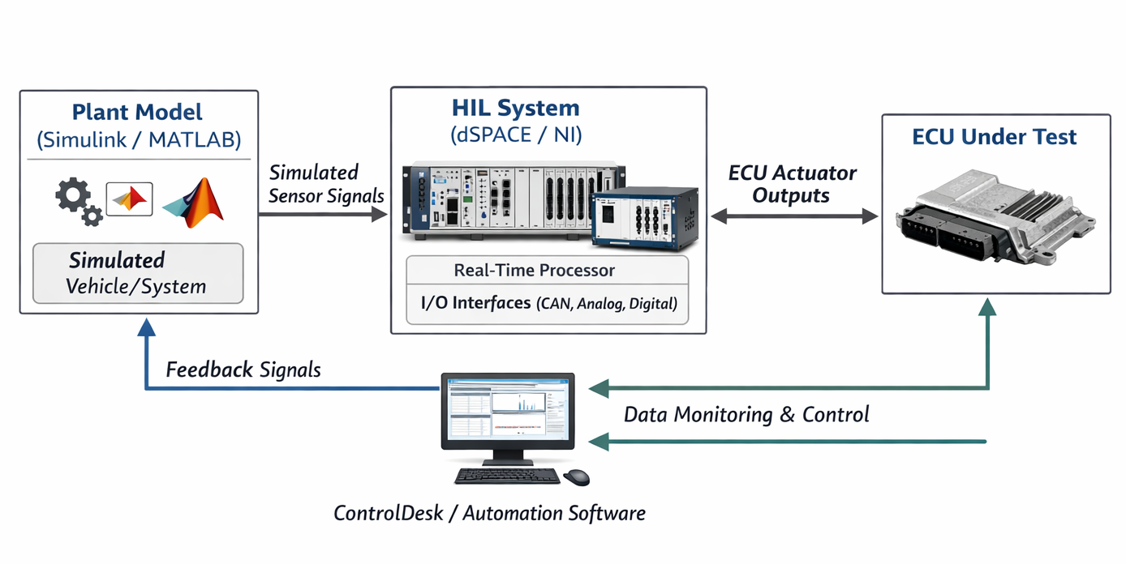

Slide 5
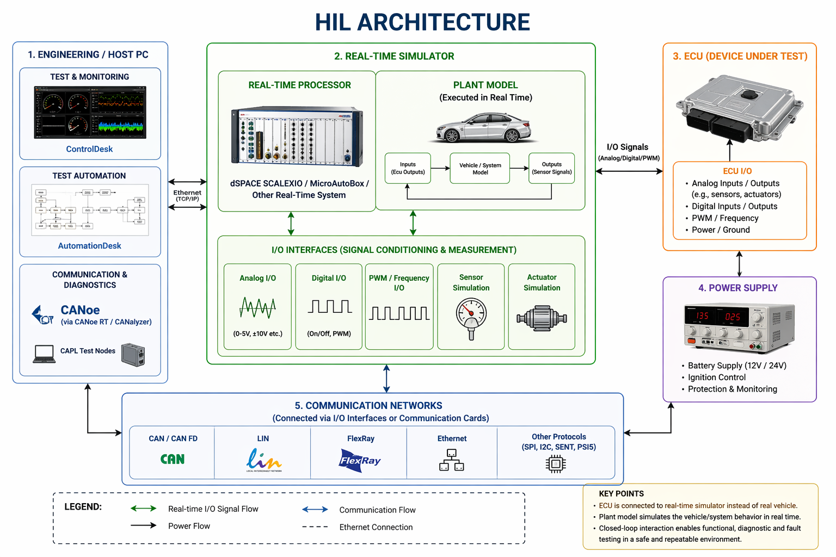

Slide 6
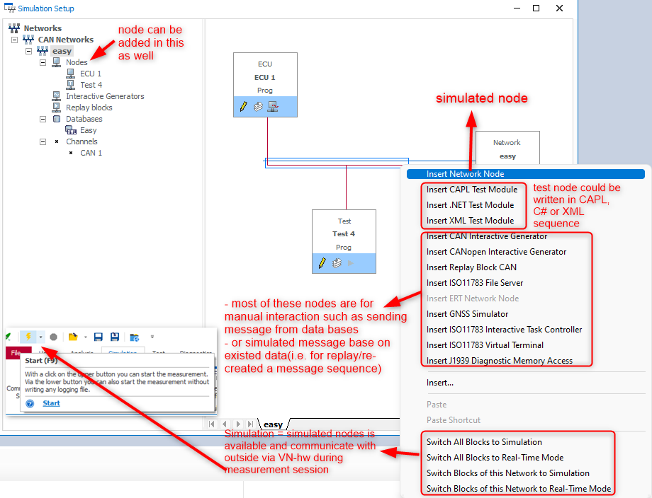
CAPL

Slide 7
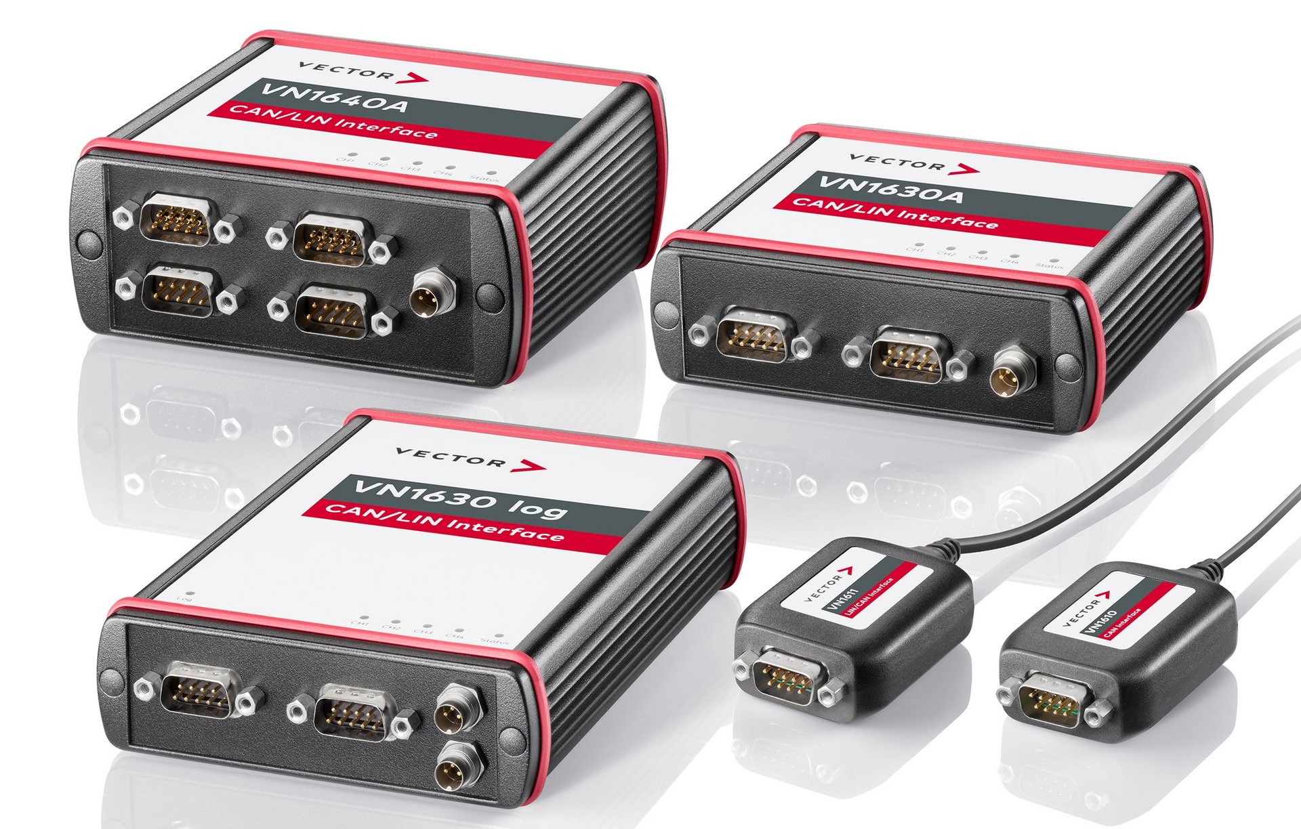
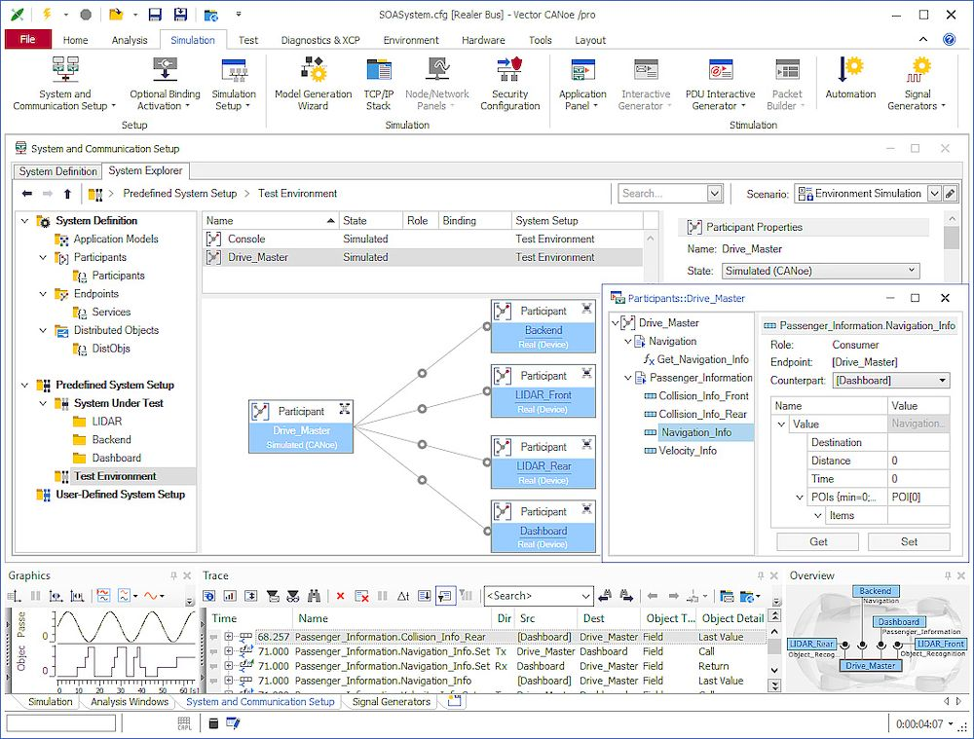
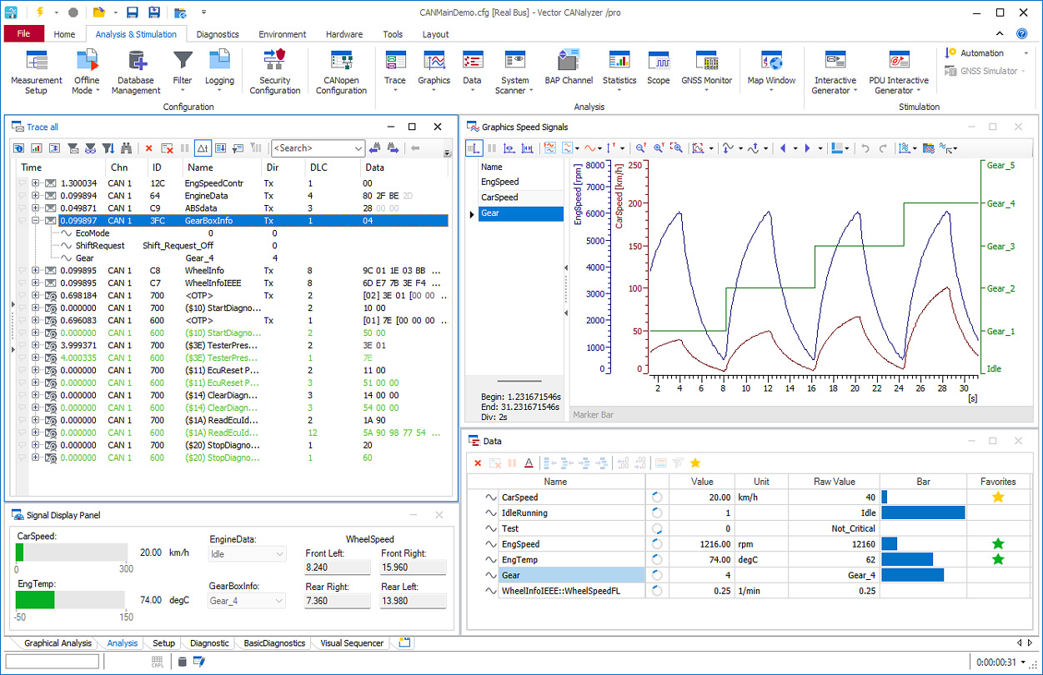

Slide 8
