Slide 1
Logistics Management System
OOAD Mini Project

Slide 2
Team Members
BINDU S : PES1UG23CS840
KUNA VARENYA : PES1UG23CS842
RANI : PES1UG23CS821
DIGANTH S D : PES1UG23CS841

Slide 3
Problem Statement
The Smart Logistics and Shipment Tracking System is designed to improve how shipments, warehouses, and delivery trucks are managed. It will automate scheduling, provide real-time updates, and optimize resources for faster deliveries and cost savings. The system will make logistics operations more efficient and transparent.

Slide 4
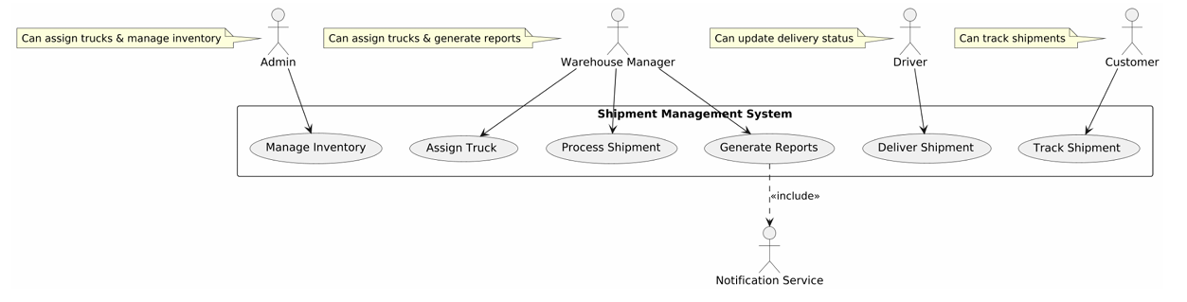
Use Case Diagram

Slide 5
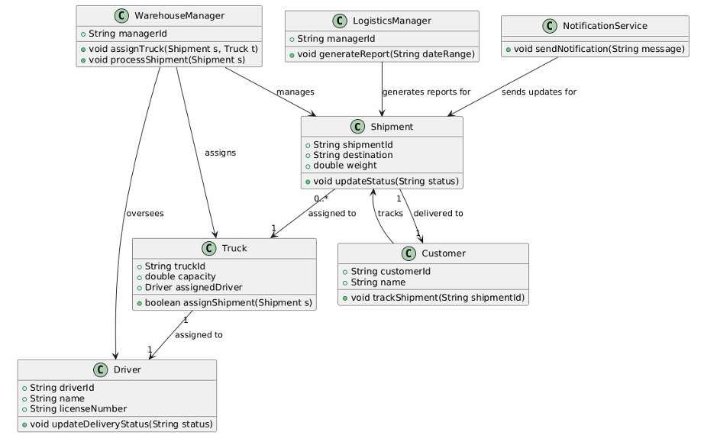
Class Diagram

Slide 6

Thank you

