Slide 1

Introduction
API Documentation 1: JSON and XML
What is an API and Why are They Important?

Slide 2
Introduction
This Course Covers:
What are APIs?
Why are they important?
What is structured data?
Two common data formats: JSON and XML
Tools
This Introduction Covers
API Overview
What is JSON and XML?
How are they different?

Slide 3
What are APIs?
Application Programming Interface
It defines how two pieces of software talk to each other
For this course, we are focusing on Web APIs

Slide 4

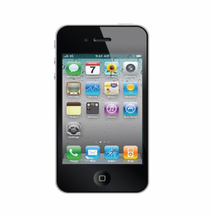
Web APIs
API request
API response
Creative Commons Attribution 3.0.
webdesignhot.com
Not a full web page ─ just the data!
Creative Commons Attribution 3.0.
openclipart.org
Software developers need to know:
What the request looks like so that the server can understand it
What the response looks like so that they can make sense of the data.

Slide 5

The first web API: eBay
Using the eBay website
Works great for individuals
Companies (like thrift stores) had to manage the website and their own accounting software
Wouldn’t it be great if they could use their accounting software to sell things on eBay?
eBay creates an API to do this in 2005
More than half the items sold are through the API!

Slide 6

Mash-ups
APIs allow developers to create apps that “mash up” data from different sources
Example: you want to create an app that shows how to get to the nearest dog park
The city provides an API that says where all the dog parks are
Google Maps provides an API that says how to get to a given location
Your app calls them both!
Creative Commons Image: Jim’s Photos1 on Flickr

Slide 7
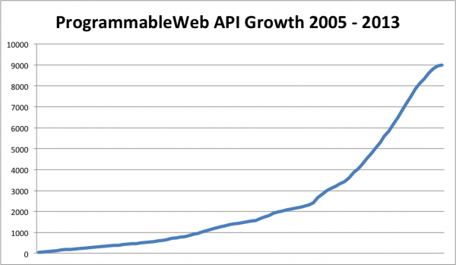
How many public APIs are there?

Slide 8
Why do we need good API documentation?
Same reasons as for end user documentation
Developers (usually) hate to write
Developers (usually) are bad at writing
What makes API documentation different than end user documentation?
You are writing for a developer audience
The documentation is very text-based

Slide 9

What are JSON and XML?
Two types of structured data
Structured data doesn’t fit into a table
XML
Older
Still used
JSON
Simpler
Less text

Slide 10
Course Overview
Introduction
Data Types and Structured Data
Tools for Writing JSON and XML
JSON: Learn and Document
XML: Learn and Document
Tools for documentation
Review

