Slide 1

Topic: Election
ICT_DS Batch 1, Group 3
Sandra Anna Shaji
Bineeth Mathew
Basil Chacko Mathew
Neenu Sebastian

Slide 2
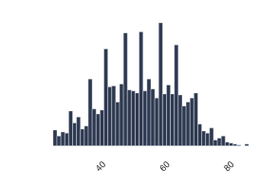
About the Dataset
The Dataset is based on Indian LokSabha Election.
539 Constituency participation data in this dataset.
There were 2263 candidates who contested 2019 LokSabha Election.
Minimum age of the candidates was 25
whereas maximum age was 86.
Average age of all the candidates who contested election was 52.
19367 postal votes were casted in the election.

Slide 3
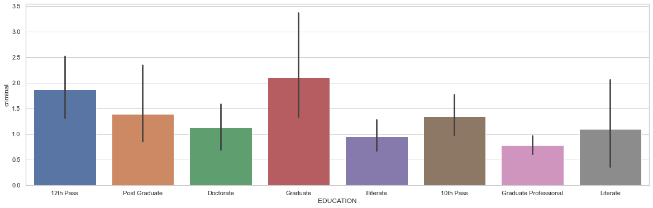
Education vs Crime Cases
We can analyze from the graph that Graduate and 12th Pass criminal candidates are maximum whereas Graduate professional candidates are minimum.

Slide 4
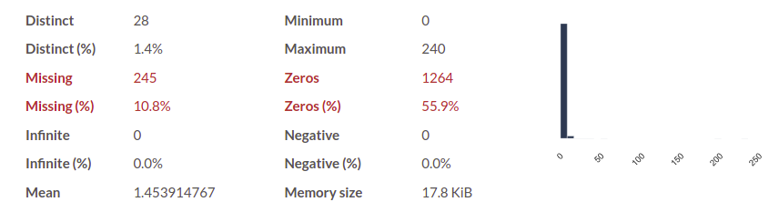
Mean of the crime among contestants is 1.45 where as the minimum crime,25% and 50% contestants did not make any crime but sadly in 75 % of total candidates the crime rate became 1.0
More surprisingly the maximum crime conceived by a person is 240,that's huge.

Slide 5
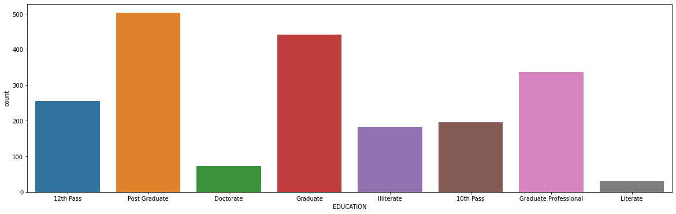
Educational Qualification of the Candidates
We can see that the number of post graduate candidates in India is maximum-502.
We can see that the number of illiterate candidates in India is minimum-183.
Doctorate candidate-73

Slide 6
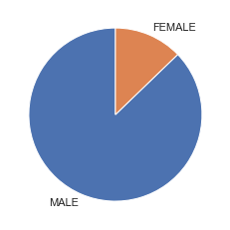

Male and Female participation in Lok Sabha Election
we can see that the number of male candidates is much greater than the number of female candidates. 75%male candidate

Slide 7
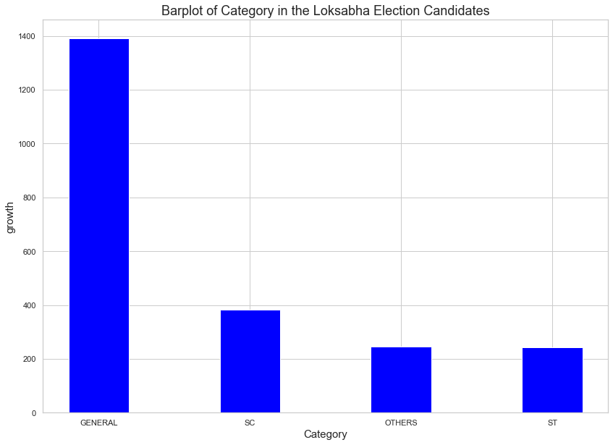
Calculating the number of SC, ST, and GENERAL candidates in the Lok Sabha election 2019.
we can see that the number of general candidates is maximum in India.
The difference between general and other categories is very high.
Category Growth

Slide 8
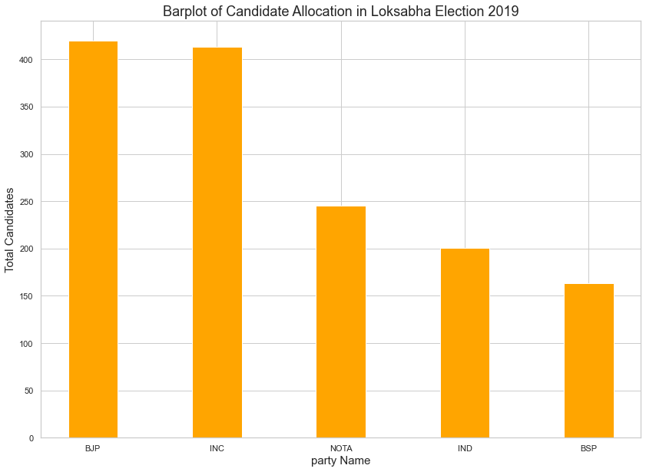
Candidate Allocation in Loksabha Election
counting the total number of allocation of candidates for different parties in different constituencies in India.
Bjp is highest number of allocation of candidates –more than 400.

Slide 9
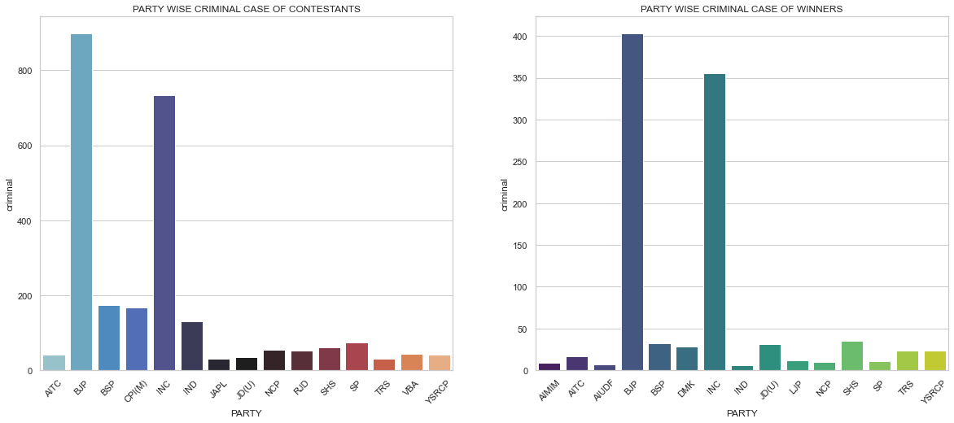
Party vs Candidates with Crime Case
We can see that the BJP-403 and Congress parties have the maximum number of criminal cases in India. This is because that, these two parties are all India-based whereas most of the other parties are regional parties.

Slide 10
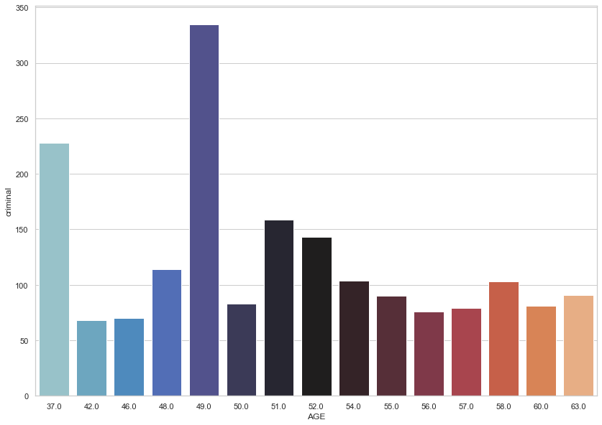
Age vs Crime Cases
From the graph, we can notice that the criminal cases history is maximum at the age of 49,37, and 51.

Slide 11
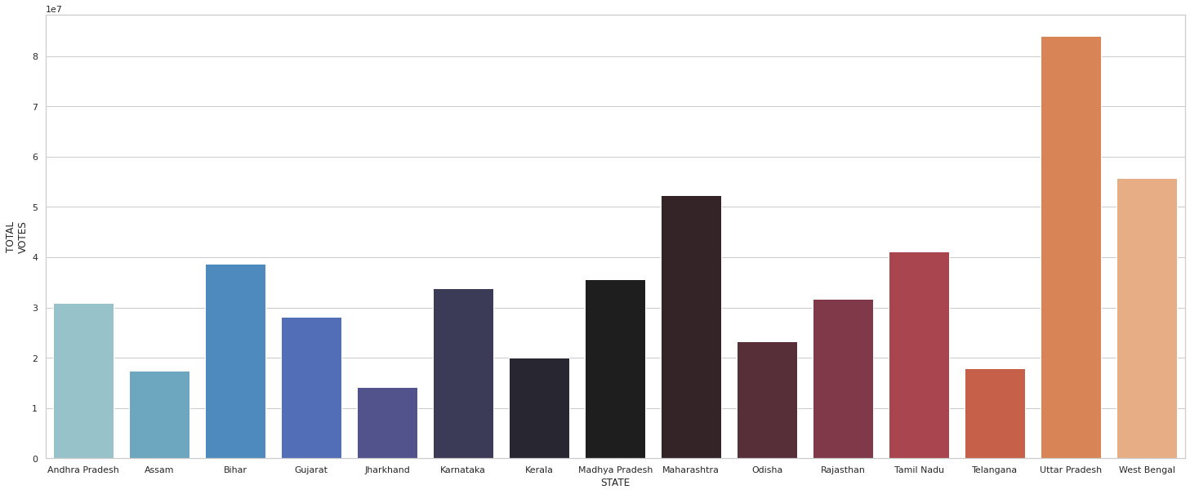
State vs Total Votes
It is transparent that the total number of votes in Maharastra, Uttar Pradesh, and West Bengal are very much higher than the remaining states in India and Uttar Pradesh holds first place in the total number of votes.

Slide 12
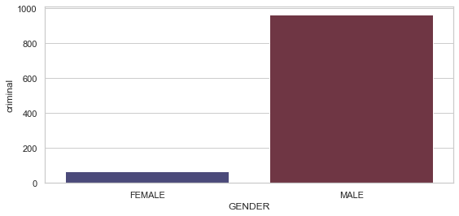
Gender vs Crime
Bar plot of gender vs Crime from which we can know that the number of female candidates is maximum or the number of male candidates is maximum in India.

Slide 13

Thank You

